Slide 1
Managing electricity system security and reliability with increased renewable generation
16-18 October
The Victoria Hotel
Melbourne, Australia

Slide 2
Welcome to Country
Mr Perry Wandin
Wurundjeri Elder
No photos please

Slide 3
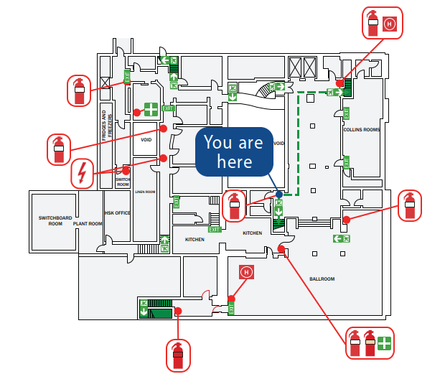
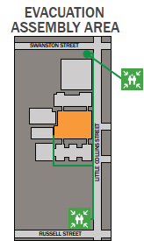
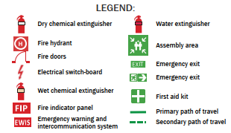
Event logistics
Defibrillator at reception
Notes:
Breaks will be outside room, where the green line is running through
The Boardroom is available for meetings and phone calls until Friday after morning tea
Collins Room is available for prayers and quiet time

Slide 4
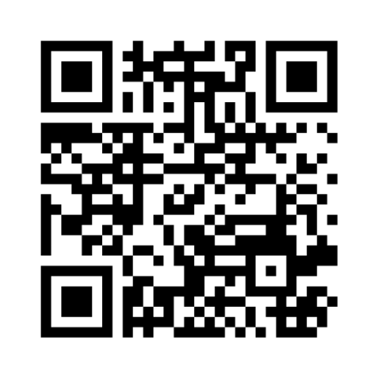
Mentimeter warm up
Menti.com
Code 1547 5677

Slide 5
Opening address
Aedan Whyatt
Assistant Secretary Southeast Asia Development Policy and Programs
Australian Department of Foreign Affairs and Trade

Slide 6
Keynote address
Luke Robinson
Executive Director - Global Power System Transformation Consortium
Operations Senior Leadership Team, Australian Energy Market Operator

Slide 7
Workshop framing
Dr John Ward
Research Director
Energy Systems
CSIRO

Slide 8
Managing electricity system security and reliability with increased renewable generation
16-18 October
The Victoria Hotel
Melbourne, Australia

Slide 9
Morning tea
Next session begins at 10:30

Slide 10
Session 1: Roadmaps for change
Please enter your questions at:
Menti.com
Code 1547 5677
10:30-12:15

Slide 11
Lunch
Next session begins at 1:30

Slide 12
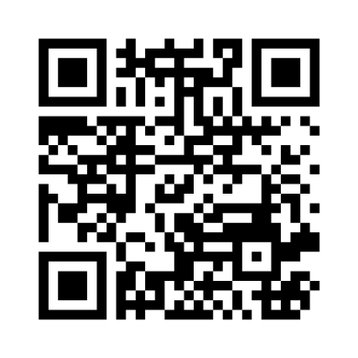
Session 2: Aspects of the energy transition – operating a system with high variable renewable energy
Please enter your questions at:
Menti.com
Code 1547 5677
Session chair: Dr Thomas Brinsmead
Power Systems Team Leader,
Energy Systems, CSIRO
1:15-2:45

Slide 13
Session 3: Integration of high variable renewable energy and energy storage
Please enter your questions at:
Menti.com
Code 1547 5677
3:15-4:15

Slide 14
Small group breakout session
Bridget McIntosh
Southeast Asia Energy Strategy, CSIRO
What are the barriers to installing energy storage in your country?
Please enter your comments at:
Menti.com
Code 1547 5677

Slide 15
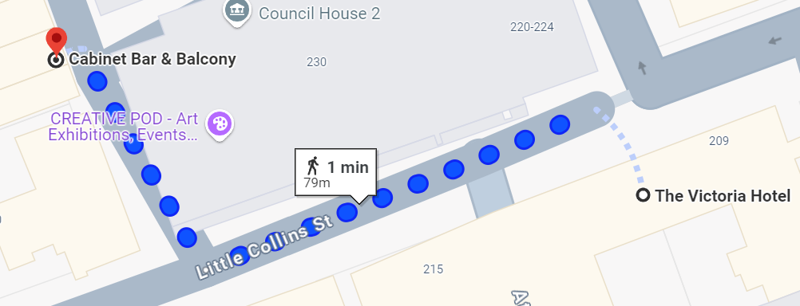
Day 1 Closing
Wrap of day
Networking 5:30-7:30 at Cabinet Bar across the road (down the alley)
Coffee and tea tomorrow at 8:30 for a 9:00 start

Slide 16
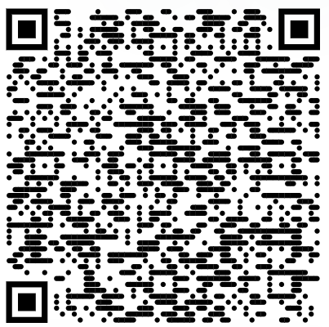
Managing electricity system security and reliability with increased renewable generation
Agenda & bios
Day 2

Slide 17
I would like to begin by acknowledging the Wurundjeri people as the Traditional Owners of the land that we’re meeting on today, and pay my respect to their Elders past and present.
Notes:
Source: https://my.csiro.au/OrgInfo/Structure/Support/Indigenous/Resources

Slide 18
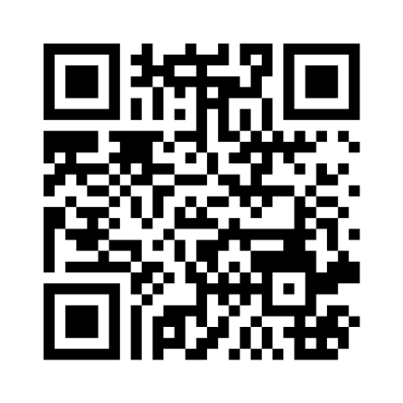
Session 4: Integrating high shares of inverter- based resources
Please enter your questions at:
Menti.com
Code 1812 0677
9:10-10:15

Slide 19
Morning tea
Next session begins at 10:45

Slide 20
Session 5: Stability tools and methods
Please enter your questions at:
Menti.com
Code 1812 0677
10:45-12:15

Slide 21
Session 6: Clean energy markets and trading arrangements
Please enter your questions at:
Menti.com
Code 1812 0677
Session chair: John McKibbin
Senior Principal Research Consultant, Energy Systems, CSIRO
1:15-3:00

Slide 22
Session 7: Grid planning
Please enter your questions at:
Menti.com
Code 1812 0677
3:30-4:50

Slide 23
Day 2 wrap up
Dinner at Mister Munro hotel restaurant
Bar opens at 6:00 pm
Entrees served at 6:30 pm
Tomorrow sessions begin at 8:30 am

Slide 24
Managing electricity system security and reliability with increased renewable generation
Day 3

Slide 25
I would like to begin by acknowledging the Wurundjeri people as the Traditional Owners of the land that we’re meeting on today, and pay my respect to their Elders past and present.
Notes:
Source: https://my.csiro.au/OrgInfo/Structure/Support/Indigenous/Resources

Slide 26
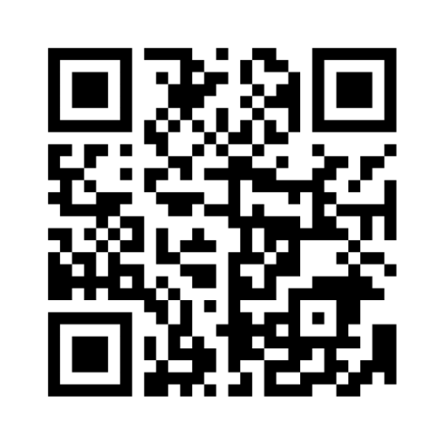
Session 8: Control room of the future
Please enter your questions at:
Menti.com
Code 8976 6379
Session chair: Dr Mahathir Almashor
Senior Engineer
Energy Systems, CSIRO
8:30-9:35

Slide 27
Feedback and brainstorm session
Panel members:
Veronica Ayu Pangestika, ASEAN Center for Energy
Ryan Thew, DFAT
Ira Drupady, CSIRO
Karin Rodrigues, AEMO
Share your thoughts at:
Menti.com
Code 8976 6379

Slide 28
Closing remarks
Dr John Ward
Research Director
Energy Systems
CSIRO

Slide 29
Morning tea
Next session begins at 11:00

Slide 30
Breakout Sessions
Victoria Room
Thailand
Laos
Board Room
Indonesia
Collins Room
Malaysia
Mister Munro
GPST researchers
11:00-12:30

Slide 31
Breakout sessions 2
12:40-1:30
Victoria Room
Next Generation Energy Systems Planning/Sienna Planning Tool
Board Room
Decarbonising Isolated Grids
Collins Room
Collins Room: GPST Researcher discussions

Slide 32
Thank you

