Slide 1
Investigating the Potential of Machine Learning in Alarm Management
18. October 2024
Elena Kranz

Slide 2
We acknowledge the Traditional Owners of country throughout Australia and recognise their continuing connection to land, waters and culture.
We pay respect to Elders past, present and emerging.

Slide 3
Agenda - Alarm Management POC
Why: Problem Statement
How: Project Roadmap
Value Proposition: Data Acquisition
Value Proposition: Exploratory Data Analysis
+ Traditional Machine Learning Clustering
Next steps: Deep Learning for Clustering and Classification
Q&A

Slide 4
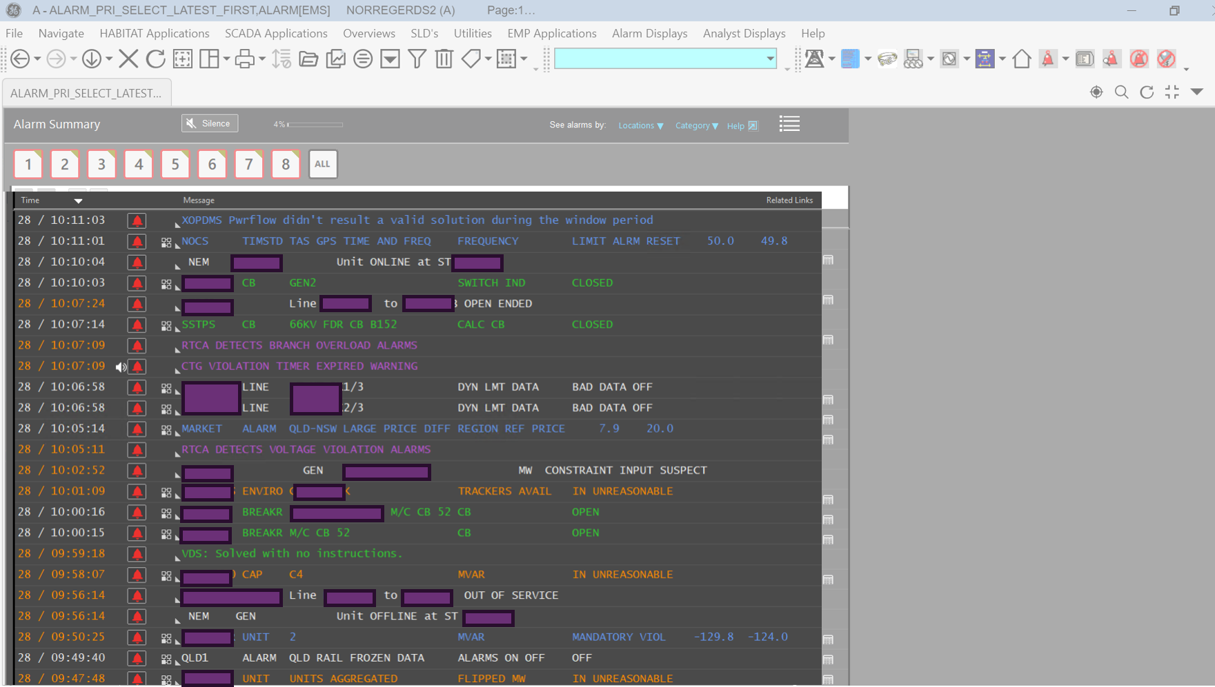
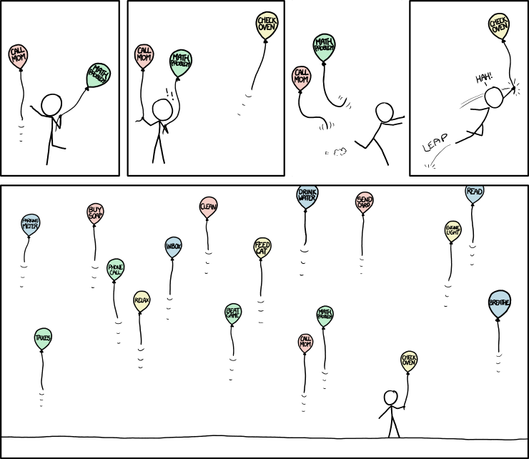
I. Problem Statement: High Volume of Alarms
Sometimes it’s up to 6500 alarms per minute
Challenges:
High Volume and Increased Complexity of Alarms
Lack of Alarm Interpretation and Contextualization
Poor Display and Usability
xkcd 1106
Operator

Slide 5
I. Problem Statement: High Volume of Alarms
Current Process
Sense Making
Consolidating alarms
Decision Making
Identify incident
Action Taking
Tie alarms into process
Validate with NSP
Feedback
Current state: overwhelming, manual, time consuming process
Vision: automation with machine learning
Clustering
Classification
Proposing process
+ Chat Bot for better Information Integration

Slide 6
II. Project Roadmap
Data Acquisition
Consolidating multiple data sources in DB
Building data pipelines
Exploratory Data Analysis
Filtering
Next Steps
Increase model complexity
Feedback Loop with Control Room
Cleaning, Parsing
Mapping
Developing interface
Apply Traditional Clustering
Find pattern and relationships
Validation of alarm cluster
Validation of Mappings
Test on real time data
Incorporate subject matter expertise
Refine models over time
Recommend actions

Slide 7
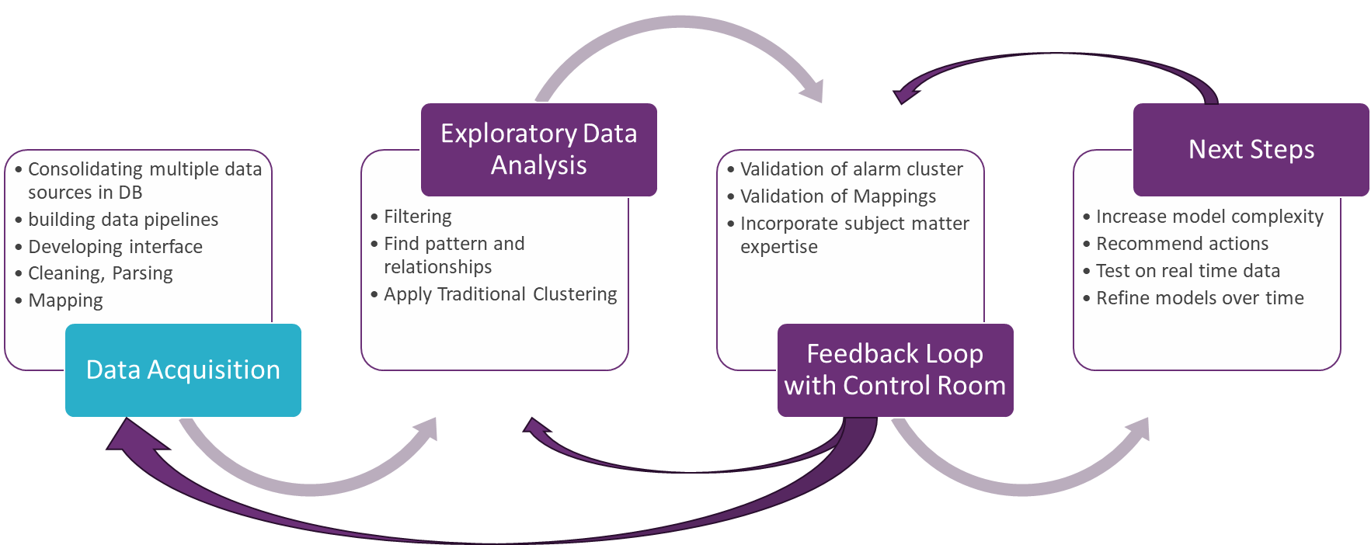
Data Acquisition
We want to connect multiple data sources across AEMO to enrich the alarms with valuable information
We already consolidated the following datasets in a PostgreSQL DB:
Archive Alarms Files
Incident Reports of Non-Credible Contingency Events
Planned and Unplanned Outages
Grid Connectivity
Control Room Logs
Market Notices
cleaning, parsing
develop interface, building data pipelines

Slide 8
Mapping Challenge: System Integration and Data Consistency Issues
Inconsistent identifiers between systems lead to challenges in linking relevant data across platforms.
Machine learning could be useful to handle these inconsistencies
eid | type | equipment_id | alarm_equipment_id | outage_id | Control Room Log
204426 | LINE/LN | STATE.SUBREGION.SUBSTATION.330.LNXX | LN.XX.0 | ND. SUBSTATION.330.LNXX | The Sub A to Sub B line tripped and failed to auto reclose. 5412 breaker also opened at A. MN108414 and MN 108415 was published. N_LDTM_XX-OPEN was invoked from 1445 hrs. NOS entry was submitted (TG_771784).
2536365 | BKR/BK/CB | STATE.SUBREGION. SUBSTATION.ISOL.5411 | SUBSTATION.ISOL.5411.ISOL | CB. SUBSTATION.BREAKR.5411
3924033 | Transformer/TX/XFMR | STATE.SUBREGION. SUBSTATION.1A.1AH | SUBSTATION.XF.1AH | XFMR. SUBSTATION.1A

Slide 9
II. Project Roadmap
Dashboard
Data Acquisition
Consolidating multiple data sources in DB
Building data pipelines
Exploratory Data Analysis
Filtering
Next Steps
Increase model complexity
Feedback Loop with Control Room
Cleaning, Parsing
Mapping
Developing interface
Apply Traditional Clustering
Find pattern and relationships
Validation of alarm cluster
Validation of Mappings
Test on real time data
Incorporate subject matter expertise
Refine models over time
Recommend actions

Slide 10
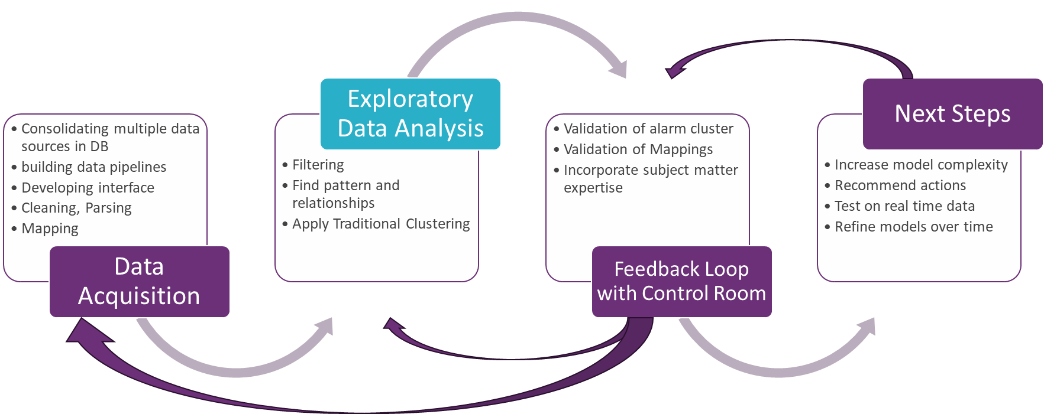
EDA - Analyse Alarm Flooding Events
Already filtered down from 6500 alarms per minute
Spike as Indicator?
Outages
Power System Event
Alarm Count
Control Room Logs
Outages
Timestamp

Slide 11
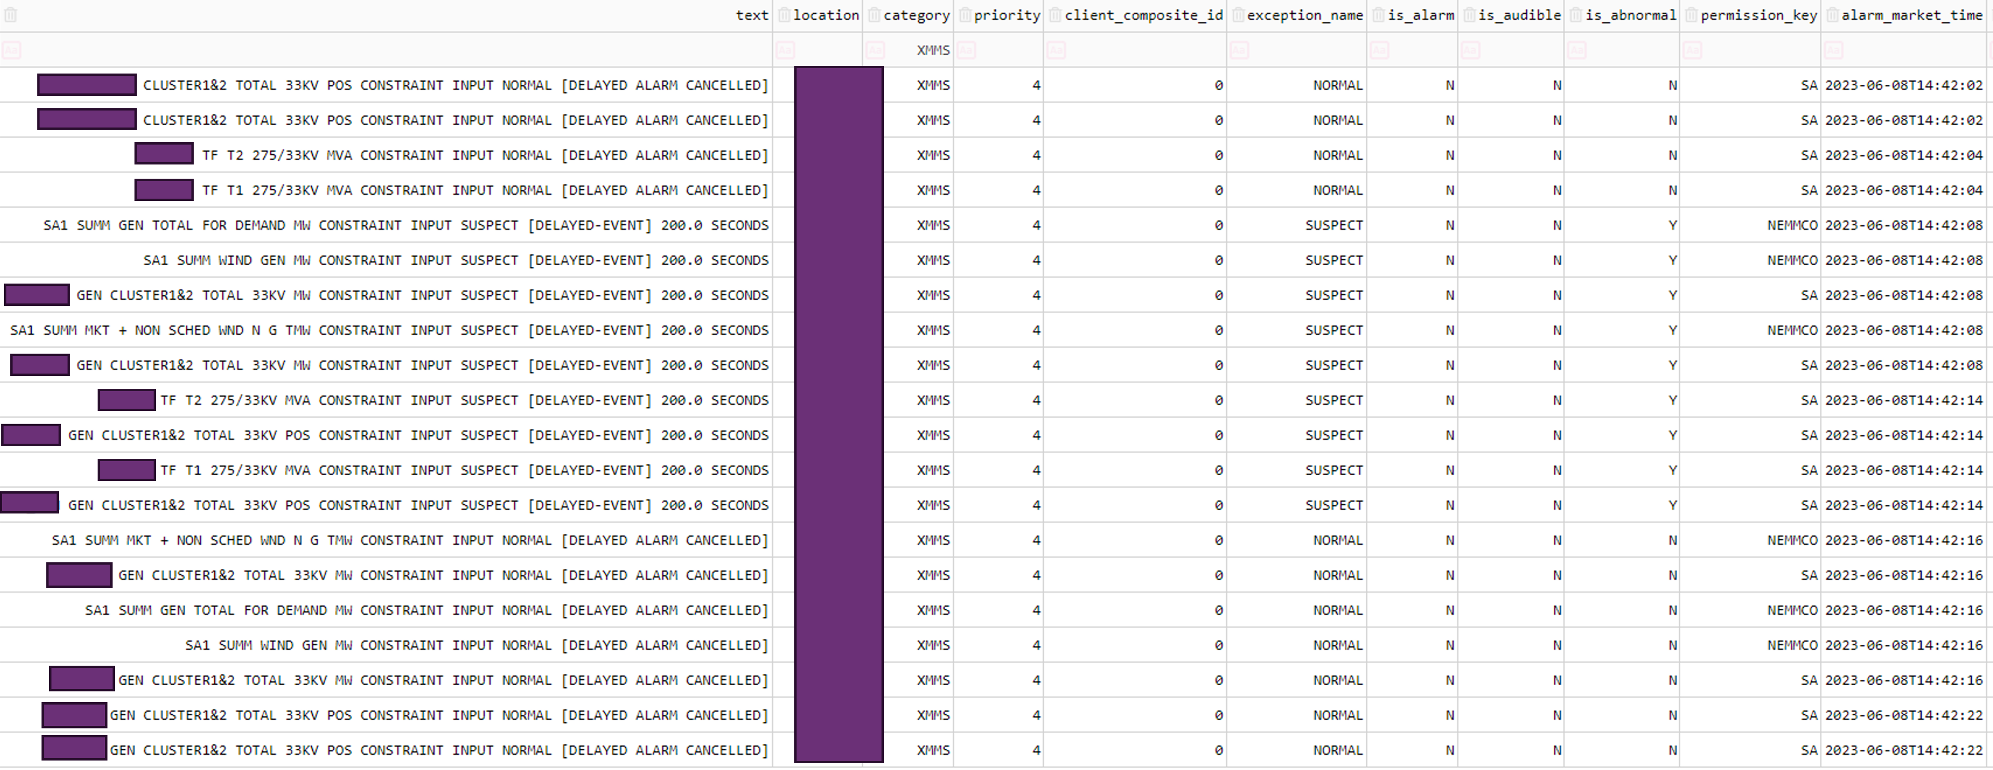
EDA - Analyse Alarm Flooding
Indicates a loss of SCADA points

Slide 12
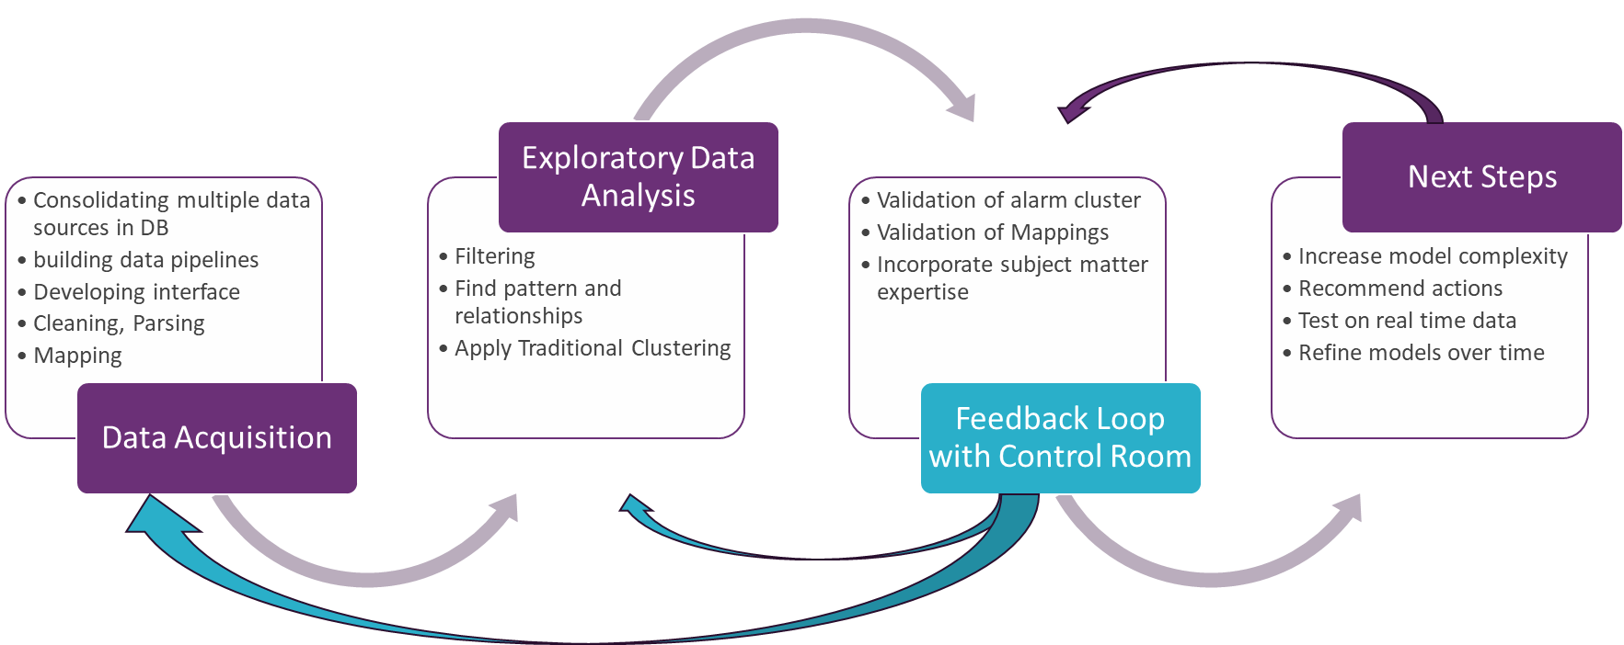
EDA - Analyze Alarm Flooding
We can apply filters:
We can filter out a list of attributes approved by Operators
Equipment related alarms are most important to identify power system events
Now we have less noisy data as machine learning input
Alarm Count doesn’t indicate mayor power system events

Slide 13
Cluster Alarms from a non-credible contingency event
Trip of Sub A – Sub B 330 kV line and Sub A 330/33 kV transformer
Filter options:
1. Alarms which are physically related
2. Filter noise

Slide 14
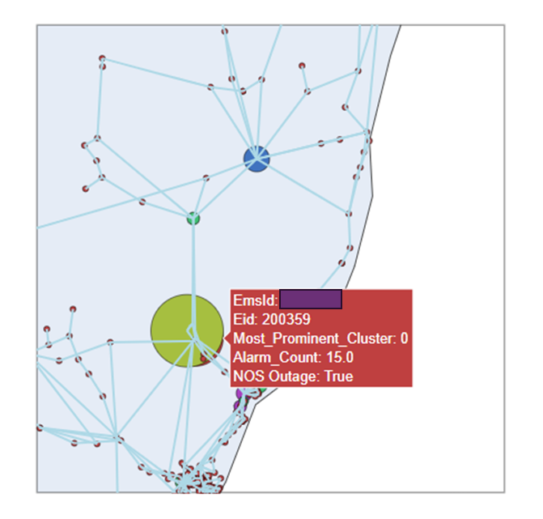
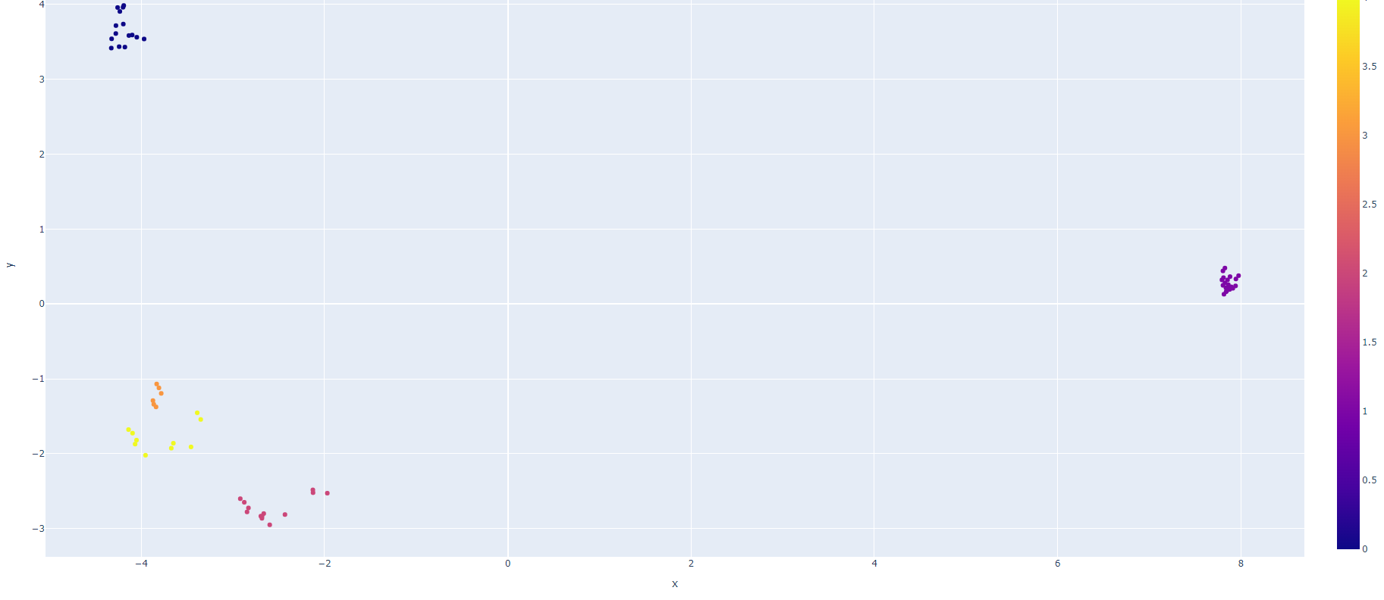
Cluster Alarms from a non-credible contingency event
Choose cluster algorithm
Alarm Cluster plotted in 2D Embedding Space
Cluster
Cluster 0

Slide 15
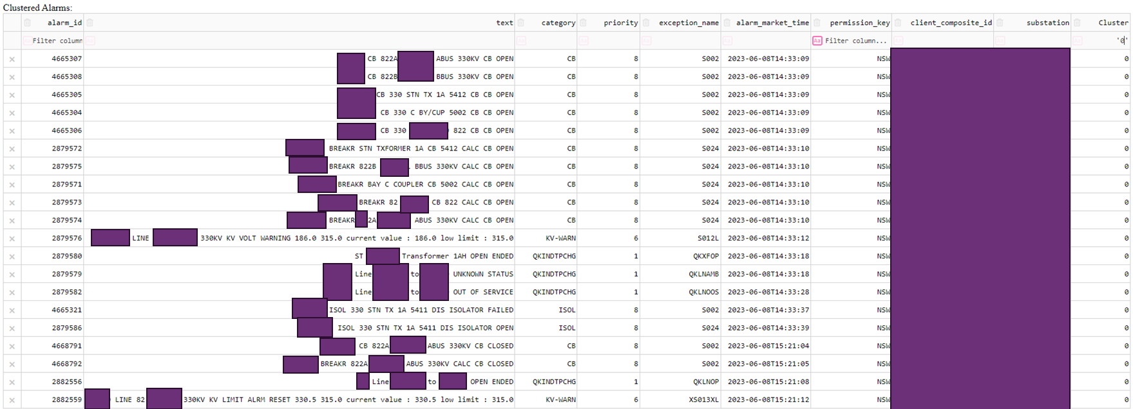
Cluster Alarms from a non-credible contingency event

Slide 16
How does this help the Control Room again?
NSW Substation A to Substation B line X and transformer 1A deenergized
Sense Making | Decision Making | Action Making
The Substation A – Substation B 330 kV line and 1A transformer tripped. + precise sequence of equipment faults Additional information: it could be related to a planned outage – NSP is testing cable,… Feature to zoom into details |  | Suggesting actions that can be taken: Constraint invocation Inform market of incident Resecure the system and improve the situation (reserve, system strength, etc)
You can imagine there is a lot of different system conditions
We will use a Combination of Machine Learning and Traditional Coding

Slide 17
II. Project Roadmap
Data Acquisition
Consolidating multiple data sources in DB
Building data pipelines
Exploratory Data Analysis
Filtering
Next Steps
Increase model complexity
Feedback Loop with Control Room
Cleaning, Parsing
Mapping
Developing interface
Apply Traditional Clustering
Find pattern and relationships
Validation of alarm cluster
Validation of Mappings
Test on real time data
Incorporate subject matter expertise
Refine models over time
Recommend actions

Slide 18
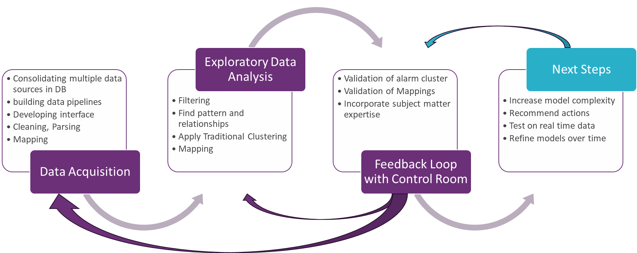
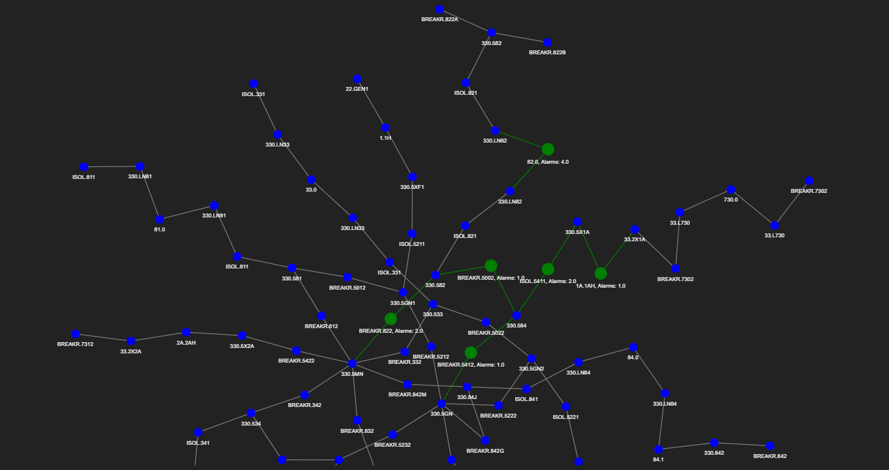
Idea Model Input: Graph based on Topology + additional Logging Sources
+ dynamic topology changes
Alarm Type
Planned Outage
Constraints
Weather events

Slide 19
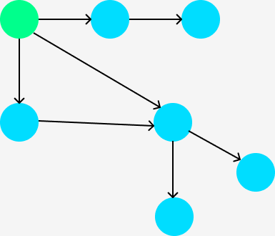
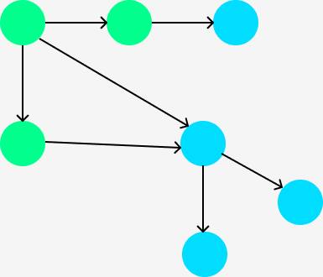
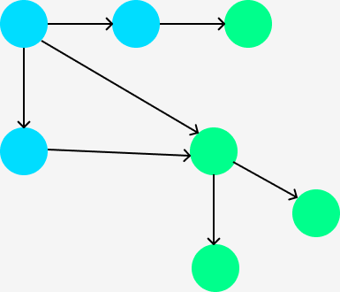
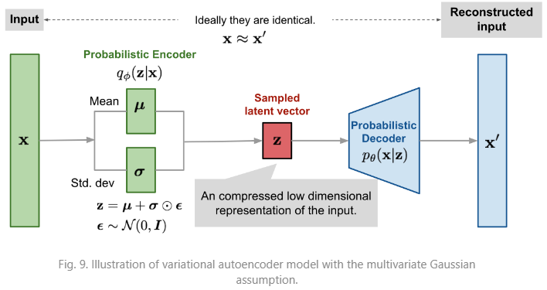
Training a Variational Graph Autoencoder
snapshots of the grid as time series of SCADA scans
New Alarm sequence
Clusters Alarms for critical event

Slide 20
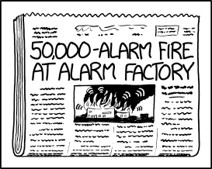
Thank you for your attention.
xkcd 1794

Slide 21
POV Control Room
Consolidate related alarms
Check SLD/Wallboard
Coordination with TNSP’s
Look up Planned Outages
Weigh up information from different EMS Applications
Weather and Environmental Considerations
Look up historical Logs and outages under similar conditions
System Security Assessment
….
Administrative Streamlining:
Log “subjective” investigations
Create templates for reporting and actions
…

Slide 22
Traditional Clustering - Conclusion
Requires manual filtering steps on the topology and the time window beforehand
Hyperparameter tuning can be very individual to each case
Clusters are based only on the Euclidean distance of the alarm embeddings
Useful for investigating past power system events by mapping different logging sources and clustering the alarms
Useful benchmark for comparison with more advanced models
And to label alarm cluster of relevant power system events for further machine learning model improvements
For now, focus on unsupervised learning

Slide 23
Which model should we use next?
Integrate time and connectivity pattern?
IEEE Xplore Full-Text PDF:

Slide 24
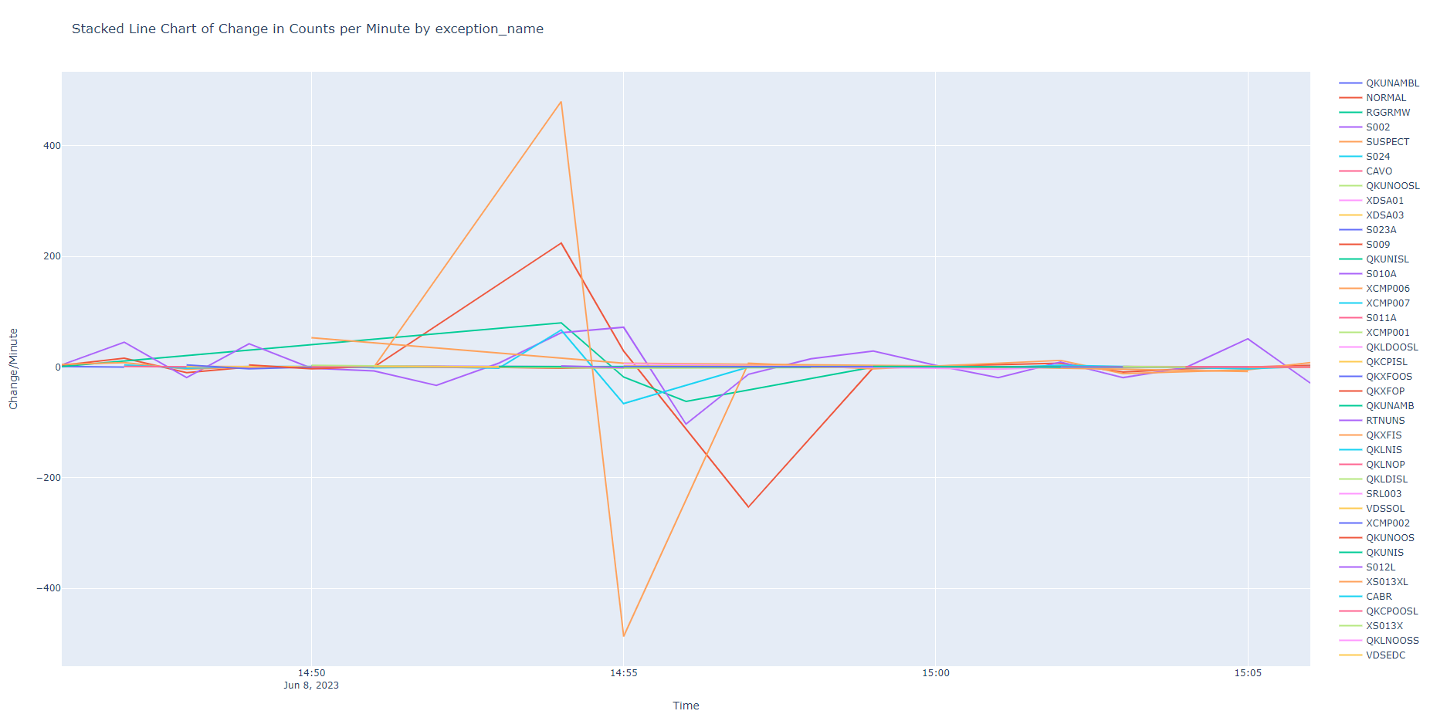
EDA - Derivative of exception_name Alarm Count per Minute
Indicates a loss of SCADA points

Slide 25
I. What is an Alarm?
Modelling Information
Attributes
Alarm clients can be on any computer (equipment or application) within the site.
Bilder von assets

Slide 26
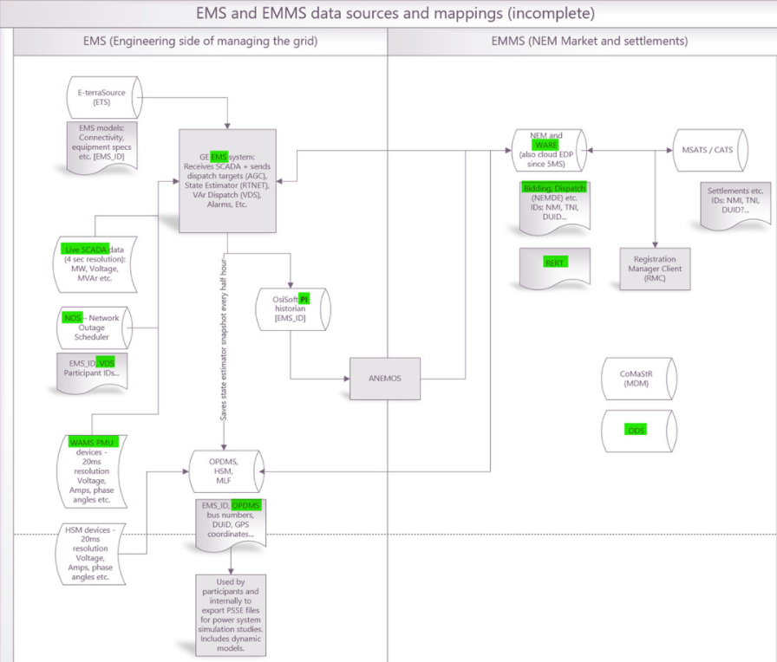
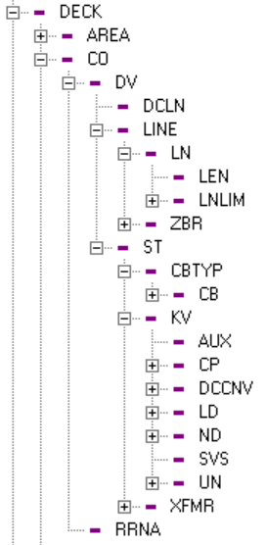
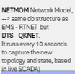
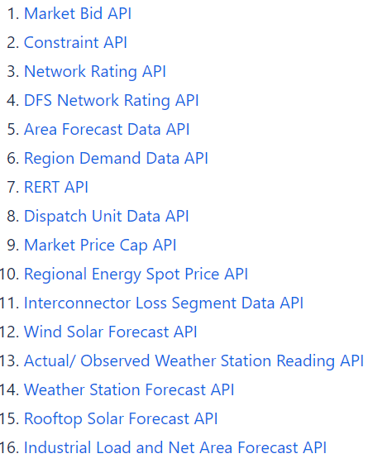
NEMMCO oracle database
NETMOMID
client_composite_id
Weather, Generation, Load Forecast
MIAMI
SCADAMOM
EMS Alarms
obj_mrid
STPASA database Constraints maps to DUID
NOS_ID
EPSOC_Log
Market notice
EID
ODS Mapping
EMS_ID
cim_mrid
OPDMS Mapping
Inconsistent ids between systems
Mapping attempts across AEMO

Slide 27
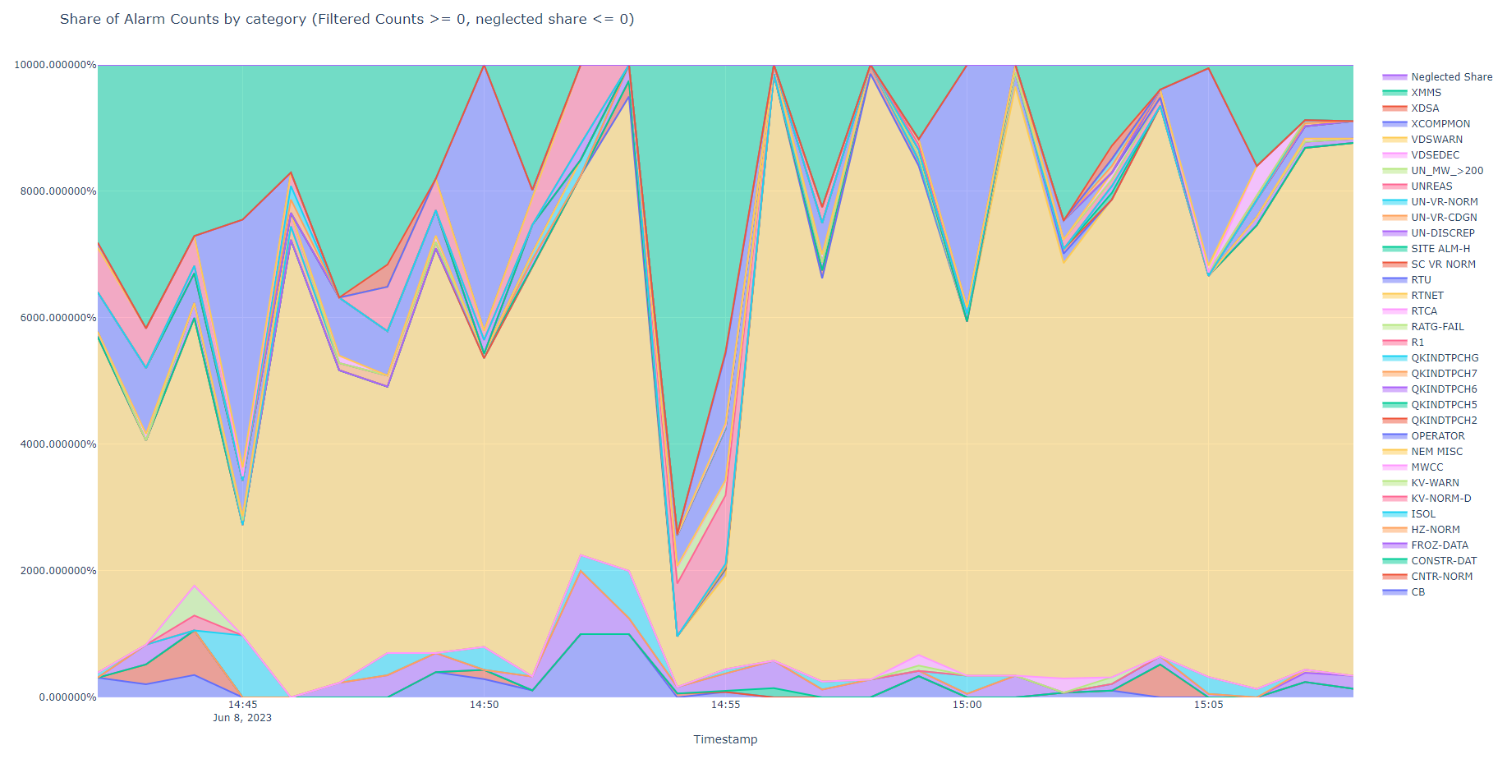
EDA - Spike originated from the share of XMMS category in the Alarm Count per Minute
100%
80%
60%
40%
20%
0%

