Slide 1
Distribution grid planning in Australia
Lessons learnt from managing high volumes of distributed resources
Thomas S Brinsmead

Slide 2
Managing high volumes of distributed energy resources in Australia*
Lessons learnt in recent decades
Rooftop solar photovoltaic uptake in the Australian energy market: history and future prospects
Emergent technical challenges and practical responses
A spectrum of technical solutions (and required institutional and social capabilities)
(Easier) distribution network solutions
System operator solutions
Solutions with high customer impact
Solutions requiring coordination mechanisms
Implications for future developments in distribution network planning
*Presentation based on Brinsmead, T.S., Lovasz, T., Nguyen, K., Sawdon, J., Braslavsky, J., Heidari, R., Mahdavi, N., Mohy-ud-din, G., Uddin, S.M.M., & Wearne, T. (2024, September). Future of Electricity – Vietnam – Increasing distributed energy resources in reliable electricity grids. Collaborative Research Report No.3 Grid. https://www.fe-vietnam.info/

Slide 3
Spoiler alert: implications of DER management lessons learnt for grid planning
Long term planning results depend crucially on how “deeply” within a technical and institutional coordination spectrum (and new coordination functionality development) the energy industry can realistically aspire to.
Relatively shallow institutional coordination (network operators, system operators, customers, new coordination institutions, regulators) will result in relatively limited benefits realisation.
Unlocking the full potential of whole-of-system optimisation can only be achieved by deeper cross-organisational collaboration and capability development.
The costs of coordination and capability development may or may not be warranted.

Slide 4
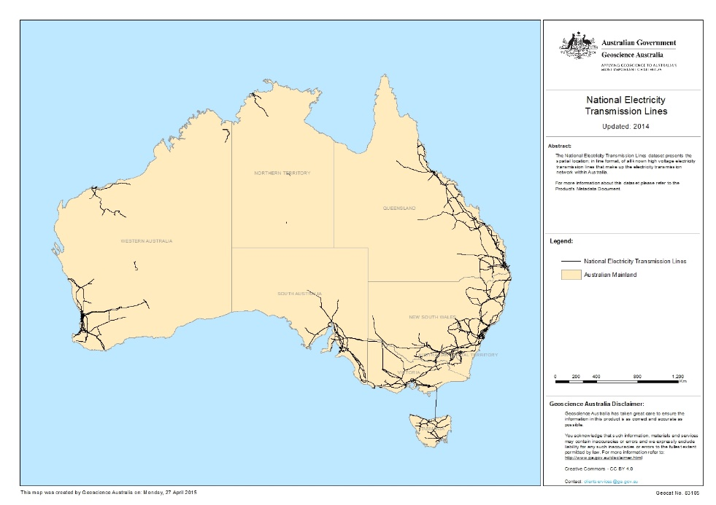
Australian energy market: context
Numerous minigrids in Western Australia
Darwin-Katherine Interconnected System
North-West Interconnected System
South-West Interconnected System (SWIS)
National Electricity Market (NEM, east coast)
NEM: ~200 TWh/pa, 55GW installed (>500 participants), 10.7 million customers
SWIS/WEM: ~20 TWh/pa, 6GW, ~70 generators, 1.1 million customers
Source: Wikimedia commons

Slide 5
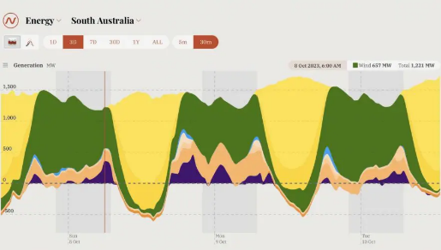
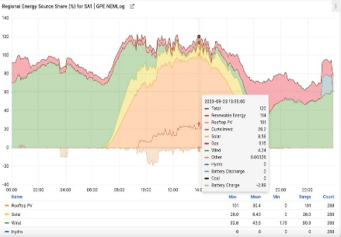
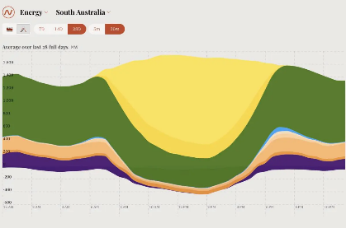
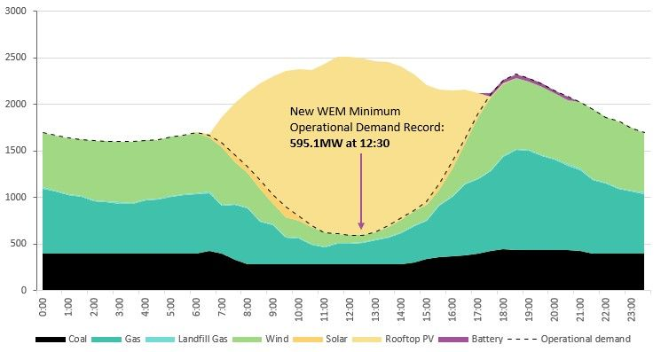
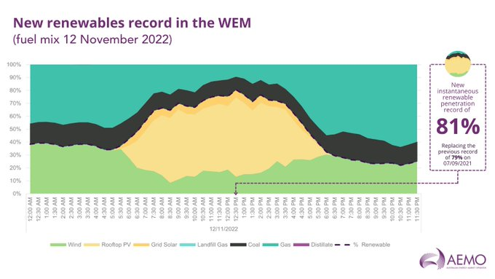
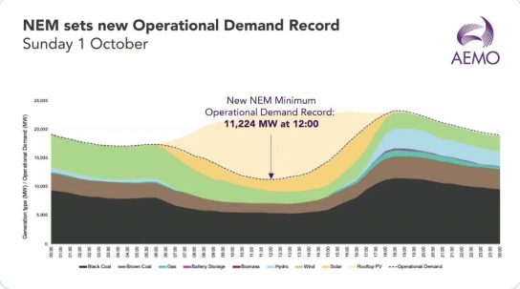
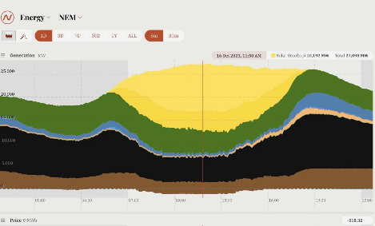
Rooftop solar photovoltaic uptake in the Australian energy market: history
South Australia:
RTS 101%, Renewables 120%
One month renewable average 87%
Wholesale Electricity Market (west):
RTS 76%, Renewables 84%
National Electricity Market (east):
RTS 51%, Renewables 72%

Slide 6
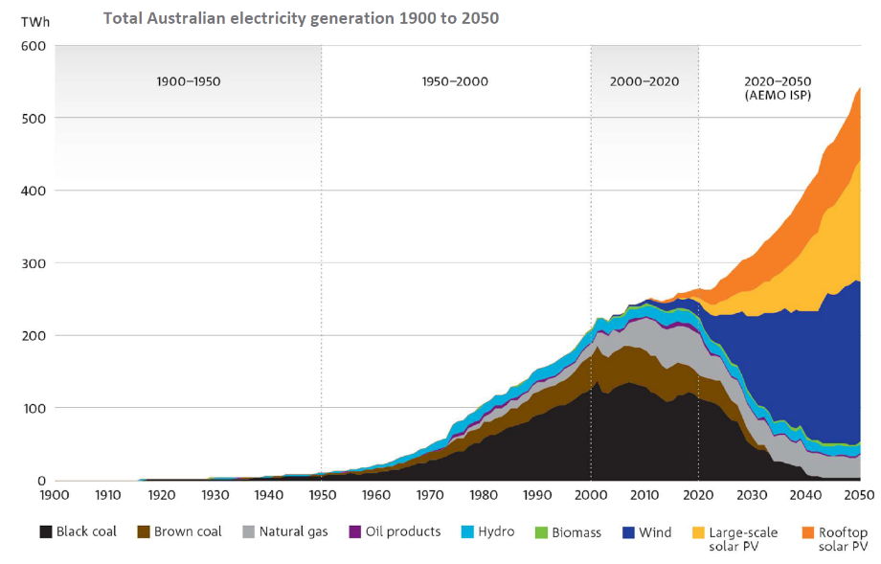
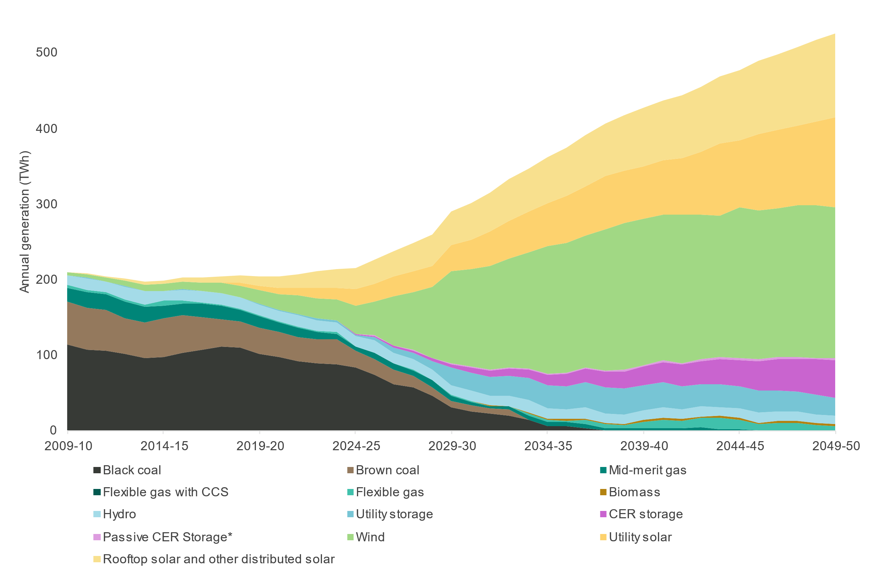
Rooftop solar photovoltaic uptake in the Australian energy market: prospects
Left: Total Australian electricity market Right: National Electricity Market (east coast)
Snowy Hydro from 1972
Gas substitution and wind from 2000
Renewables transition from 2020
More Information
Source: ISP 2024 (Figure 9)

Slide 7
Managing high volumes of distributed energy resources in Australia*
Lessons learnt in recent decades
Rooftop solar photovoltaic uptake in the Australian energy market: history and future prospects
Emergent technical challenges and practical responses
A spectrum of technical solutions (and required institutional and social capabilities)
(Easier) distribution network solutions
System operator solutions
Solutions with high customer impact
Solutions requiring coordination mechanisms
Implications for future developments in distribution network planning
*Presentation based on Brinsmead, T.S., Lovasz, T., Nguyen, K., Sawdon, J., Braslavsky, J., Heidari, R., Mahdavi, N., Mohy-ud-din, G., Uddin, S.M.M., & Wearne, T. (2024, September). Future of Electricity – Vietnam – Increasing distributed energy resources in reliable electricity grids. Collaborative Research Report No.3 Grid. https://www.fe-vietnam.info/

Slide 8
Emergent technical challenges and practical responses
Challenge | Capability | Standards | Description
Voltage limits | Power Quality Response modes | AS 4777.2:2015 AS 4777.2:2020 | More sophisticated local real/ reactive power dynamic response and greater stability
Disturbance vulnerability | Fault and low-voltage ride-through | AS 4777.2:2020 | Greater connection reliability under disturbance conditions
Optimising inverter settings to local conditions | Regional standardisation of settings | AS 4777.2:2020 | Default inverter settings for simplicity and ease of installation and compliance
Excessive (locally or in aggregate) load | Demand response mechanism | AS 4755 | External management of flexible load and generation
Insufficient load/ excessive distributed generation | Enhanced voltage management | NA | Emergency ability to disconnect RTPV (non-targeted)
 | Emergency RTPV disconnection | NA | Remote signalling (fully or partially automated) causes inverters to cease active power injection (targetted)
 | Device communication over internet | IEEE 2030.5, CSIP-Aus | Sophisticated communications capability to permit external management of inverters
Frequency management/ aggregate power balance | Frequency control system services | Not mandatory | Locally automated frequency droop (or slower dispatched raise/ lower)

Slide 9
Managing high volumes of distributed energy resources in Australia*
Lessons learnt in recent decades
Rooftop solar photovoltaic uptake in the Australian energy market: history and future prospects
Emergent technical challenges and practical responses
A spectrum of technical solutions (and required institutional and social capabilities)
(Easier) distribution network solutions
System operator solutions
Solutions with high customer impact
Solutions requiring coordination mechanisms
Implications for future developments in distribution network planning
*Presentation based on Brinsmead, T.S., Lovasz, T., Nguyen, K., Sawdon, J., Braslavsky, J., Heidari, R., Mahdavi, N., Mohy-ud-din, G., Uddin, S.M.M., & Wearne, T. (2024, September). Future of Electricity – Vietnam – Increasing distributed energy resources in reliable electricity grids. Collaborative Research Report No.3 Grid. https://www.fe-vietnam.info/

Slide 10
A spectrum of technical solutions
Timing | Export management Strategy | Technical Standards Required | Network Capability Required | Incentives
Previous | Prohibit Exports | None | Zone Substation monitoring. Planning Load forecasting. | Bill savings
Current | Static Export Limits | Power quality. Reactive power control | Distribution substation monitoring. Feeder load forecasting | Feed-in tariff
Emerging | Dynamic export control | Communication and control. Remote disconnect | Customer monitoring. Dynamic export limit calculation | Dynamic pricing
Ambition | Coordinated demand, storage, export | As above | DER scheduling ability. Network / aggregator data exchange | Network support payments
Ideal | Open platform | Bid and offer market communications | Trading platform data exchange | Market

Slide 11
A spectrum of technical solutions
Distribution network solutions (direct constraint management)
Operations – voltage management
Planning and investment – reactive compensation and batteries
System operator solutions (indirect constraint management)
Energy balance: enhanced forecasting
Frequency regulation: enhanced dynamics modelling
Contingency and system restart: ?
Solutions with high customer impact or requiring customer engagement
Operations: Distributed energy resource technical standards, dynamic management
Planning and Investment: Behind the meter flexibility investments, connection requirements
Coordination mechanisms to incentivise cooperation
Fixed, upfront incentives
Ongoing incentives
Contracted terms versus real time market

Slide 12
…and required institutional/ social capabilities
Who is engaged in (technical) solution implementation & management, and their capabilities, matters
Distribution network solutions (direct constraint management)
System operator solutions (indirect constraint management)
Solutions with high customer impact or requiring customer engagement
Coordination mechanisms to incentivise cooperation
The depth of integration of distributed energy resources is enabled by who cooperatively participates
Distribution network operators can: make partial progress on their own via operations (& investment with regulator consent)
The system operator can: reduce total system integration costs and extend the safe envelope of distribution behaviour, with appropriate cooperation from distribution network operators.
Solutions involving significant behavioural change from customers or change in customer expectations of service requirements will need greater customer engagement or capability.
Highly sophisticated real time management solutions require additional capability (aggregation, market or quasi-market coordination mechanisms), possibly third/fourth party. A further step change in institutional structure.

Slide 13
Managing high volumes of distributed energy resources in Australia*
Lessons learnt in recent decades
Rooftop solar photovoltaic uptake in the Australian energy market: history and future prospects
Emergent technical challenges and practical responses
A spectrum of technical solutions (and required institutional and social capabilities)
(Easier) distribution network solutions
System operator solutions
Solutions with high customer impact
Solutions requiring coordination mechanisms
Implications for future developments in distribution network planning
*Presentation based on Brinsmead, T.S., Lovasz, T., Nguyen, K., Sawdon, J., Braslavsky, J., Heidari, R., Mahdavi, N., Mohy-ud-din, G., Uddin, S.M.M., & Wearne, T. (2024, September). Future of Electricity – Vietnam – Increasing distributed energy resources in reliable electricity grids. Collaborative Research Report No.3 Grid. https://www.fe-vietnam.info/

Slide 14
Distribution network solution options
Operational solutions
Enhanced voltage management
Tap changing transformers
Planning and investment solutions
Installation of reactive power compensation
Installation of utility scale batteries
These technical solutions do not require significant organisational coordination, but are arguably limited in scope

Slide 15
System operator solution options
Improved forecasting and modelling (to enhance safe operating envelope of distribution network behaviour, especially including maximum distributed energy resource operating capacity)
Management of energy balance under variable / intermittent supply and demand
Probabilistic forecasting
Forecasting of thermally dependent loads
Wind and solar forecasting
Frequency regulation
Distribution network / load dynamics modelling
Contingency management and restart?
What limitations do system operator requirements on contingency management (supply security) place on acceptable DER behaviour?
What shared requirements on DER behaviour and bulk network capability is appropriate to enable adequate system restart capability?
In principle, system operator capability enhancement alleviates limitations on DER operations in distribution networks – but some minimum communication is required for coordination.

Slide 16
Solutions with high customer impact or requiring customer engagement
Operational changes to customer equipment
Technical standards
Enforcement -> Enhancement
Capacity limits
Static -> Dynamic
Distribution network mapping and state estimation
New investments by customers
Behind the meter investment
batteries and flexible loads
This includes electric vehicles as flexible loads
The above is in order of increasing requirement for customer acceptance and engagement for full benefits to be realised, and also require involvement from distribution network and/or system operator for assessment and exploitation of system-scale benefits.

Slide 17
Coordination mechanisms required for enhanced system performance
Fixed, up front
Direct payments, other incentives and support,
Ongoing: Contracted
Tariff incentives
Virtual power plants
Ongoing: real time
Distributed markets
Energy
System Services
The above is in order of increasing requirement for sophisticated capability and increasing role differentiation, with virtual power plants performing an aggregation across distributed service providers and markets in distribution network energy flows performing a yet more complex aggregation of net system benefits calculation.

Slide 18
A spectrum of required capability
Who is involved significantly impacts integration scope
Distribution network solutions
System operator solutions
Solutions with high customer impact
Solutions requiring (sophisticated) coordination mechanisms
Who → ↓ When | Power Companies | System Operator | Customer Focussed | Coordinated Action
Implemented | Tap changing transformers |  | Static export capacity limits Technical standards enforcement,
Demonstrated, in progress | Enhanced voltage management, Utility scale batteries and reactive power compensation | Improved forecasting: solar generation and thermally dependent loads | Dynamic capacity limits Distribution network mapping | Virtual power plants
Medium Term |  | Probabilistic forecasting, load dynamics modelling, Wind forecasting | Technical standards enhancement, Behind the meter batteries and flexible loads State estimation | Direct payments, other incentives & support, tariff incentives
:
Long Term | Protection enhancement, harmonics suppression, DC networks |  |  | Distributed energy and services markets

Slide 19
Managing high volumes of distributed energy resources in Australia*
Lessons learnt in recent decades
Rooftop solar photovoltaic uptake in the Australian energy market: history and future prospects
Emergent technical challenges and practical responses
A spectrum of technical solutions (and required institutional and social capabilities)
(Easier) distribution network solutions
System operator solutions
Solutions with high customer impact
Solutions requiring coordination mechanisms
Implications for future developments in distribution network planning
*Presentation based on Brinsmead, T.S., Lovasz, T., Nguyen, K., Sawdon, J., Braslavsky, J., Heidari, R., Mahdavi, N., Mohy-ud-din, G., Uddin, S.M.M., & Wearne, T. (2024, September). Future of Electricity – Vietnam – Increasing distributed energy resources in reliable electricity grids. Collaborative Research Report No.3 Grid. https://www.fe-vietnam.info/

Slide 20
Conclusion: implications of DER management lessons learnt for grid planning
Long term planning results depend crucially on how “deeply” within a technical and institutional coordination spectrum (and new coordination functionality development) the energy industry can realistically aspire to.
Relatively shallow institutional coordination (network operators, system operators, customers, new coordination institutions, regulators) will result in relatively limited benefits realisation.
Unlocking the full potential of whole-of-system optimisation can only be achieved by deeper cross-organisational collaboration and capability development.
The costs of coordination and capability development may or may not be warranted.
Weak implication: prospective coordination depth (and timing) should be considered an important scenario differentiator.

Slide 21
Implications for future developments in distribution grid planning
How far across the technical and institutional coordination spectrum (and new coordination functionality development) will we, should we, progress?
How far and how fast is appropriate at each of various system scales? [SAPS through microgrids to integrated energy markets]
How much benefit (approximately) is unlocked at various locations along the coordination spectrum? Benefits to
Operational and capital expenditure, capacity utilisation
Customer service quality and consumer welfare
Renewable energy usage
What are the technical requirements for communication and coordination along the spectrum?
What are the technology development requirements and likely costs
What are the institutional risk management requirements for coordination along the spectrum?
What, if any, are required professional occupational or cultural capability requirements and likelihood of development
Where does your piece of the technical solution puzzle fit?

Slide 22
You are welcome
Energy Research Unit
Thomas S Brinsmead Power Systems Team Leader
+61 2 4960 6143
Thomas.brinsmead@csiro.au

Slide 24
I would like to begin by acknowledging the [Traditional Owner/s name] people as the Traditional Owners of the land that we’re meeting on today, and pay my respect to their Elders past and present.
Notes:
Source: https://my.csiro.au/OrgInfo/Structure/Support/Indigenous/Resources

Slide 25
Two column layout tips and formatting
To remove the bullets and indent on the text level one
right-click and select Bullets | None, or select the Bullets button and select None
right-click select Paragraph | Indentation – set Before text to 0cm and change Special: Hanging to (none)
Example of Text level one without bullets
Text level two (to make this a bullet select all the text and click tab or increase indent button, and then click the bullet button)
Text level three
Text level four

Slide 26
Managing high volumes of distributed energy resources in Australia*
Lessons learnt in recent decades
Rooftop solar photovoltaic uptake in the Australian energy market: history and future prospects
Emergent technical challenges and practical responses
A spectrum of technical solutions (and required institutional and social capabilities)
(Easier) distribution network solutions
System operator solutions
Solutions with high customer impact
Solutions requiring coordination mechanisms
Implications for future developments in distribution network planning
*Presentation based on Brinsmead, T.S., Lovasz, T., Nguyen, K., Sawdon, J., Braslavsky, J., Heidari, R., Mahdavi, N., Mohy-ud-din, G., Uddin, S.M.M., & Wearne, T. (2024, September). Future of Electricity – Vietnam – Increasing distributed energy resources in reliable electricity grids. Collaborative Research Report No.3 Grid. https://www.fe-vietnam.info/

