Slide 1
Connecting CER – TSO/DSO Coordination
Alex Ward
Future Networks Program Manager
SA Power Networks
16 October 2024

Slide 2
South Australia’s renewable milestones
70% of Annual Generation met by Renewables
More than 1 in 3 customers have solar
2.5GW of Rooftop PV
-26MW Minimum Demand and 100% Rooftop Solar
1.5GW Average Demand

Slide 3
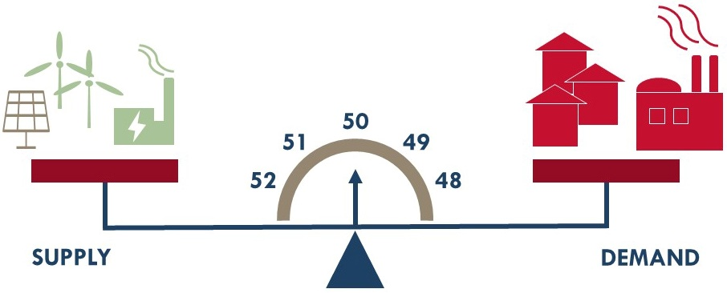
Under Frequency Load Shedding
Power Quality = Nominal Voltage + Nominal Frequency.
EFCS – Emergency Frequency Control Schemes
Under Frequency Load Shedding
Notes:
Aim: Explain Under Frequency Load Shedding and how it operates. Time: 1 minute

Slide 4
Impact of Distributed PV on the UFLS Scheme
SA DPV Generation – 12 Month Rolling
UFLS Operation with Increased Levels of DPV
↓ Net UFLS Load
+
Reverse Flows
↑ Distributed Solar
↓ SA Power System Security
Notes:
Aim: Demonstrate SA’s High Penetration of DPV, and how this feeder-level generation impacts the Efficacy of UFLS Scheme Time: 1.5 mins

Slide 5
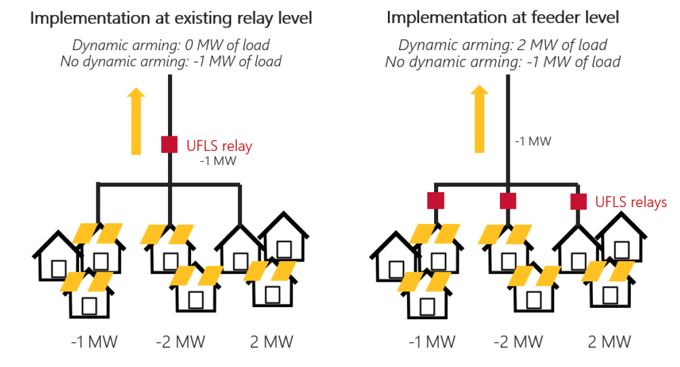
Dynamic Arming
Existing UFLS Scheme
P“Dynamic Arming” Solution
Notes:
Aim: Explain the concept of Dynamic Arming w/ reference to DPV on Feeders.

Slide 6
Improving consideration of demand-side factors in the ISP
Include distribution constraints as inputs to the ISP
This will lead to some additional unserved energy met in AEMO’s modelling
This energy would currently be assumed to be met by PV exports, some of which would be constrained in reality
AEMO has three options from there:
Recommend more large-scale generation + transmission infrastructure to meet that demand;
Recommend investments in distribution network capacity to resolve those constraints;
Most economic mix of (i) and (ii)
This could see AEMO having “actionable” distribution projects in the ISP, similar to transmission
This could be “actionable” up to a certain level of residual constrained energy – the tipping point at which large generation + transmission investment becomes cheaper than resolving the distribution constraints
This leads to a second requirement;
2. Expand the scope of the ODP to include recommendations in distribution network capacity and CER capacity
The ODP does not currently include either of these, and the AEMC has made it clear that the current rule change request does not include any changes to the ODP
In the absence of change to the ODP, AEMO would need to go for option (i), which is the least economic option from a whole-of-system perspective

Slide 7
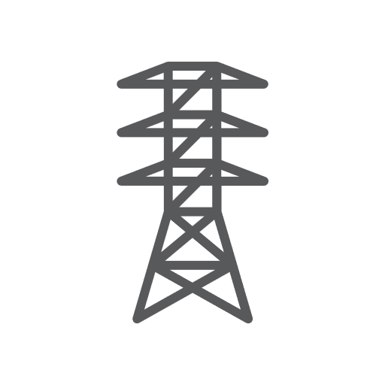
Balancing transmission and distribution investment
AEMO’s future ISP process would look like:
Dx constraints
Dx flexibility schemes
Residual unserved energy
1.
+
=
Forecast “natural” adoption of CER & behaviour, constrained to the intrinsic hosting capacity of the distribution network
Existing/committed large-scale generation & transmission infrastructure
$/MW CER uptake
$/MW CER hosting
*A true “lowest cost” ODP would include recommendations for targeted CER uptake where the distribution network has capacity
Residual unserved energy
=
+
vs
+
2.
Large generation/storage
Transmission capacity
Distributed generation/storage
(via policy/subsidy*)
Distribution capacity

Slide 8
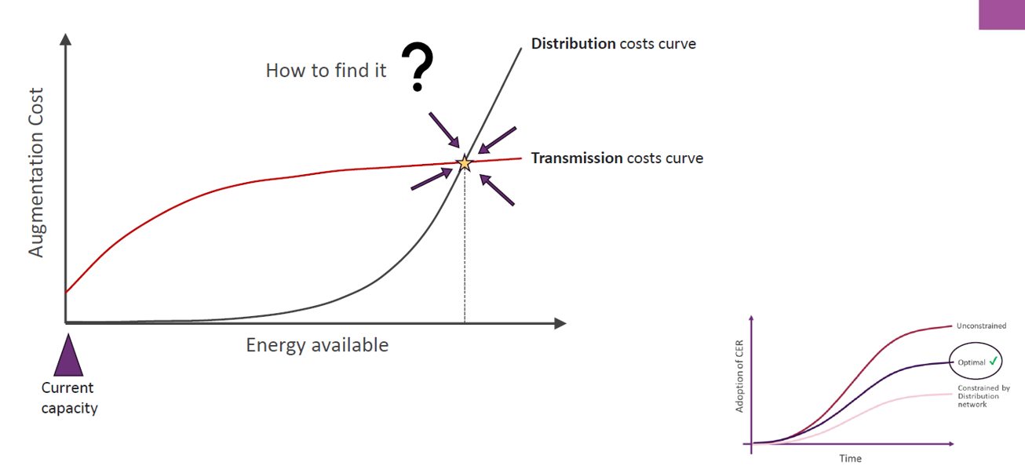
Optimal CER Adoption
Source: AEMO

Slide 9
Next Steps for DSO/TSO Coordination
Sharing CER curtailment forecasts
Sharing operational DPV forecasts
Determining how we incorporate Tx constraints in DOEs
Utilising CER curtailment to extend Tx maintenance windows
Procuring network support services from CER for Tx and Dx constraints
Integrating price-responsive resources into the NEM
Planning criteria for flexible loads

