Slide 1
Engineering Roadmap to 100% Renewables
CSIRO workshop
16 October 2024
Chris Davies – Group Manager Future Energy Systems

Slide 2
We acknowledge the Traditional Custodians of the land, seas and waters across Australia. We honour the wisdom of Aboriginal and Torres Strait Islander Elders past and present and embrace future generations.
We acknowledge that, wherever we work, we do so on Aboriginal and Torres Strait Islander lands. We pay respect to the world’s oldest continuing culture and First Nations peoples’ deep and continuing connection to Country; and hope that our work can benefit both people and Country.
‘Journey of unity: AEMO’s Reconciliation Path’ by Lani Balzan
AEMO Group is proud to have delivered its first Reconciliation Action Plan in May 2024. ‘Journey of unity: AEMO’s Reconciliation Path’ was created by Wiradjuri artist Lani Balzan to visually narrate our ongoing journey towards reconciliation – a collaborative endeavour that honours First Nations cultures, fosters mutual understanding, and paves the way for a brighter, more inclusive future.
Read our RAP
Notes:
Angela

Slide 3
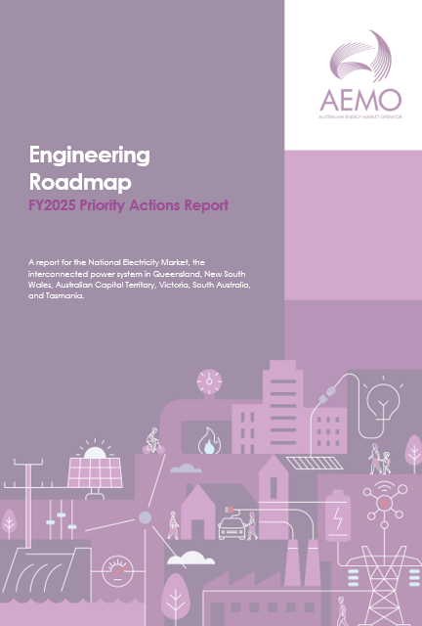
Objectives
Introduce the Engineering Roadmap and how it’s supporting the energy transition
Outline the Roadmap development process
Explore priorities for year ahead
Notes:
Chris Davies

Slide 4
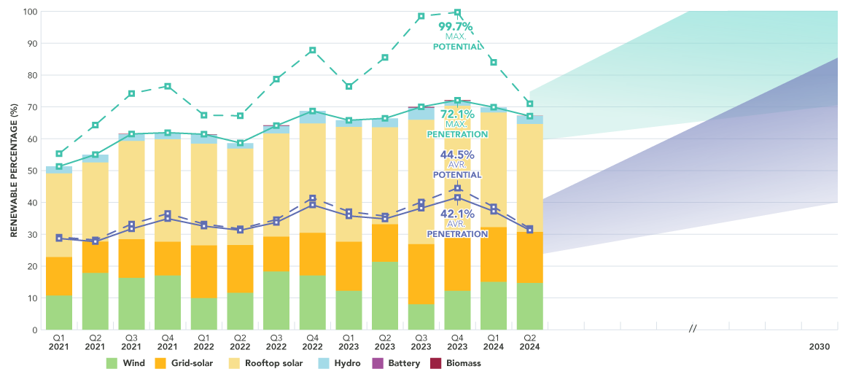
Renewable contributions are increasing rapidly
New max of 74.1%
Q4
2024
Potential: available renewable generation given weather conditions for a 30-minute window – regardless of whether available generators are running
Penetration: generation actually produced by renewables over 30 minutes
Notes:
Chris Davies

Slide 5
Scope of Engineering Roadmap
Detailed, engineering-focussed roadmap
AEMO’s view of the technical, engineering, and operational actions required to operate the NEM at 100% instantaneous renewables for the first time
Technical base to inform industry prioritisation of steps necessary to transition through key milestones on the way to 100% renewables
Provide confidence around underway actions and highlight areas requiring further attention
Notes:
Presenter: Alastair Belder
Speaking notes: TBC
What the roadmap is:
The Engineering Roadmap to 100% Renewables is a detailed, engineering-focussed roadmap.
Presenting AEMO’s view of the technical, engineering, and operational actions required to operate the NEM at 100% instantaneous renewables for the first time.
The intention was to provide a technical base to inform industry prioritisation of steps necessary to transition through key milestones on the way to 100% renewables
Provide confidence around underway actions and highlight areas requiring further attention.

Slide 6
Roadmap structure
Frequency & inertia
Transient & oscillatory stability
System strength & converter driven stability
Voltage control
System restoration
Power system security
Monitoring & situational awareness
Operational processes
Power system modelling
System operability
Utility-scale variable renewable energy (VRE)
Distributed energy resources (DER)
Structural demand shifts
Transmission
Distribution
Firming
Resource adequacy & capability
Notes:
Presenter: Alastair Belder
Speaking notes: TBC
As shown on this graphic; the roadmap structure is broken down into three different overarching sections, which is further refined into 14 sub-sections. The over-arching sections are;
Power system security
Maintaining the secure technical operating envelope of the power system under increasing renewable penetrations.
System operability
The ability to securely and reliably operate the power system and transition through increasingly complex operating conditions.
Resource adequacy & capability
Building the energy resources and network capability to unlock the renewable potential and the flexible capacity to balance variability over different timeframes.

Slide 7
Roadmap example: Operational processes
What the transition to 100% renewable operation will require
Preconditions for first 100% periods
In progress
Commence soon
First 100% periods
More regular 100% operation
Ability to operationally forecast energy adequacy and quantify VRE variability and uncertainty over different timeframes
Ability to securely and reliably manage planned outages for maintenance and the augmentation required in the transition to 100% renewables
Collaborate with DNSPs and participants to capture in AEMO’s operational forecasting the impacts of distribution network and other constraints on the output of semi-scheduled plant, non-scheduled generation, and small-scale DER
OTR
EF15 OTR
Redevelop AEMO operational forecasting infrastructure to enable the rapid development of tools and systems with increasing VRE and DER uptake
Extend AEMO operational forecasting capability to enable the assessment and scheduling of energy as well as capacity, required in the transition to a power system dominated by VRE and large amounts of non-scheduled plant
OTR
OTR
Shift from deterministic forecasts to probabilistic and consensus forecasting techniques to enable the quantification and management of uncertainty, variability and risk
Incorporate operational forecasting across a wider range of plausible uncertainty within operational look-ahead tools and automated studies
Establish better defined processes for coordinated outage planning, limit advice and instructions across NSPs and AEMO, over time frames longer than 7 days
AEMO to collaborate with TNSPs to assess possible procedural changes to enhance flexibility and adaptability in the outage management process as continuous outages may become harder to accommodate
Develop enhanced tools and risk assessment approaches for AEMO and TNSP outage assessment studies
Develop structured mechanisms for ensuring adequate operational levers for managing system security during outage conditions
Legend
Identified action
Related to AEMO inflight action: EF = Engineering Framework FY23 priority OTR = Operations Technology Roadmap
High priority action requiring urgent progression
Critical output needed from ongoing action to enable operation at 100% renewables
Action relates to inflight reform
Notes:
Presenter: Alastair Belder
Speaking notes: TBC
Each sub-section in the report has it’s own roadmap of actions that will be required to enable operating the NEM at 100% renewables.
These individual actions are sorted by the precondition; which defines the system capability needed to confidently allow the power system at 100% renewables.
Shown on the screen is the excerpt for the “Operational processes” roadmap; and the first pre-condition is the “Ability to operationally forecast energy adequacy and quantify VRE variability and uncertainty over different timeframes”, we have identified five actions needed to meet this precondition, and as can be seen by this graphic four out of the five are in progress with all needed to be completed before the first periods of 100% renewables.
Some actions might only be needed for more regular 100% operation, as well as some being indicated as more urgent than others. I will now handover to Kirstan who will manage our first of two Q+A sessions. (show slide 12)

Slide 8
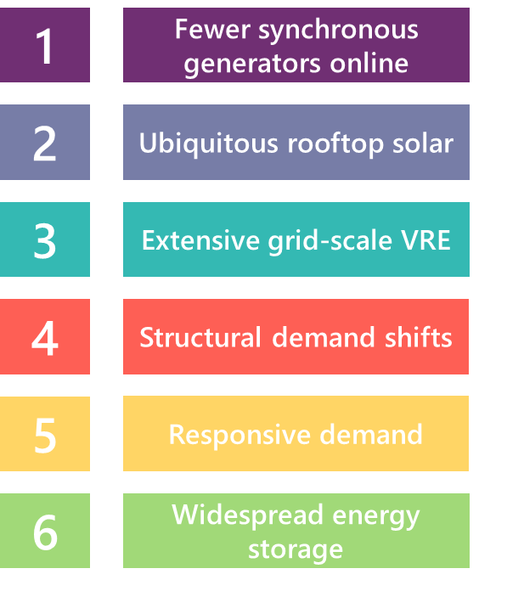
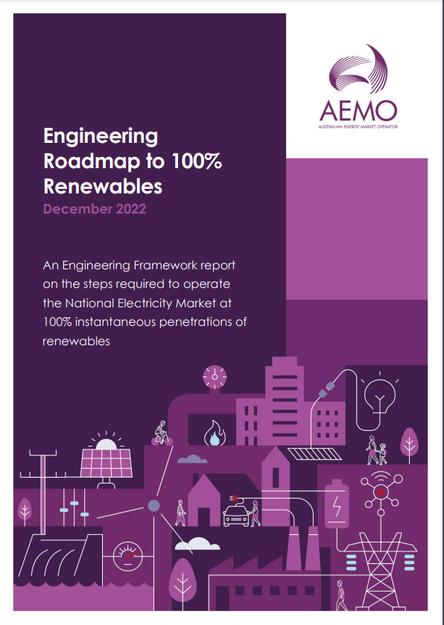
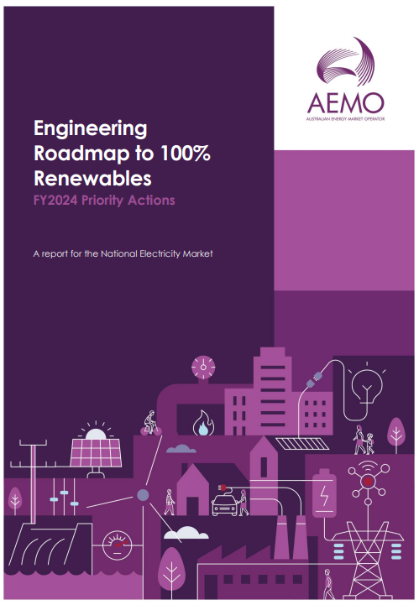
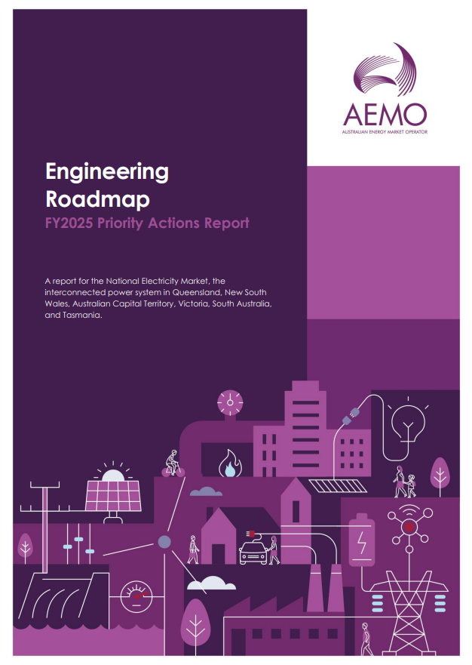
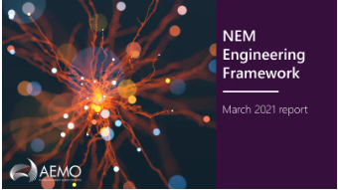
NEM Engineering Roadmap journey
March 2021
July 2021
December 2021
June 2022
December 2022
June 2023
August 2024
Engineering Framework
Engineering Roadmap
Stocktake of work in progress across industry
Defining future operational conditions
Comprehensive gap analysis
FY23 priority actions
Engineering Roadmap to 100% Renewables
FY24 priority actions
FY25 priority actions
300+ individual potential gaps
Present forward
Future back
Notes:
Chris Mock

Slide 9
Linkages to research

Slide 10
Priorities for the year ahead
Accelerating implementation efforts
Strengthening collaborations with industry and research groups
Strengthening international collaborations

Slide 11
Summary
Overview of the Engineering Roadmap and how we’re using it to guide priorities
Roadmap development process
Opportunities for increased collaboration
Contact us at: futureenergy@aemo.com.au
Notes:
Chris Davies

Slide 12
Reference resources
Power System Requirements – a summary of the elements required operate any large power system - https://www.aemo.com.au/-/media/Files/Electricity/NEM/Security_and_Reliability/Power-system-requirements.pdf
Engineering Roadmap reports and resources - https://aemo.com.au/en/initiatives/major-programs/engineering-roadmap
Notes:
Angela

Slide 14
Supplementary slides

Slide 15
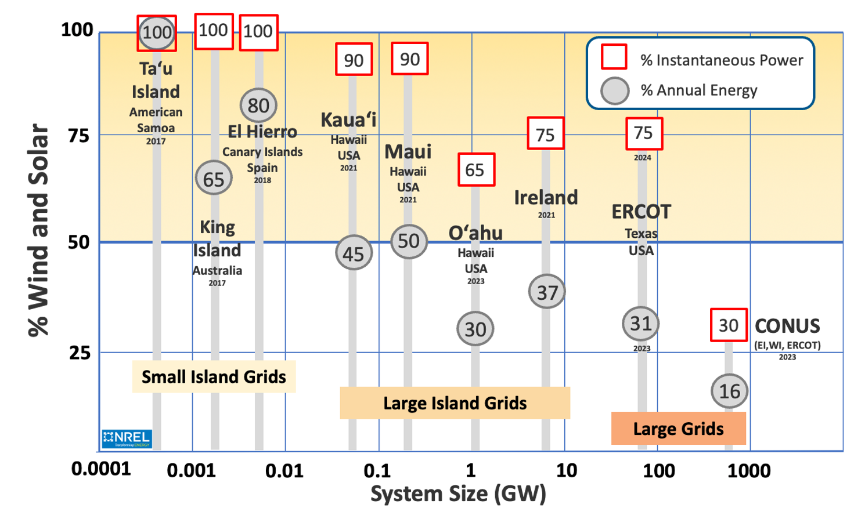
International progress
Notes:
Chris Davies

Slide 16
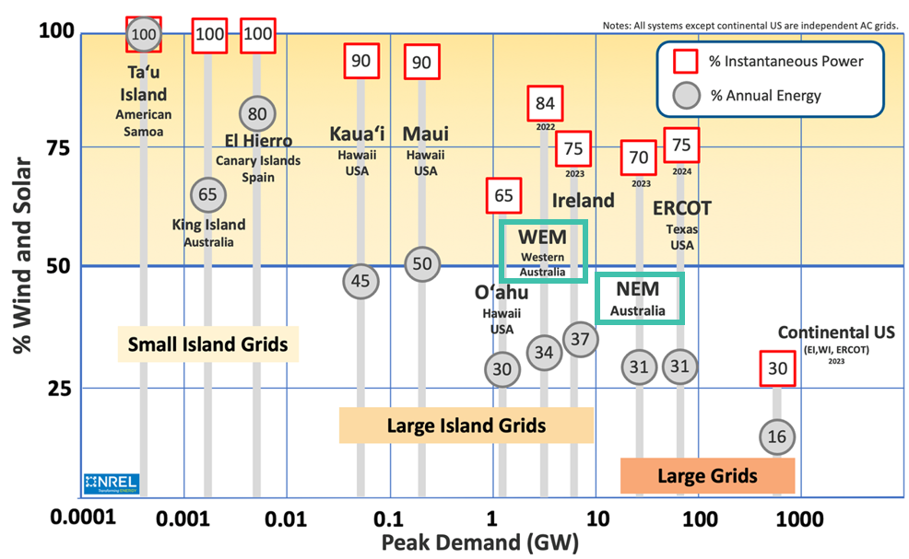
International progress
Notes:
Chris Davies

Slide 17
International progress
SA
South Australia (islanded) 2022
92
Large Island Grids
Notes:
South Australia (when islanded for 7 consecutive days from 1639 on 12 November 2022 to 1804 on 19 November 2022
Instantaneous: 91.5% instantaneous renewable penetration when islanded on 19 November 2022.
% annual energy: 72%, % energy when islanded 62%
System size: ~3.4GW

Slide 18
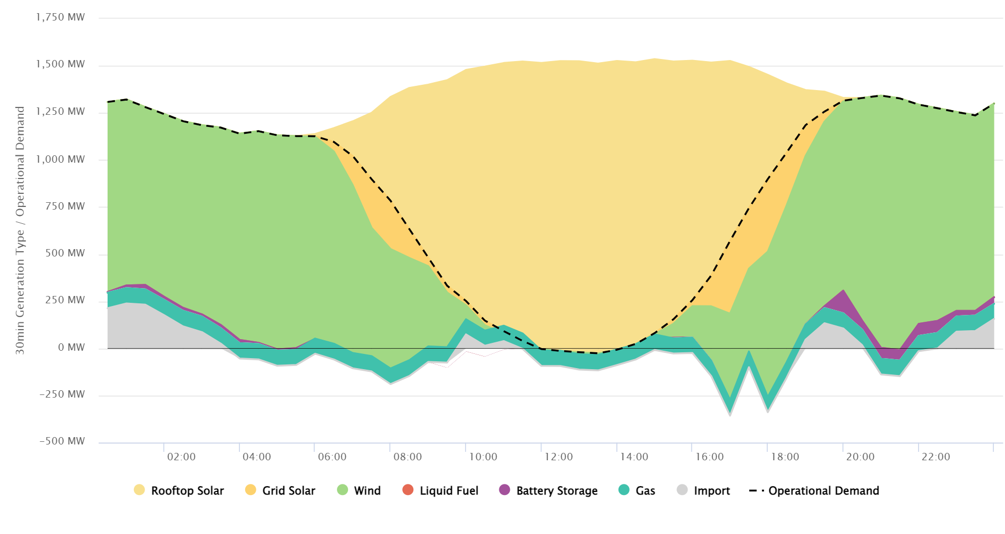
Rooftop solar hits 100% in SA
New SA Minimum Operational Demand Record: -26 MW at 1330 hrs
SA Generation Mix for 31 December 2023
Notes:
Chris Davies

Slide 19
FY2025 Priority Actions
Committed to 37 actions in FY2025 across six workstreams
Priority focus areas
Delivering foundational transition enablers
Providing long-range investment visibility
Progressing operational readiness
Workstreams
DER Governance
Operational DER integration
Future power system phenomena
New technology capabilities
Operational transition planning
RTO and operations support
Actions
16 actions
11 actions
10 actions
Notes:
For the upcoming FY, 3 priority areas were identified, along with workstreams under each.
Emphasise that the report has plenty of detail on each of these areas, workstreams and actions, including the target outcomes/outputs of each. Purpose of this slide is just to give you an overview and understanding of the focus for this year. Next slide provides some specific deliverables for the upcoming year
Why these 3 priority areas?
Delivering foundational enablers: Recognises that many of the actions needed to enable the transition have long lead times and require concerted collaborative effort across the energy sector to progress. A number of these initiatives relate to those that will build a foundation for the system to operate effectively and efficiently with very high levels of DER.
Providing long-range investment visibility: Timely investment in assets to support the secure operation of the power system is critical to enable the transition to net zero. Seeks to identify emerging gaps that require investment, enabling solutions to be deployed in advance of their real-time need
Progressing operational readiness: builds AEMO’s operational readiness to navigate new conditions with high penetrations of inverter-based renewables and distributed resources by establishing a dedicated framework for transition planning through the definition, preparation, and secure management of operational transition points.

