Slide 1
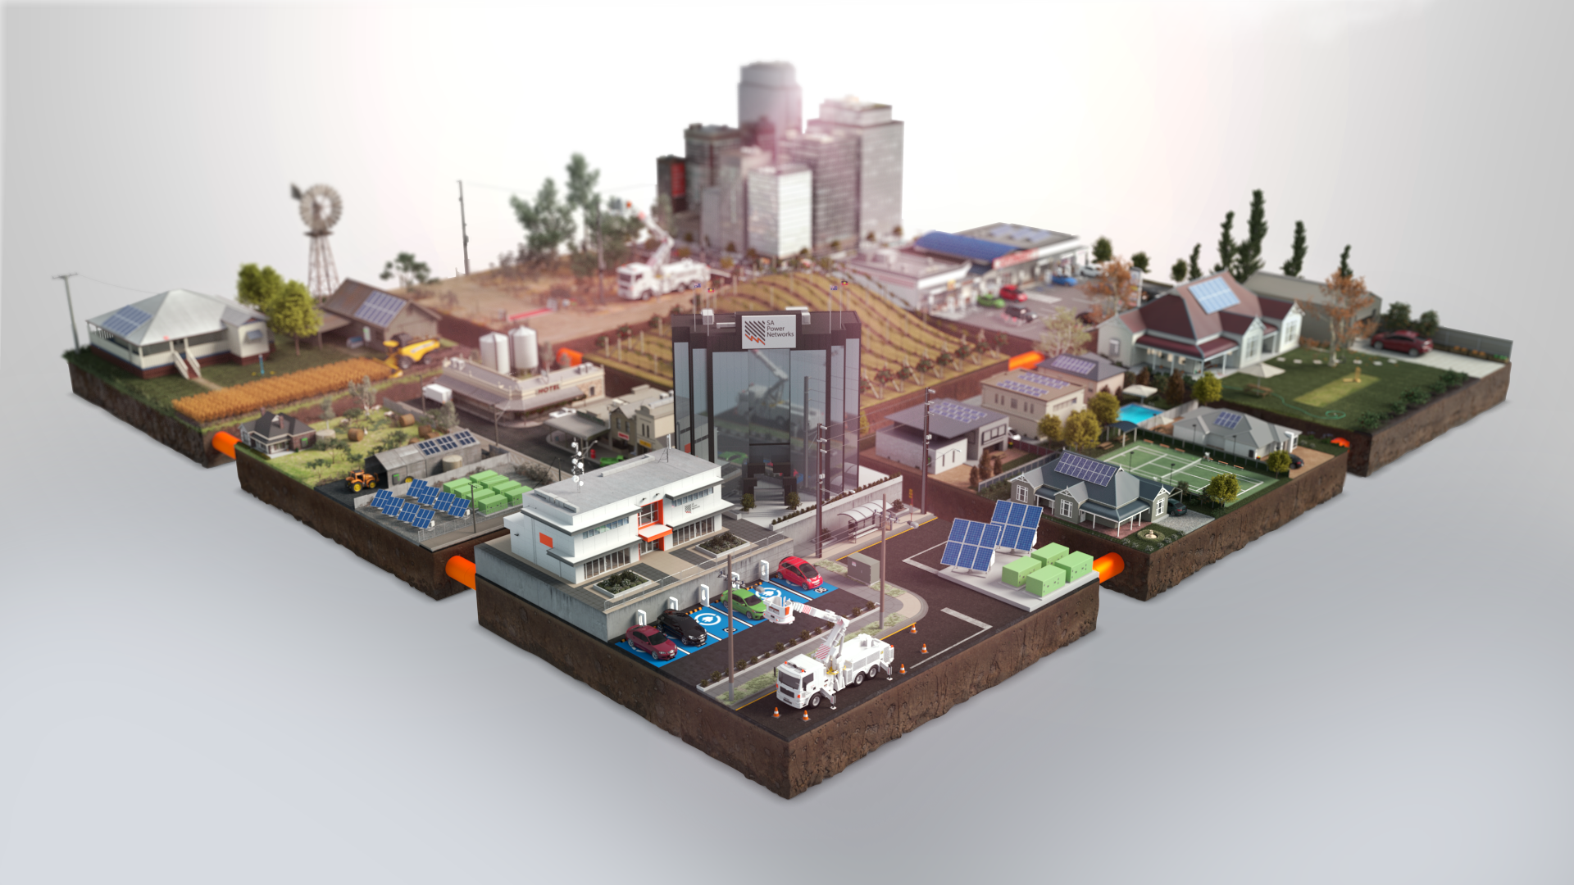
The Distributed Energy Transition in South Australia
Alex Ward
Future Networks Program Manager
SA Power Networks
16 October 2024

Slide 2
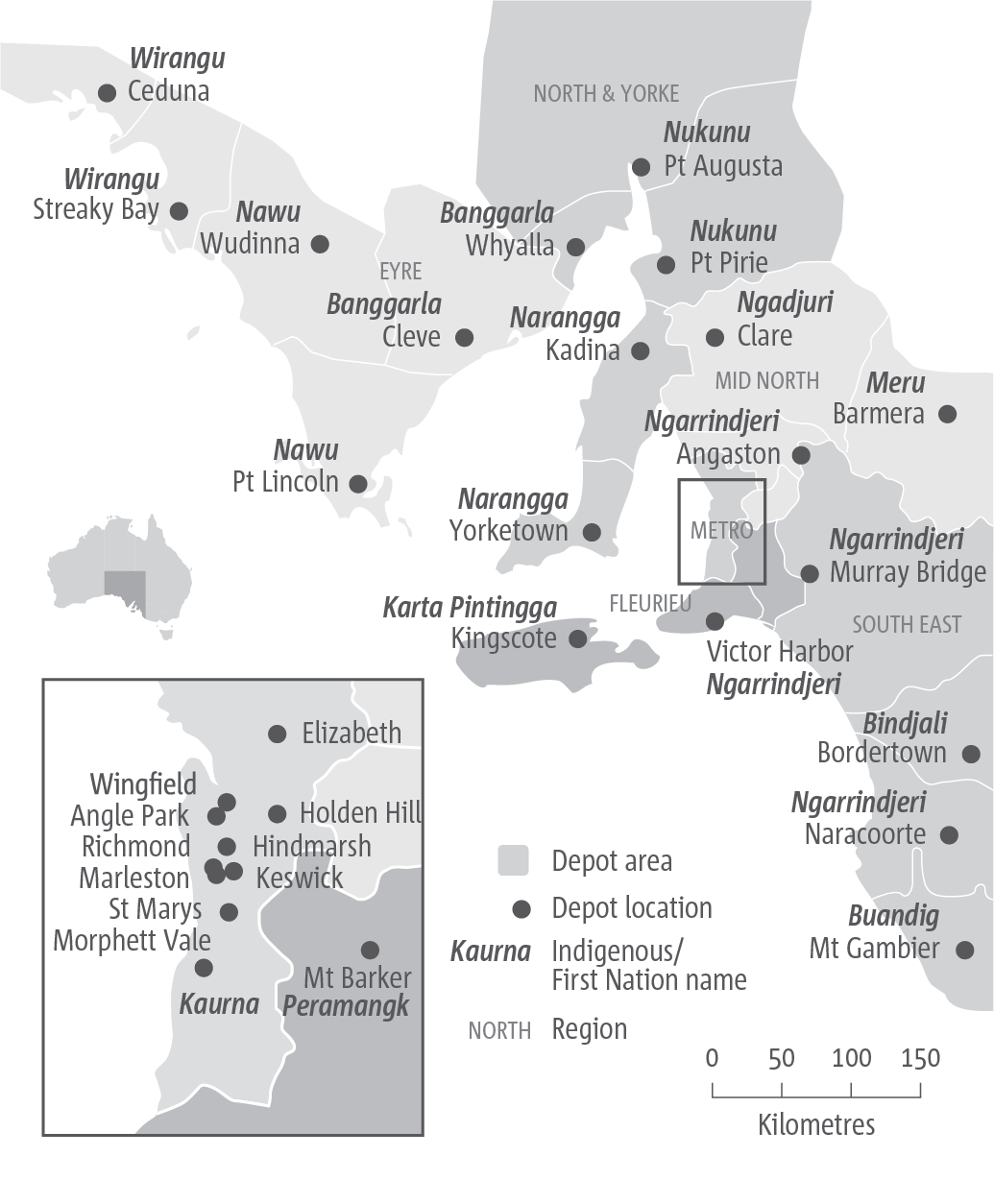
Acknowledgement of Country SA Power Networks acknowledges the multiple Traditional Owners of the lands that host the South Australian electricity network and their connections to land, sea and community. We would also like to pay our respects to Elders past and present, and acknowledge that these are living cultures.
Empowering South Australia, 2023
^{by Presten Warren (b. 2000)}

Slide 3
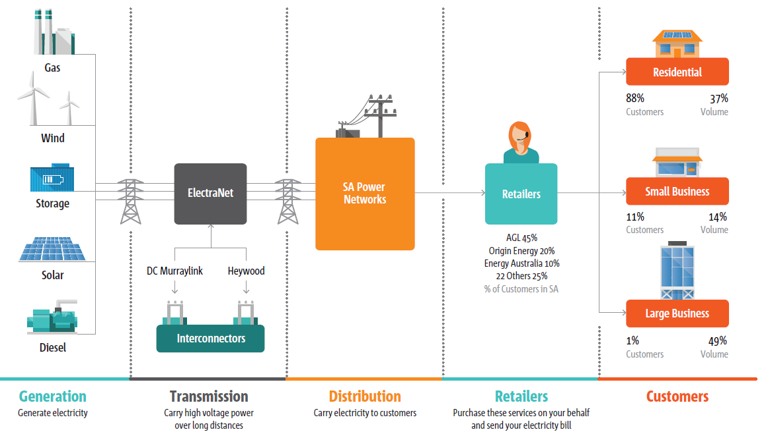
SA Electricity System
3
Notes:
The energy industry is a confusing place, even for those of us who work in it.
Before we start talking about some of the major shifts that are happening in the industry, it’s good to refresh ourselves on a little overview of exactly where SAPN sits in all of this.
We’re an electricity distributor, and only a distributor.
We don’t generate or sell any electricity, we’re purely the people in the middle running the poles, wires and substations that keep everything flowing.
We receive supply from ElectraNet, who in turn receives supply from various generators, both gas and renewable.
Although now, we’re seeing an increasing portion of our generation coming directly onto our network, through the rise of rooftop solar.
We then distribute that supply, regardless of where it came from, across our customer base of 900,000.
The costs of running our network are covered via distribution tariffs that we charge to retailers, who then pass it on to customers along with their retail energy use.
Typically, our network tariffs represent about 26% of an average customer bill.
We’re a regulated monopoly – so we’re the only ones doing what we do in SA, and our annual revenue, and hence the amount that we charge to retailers, is set by the Australian Energy Regulator.
Our revenue is set in 5 year cycles, or ‘resets’ as we call them. Our next one is coming up in 2025, which many parts of the business are in the midst of preparing for.

Slide 4
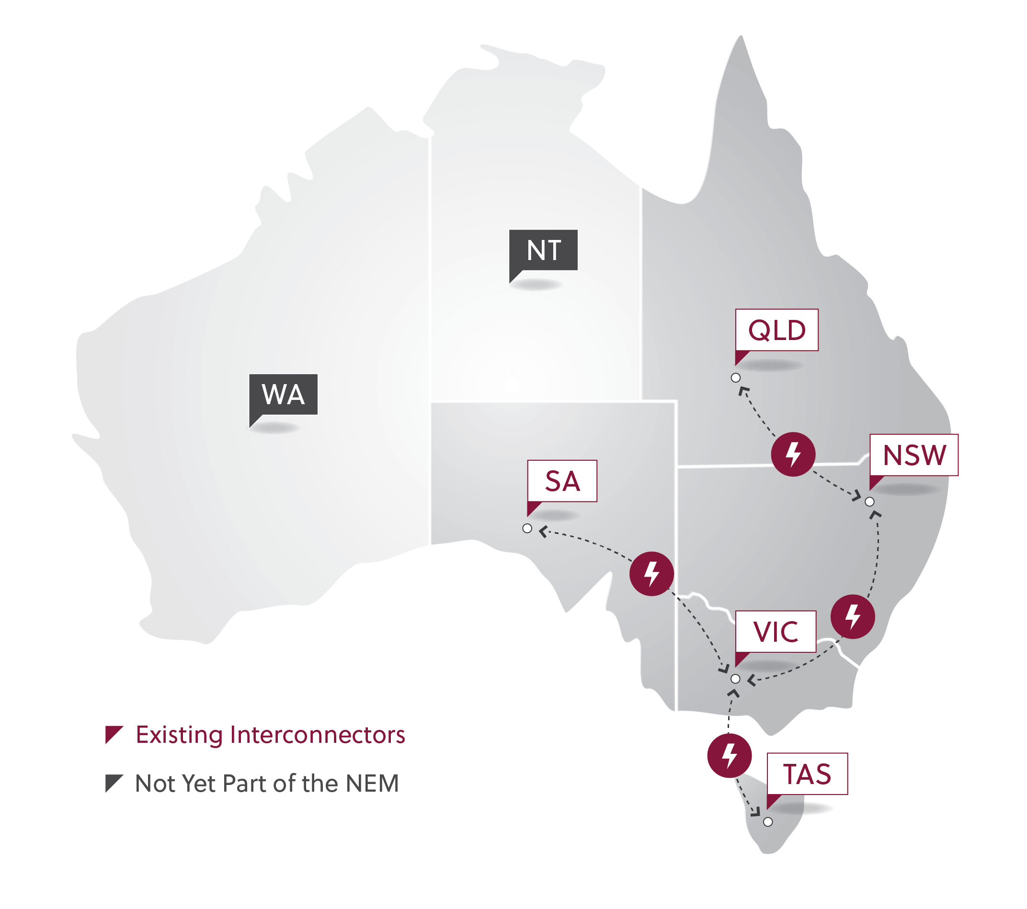
The National Electricity Market

Slide 5
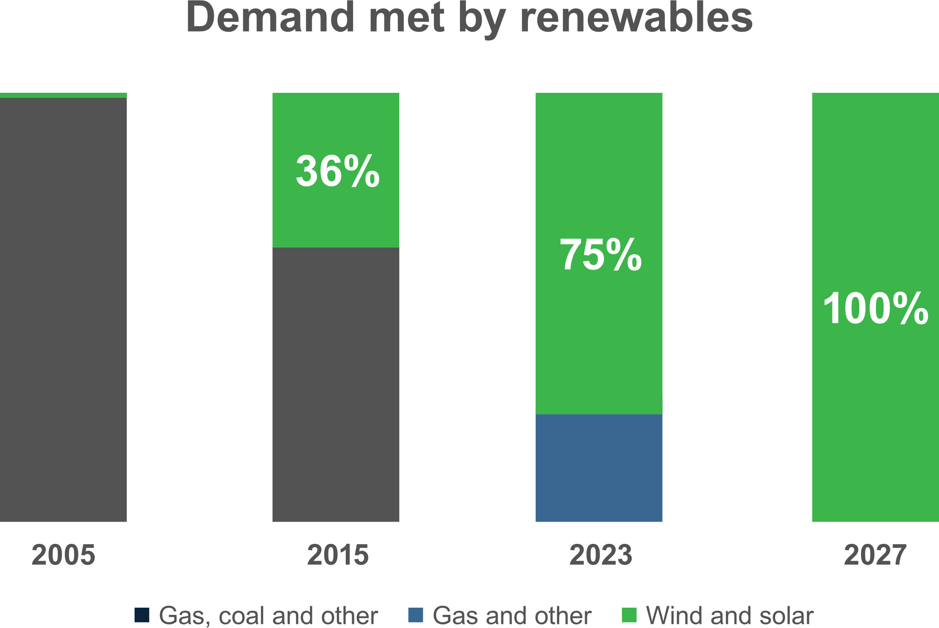
South Australia’s profound transition to renewable electricity
Energy supplied by variable renewables
Notes:
We just spoke about the fact that we take generation in, and deliver it down to our customers.
But what’s really interesting, is the huge shift that’s happening in where that generation comes from.
Historically, all of our power came from gas-fired power stations such as AGL Torrens Island, or coal-fired power stations such as the former Northern Power Station in Port Augusta.
But now, we’re seeing an increasing amount of our energy coming from distributed and renewable generators – specifically wind and solar.
This year, we’ve seen almost 70% of our state demand for electricity met by renewables – that’s almost double what it was only 7 years ago!
By the end of the decade, we expect that we will be well and truly 100% renewable in our electricity supply.

Slide 6
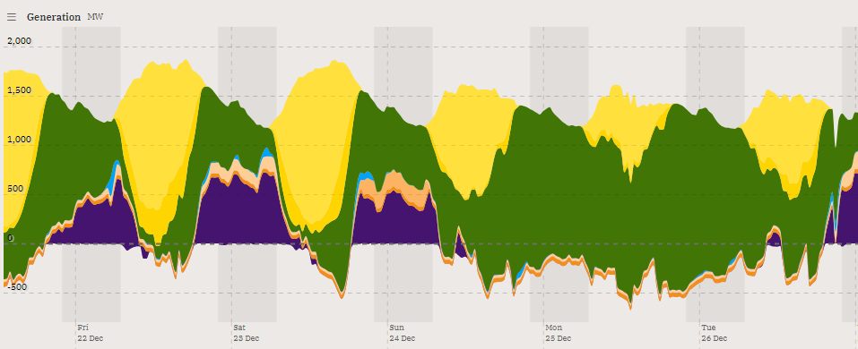
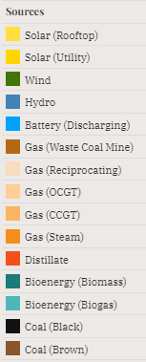
SA vs the National Electricity Market
88% renewable
9% gas
43% renewable
54% coal
Notes:
SA’s unique challenges and opportunities
Low dependence on cheap coal
Highest levels of Variable Renewable Energy in the world
Excess renewables in the middle of the day
Reliance on imports and exports for stability
Volatile (often negative) wholesale prices
World-leading levels of distributed energy resources (DER)

Slide 7
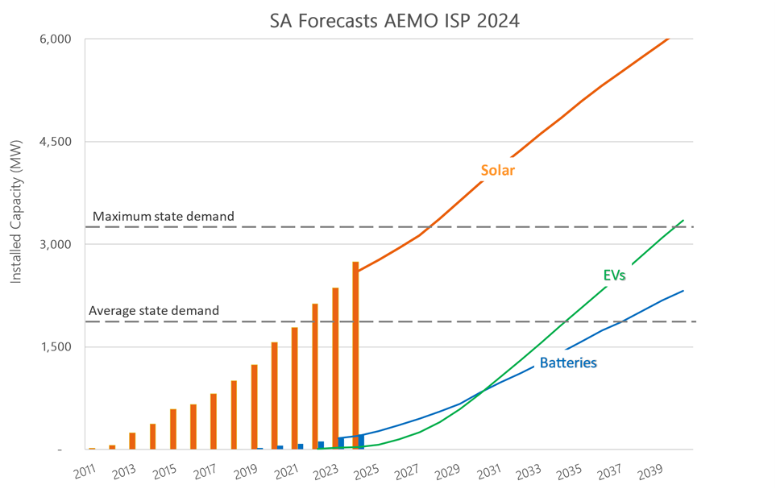
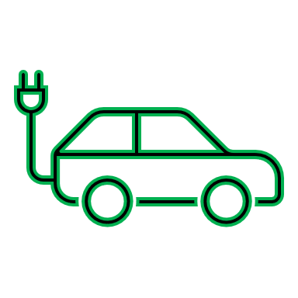
A profound transition is underway
~360,000 Rooftop solar systems
44% of homes - world’s highest
State’s largest generator
~43,000 Home batteries
18 Virtual Power Plants operating in SA
Up to 1,500,000 EVs by 2050
Additional 3,000 GWh of energy

Slide 8
Impact on our network today
Import capacity
IMPORTS
EXPORTS
Export capacity
High PV penetration overloading parts of the network and causing system security risk
8
Notes:
Take a look at how the network runs today
Talk through seasons

Slide 9
Challenges in 2030
New loads like Virtual Power Plants, Electric Vehicles and broader electrification could increase peak demand, requiring significant network capacity upgrades
EV growth could double the height of the peaks
IMPORTS
EXPORTS
Additional PV could double the depth of the troughs
9

Slide 10
Untapped potential of our assets
Underutilised network capacity
IMPORTS
EXPORTS
10
Notes:
Discuss that while the network can get overloaded for short periods of time for a few days a year, most of the time there’s actually lots of unused capacity

Slide 11
Strategies to “make it fit”
Stretch the network capacity through smarter network management
E.g. dynamic voltage control, inverter settings & VPP services
Targeted upgrades
Flexible loads
IMPORTS
EXPORTS
Flexible exports
Voltage management
Targeted upgrades
Fill the spare capacity with flexible DER
E.g. Tariffs and dynamic operating envelopes
11
Notes:
Key strategies are twofold
1. Maximise our peak capacity through smarter network management
Smart inverter settings
Enhanced voltage management
VPP services, network voltage support from batteries
2. Incentivise loads and gen to shift into those spare times
To do this, we need flexible DER
Incentivise via pricing signals (tariffs)
We can implement these within a dynamic operating operate

Slide 12
Electrification will require the network to carry much more energy
Currently, the electricity distribution network delivers around 20% of state end-use energy
In the future, the distribution network may supply approximately 60% of the state’s energy needs through electrification
Notes:
Whilst we fully support the electric revolution, and the many benefits that it will bring, it does pose a major challenge for our network.
We currently supply about 20% of the state’s energy use.
With full electrification of our homes and vehicles, this figure could shift to up to 60% of state energy supply.
Without intervention, this could ~double the peak load on the electricity network and drive $billions of unnecessary investment

Slide 13
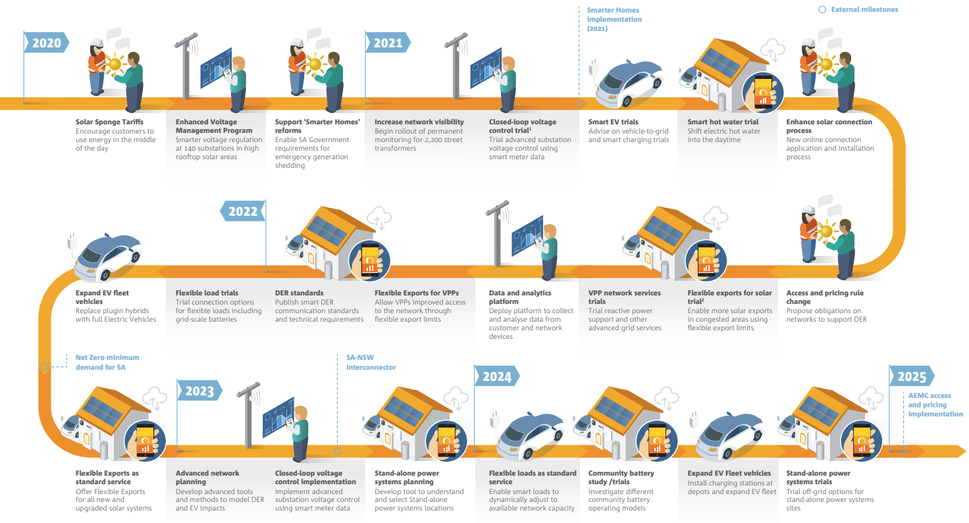
Our Distributed Energy Transition Roadmap 2020-25

Slide 14
Our DSO Journey
Key services:
Backstop mechanisms: reduction of demand or generation to maintain system security under maximum or minimum demand conditions – mandatory
Flexible network connections: to communicate network guard rails to flexible CER – incentivised via LRMC pricing
Flexibility services: leveraging customer CER to ensure sufficient levels of service to flexible & non-flexible customers – incentivised via SRMC pricing
Flexibility-as-a-service: Leverage SAPNs CER communications infrastructure for retailers, aggregators and traders - optional
Smart CER
(HEMS technology, national standards + ‘smart ready’ mandates)
Flexible customer offers
(Customers are rewarded for their response to a DOE)
Ability to publish DOEs
(Systems are robust and scalable)
New organisational capabilities
(Connections, planning, operations)
Network models that span LV and HV
(combination of model and time-series data)
Flexibility Marketplace
Procure services from CER
Market interfaces
(Share operational data with AEMO to inform power system operation)
Flexibility as a service platform
Provide retailers connectivity and control of CER
DSO 1.0
DSO 2.0
DSO 3.0

Slide 15
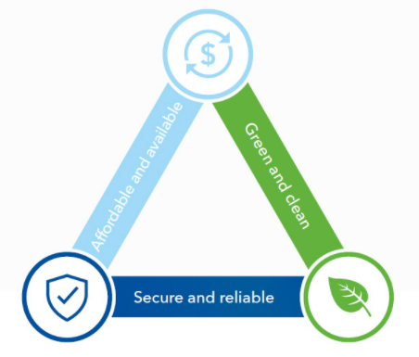
Our vision: breaking the energy trilemma
Traditionally, the trilemma has been seen as a key challenge to the industry …
How do we trade off sustainability, reliability and affordability?
The energy transition presents a unique opportunity in South Australia:
Abundant renewable resources
Significant latent capacity in our network
Existing strong industry collaboration
Bipartisan political support
Our goal is to continue to transform our network and services to support this customer-led energy transition
We believe we can maintain reliability, while fully decarbonising and dramatically reducing customers’ energy bills
A future of energy prosperity, where energy is clean, reliable and affordable

