Slide 1


Australia’s Global Power System Transformation Research Roadmap
Australian research opportunities to rapidly accelerate the transition to advanced low emission power systems
Proudly supported by GHD Advisory
Jessica Guth - GHD
October 2024

Slide 2
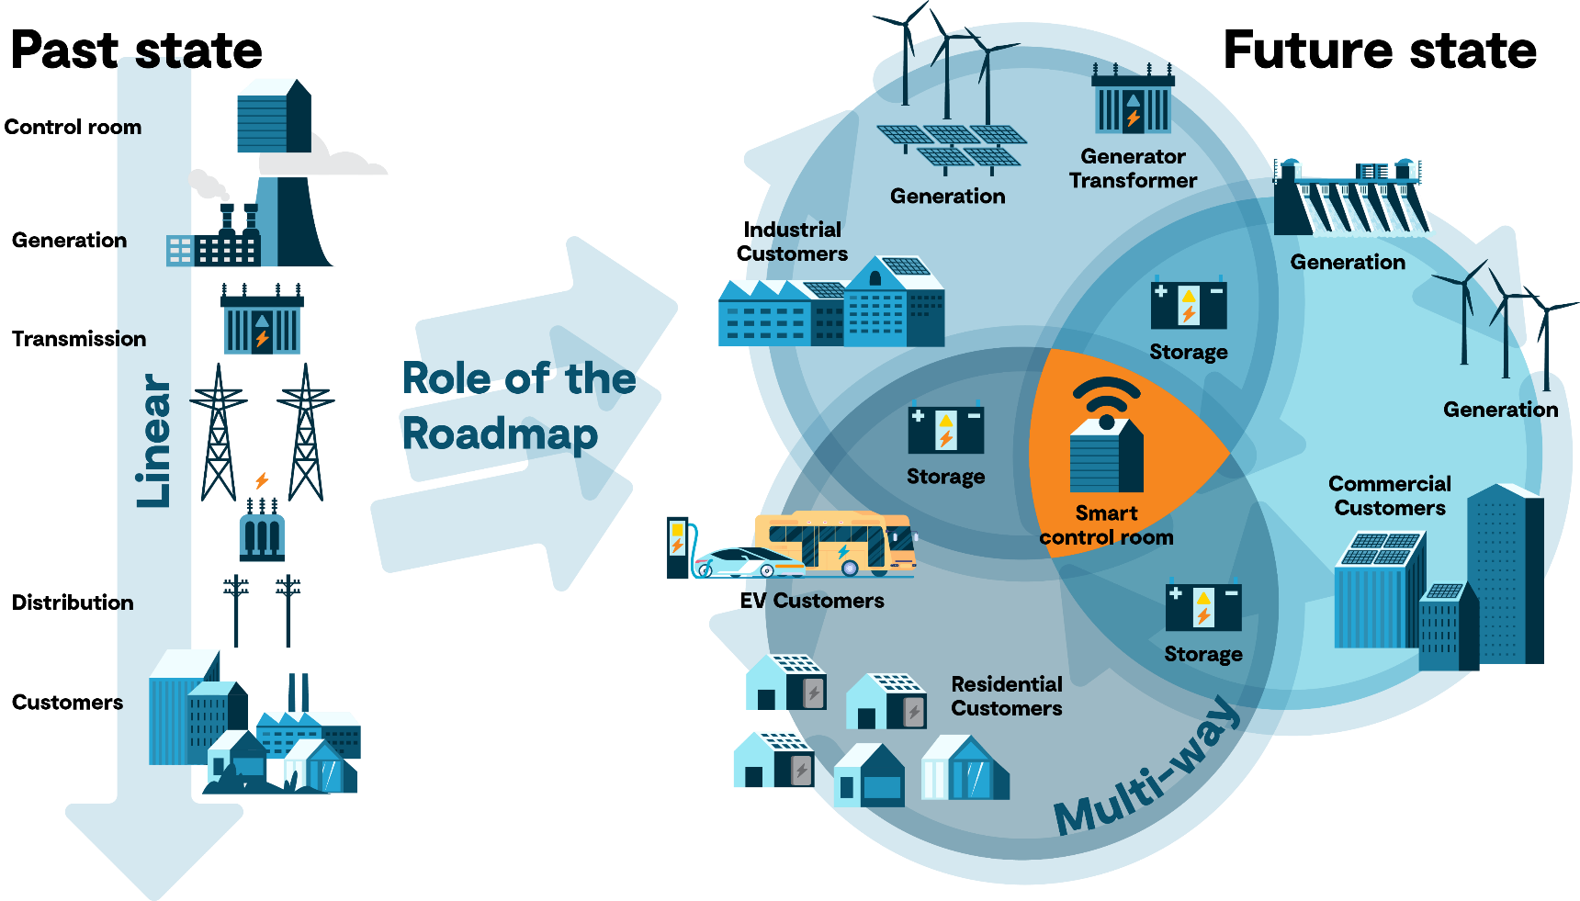
Energy Transition

Slide 3








Associated challenges
System security
System reliability
Workforce capability
& development
Rise of consumer activism
Enabling consumer participation
Accelerating local technology adoption
Need for open data and tools
Standards development

Slide 4















Aaddressing challenges together
The GPST Consortium, CSIRO, and AEMO came together to accelerate addressing issues arising from the energy transition by developing tools and processes to allow for things to move further and faster.
Australian universities, engineering organisations, and international research institutes have been involved in the research to address the challenges.

Slide 5




Australia’s GPST Research Roadmap
Details the research required to support Australia's transition to a stable, secure and affordable power system.
Pilot programs
Research tasks and resources required
Implementation plan to share outcomes
Strategy to tackle highest priorities

Slide 6










Research focus areas
A
Advanced Inverter Applications
Topic 1
Inverter Design
Topic 2
Stability Tools and Methods
Topic 3
Control Room of the Future
Topic 4
System Planning
A
A
C
B
B
Power System Planning
C
Power System Operation
D
DER
Integration
Topic 5
Restoration and Black Start
Topic 6
Essential System Services
Topic 7
Power Systems Architecture
Topic 8
Distributed Energy Resources (DERs)
Topic 9
DERs and Stability
C
C
B
D
D

Slide 7
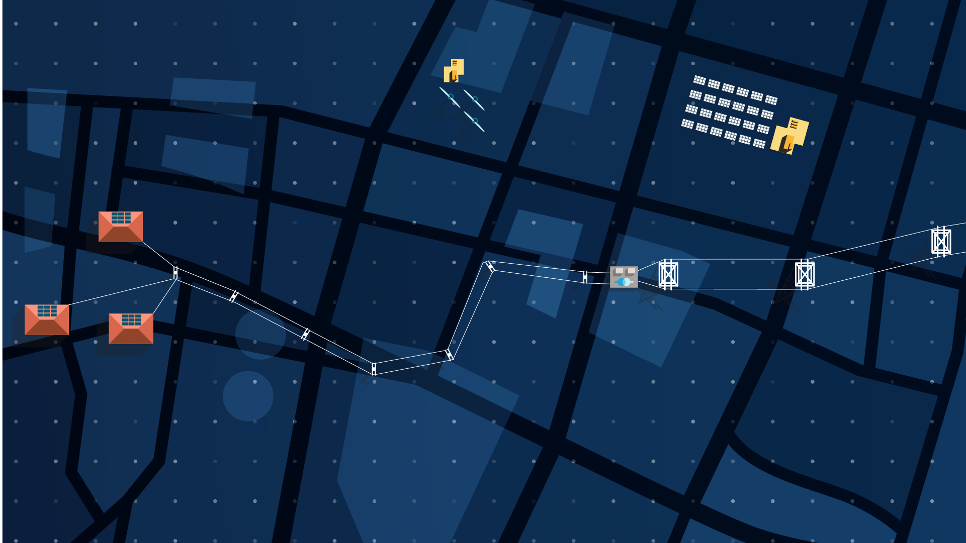

Key breakthroughs
KEY BREAKTHROUGHS TOPIC 5:
Ability to support 100% IBR restart of black start incapable IBRs up to 10 times the MVA rating of the black start device
KEY BREAKTHROUGHS TOPIC 2:
Framework to estimate the frequency characteristics at any operating point for an IBR
KEY BREAKTHROUGHS TOPIC 8:
Demonstrate flexible dynamic export limits are key to significantly increase residential solar PV generation rather than fixed limits.
KEY BREAKTHROUGHS TOPIC 4:
New multi-stage stochastic planning methods that can hedge against long-term uncertainty
KEY BREAKTHROUGHS TOPIC 1:
Transient stability assessment tool for multi-IBR networks
KEY BREAKTHROUGHS TOPIC 7:
Gaining industry traction for Power Systems Architecture as an enabler of structured grid transformation in Australia.
KEY BREAKTHROUGHS TOPIC 9:
Extensive testing of DER, ESS, loads has led to AEMO producing more accurate composite load models for system security assessment
KEY BREAKTHROUGHS TOPIC 3:
Prototype that uses machine learning to identify incidents from alarms in operational data sets.

Slide 8
Benefits of the GSPT Roadmap
Security
Facilitate a safe, cost-effective energy transition for consumers
Reliability
Controlling the chaos of weather dependent energy systems
Research
Advance critically needed Australian research
Environment
Support achievement of Australian net-zero emission goals
Affordability
Create more stability and financial security for consumers
Knowledge sharing
Share knowledge and export solutions to support a global transition

Slide 9

Where to next?
Continuing stage 4 research
Refining research and conducting pilot projects
Reassessing to align with industry needs and priorities
Longer research
5 – 10 years +
Implementation & piloting
3 – 5 years
High priorities
3 years

Slide 10
Questions?
Thank you!
For further information visit: https://www.csiro.au/en/research/technology-space/energy/g-pst-research-roadmap

