Slide 1
Renewable Energy Development and Way Forward in ASEAN: Findings from ASEAN Energy Outlook 8 & ASEAN RE Long-term Roadmap
GPST Workshop
16 – 18 October 2024
Presentation by:
Sustainable and Renewable Energy (SRE) Department
ASEAN Centre for Energy

Slide 2
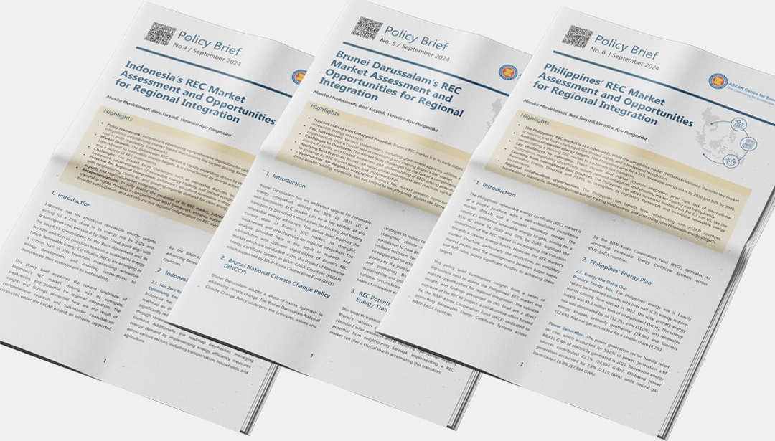
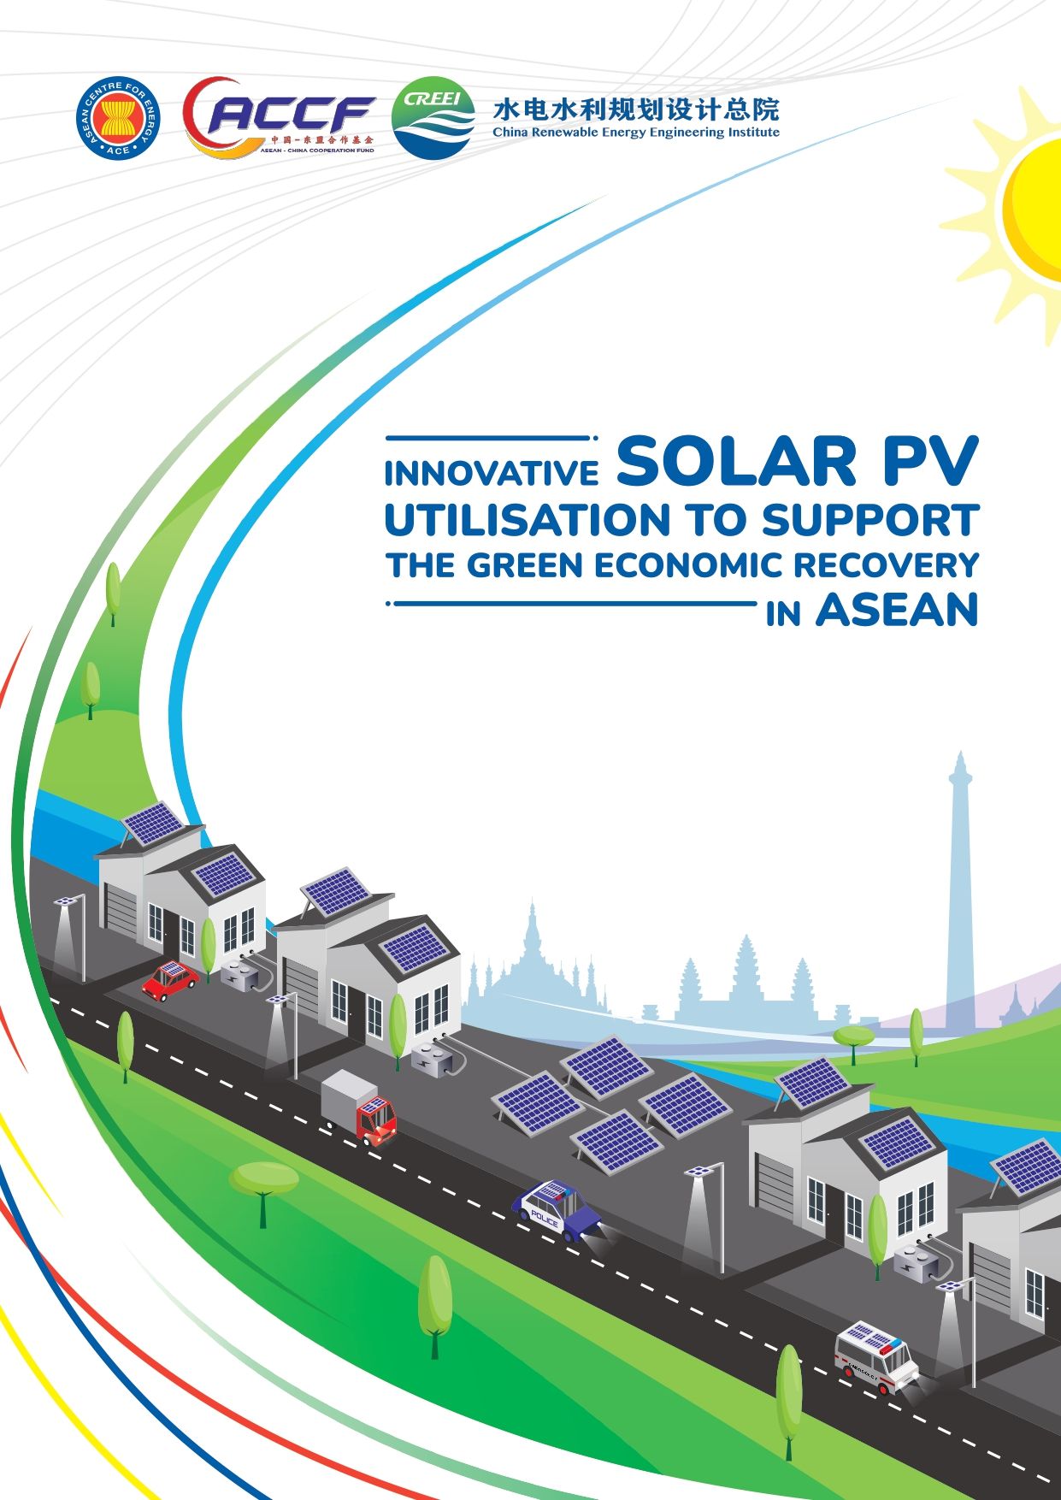
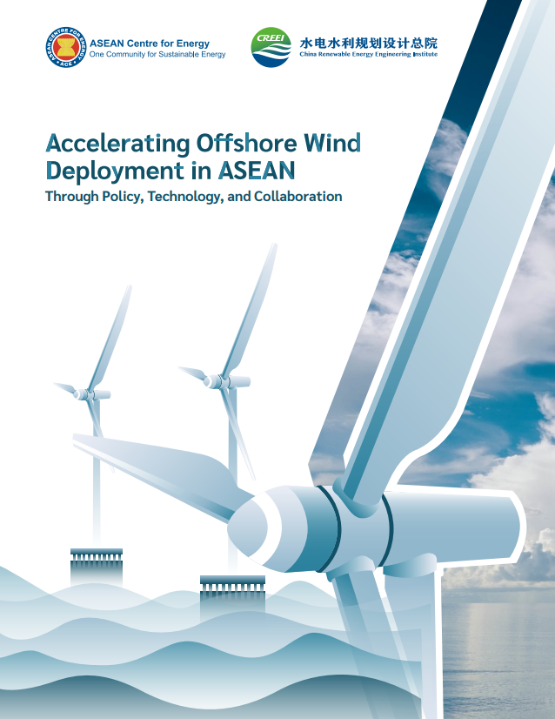
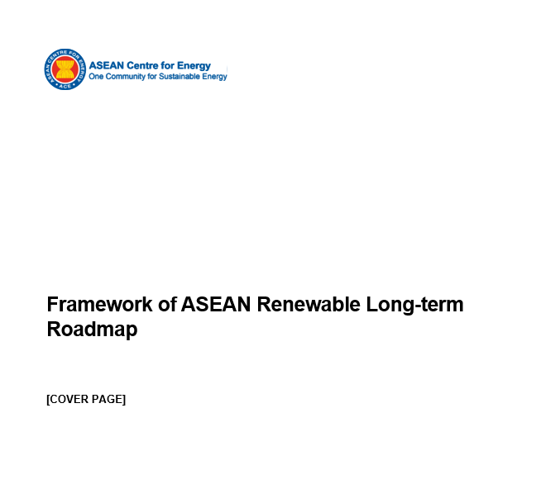
About ASEAN Centre for Energy (ACE)
Think Tank
Energy Data and Knowledge Hub
Catalyst
Identifying and surfacing innovative solutions
Provide a knowledge depository for AMS
Unify and strengthen ASEAN Energy Cooperation and Integration
Policies, Legal & Regulatory Frameworks and Technologies
Policy and Research Analytics
Energy Database
APAEC Activities, including with DPs/IOs
Secretariat
Research, publication, training, capacity building, workshop, policy exchange and recommendations, etc.
Policy Brief on REC

Slide 3
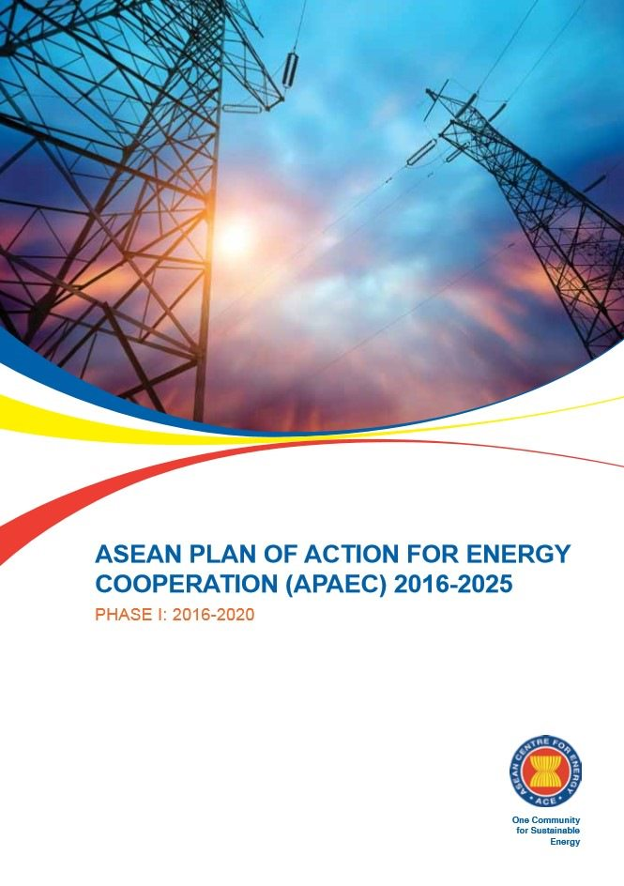
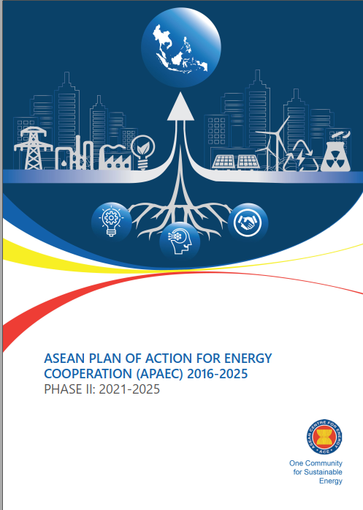
ASEAN Plan of Action for Energy Cooperation (APAEC)
APAEC is a series of guiding policy documents to support the implementation of ASEAN multilateral energy cooperation to advance regional integration and connectivity goals.
Serves as a blueprint for better energy cooperation under seven (7) programme areas in achieving the goals of the ASEAN Economic Community (AEC) pillar of the ASEAN Community.
ASEAN Community Vision 2025:
Forging Ahead Together
5-year period
10-year period
APAEC 1999-2004
APAEC 2004-2009
APAEC 2010-2015
APAEC 2016-2025
Phase 1:
2016-2020
APAEC 2016-2025
Phase 2:
2021-2025
Upcoming APAEC 2026-2035
Phase 1 and 2
16th AMEM
in 1998
21st AMEM
in 2003
27th AMEM
in 2009
33rd AMEM
in 2015
38th AMEM
in 2020
Source: APAEC Phase II: 2021-2025, 2020

Slide 4
ASEAN Plan of Action for Energy Cooperation (APAEC)
1. ASEAN Power Grid
2. Trans-ASEAN Gas Pipeline
3. Clean Coal Technology
To expand regional multilateral electricity trading, strengthen grid resilience and modernisation, and promote clean and renewable energy integration.
To pursue the development of a common gas market for ASEAN by enhancing gas and LNG connectivity and accessibility.
To optimise the role of CCT in facilitating the transition towards sustainable and lower emission development.
.
4. Energy Efficiency and Conservation
5. Renewable Energy
6. Regional Energy Policy and Planning
7. Civilian Nuclear Energy
To reduce energy intensity by 32% by 2025 and encourage EE&C efforts, especially in transport and industry
To increase the share of RE to 23% in TPES and 35% in installed power capacity by 2025
To advance energy policy and planning to accelerate the region’s energy transition and resilience
To build human resource capabilities on nuclear science and technology for power generation.
Source: APAEC Phase II: 2021-2025, 2020

Slide 5
ASEAN Energy Outlook 8 Highlights & Scenarios
Findings from ASEAN Energy Outlook 8 (AEO8)
Updated historical data 2005-2022, with projection period up to 2050.
Updated modelling (equations, technology options, assumptions, etc.)
Thematic chapters designed to address 7 APAEC programme areas.
Official ASEAN Outlook, in collaboration and endorsed by AMEM
Baseline Scenario [BAS]
Historical achievement excluding any policy interventions — Exploring pathway of no additional efforts on the energy efficiency (EE) and renewable energy (RE) policies.
AMS Target Scenario [ATS]
Achievement of existing ASEAN Member States (AMS) targets — Exploring impact of current national policies & measures from official documents on Power Development Plan, EE & RE.
Regional Aspiration Scenario [RAS]
Least-cost optimisation in power sectors, while keeping the regional targets and standards, and using accelerated AMS policies.
Carbon Neutrality Scenario [CNS]
Decarbonisation efforts using optimisation of net zero technologies, aligned with ASEAN Strategies for Carbon Neutrality.
Source: 8th ASEAN Energy Outlook (AEO8)

Slide 6
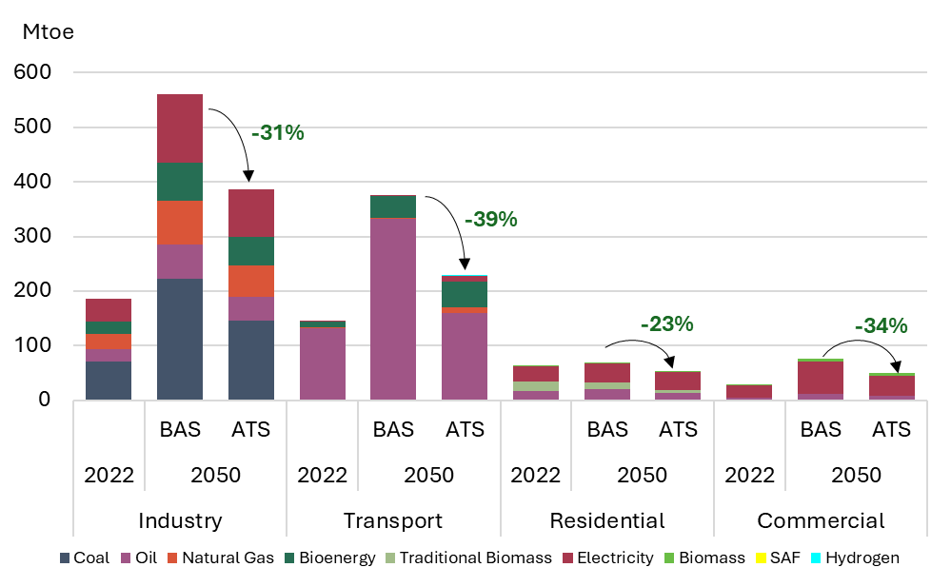
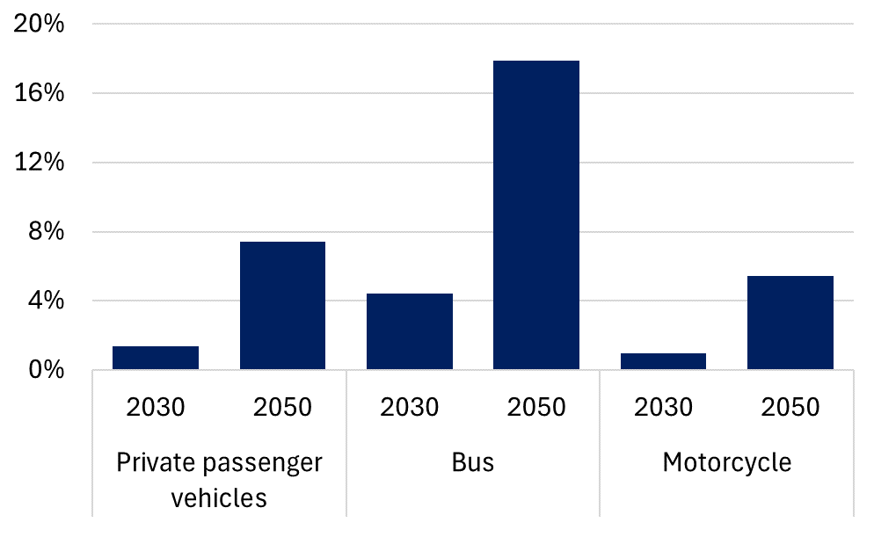
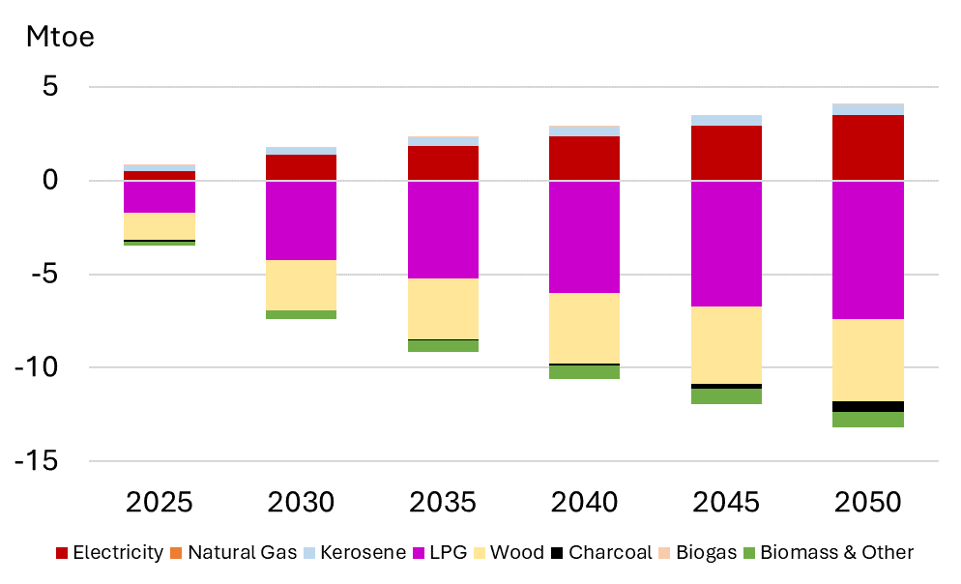
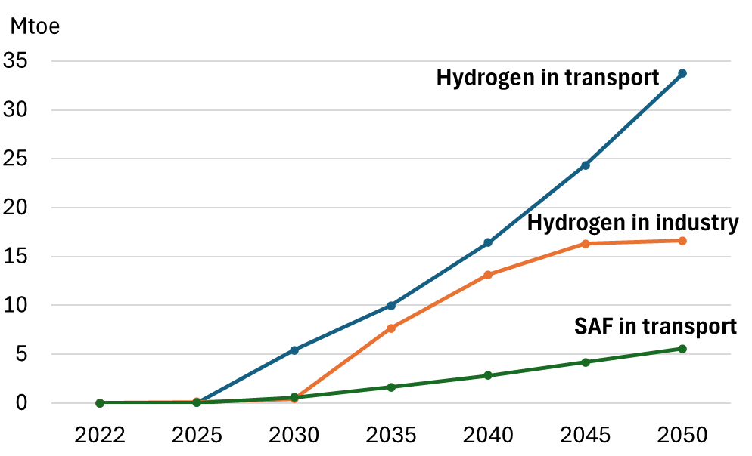
Understanding ASEAN Energy Landscape: Demand Projections
Findings from ASEAN Energy Outlook 8 (AEO8)
Final Energy Demand in 2050
EV Penetration in Road Transport, ATS
Energy demand in 2050 is 2.6 times higher than 2022 (BAS)
Industry and Transport are the highest energy-consuming sectors, dominated by coal and oil
Potential reductions of 33% (ATS) are driven by efficient appliances and fuel economy
The need for fuel shifting to cleaner energy sources like electricity, bioenergy, and hydrogen.
In road transport, buses leading the EV penetration in road transport (ATS)
In residential, phase out of traditional biomass (wood, charcoal) and LPG to electricity by 2050 (ATS)
Hydrogen in transport grows exponentially
TFEC in BAS 2022-2050: 2.6 times
Fuel Shift in Residential (Clean cooking), ATS
Emerging Technologies in Demand, CNS
Notes: BAS = Baseline Scenario; ATS = AMS Targets Scenario; CNS = Carbon Neutrality Scenario
Source: 8th ASEAN Energy Outlook (AEO8)

Slide 7
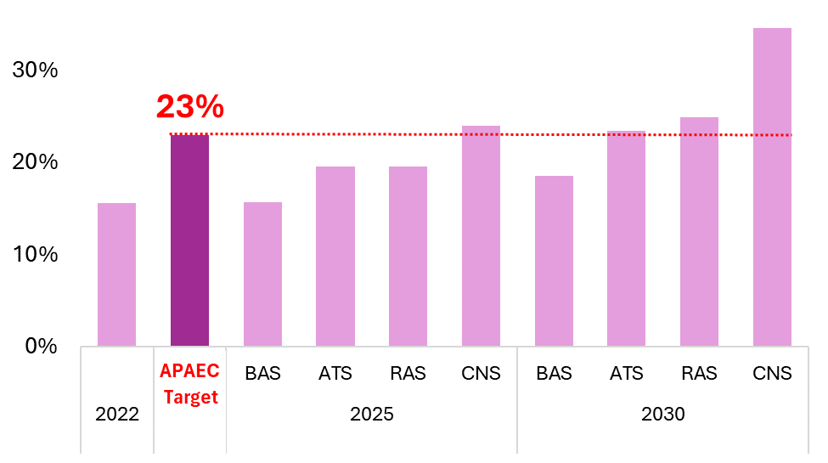
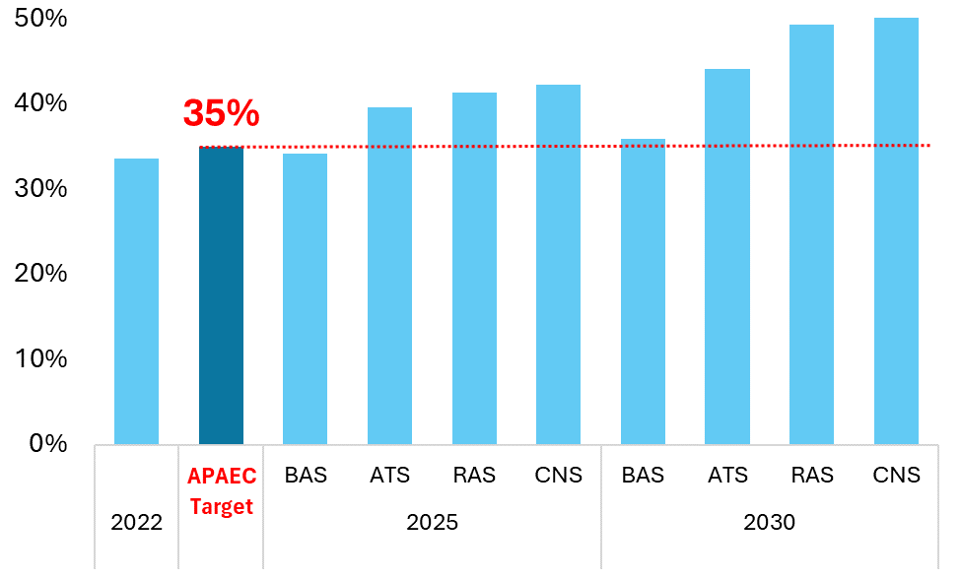
Understanding ASEAN Energy Landscape: Supply & RE Status
Findings from ASEAN Energy Outlook 8 (AEO8)
RE Share in TPES
Steady Growth:
RE share increase from 14.6% (2020) to 15.6% (2022)
14.6%
15.6%
15.4%
Gap for 2025 Target:
Region’s effort in power sector is not translated well to TPES
What’s next?
Retaining 23% target to 2030 or increase it?
RE Share in Installed Capacity
33.5%
Hydro Dominance:
Largest contributor to power capacity → Pumped hydro solution/ small cascading
33.8%
32.8%
Geothermal & Solar Growth:
Significant contributors in recent years but diversification is still needed to wind and bioenergy
Source: 8th ASEAN Energy Outlook (AEO8)

Slide 8
Policy Recommendations based on AEO8
Findings from ASEAN Energy Outlook 8 (AEO8)
AEO8 provides policy recommendations from an economic-wide approach, offering broad strategies for energy development, which includes 3 main strategies:
1
Demand Side: Maximise Energy Efficiency
2
Supply Side: Ensure Energy Diversification & Security
3
Regional Cooperation: Promote multistakeholder collaboration
Enhance energy efficiency standards for buildings, appliances, and industrial processes
Invest in efficient technologies to lower energy intensity and operational costs
Encourage energy diversification for long-term decarbonization
Smart demand response through power sector energy use and RE integration for grid efficiency improvement
Renewable energy sources diversification for greater energy security
Modernise electrical grids for handling renewable inputs and improving grid reliability
Balance clean energy with security for a secure energy shift (natural gas and CCS utilization)
Ensure community inclusion in renewable energy projects
Expand rural electrififcation efforts to ensure equitable access to energy
Implement carbon pricing strategies to accelerate decarbonisation
Promote interconnectivity, including ASEAN Power Grid and cross-border gas pipelines for energy flexibility
Develop supportive policies, including clean energy investment incentives while ensuring energy security and affordability
Foster international cooperation to accelerate the transition
Engage with various stakeholders to ensure broad support and address concerns
Effective and sustainable RE growth requires detailed scenario analysis and projections for long-term development—hence the need to develop the ASEAN RE Long-term Roadmap
Source: 8th ASEAN Energy Outlook (AEO8)

Slide 9
Introduction of ASEAN Renewable Energy Long-term Roadmap
The Development & Past Activities related to ASEAN RE Long-term Roadmap
ASEAN Renewable Energy Long-term Roadmap aims to chart pathways for the development of RE that considers new and emerging sustainable systems.
The roadmap is aimed at facilitating RE development of all member states, by considering each AMS unique socio-economic characteristics, national priorities, and available RE resources
The roadmap is also expected to clearly outline specific timelines and strategies for increasing intra-region green electricity supply, improving power system operation for higher variable RE (VRE) integration, promoting low-carbon fuels for industry and transport, and encouraging technology sharing
ACE has conducted several Focus Group Discussions (FGDs) and workshops to discuss the development of the Roadmap:
1st FGD on 12 May 2022 (during the 29th RE-SSN Meeting)
2nd FGD on 3 May 2023 (during the 30th RE-SSN Meeting)
3rd FGD on 10 July 2023 (online FGD)
4th FGD on 13-14 December 2023 in Jakarta
Workshop or 5th FGD (during the 31st RE-SSN Meeting)

Slide 10
Stages of the RE Long-term Roadmap Development
The Development of ASEAN RE Long-term Roadmap
1st Stage: Align Regional Vision
ASEAN RE Long-term Roadmap Framework
2nd Stage: Scenario Development and Energy Modelling
Integrated with AEO8
3rd Stage:
Developing the full ASEAN RE Long-term Roadmap
The harmonised framework aims to address diverse AMS priorities, fostering streamlined planning and policy development across ASEAN.
Several objectives of the framework are:
Outline the Steps to Develop a Comprehensive RE Roadmap
Evaluate Progress Towards the APAEC Target
Align Regional and Global Objectives with Metrics for RE development
The initial phase of developing the regional RE long-term roadmap involved securing endorsement from senior officials, following the Framework’s endorsement at the 42nd AMEM this year.
The development of scenario and energy modeling for the RE Long-term Roadmap will be based on a comprehensive evaluation of:
Current energy demand and projections of future energy demands.
Scale and cost of existing energy supply infrastructures,
Scale and cost of future energy supply (technical and economic potential), especially renewable resources,
Scale and cost of future energy distributed and demand-side resources, and
Available policy instruments, including regulatory and price reform
The final phase of the roadmap development will involve:
Compile the comprehensive roadmap document with strategies, action plans, targets, and outcomes
Serves as a blueprint for member states, investors, and stakeholders
Implement annual reporting to track progress, ensure transparency, and address challenges

Slide 11
Mapping of Member States Energy Targets
Findings from the ASEAN RE Long-term Roadmap Framework
Countries | Electricity |  |  |  | Industry | Transport | Residential | Commercial
 | TPES | Elec Generation | Elec Installed Cap | TFEC
Brunei Darussalam | × | × | √ | × | × | √ (EV) | × | ×
Cambodia | × | √ | √ | × | × | √ (EV) | √ | √
Indonesia | √ | √ | √ | × | × | √ (BIO) | × | ×
Lao PDR | × | √ | √ | √ | × | √ (BIO) | × | ×
Malaysia | √ | √ | √ | × | × | √ (EV and BIO) | × | ×
Myanmar | × | √ | √ | × | × | × | √ | ×
Philippines | × | √ | √ | × | × | √ (BIO) | × | ×
Singapore | × | × | √ | × | × | √ (EV) | × | ×
Thailand | × | √ | √ | √ | × | √ (EV and BIO) | × | ×
Vietnam | √ | √ | √ | √ | × | √ (BIO) | × | ×
AMS Have diverse set of targets
Only 3 AMS have targets in TPES
Almost all AMS have target in power sector, however the units are diverse
Target in TFEC are diverse, most AMS have target in transport but differing between biofuel and EV target
RE Development in Power Sector is more prominent
However, TPES are still lacking, which means most end-use sectors are still reliant on non-renewables

Slide 12
Analysis on RE Progress & Ambition on Sectoral Level
Findings from the ASEAN RE Long-term Roadmap Framework
Defining Long-term RE Ambition in Power Sector
Sectoral Contribution to TPES and TFEC
Regional RE Share Installed Capacity Projection in 2030 | Regional RE Share Installed Capacity Projection in 2040 | Regional RE Share Installed Capacity Projection in 2050 | Source | Description
41.2% | 45.4% | 49.3% | AEO 7 (2022) | ATS Scenario
45% | 52% | - | AIMS III (2022) | Updated PDP Scenario (Modelled until 2040)
43.9% | - | - | Global Energy Monitor (July, 2024) | Based on Collected Data on Announced, Planned, In-Construction and Operating Power Plant
Country | Highest Sensitivity Sector
Brunei Darussalam | Transport
Cambodia | Transport
Indonesia | Transport
Lao PDR | Residential
Malaysia | Transport
Myanmar | Residential
Philippines | Residential
Singapore | Industry
Thailand | Industry
Vietnam | Industry
ASEAN's RE share in installed capacity is projected to rise significantly in the coming decades.
Short-term projections align on strong RE growth by 2030, but AIMS III shows higher long-term potential due to regional grid integration via the APG.
Cross-border interconnection could be key to accelerating RE adoption and optimising the energy mix in ASEAN.
A sensitivity assessment indicates which sector that contributes the most to energy demand and supply, where transport occurred in most countries, but industry and residential followed closely
Further analysis also indicates that Industry and Transport sector has been the highest sector using fossil fuels
This indicates that conducting measures in these sectors will be important to induce more renewable energy in TPES

Slide 13
Aligning Regional Vision: ASEAN Member States Objectives
Findings from the ASEAN RE Long-term Roadmap Framework
The latest FGD on the RE Long-term Roadmap emphasises AMS's goal to boost regional RE and support diverse economic growth through a unified energy framework based on five pillars: security, affordability, accessibility, resiliency, and sustainability.
Tracking progress toward these pillars below is essential for ASEAN's energy objectives:
Key Metrics | Relevance | Description | Unit
Import dependency for all fossil fuels | Security | Vulnerability to imports from other countries | %
Diversification (Herfindhal-Hirschman index) | Security | Variation of energy sources in a country | Index
Residential Energy Expenditure share towards average household expenditure | Affordability | Measures energy bills burden towards average household expenditure | Average residential energy expenditure as % of average household expenditure
Total energy expenditure share towards economic growth | Affordability | Measure total energy expenditure in a country towards national economic growth | Total energy expenditure as % of GDP (include subsidies)
Households energy access rate | Accessibility |  | % of population with access to clean cooking and electrification
Households receiving energy subsidies | Accessibility |  | % of households receiving energy payment assistance
Reliability of energy supply | Resiliency | Measures disruption frequency per year (SAIDI) | Minutes/Year
Carbon intensity | Sustainability | Measures Carbon Emission towards TPES | Carbon Emission as % of TPES

Slide 14
Aligning Regional Vision: Target & Metrics for Sectoral Measures
Findings from the ASEAN RE Long-term Roadmap Framework
As part of improving the regional coordination, further metrics to measure the RE achievement towards the target are needed. The metrics is tailored to each AMS objective and to specific sectors, especially transport and industrial, which have the highest sensitivity in the regional attainment of the RE share.
Primary target for APAEC-wide approach
Target of APAEC RE Programme Area
Additional or Secondary Target & Metric for Tracking Purposes
Before
(APAEC 2021-2025)
None (RE targets only falls under the RE Programme Area)
% of RE in TPES
% of RE in Installed Electricity Generation Capacity
None
After
(Proposal for APAEC post-2025)
% of RE in TPES
% of RE in Installed Electricity Generation Capacity
(Transport) % of RE in Transport Final Demand
(Industry) % of RE in Industry Final Demand
The proposed changes where made based on the result of the FGDs and latest workshop or consultation meeting on ASEAN RE Long-term Roadmap and APAEC Post-2025
The latest consultation meeting emphasised the RE share in TPES as a key target reflecting all programme areas and their respective SEBs and SSNs
The RE share in installed capacity is the main target-oriented indicator for the RE-SSN programme area.
RE share in transport and industrial sectors are non-target indicators, monitored up to 2030 to guide target setting for APAEC 2031-2035

