Slide 1
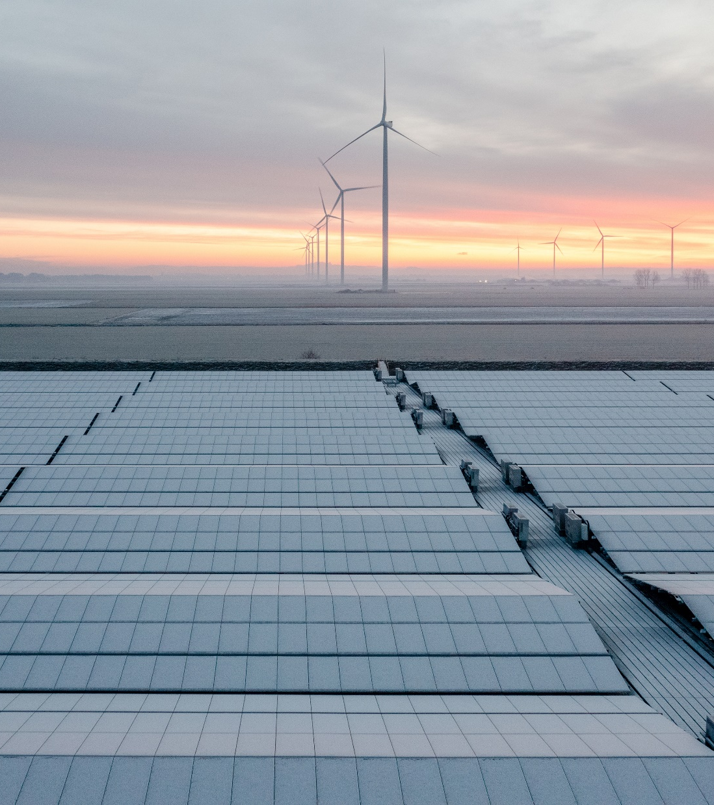
Co-optimisation of Wind and Solar Energy and Intermittency for Renewable Generator Site Selection
Helen Wu
Jenny Hayward
Sam West
17 Oct 2024

Slide 2
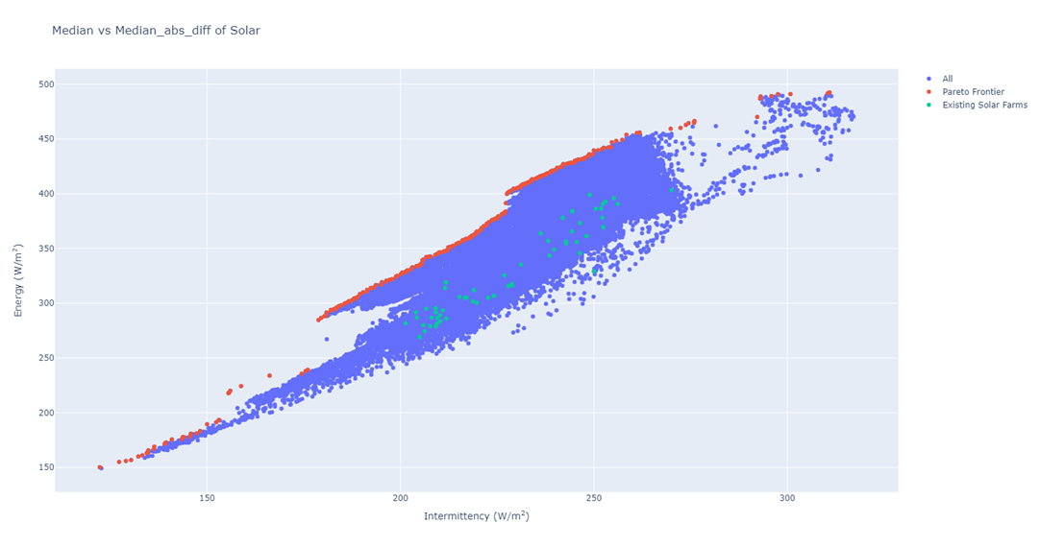
Motivation
Consider the trade-off between energy generation and intermittency
A new multi-objective pareto-frontier approach to identify high performing renewable generation sites

Slide 3
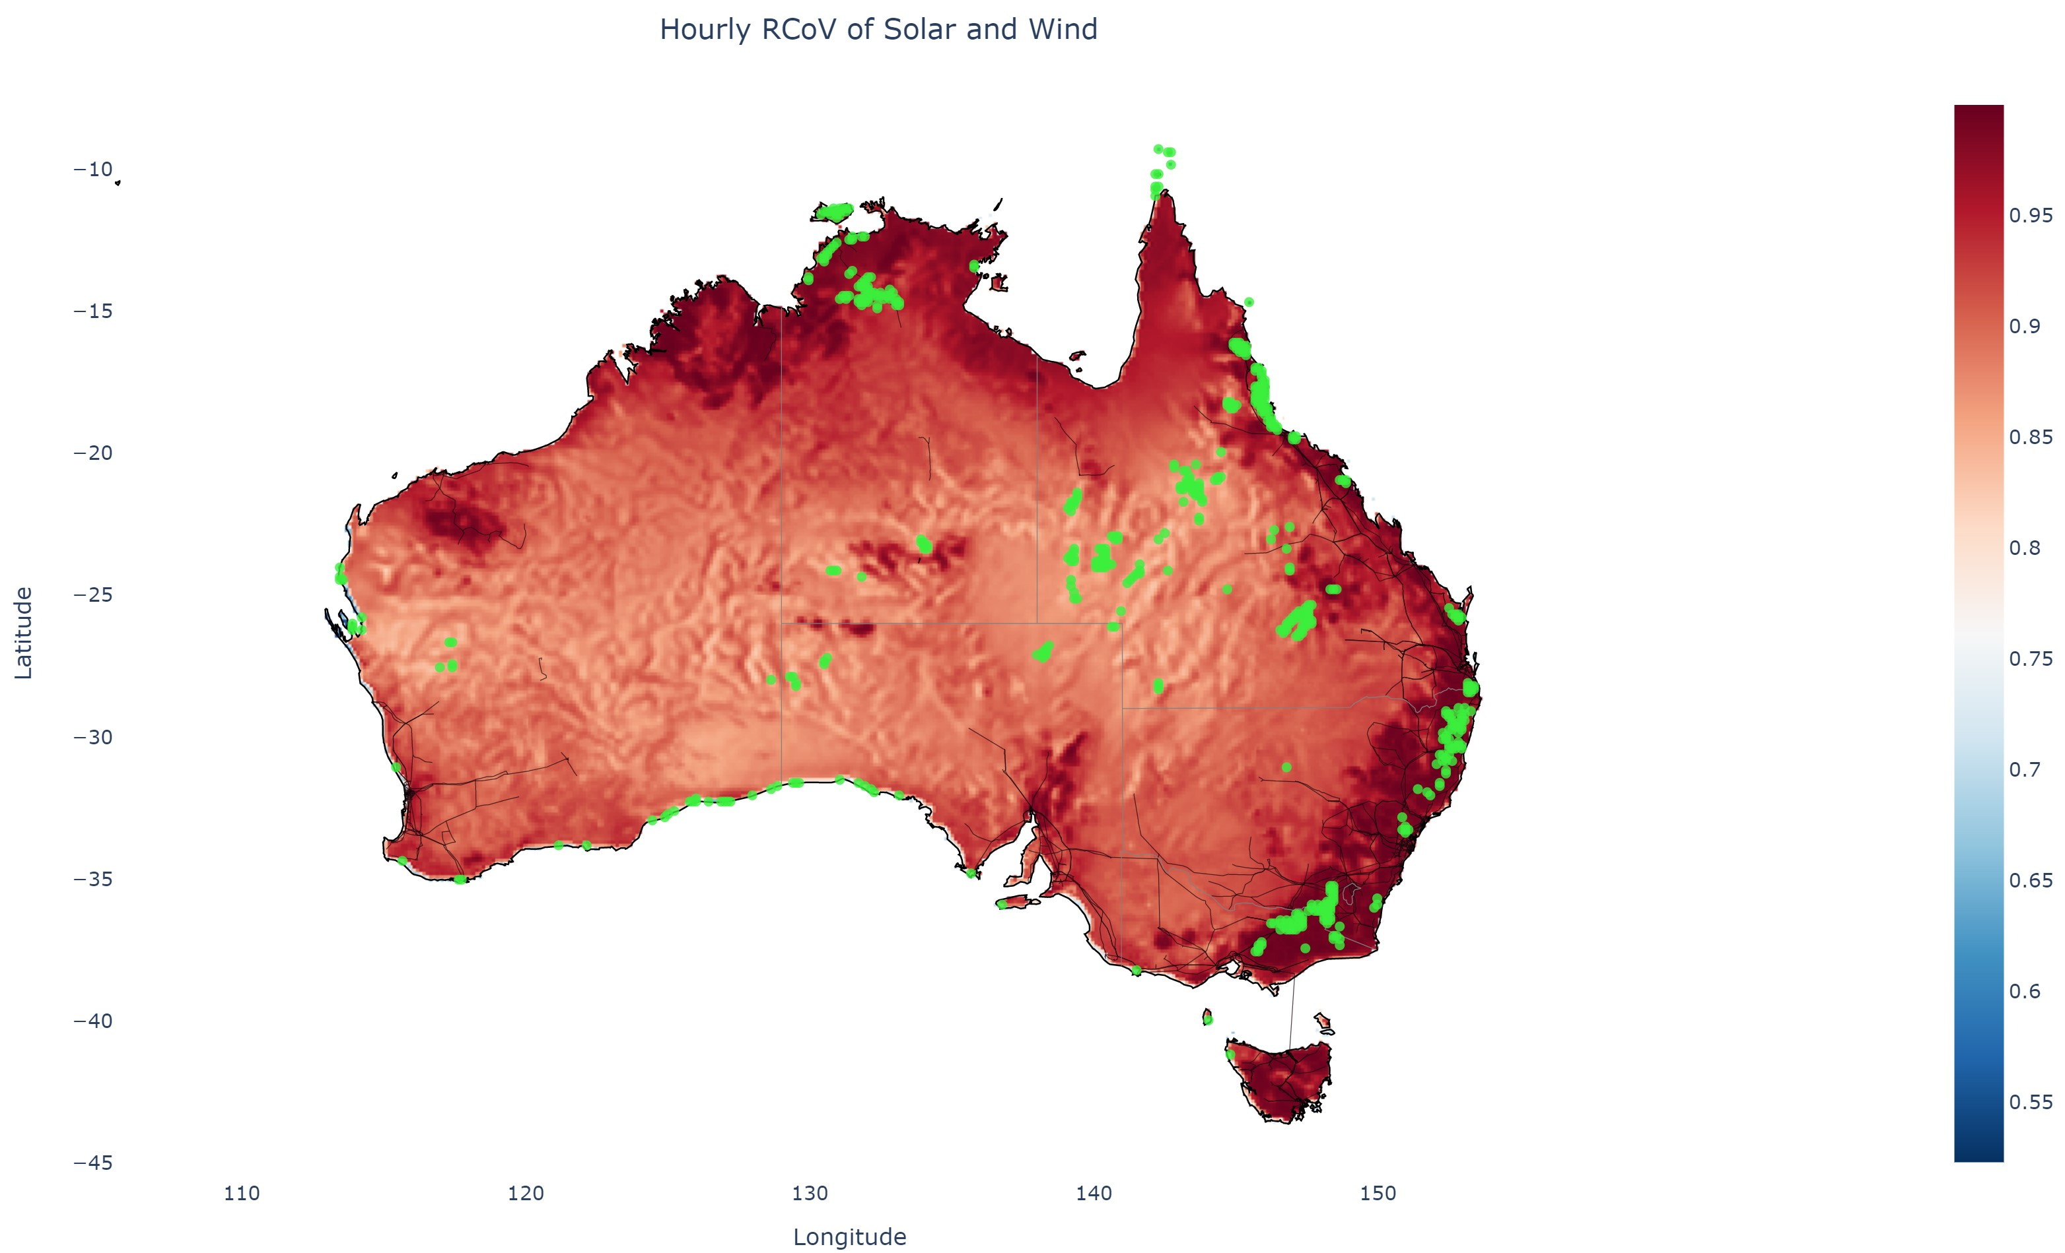
Pareto Frontier: Solar+Wind

Slide 4
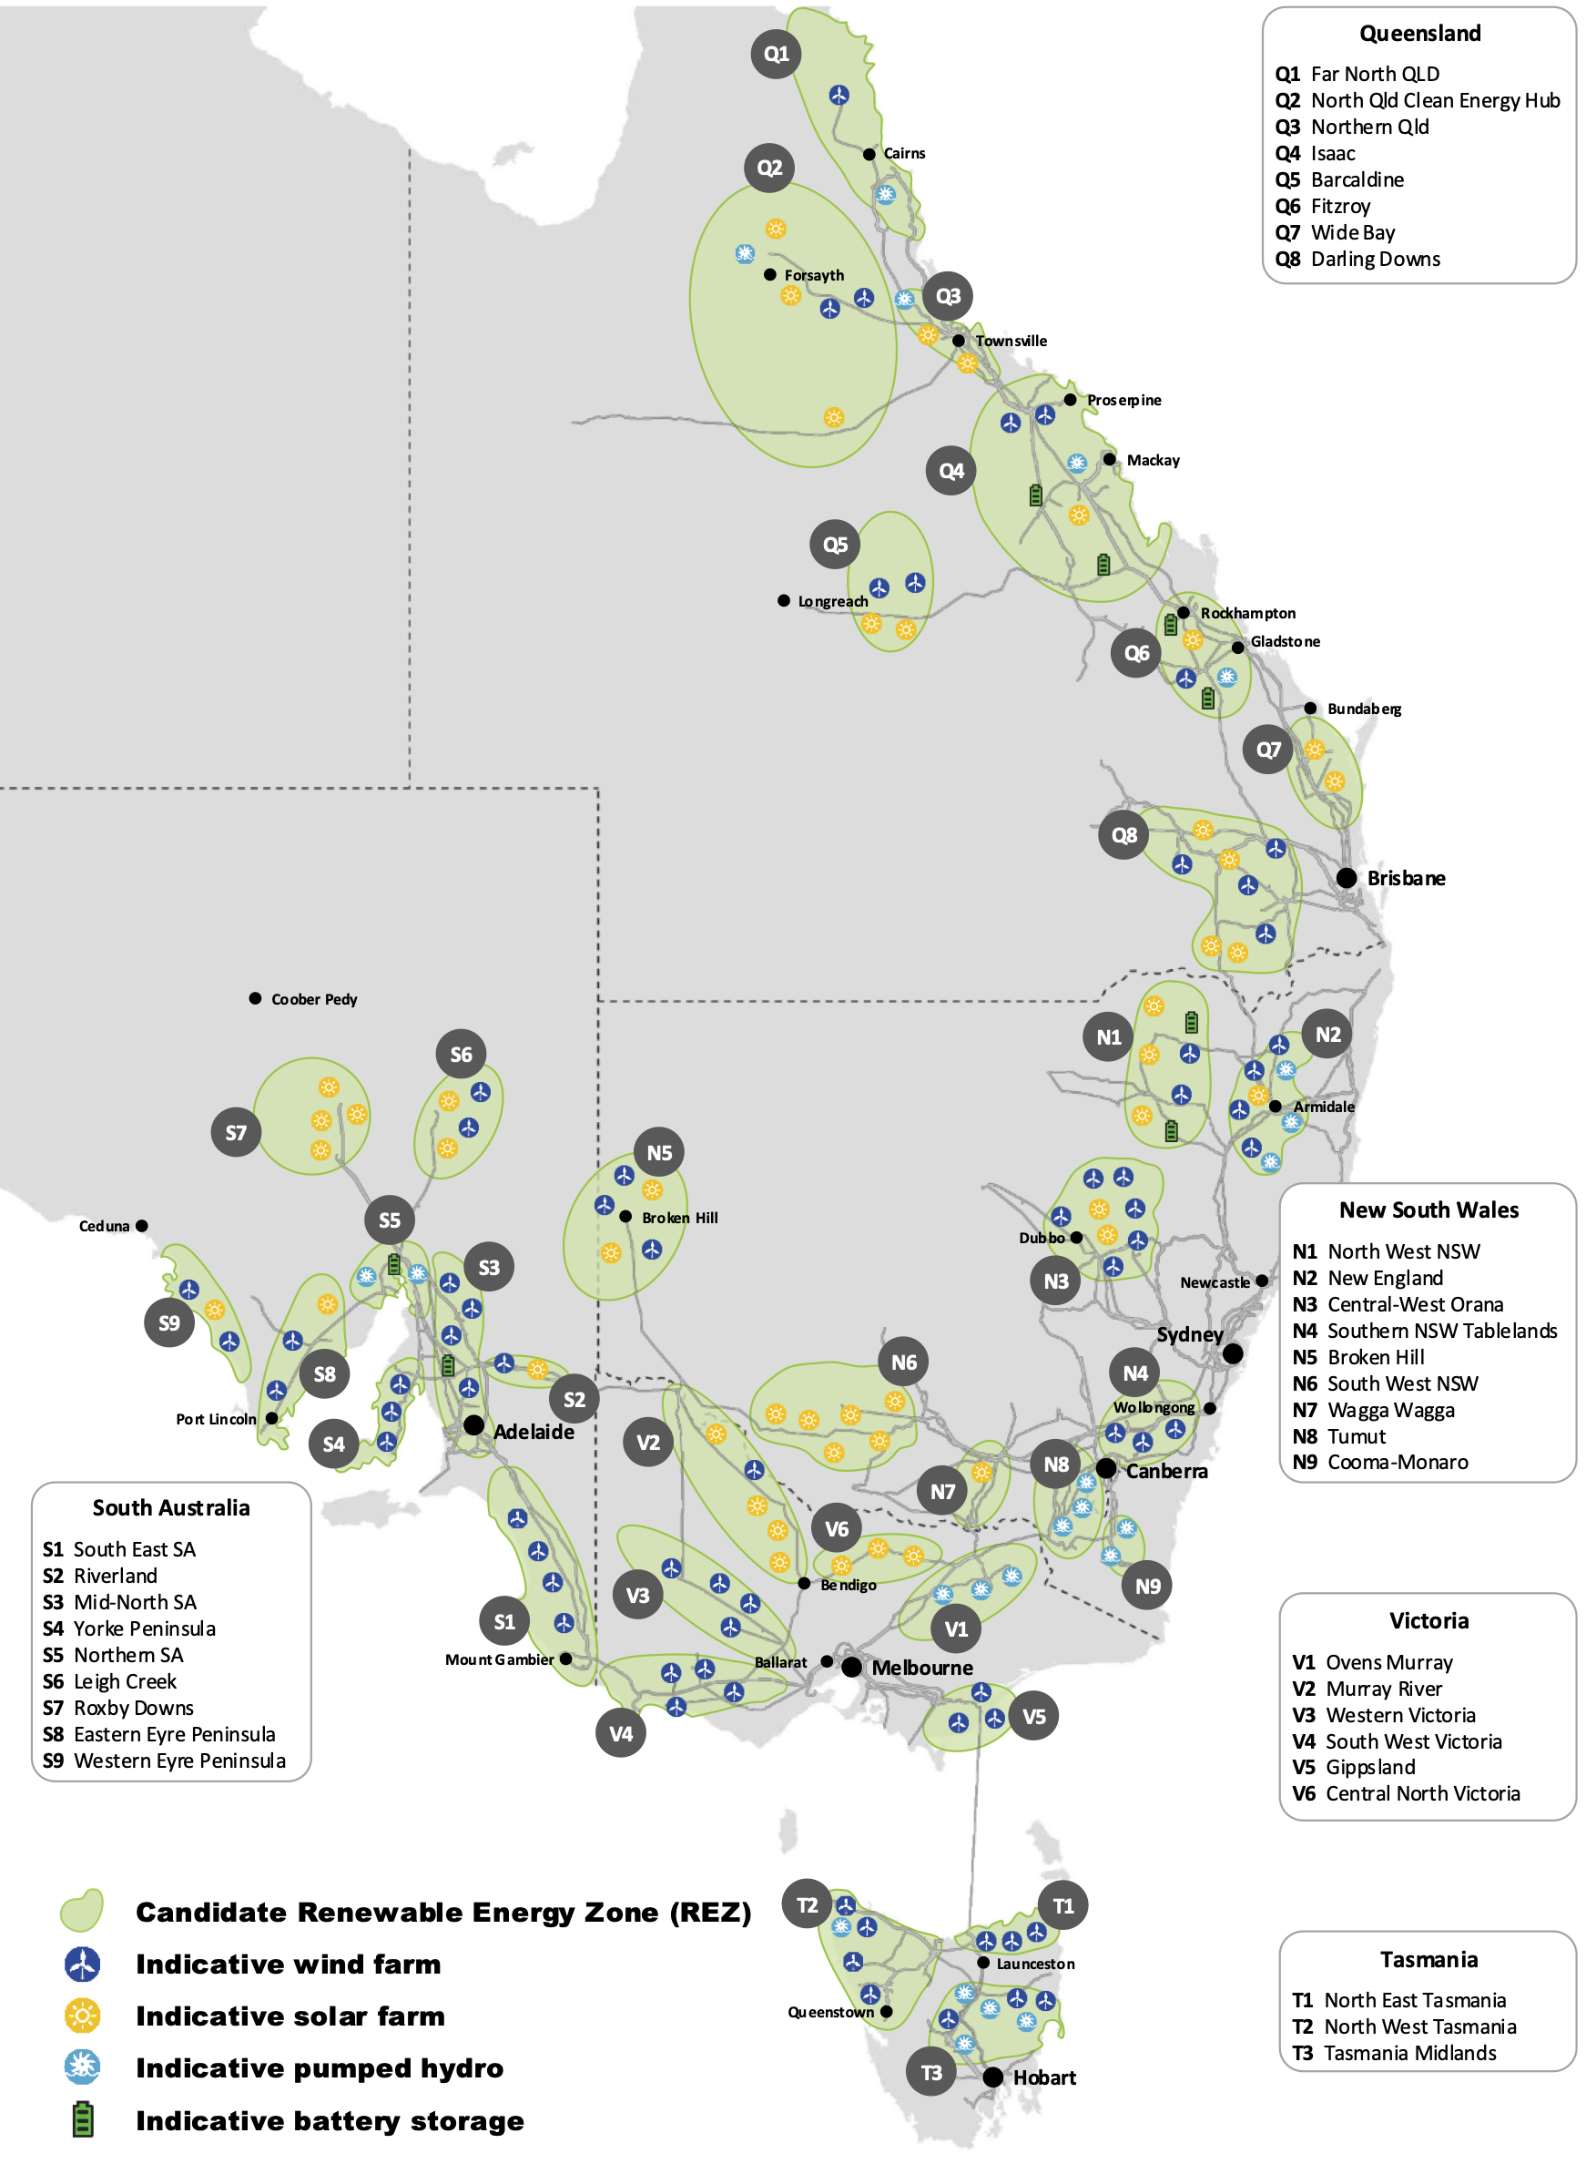
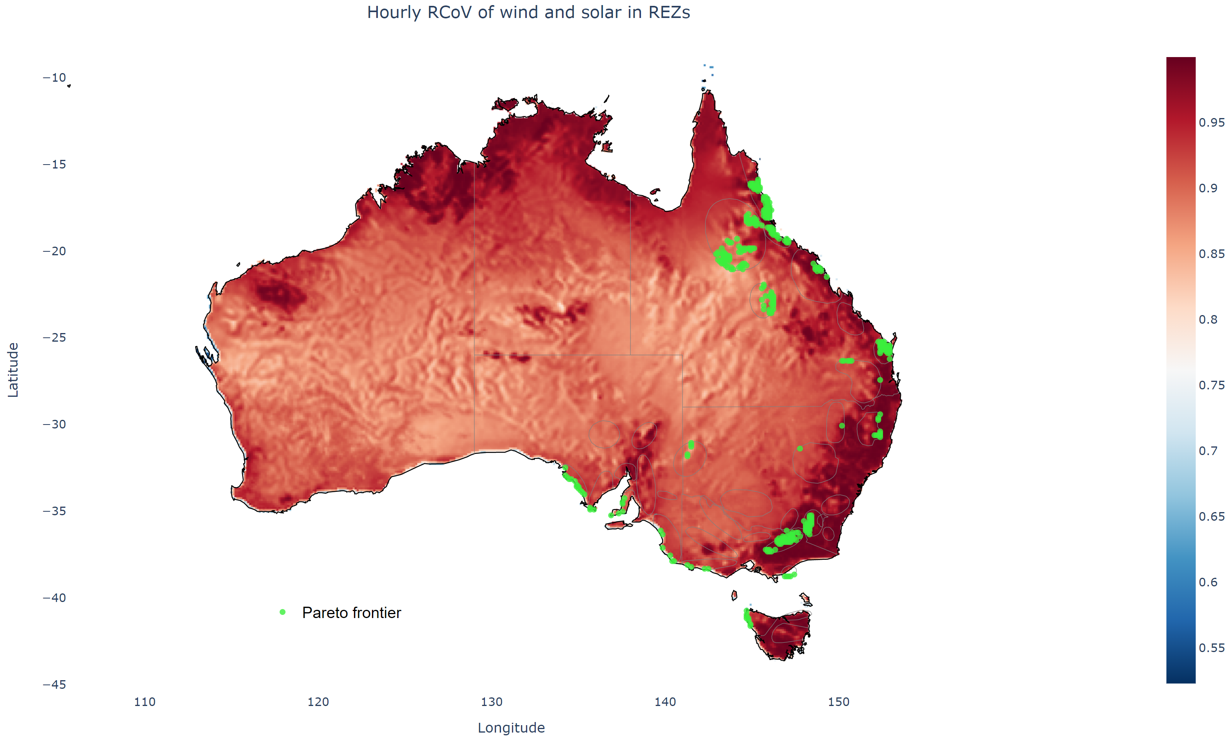
Pareto Frontier in REZs
Potential Renewable Energy Zones in the National Energy Market, Australia. Source: 2020 Integrated System Plan, AEMO.

Slide 5
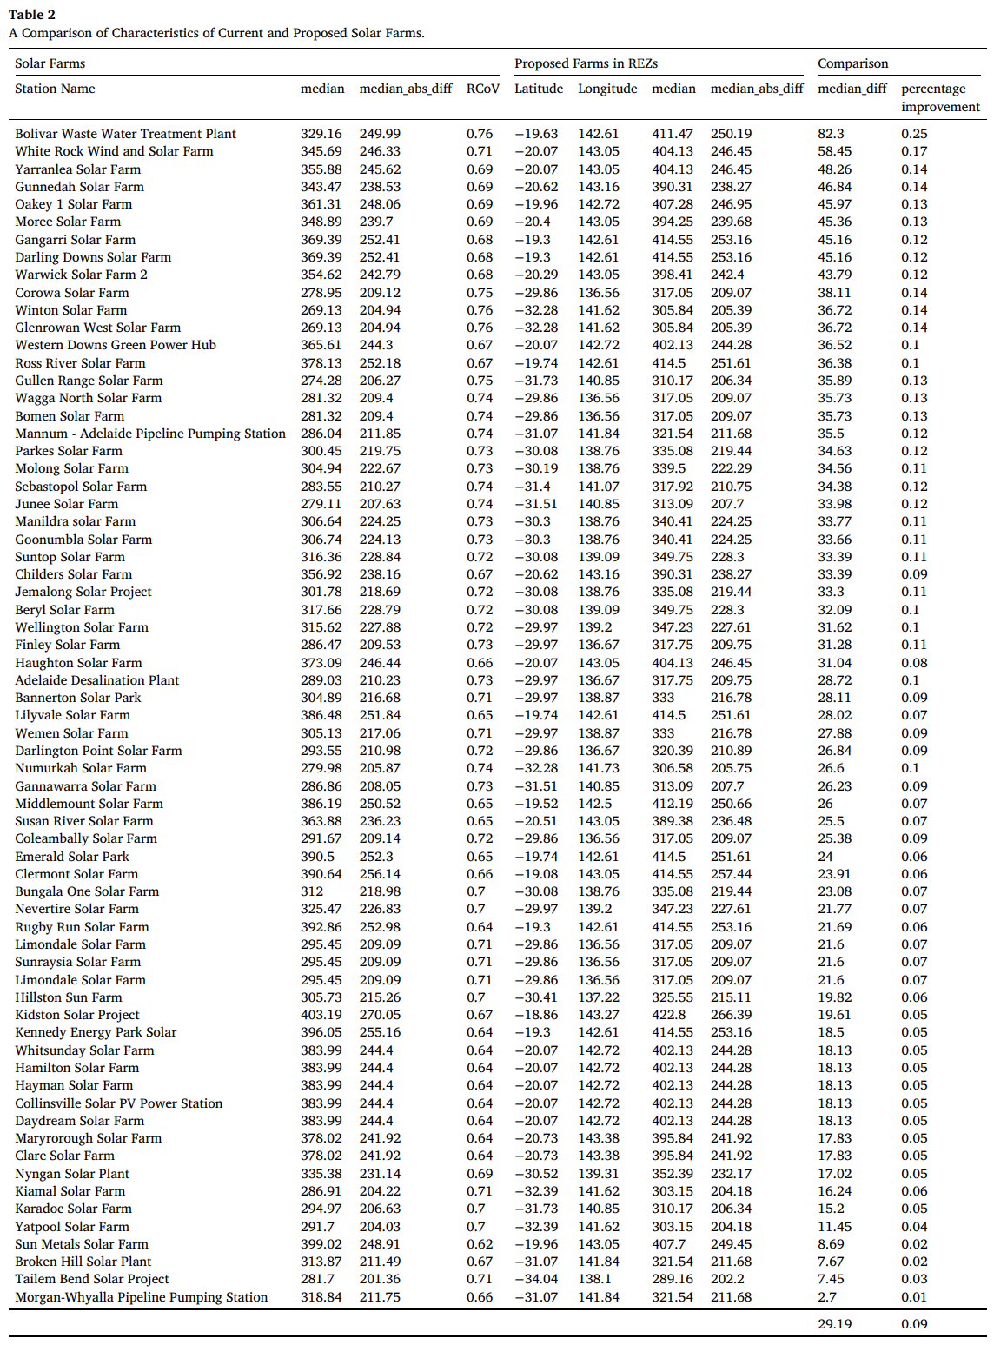
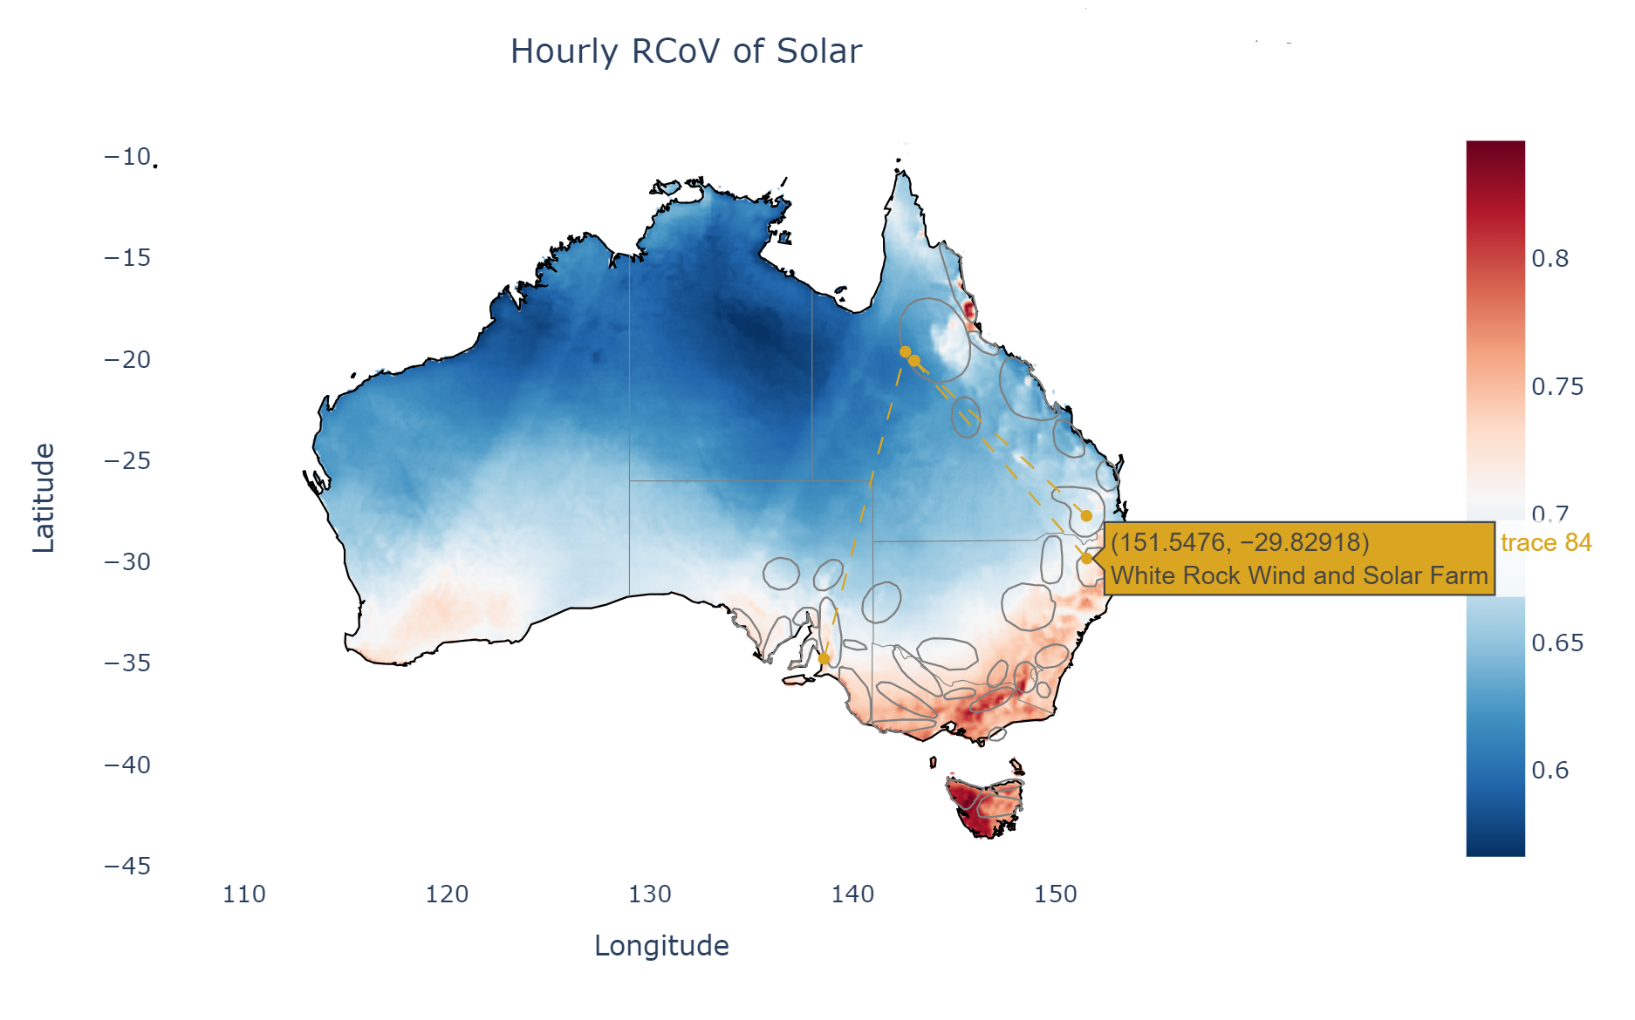
Pair them up
The proposed wind-only and solar-only sites show
an average energy increase of 9% (solar, 67 sites),
an average energy increase of 28% (wind, 50 sites)
for the same level of intermittency, as compared to the existing generation sites.

Slide 6
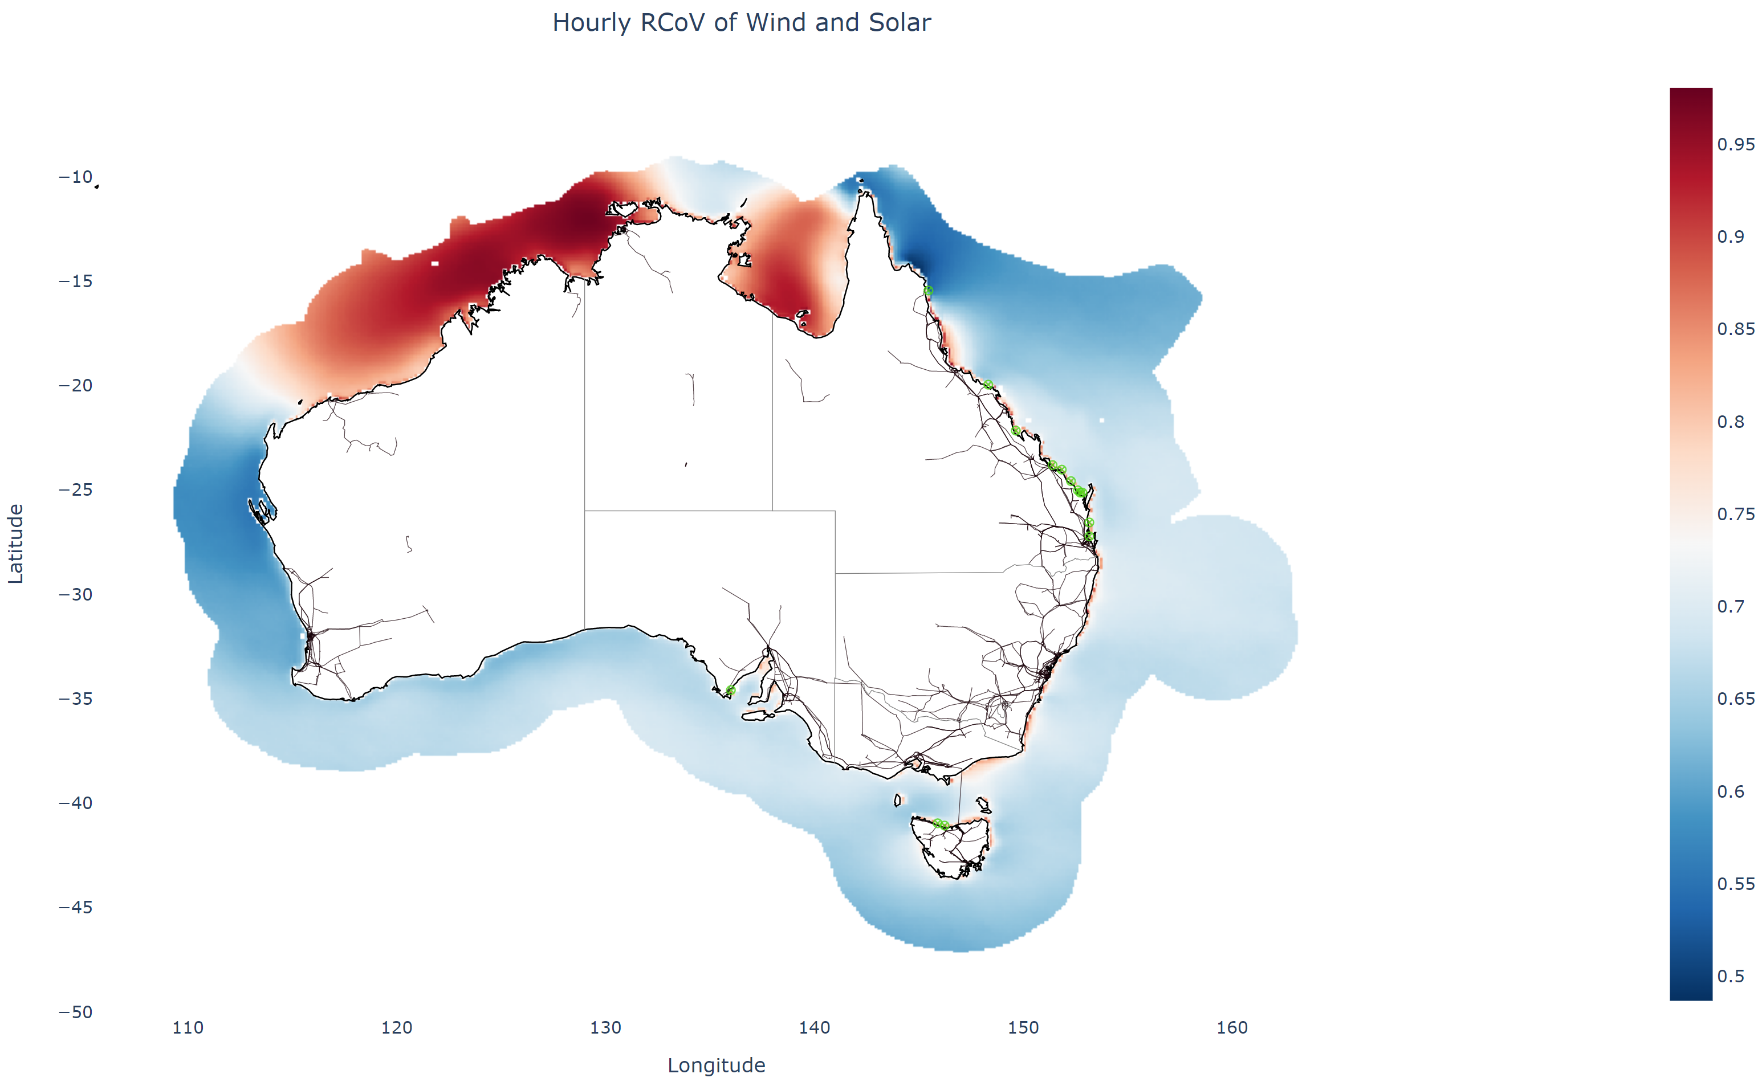
Optimal offshore renewable generation sites

Slide 7
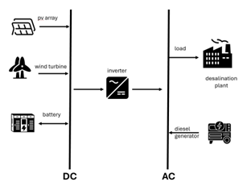
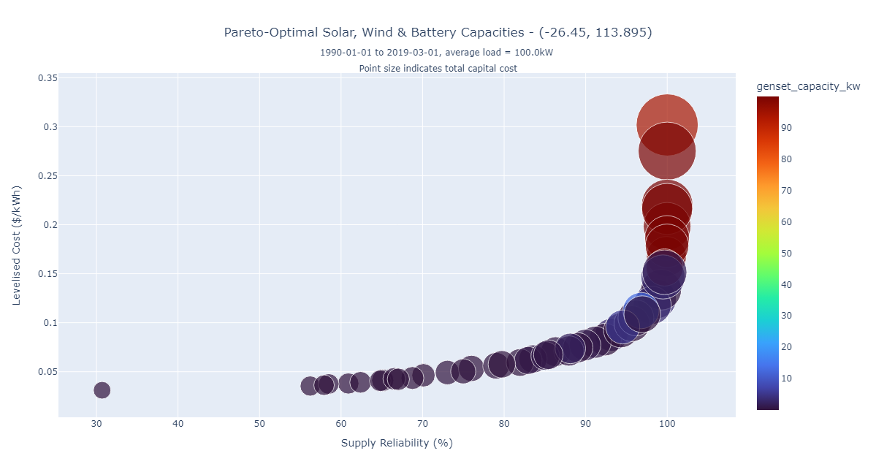
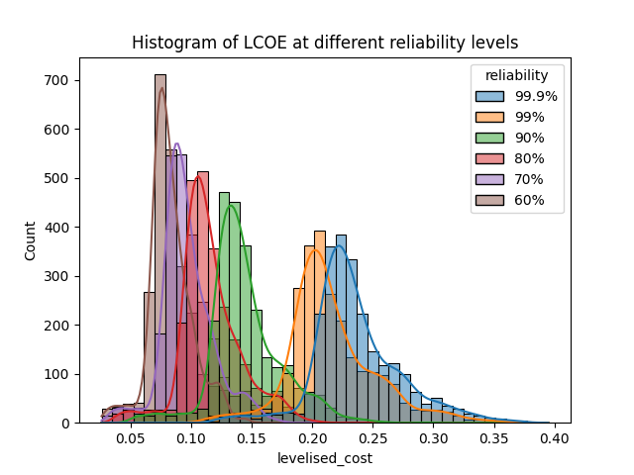
Desalination Plant in Western Australia

Slide 8
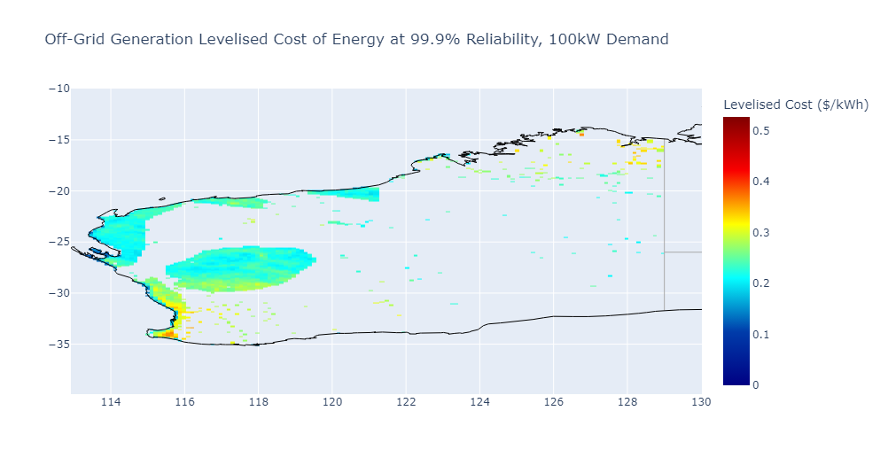
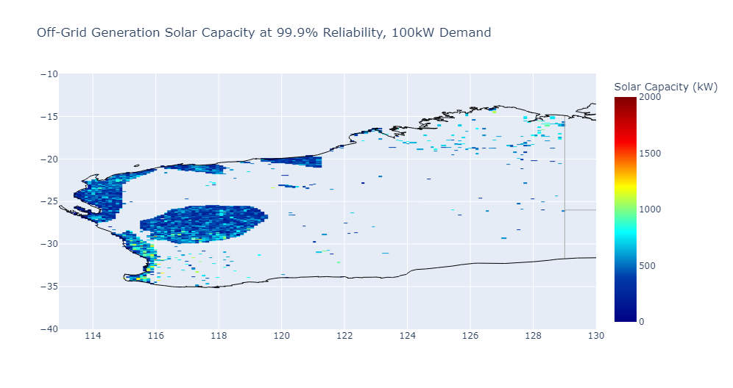

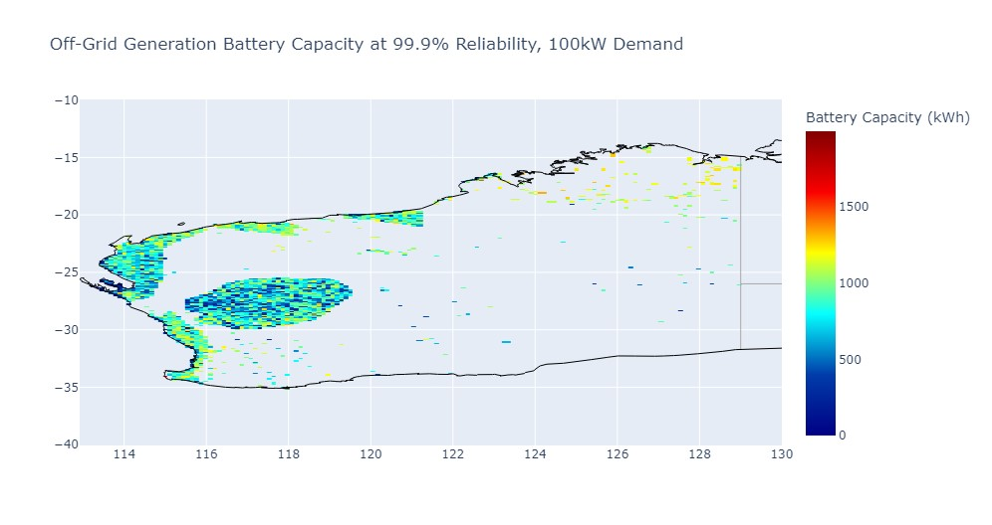
Desalination Plant in Western Australia

Slide 9
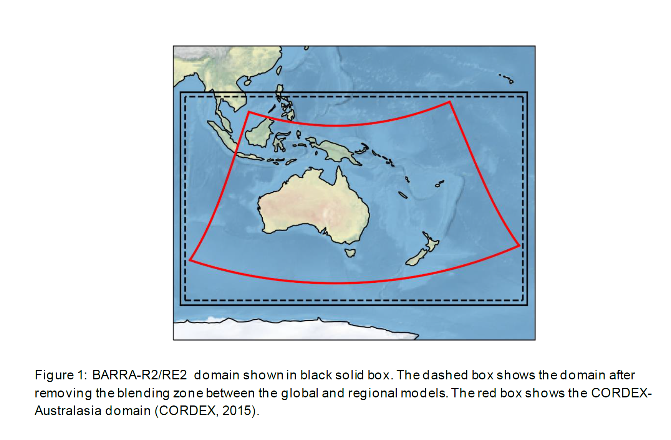
BARRA-R2
Su, C. H., Dharssi, I., Le Marshall, J., Le, T., Rennie, S., Smith, A., ... & Warren, R. A. (2022). BARRA2: Development of the next-generation Australian regional atmospheric reanalysis. Bureau of Meteorology.

Slide 10
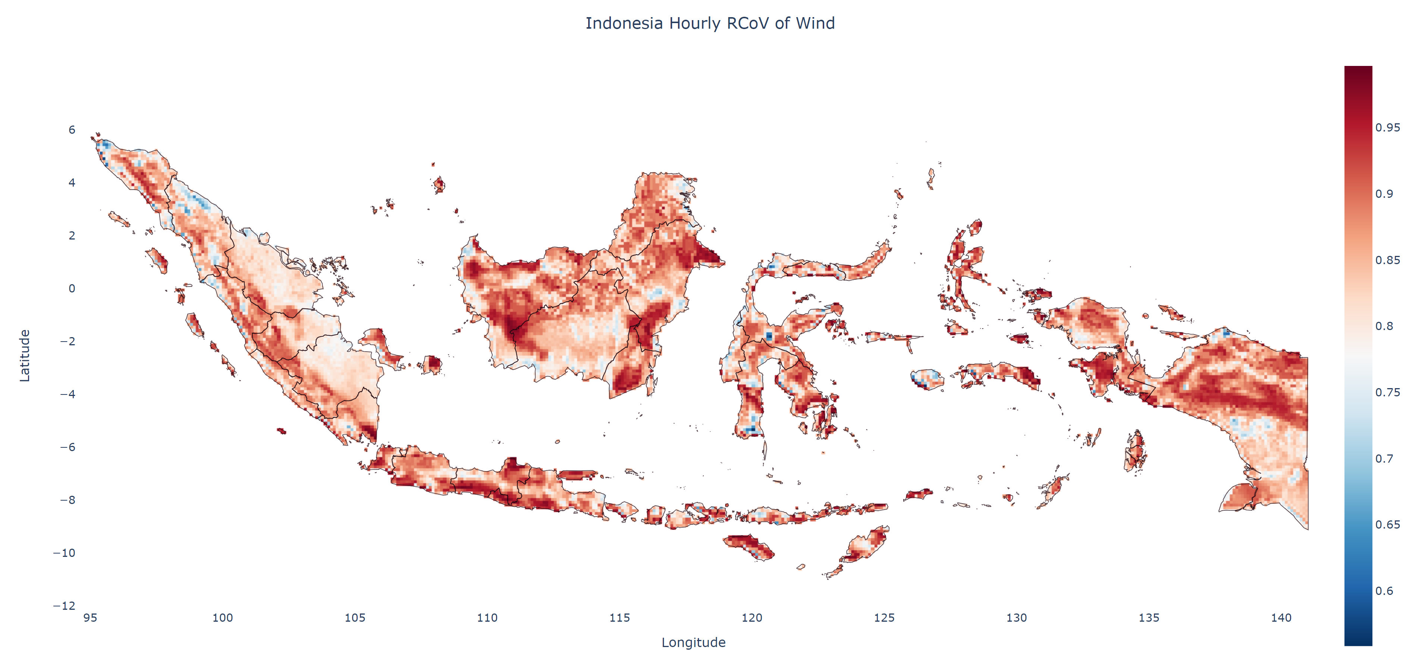
Indonesia

Slide 11
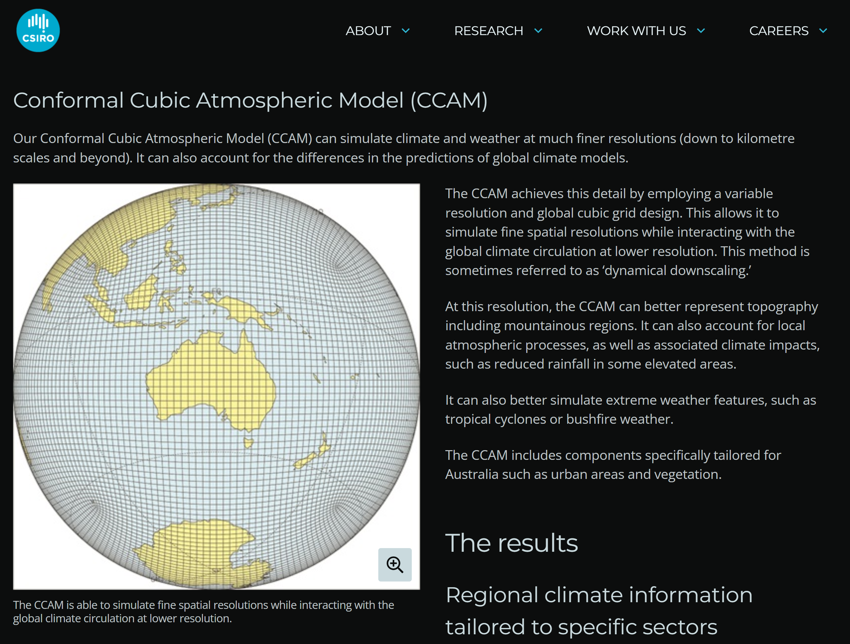
CCAM
At much finer resolution
Account for the differences in the predictions of global climate models
Better simulate extreme weather features, such as tropical cyclones or bushfire weather

Slide 12
Future work
Onshore/offshore Renewable resource assessment for SEA
Multi-site and multi-period optimization model for the regional integrated renewable energy networks
Reference
https://www.sciencedirect.com/science/article/pii/S2405844024029220
GenCost
High-resolution regional climate and weather modelling - CSIRO

Slide 13
Thank you
Energy BU
  Helen Wu
    Helen.wu@csiro.au

