Slide 1



ASEAN power grid and integration
Peninsular Malaysia perspective
CSIRO G-PST Workshop, Melbourne
17 October 2024
Single Buyer | www.singlebuyer.com.my

Slide 2





1
Single Buyer Peninsular Malaysia
Single Buyer is a ring-fenced entity authorised by the Minister pursuant to the Electricity Supply Act (ESA) 1990 to conduct electricity planning and manage electricity procurement services for Peninsular Malaysia
Ministry of Energy Transition & Water Transformation (PETRA)
Policy maker
Main characteristics of
Malaysian Single Buyer Model
Energy Commission (EC)
Regulator
MESI operates in a single buyer model.
Generators with PPA¹/SLA²
Ring-fenced Single Buyer (SB) procures electricity in Peninsular Malaysia for TNB:
  based on PPA/SLA
  Via NEDA arrangement
  Through interconnections
Oversight Panel
Chaired by ST
NEDA Participants
Interconnections
Members:
  Suruhanjaya Tenaga (ST)
  Representative from PETRA
  Industry experts appointed by ST
Ring-fenced departments within Tenaga Nasional Berhad (TNB)
New Enhanced Dispatch Arrangement (NEDA) is a platform launched in 2017 for generators to sell their energy to the system without the need for long term contracts
TNB Grid
Franchised Distributors
TNB Retail
SB operation is strictly governed by Guidelines for SB Market & Guidelines to NEDA
Oversight Panel chaired by ST oversees compliance of SB to the Guidelines
Consumer
1. Power Purchase Agreement
2. Service Level Agreement

Slide 3










1
Single Buyer Peninsular Malaysia
Single Buyer is responsible for the planning of generation capacity and the management of electricity procurement in Peninsular Malaysia
Planning & Operation
Long-term planning
Electricity procurement
Operations
Settlement
System Planning
Develop long-term demand forecast and capacity expansion planning for Peninsular Malaysia
  Load Forecast
  Capacity Planning
PPA Management
Develop, negotiate and manage PPAs/SLAs and interconnection and fuel agreements & management
New Energy (pre-COD)
Contract Performance
Fuel Management
Market Operations
Provide day-ahead generation scheduling and medium-term scheduling for fuel and generation planning
Short Term Scheduling
Medium Term Scheduling
NEDA Management
Settlement & Finance
Manage PPAs/SLAs billing and settlement, SB Generation Costs, SB Operation Costs, ICPT
Settlement & Clearance
Finance & Reporting
Advisory
Legal Management
Formulate strategy and provide legal assists and input for SB
Technical Advisory & Industry Development
Provide independent advice on technical and industry related matters
Internal support
Enterprise Management
Support functions (Compliance, ICT, HR, Risk)

Slide 4

2
Integrated System Planning
Peninsular Malaysia is currently embarking on its first ISP. The ISP process spans across 2 years, involving 5 major activities and 2 key deliverables
ISP Process and Responsibilities
Responsibility of:
Scenario Planning
Scenario design, input and assumption
Single Buyer
Grid Owner
Petronas
Load Forecasting
Aggregate and regional load forecasting
Ministry of Energy Transition & Water Transformation (PETRA)
ISP YEAR 1
Single Buyer & Energy Commission
JPPPET (1)
(Scenarios + Gen. Capacities)
Inputs on gas related information
Generation Development Plan
Generation optimization (PLEXOS)
Stakeholder consultation
Annual Transmission Development Plan
(ATDP)
JPPPET (2)
(Scenarios + Gen. Capacities
+ Gen. Locations)
Grid Integration
Nodal assessment and power system analysis (PSS/E)
ISP YEAR 2
System Development Plan (SDP)
System Development Statement (SDS)

Slide 5

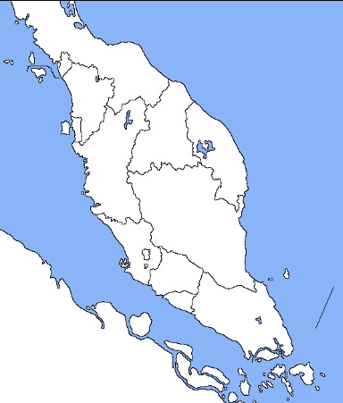


3
Peninsular Malaysia – Existing Interconnections
Interconnection between Peninsular Malaysia-Thailand and Peninsular Malaysia-Singapore began as early as the 1980s
Existing interconnections:
1
1
Malaysia – Thailand
132kV HVAC Chuping – Sadao (86MW)
300kV HVDC Gurun – Khlong Ngae (300MW)
2
Malaysia – Singapore
275kV HVAC Plentong – Woodlands (1,000MW)
2
Notes:
Malaysia currently has a 1GW interconnection with Singapore (upgraded in 2022)
500MW of capacity for grid balancing & security
100MW for TNB’s export to Singapore via YTL Power Seraya Pte Ltd, of which an agreement was signed in 2023.
There is also another 100MW previously allocated for supply of hydro-generated power from Laos, but an extension is reportedly halted amid disagreements over the committed volume, as well as the rate of the transmission charges for delivery through Thailand and Malaysia.

Slide 6
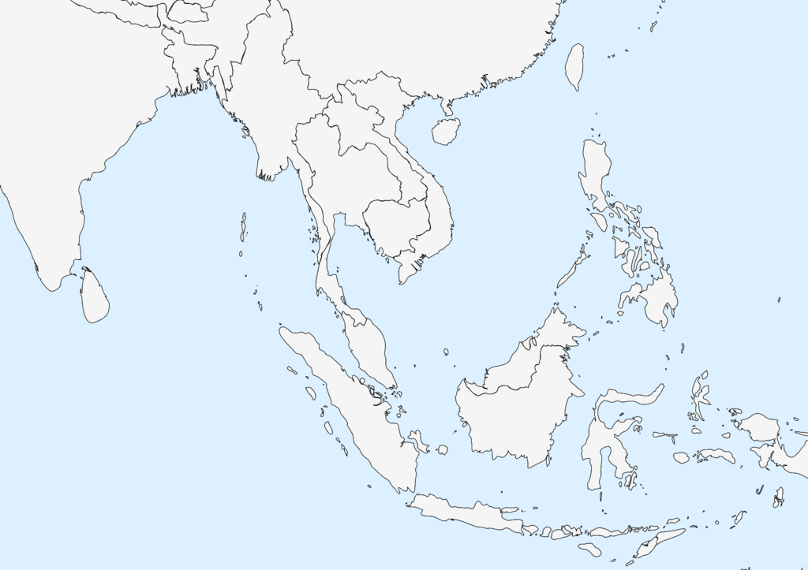
3
Peninsular Malaysia – Existing and Future Interconnections
Several new future interconnection projects are under consideration
P. M’sia – Vietnam
P. M’sia – Thailand
P. M’sia – Singapore
P. M’sia – Sarawak
P. M’sia – Sumatera
Notes:
Thailand 1GW (2030)
Swak 1GW (2036)
Vietnam 1GW (2034)
Sumatera 1GW (2039)

Slide 7






4
Cross border trade
Cross-border trade initiatives in Peninsular Malaysia uses existing interconnection facilities
1
LTM 1.0 & 2.0
Laos–Thailand-Malaysia
2
LTMS - PIP
Laos–Thailand-Malaysia-Singapore Power Integration Project
3
CBES
Cross-Border Electricity Sales
Lao PDR Grid
Dedicated Generator
Lao PDR Grid
Thailand Grid
Thailand Grid
Malaysia Grid
Malaysia Grid
Malaysia Grid
Singapore Grid
Singapore Grid
 | Framework | Laos as seller & Malaysia as buyer Thailand as wheeler Energy sales and purchase is based on a non-firm basis (only if available) | Multi lateral power trade Laos as seller, Singapore as buyer. Thailand and Malaysia as wheeler Malaysia as seller, Singapore as buyer | CBES (Non-RE) from dedicated plant CBES (RE) from system (primarily from large scale solar and/or large hydro registered with I-REC
 | Key highlights | LTM 1.0 : 2018 – 2019, up to 100MW LTM 2.0 : 2020 – 2021, up to 300MW | LTMS – PIP Phase 1: 2022 – 2024, up to 100MW LTMS – PIP Phase 2: 2024 – 2026, up to 200MW | CBES Guide first issued by the Energy Commission on 31 Dec 2020 to facilitate CBES between Pen. Malaysia and Singapore or Thailand. CBES Guide revision on 15 Apr 2024 addresses cross-border renewable energy sales mechanism (CBES-RE)
Notes:
LTMS-PIP 2.0
On 20 June 2024, the Government has approved for implementation of LTMS-PIP Phase 2 , discussions ongoing to finalise key parameters
Malaysia as wheeler, balancer and second supplier
Up to 200MW (2 years beginning 22 June 2024 or until early termination of Thailand Malaysia HVDC Interconnection)
In Sept 2024, TNB, has inked an agreement with Singapore’s Keppel Electric Pte Ltd to supply up to 100MW, is part of the Lao PDR-Thailand-Malaysia-Singapore Power Integration Project (LTMS-PIP).
The LTMS-PIP was launched on 23 June 2022 and marked the first collaboration among four Association of Southeast Asian Nations (ASEAN) member states on multilateral cross-border electricity trading of renewable energy.
Phase Two of LTMS-PIP, with an increased import capacity of up to 200 MW from Lao PDR and Malaysia.

Slide 8
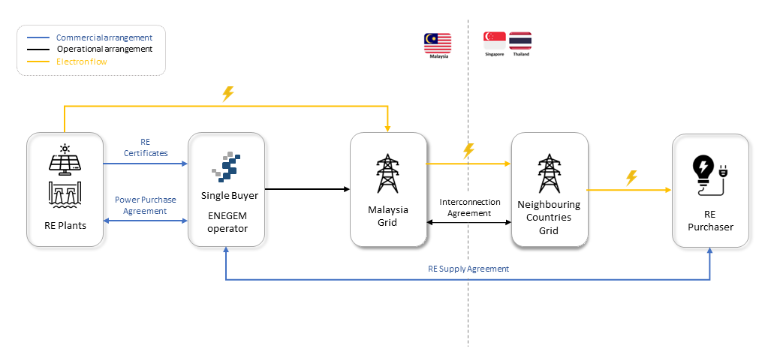
4
Cross border trade
Energy Exchange Malaysia (ENEGEM) and the CBES RE Scheme
CBES RE Scheme will be carried out through a platform known as the Energy Exchange Malaysia ("ENEGEM"), which acts as the marketplace to sell Green Electricity through a bidding mechanism operated by Single Buyer.
Single Buyer (once independent) will enter into PPA with the RE power producers, and RE supply agreements for the sale and purchase of the RE with the RE purchaser(s) in Singapore or Thailand.
Single Buyer will also be responsible for all operations and activities associated with the CBES RE Scheme including:
  procurement and sale of RE
  conducting auction processes
  scheduling
  settlement
  verification and issuance of renewable energy certificates (REC) related to the CBES RE Scheme
The CBES RE Scheme will utilise the existing interconnection between Peninsular Malaysia and Singapore or Thailand, with a capacity of up to 300 MW allocated for Singapore and subject to availability for Thailand.

Slide 9
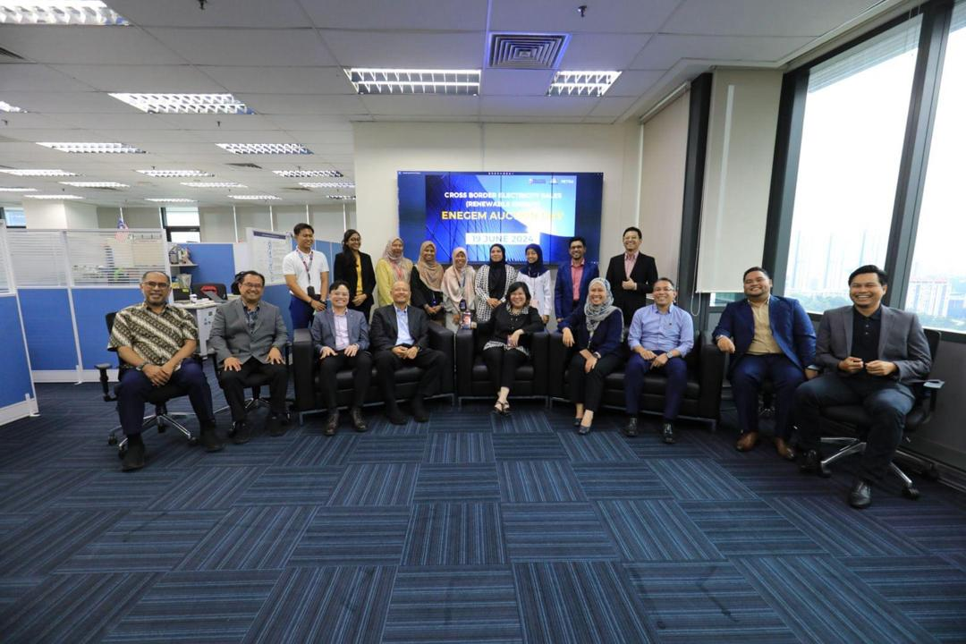
4
Cross border trade
Pilot ENEGEM Auction (100MW) of RE Export to Singapore
To kickstart the CBES RE Scheme, a pilot auction was carried out on 19 June 2024 for the export of RE from Malaysia to Singapore
This pilot auction is only open to interested bidders who holds electricity generation and/or retailer license from Singapore.
The pilot auction offers a RE export capacity of 100MW for a duration of one year (1 Sept 2024 – 31 Aug 2025)
Green electricity sold during the pilot phase is bundled with REC

Slide 10
5
Benefits and Challenges
Interconnection offers several benefits but also challenges
Benefits
Enhanced reliability – sharing of resources to balance supply and demand more effectively
Provides diversification of energy resources
Supports higher amounts of vRE – manage variability by transferring surplus renewable energy from one country to another
Cost efficiency – through sharing of resources
Challenges
Requires strong commitment from all parties involved
Long lead time for interconnection projects (5-9 years)
High capital costs
Uncertainties/ risks when incorporated in power system planning
Quantification of cross border RECs
Operation coordination
Cascade failures

Slide 11


Single Buyer
Thank You
Single Buyer 2024
www.singlebuyer.com.my
Disclaimer Clause for Single Buyer
All information contained herein are solely for the purpose of this presentation and for general information purposes only. For the avoidance of doubt, Single Buyer reserves the right to modify, delete or replace any information from time to time and at any time, without notice in the absolute discretion of Single Buyer. Single Buyer shall not be liable for any claims, demands, cost, action on any losses or damages suffered by any party arising from or in connection with the use of and reliance of the information contained herein.

