Slide 1
Power Systems Architecture
Applying Systems Engineering-based tools and methods to enable future-ready power systems
Energy Catalyst Pty Ltd, Copyright (2024)
Notes:
Thanks for the opportunity to update on Stage 3 of Topic 7.
Before we dive into the research, it might be useful to start with a bit of context.

Slide 2


Acknowledgement
CSIRO and AEMO are acknowledged as the joint sponsors of Australia’s contribution to the Global Power System Transition (G-PST) research initiative.
The United States Department of Energy and Pacific Northwest National Laboratory (PNNL) are also noted as valued collaborators in this program of work.

Slide 3

How do you transform from a 1930s → 2030+ Power System?
What type of power system will your nation/regions need for the future (2035, 2050)?
What combination of drivers are forcing system changes?
What legacy structural constraints make change difficult/expensive?
Beyond incremental changes, what targeted structural changes are needed to enable timely and efficient transformation?

Slide 4
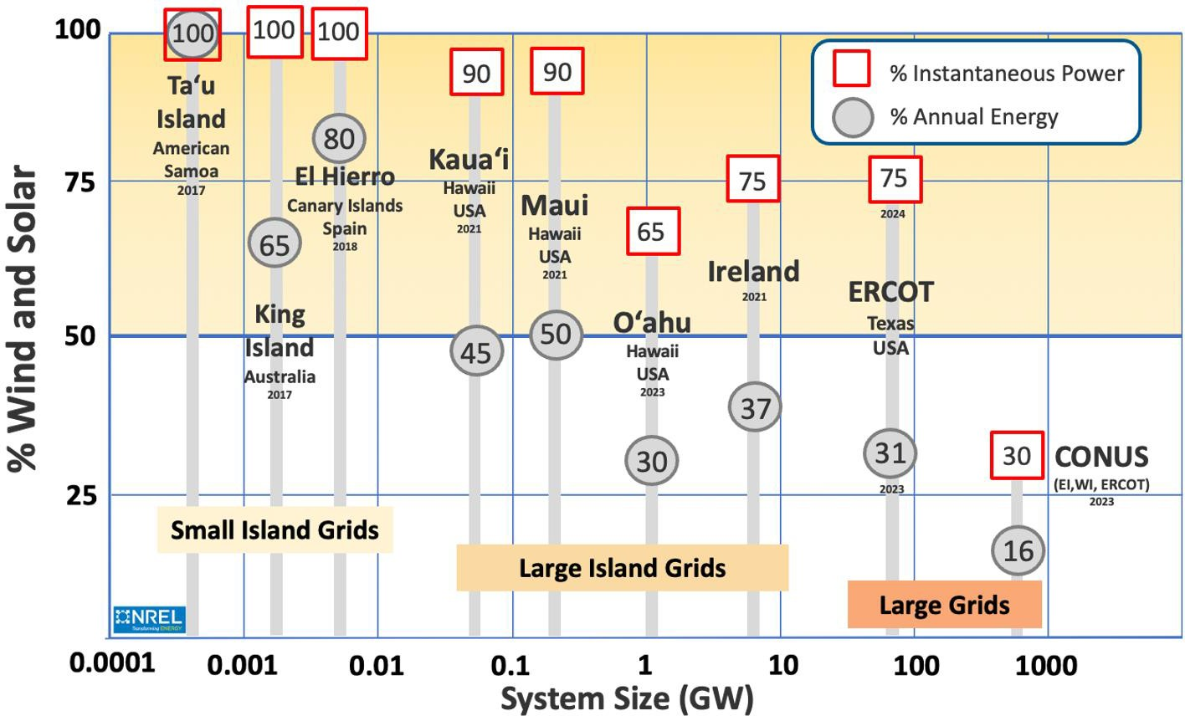
Global experience: High-renewables Islanded Systems
Image: Engineering Roadmap and Transitional Services Guideline (AEMO)

Slide 5
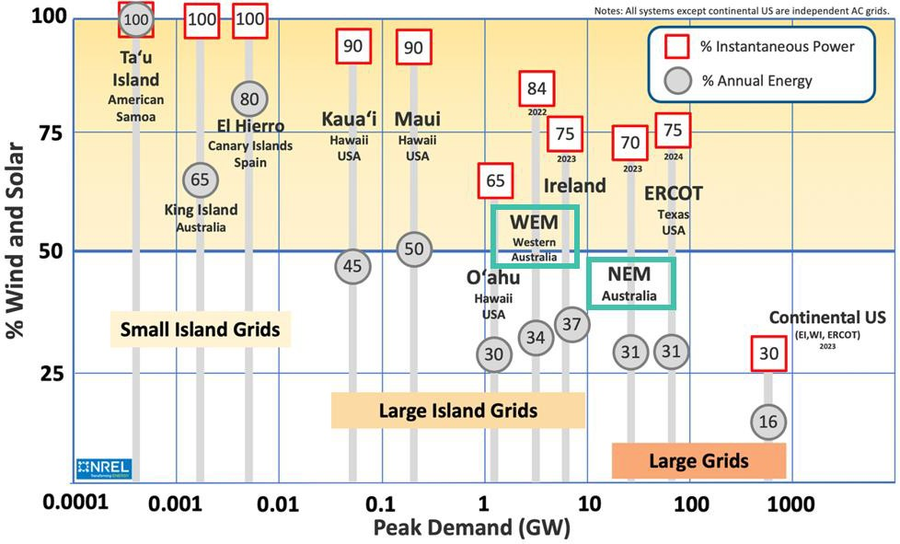
Australia’s major GW-scale systems: NEM + WEM
Image: Engineering Roadmap and Transitional Services Guideline (AEMO)

Slide 6
Australia’s major GW-scale systems: South Australia
SA
South Australia (islanded) 2022
92
Image: Engineering Roadmap and Transitional Services Guideline (AEMO)

Slide 7
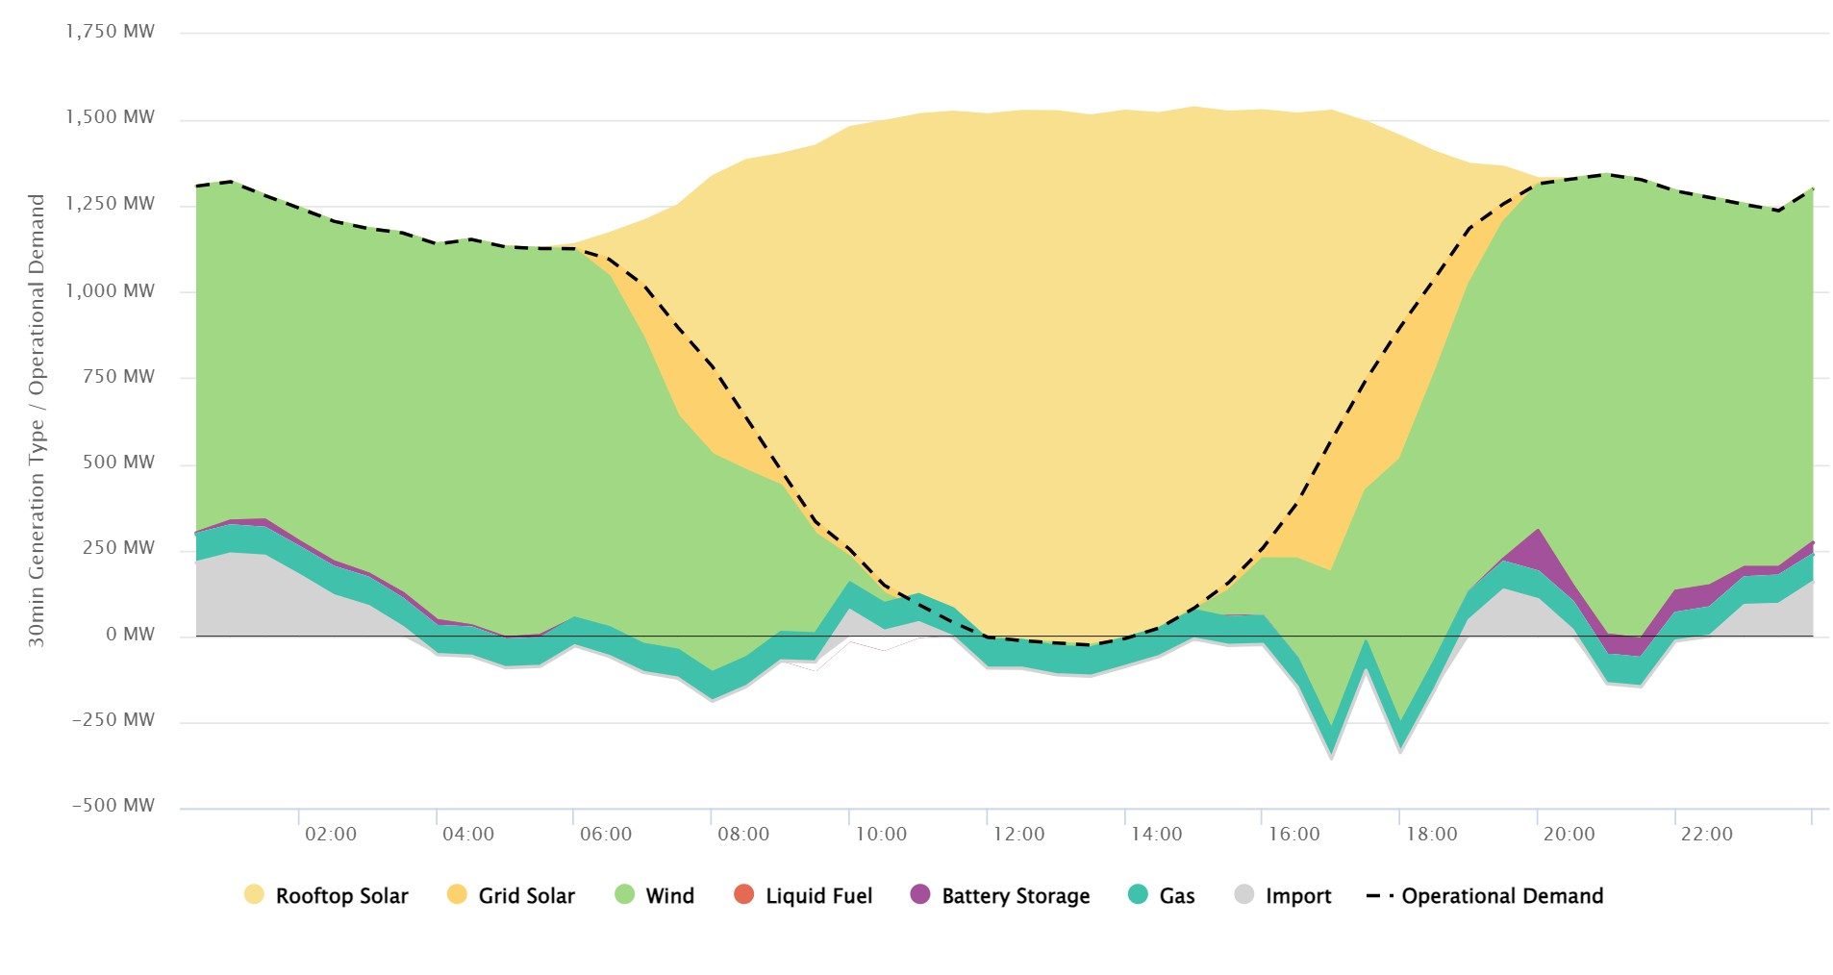
Australia is already ‘seeing the future’ today
New SA Minimum Operational Demand Record: -26 MW at 1330 hrs
SA Generation Mix for 31 December 2023
Image: Engineering Roadmap and Transitional Services Guideline (AEMO)

Slide 8
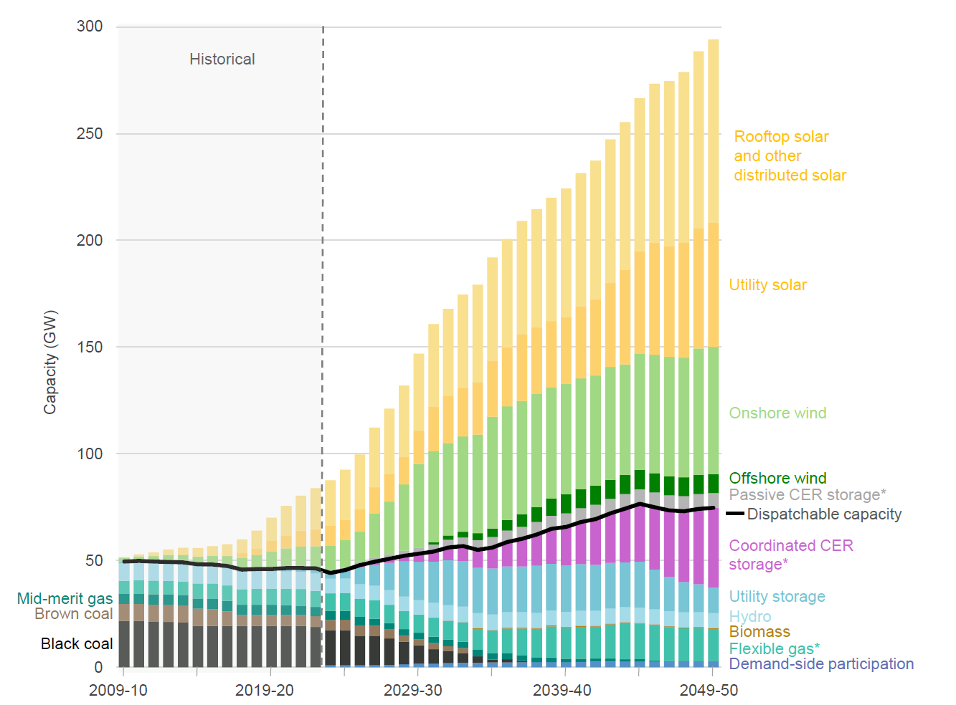
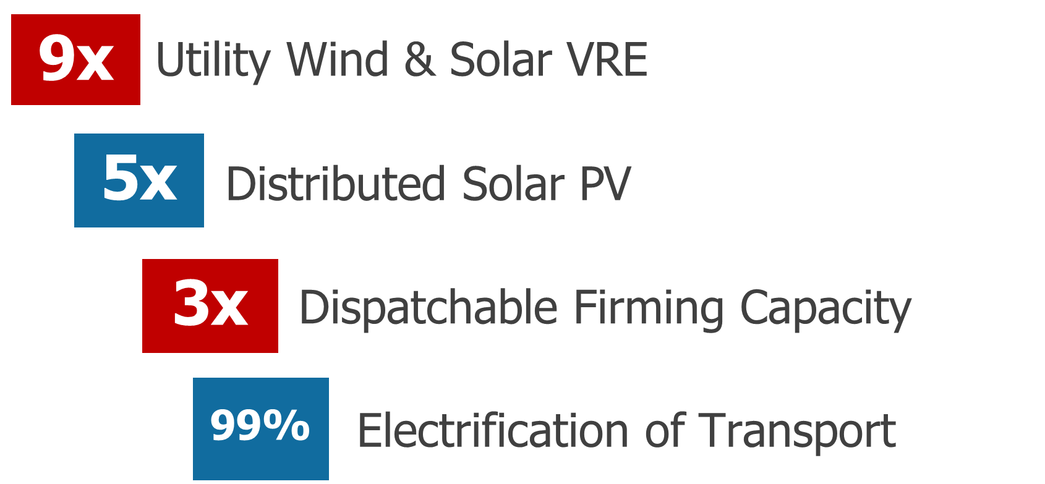
And this is only the beginning of the journey to 2050…
We must provision the whole-system for this…
Here’s where we are today
https://aemo.com.au/en/energy-systems/major-publications/integrated-system-plan-isp/2024-integrated-system-plan-isp

Slide 9
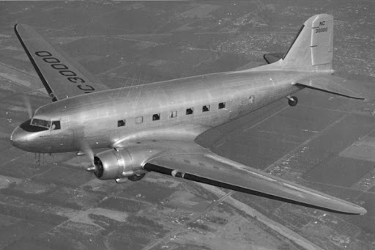

Example systems transformation via a tactical or ‘issue-in-isolation’ approach to change
DC3 Aircraft
DC7 Aircraft
Example structural choices: Upward wing angle, airframe aerodynamics, manual flight systems, etc

Slide 10
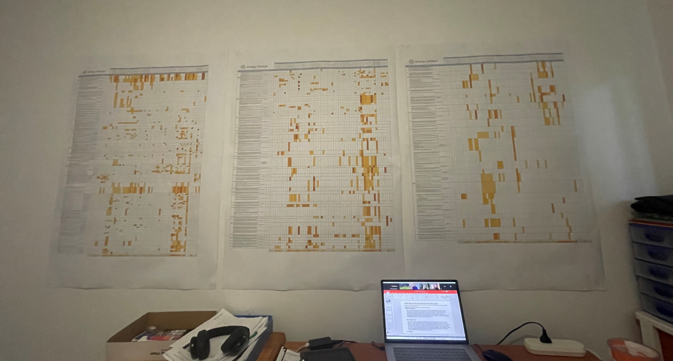
As the power sector faces structural shifts, technology trials are essential but not sufficient…
Energy Catalyst has recently applied Systems Engineering-based tools to develop a whole-system mapping of Australia’s almost 200 x DER studies, trials and demonstrations

Slide 11
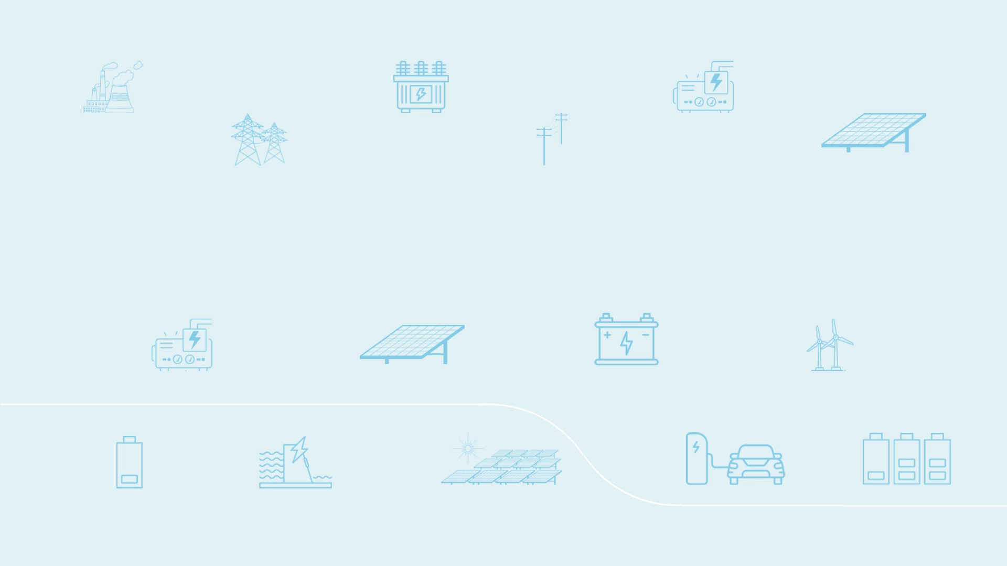


Slide 12
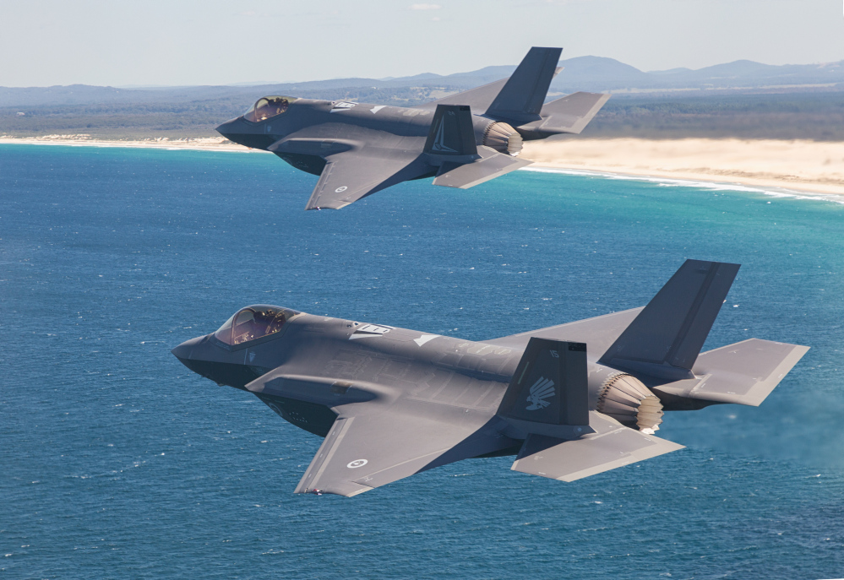
Systems transformation requires parallel paths of both tactical and structural activity
Parallel Path 1:
Incremental changes to ‘Keep the lights on’ today
Address issues-in-isolation
Parallel Path 2:
Targeted structural changes to create a scalable and ‘future-ready’ power system
Legacy Complex System
Address Systems Architecture

Slide 13
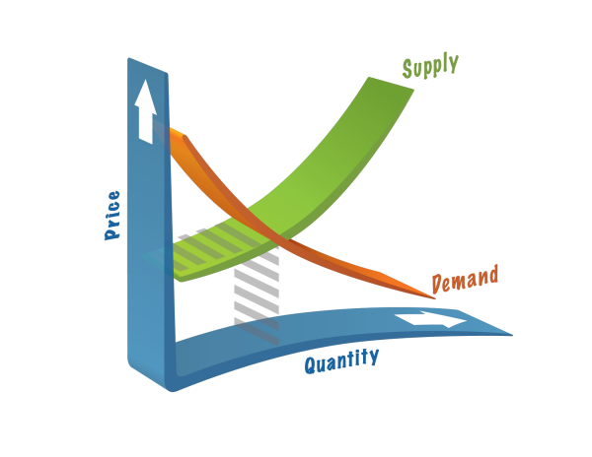
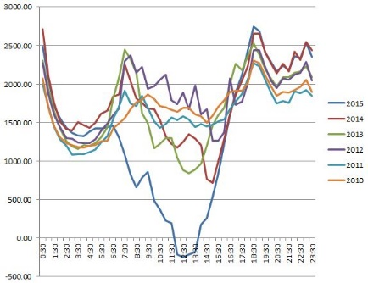
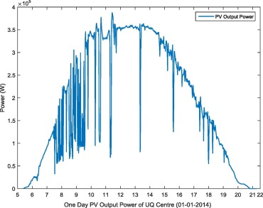
Why is this necessary? Increasingly volatile power systems still require instantaneous balancing of demand and supply
Customer demand and variable generation must still be kept ‘in balance’ every microsecond
of the year as the dispatchable generation fleet is withdrawn

Slide 14
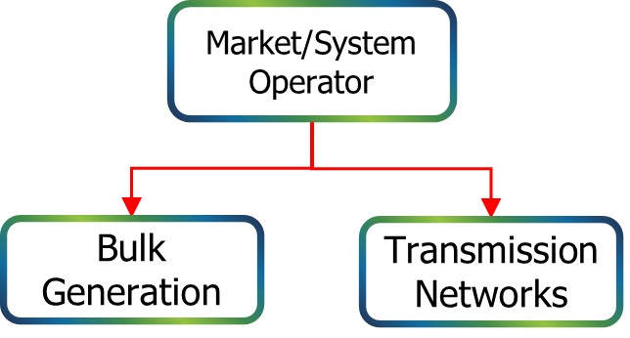
Operational Coordination of a few hundred large-scale merchant resources was (comparatively) simple
Coordination Signals

Slide 15
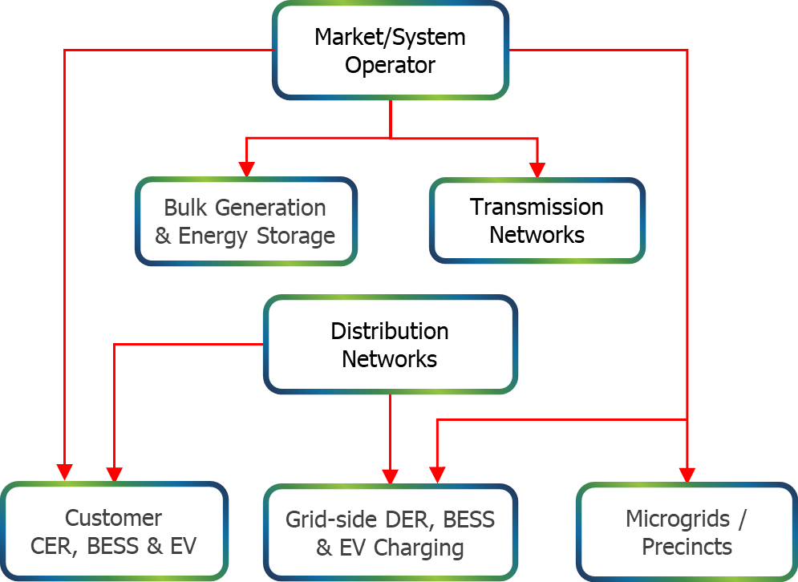
Operational Coordination is increasingly complex, fragile and non-scalable in a future of tens of millions of energy resources
Coordination Signals

Slide 16
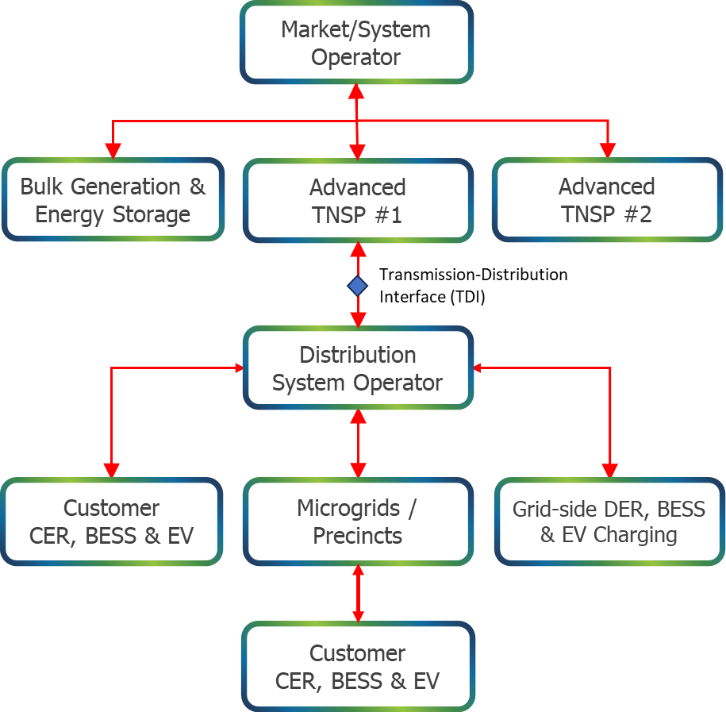
Targeted structural analysis is required to identify and address non-scalable constraints
Key Focus 2
Key Focus
Key Focus 1
As the NEM transitions from hundreds to tens of millions of participating energy resources, layered systems architecture becomes mission-critical for scalable visibility and coordination
Coordination Signals
16

Slide 17
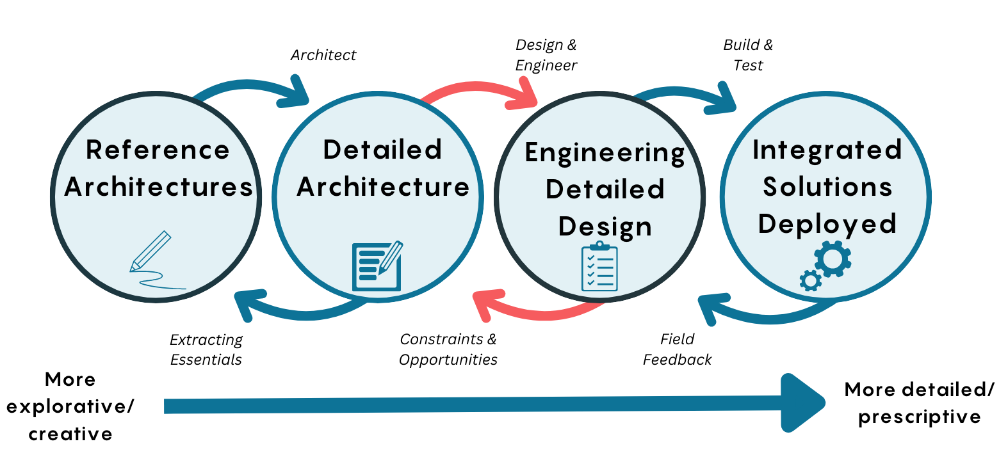
Systems Engineering applied to Grid Transformation
Stage 1
Stage 2
Stage 3
Stage 4
Global Best Practice

Slide 18
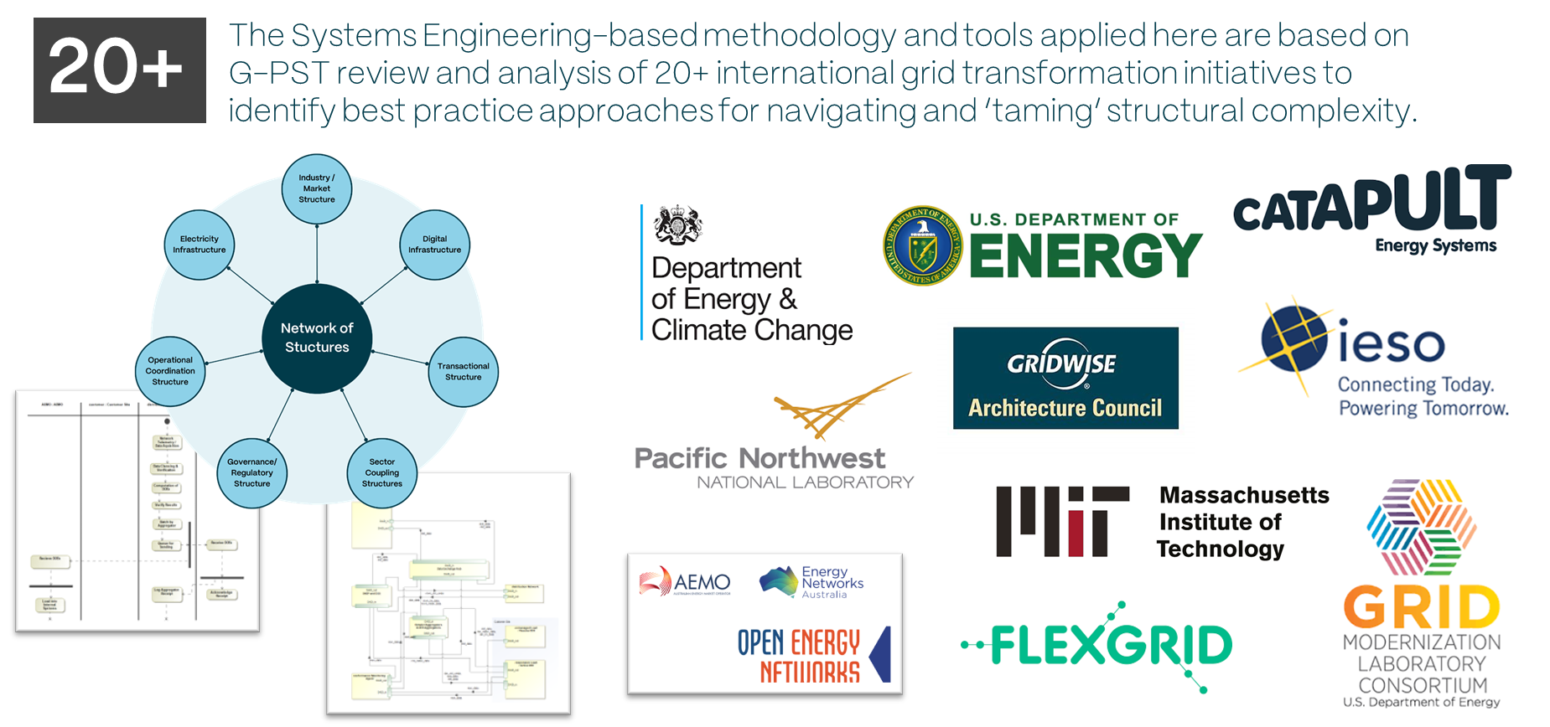
G-PST Topic 7 (Stage 1): Global Best Practice Tools
Stage 1
Stage 2
Stage 3
Stage 4

Slide 19
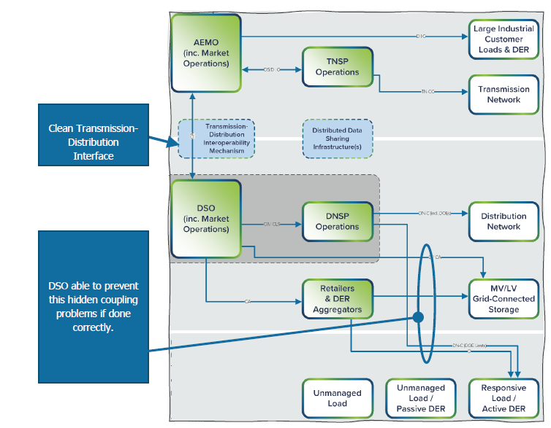
G-PST Topic 7 (Stage 2): Develop NEM Reference Architecture
Hybrid Approach
Layered Approach
Stage 1
Stage 2
Stage 3
Stage 4

Slide 20
G-PST Topic 7 (Stage 2): Identify non-scalable features
Tier/Layer Bypassing: The creation of information flows or coordination signals that ‘leapfrog’ a vertical Tier/Layer of the Power System’s operational hierarchy.
Coordination Gapping: An element of the Power System does not receive an explicit flow of coordination signals from any higher Tier/Layer of the system and therefore operates in isolation.
Hidden Coupling: Two or more control entities with partial views of System State issue simultaneous but conflicting coordination signals to a DER/CER or Component of the Power System.
Latency Cascading: Creation of compounding latencies in information flows due to the serial routing of data through various computational systems, processes and organisations.
Computational Time Walls: Where excessive data volumes, latencies and processing ‘bottlenecks’ occur, optimisation engines will hit a computational ‘time wall’ at some point where no amount of computing resource will be adequate to solve the optimisation problems in a reasonable time.
Stage 1
Stage 2
Stage 3
Cybersecurity Structural Vulnerabilities: Ill-informed and often unnecessary structural choices result in communication and routings that create non-cyber vulnerabilities to system penetration.
Back-end Integration Constraints: Multiple vertical silo structures found in many supply-chain organisations drive significant back-end integration costs, anti-resilience and are anti-extensible due to the coupling of applications in which where failure in one can ripple through to degrade others.
Stage 4
* The full Stage 2 report contains a detailed analysis of how these issues would potentially arise in the NEM under different architectural arrangements.
Image: Javier Zarracina and Vox.com
20

Slide 21
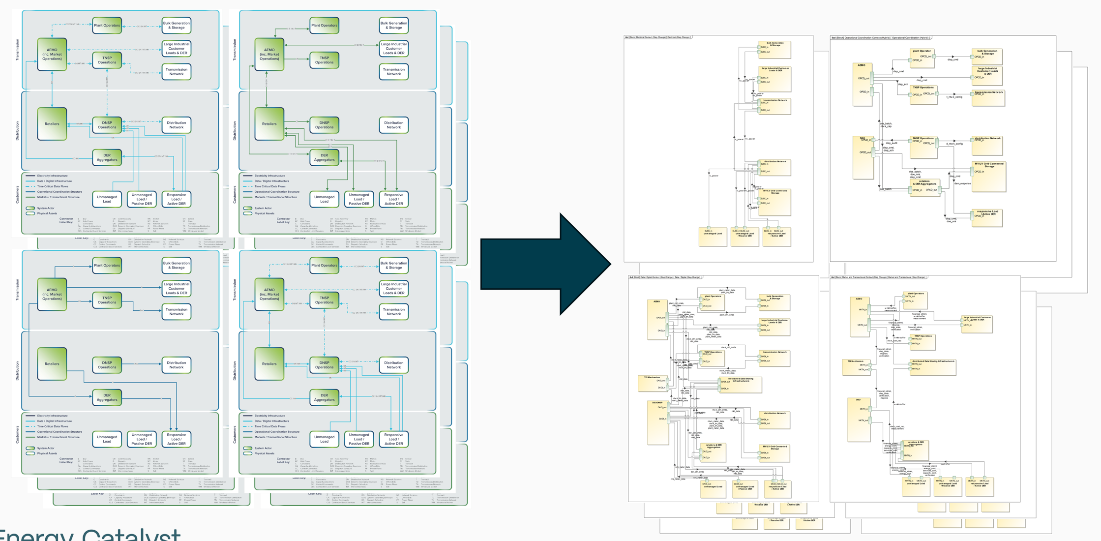

G-PST Topic 7 (Stage 3): Major demonstration project analyses and application of MBSE tools
Document-Based
Model-Based Systems Engineering (MBSE) Environment
Stage 1
Stage 2
Stage 3
Stage 4

Slide 22
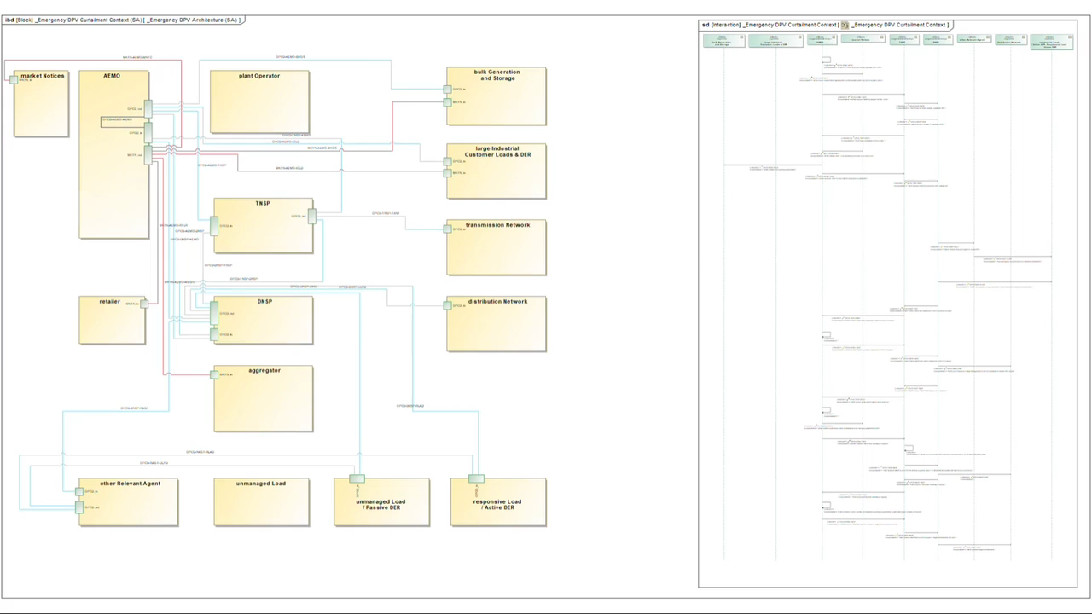
MBSE Simulation Example
Notes:
In addition, SysML is built to integrate structural and behavioural aspects of a system, which enables system functions to be simulated….
This is an example simulation that maps the behaviour of a function to system structure, showing what interfaces are required and how it propagates through the system – specifically this was developed to model SA’s implementation of EDPVC.
We’ve found that the use of simulation to help with shared understanding of the system function and that it also positions us well to identify sub-optimal routing of information and validate at a high-level design choices.
As mentioned, we hope to apply this to DSO considerations in this coming Stage 4. That’s all from me – I believe Mark will facilitate some discussion now…

Slide 23
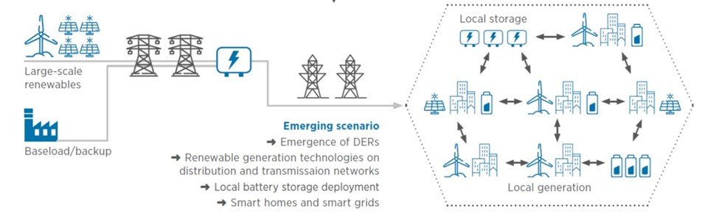
G-PST Topic 7 (Stage 4): Detailed Architecture
Distribution System Operator (DSO) models
Transmission-Distribution Interface (TDI) models
Whole-system Visibility and Operational Coordination models
Cyber-physical architectures that enable the above
Stage 1
Stage 2
Stage 3
Stage 4

Slide 24
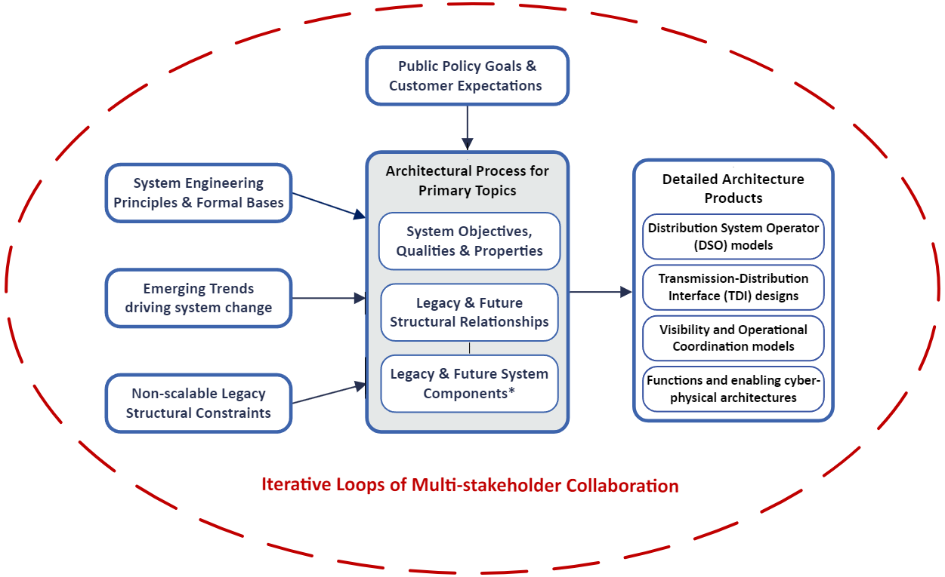
G-PST Topic 7 (Stage 4): Detailed Architecture
Stage 1
Stage 2
Stage 3
Stage 4

Slide 25
Mapping the existing structures embedded in legacy power systems is a critical first step of developing a Reference Architecture

Slide 26
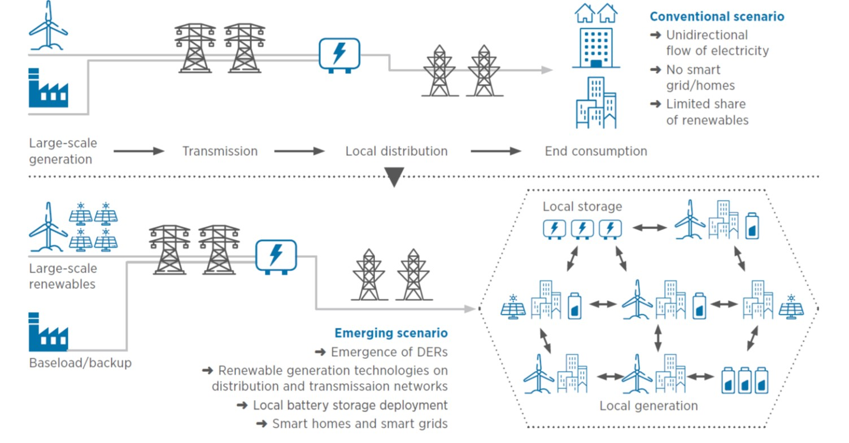
Mapping the power system structures we inherited…
Supply-side
Demand-side
A one-directional bulk delivery system made up of distinct functional siloes
Image: IRENA System Operation Collection (2020)

Slide 27
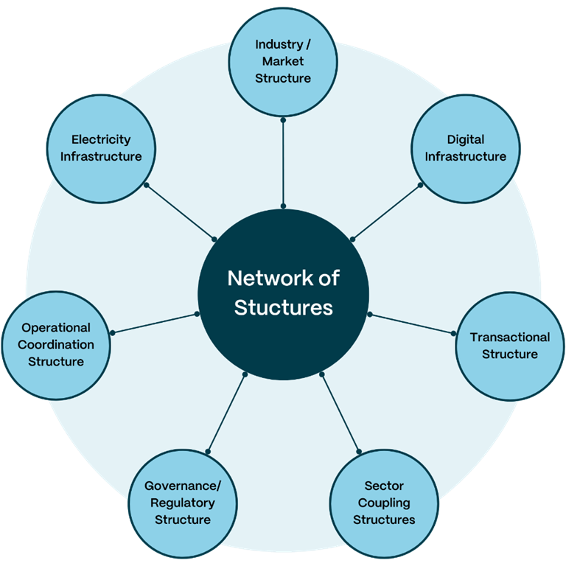
First Principles: Modern grids are a ‘super system’ of seven structures
A modern Power System is a ‘super system’ of the following seven structures:
Electricity Infrastructure (Power Flows);
Digital Infrastructure (Information/Data Exchange, Storage & Processing);
Operational Coordination Structure;
Transactional Structure;
Industry / Market Structure;
Regulatory Structure; and,
Sector Coupling Structures (Gas, Water, Transport, etc).
Structures 1 – 4 are ‘functionally interdependent’ as they dynamically influence each other on a days-to-milliseconds basis.
Network of Structures concept developed by Pacific Northwest National Laboratory (PNNL)
27

Slide 28
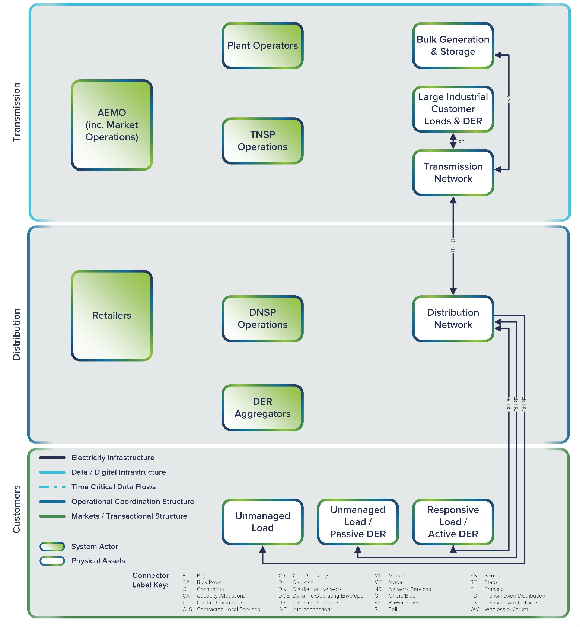
Electricity Infrastructure

Slide 29
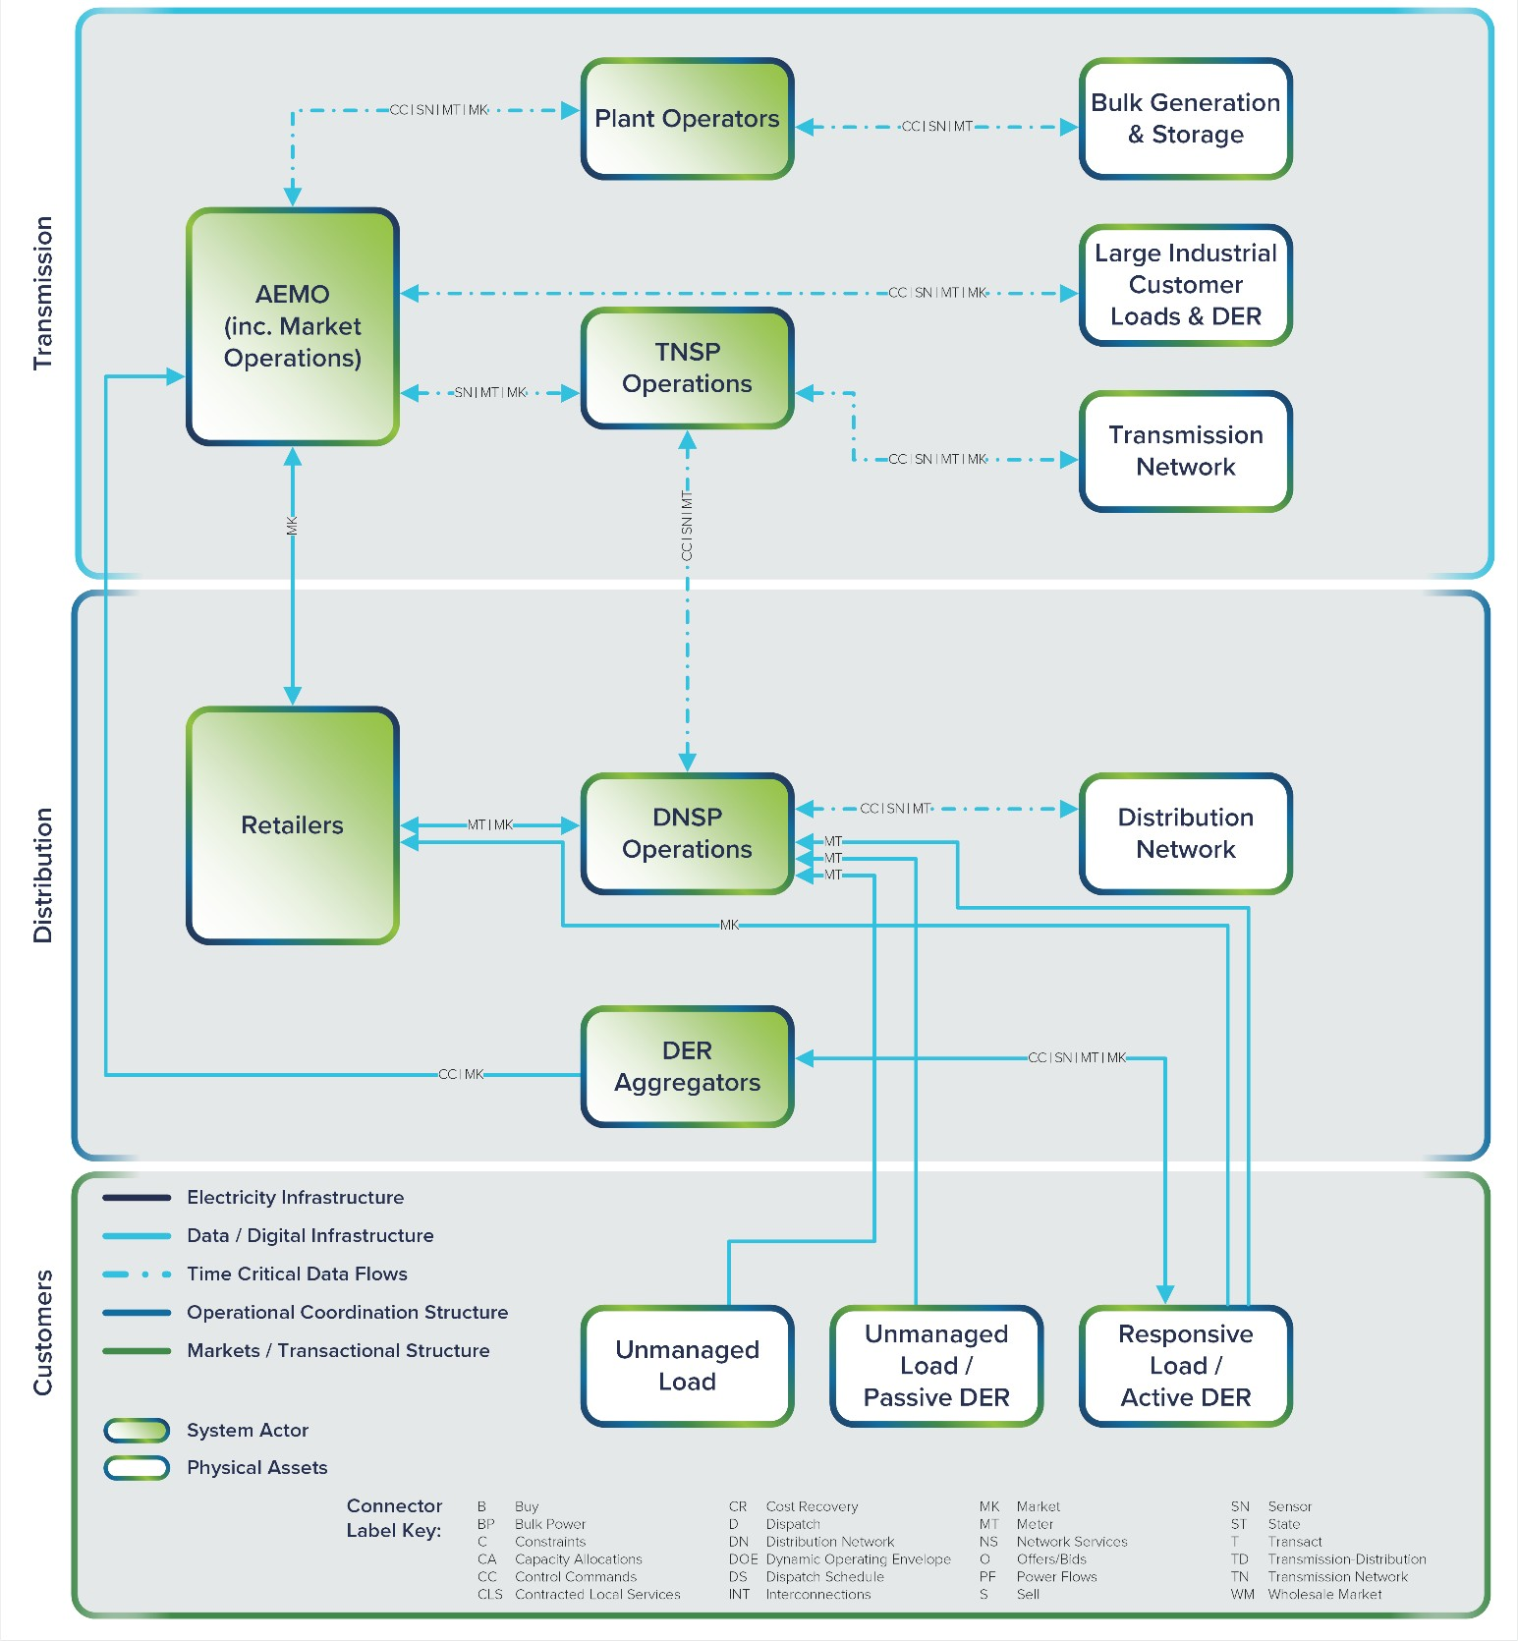
Digital Infrastructure

Slide 30
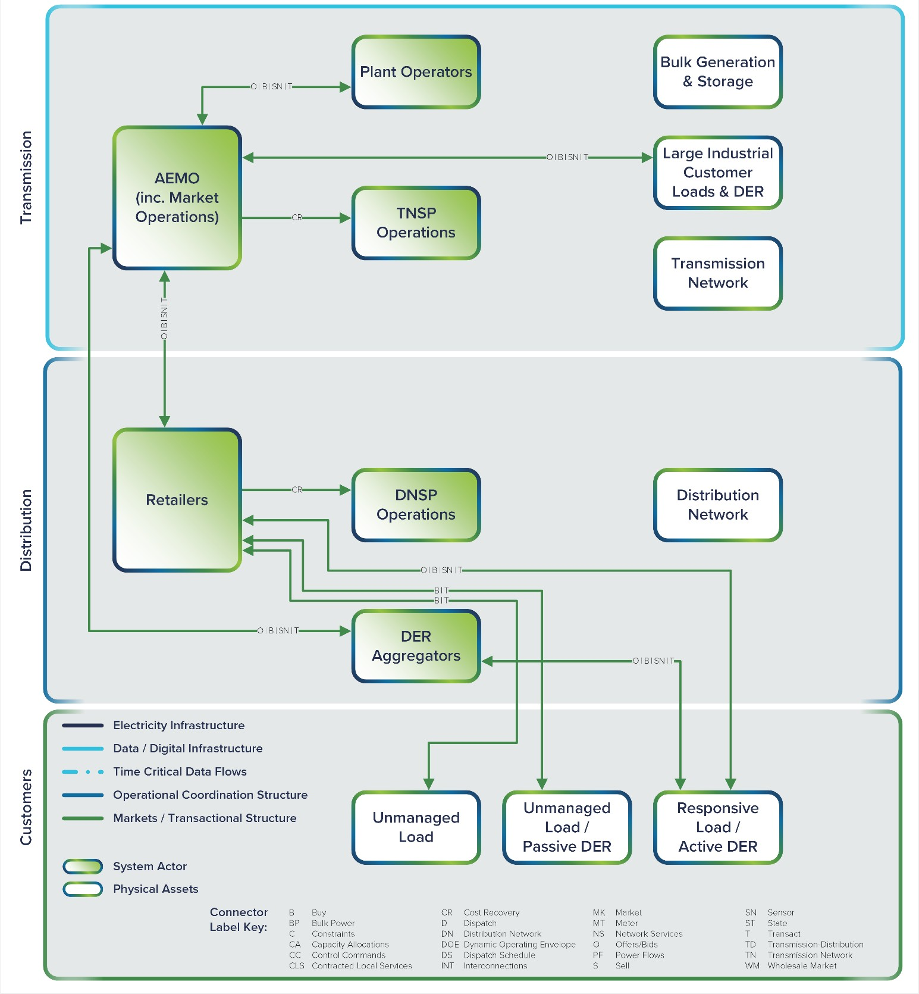
Transactional Structure

Slide 31
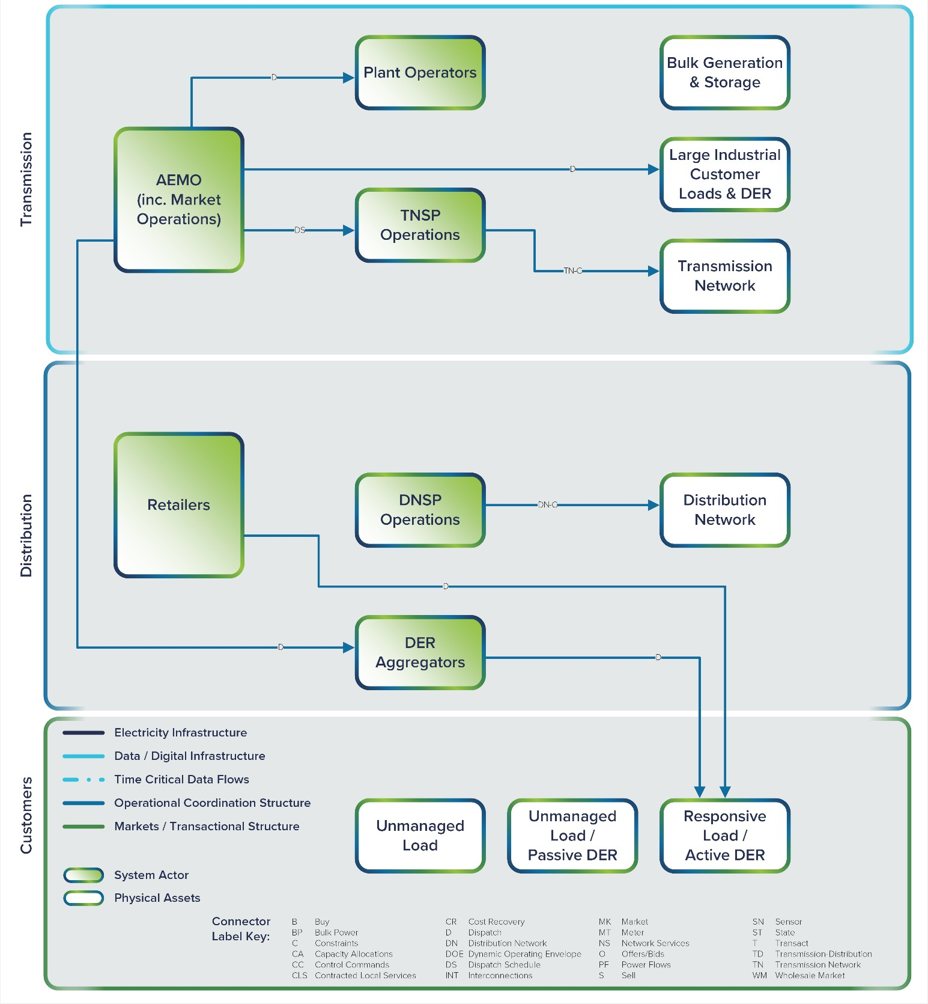
Operational Coordination

Slide 32
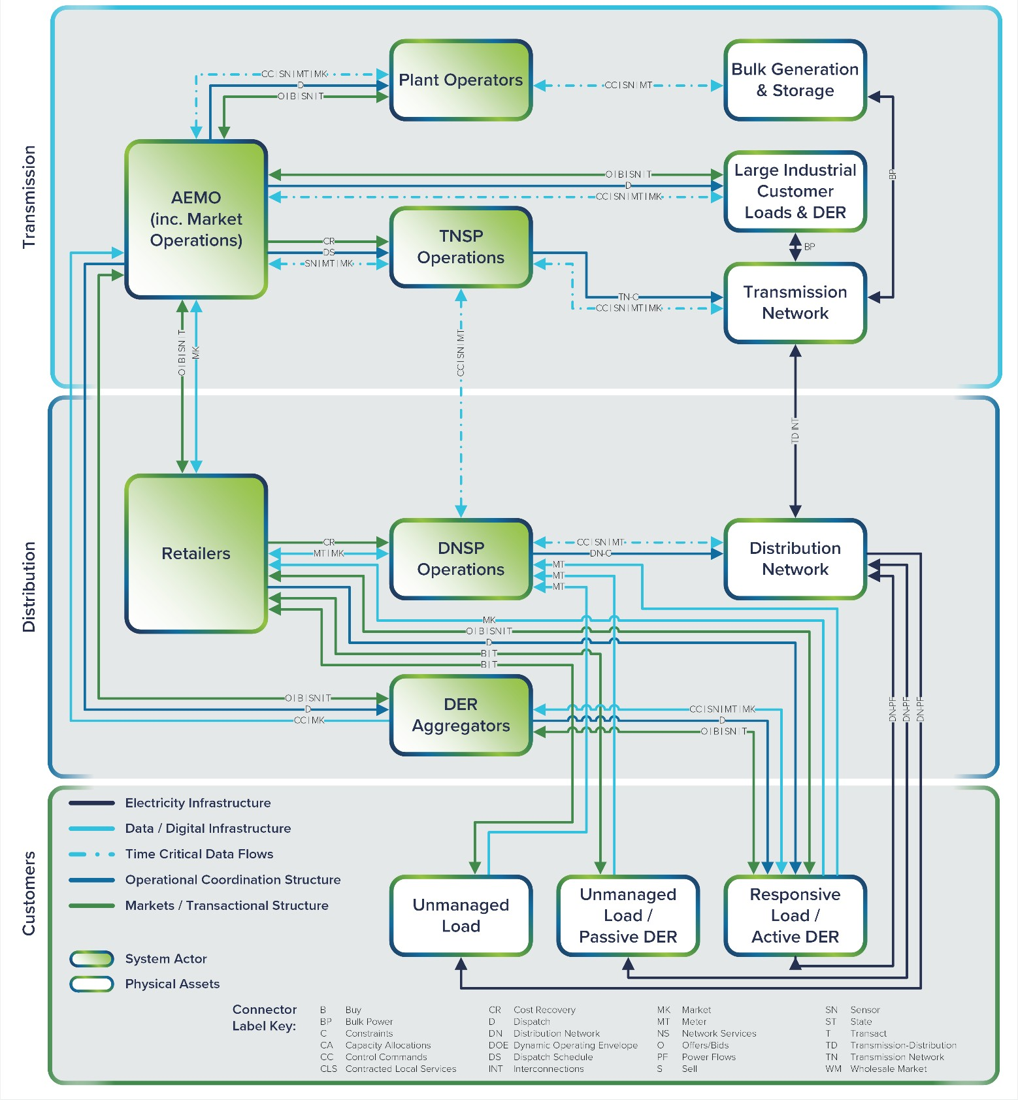
4 x Functional Layers

Slide 33
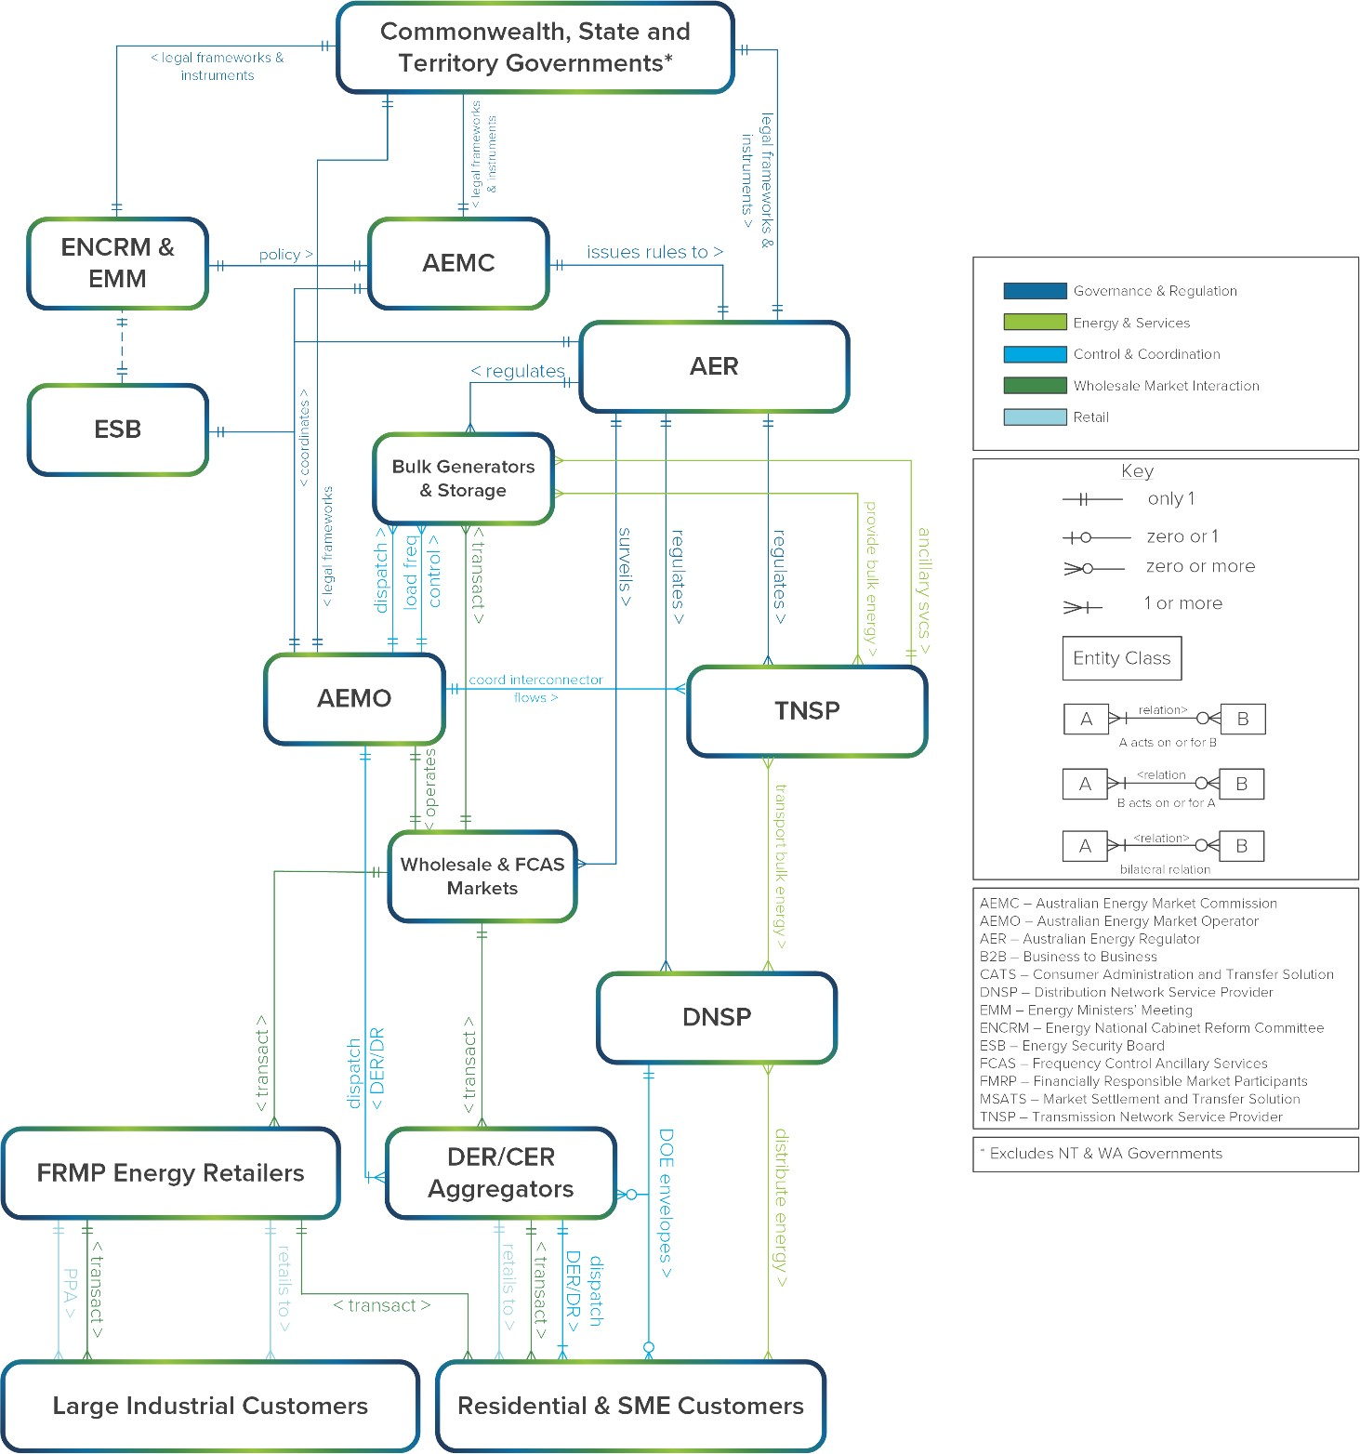
Industry & Regulatory

Slide 34
The Reference Architecture process includes consideration of key structural interventions needed for scalable, future-ready capabilities

Slide 35
Readying GW-scale grids for ‘step change’ transformation
~0% to ≥100%
Centrally-supplied
~0% to ≥100% Locally-supplied
Power systems that require an entirely new level of dynamic, whole-system inter-dependence

Slide 36
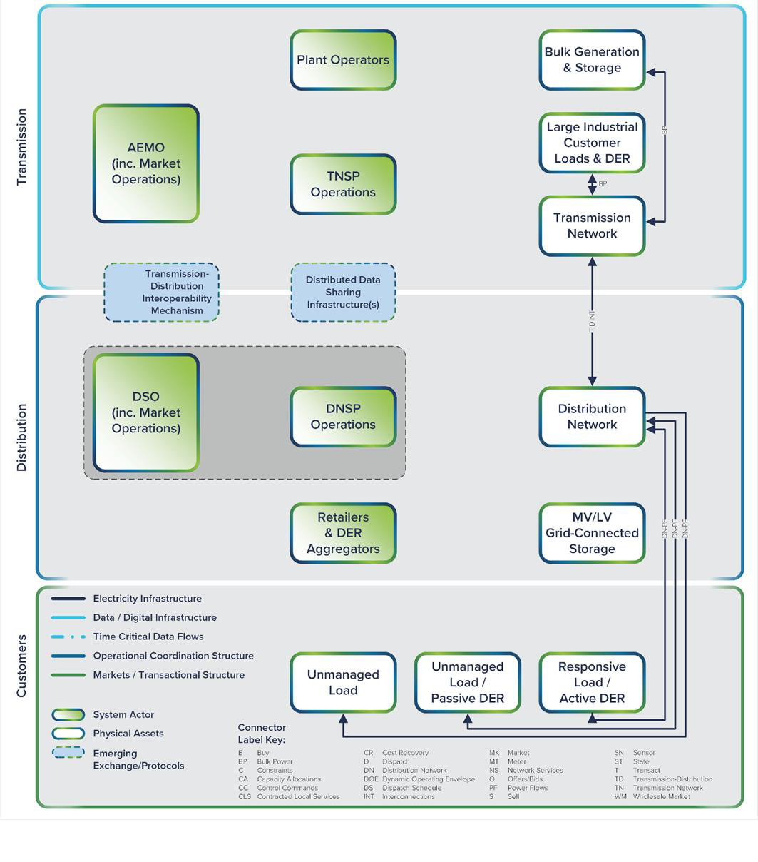
Electricity Infrastructure

Slide 37
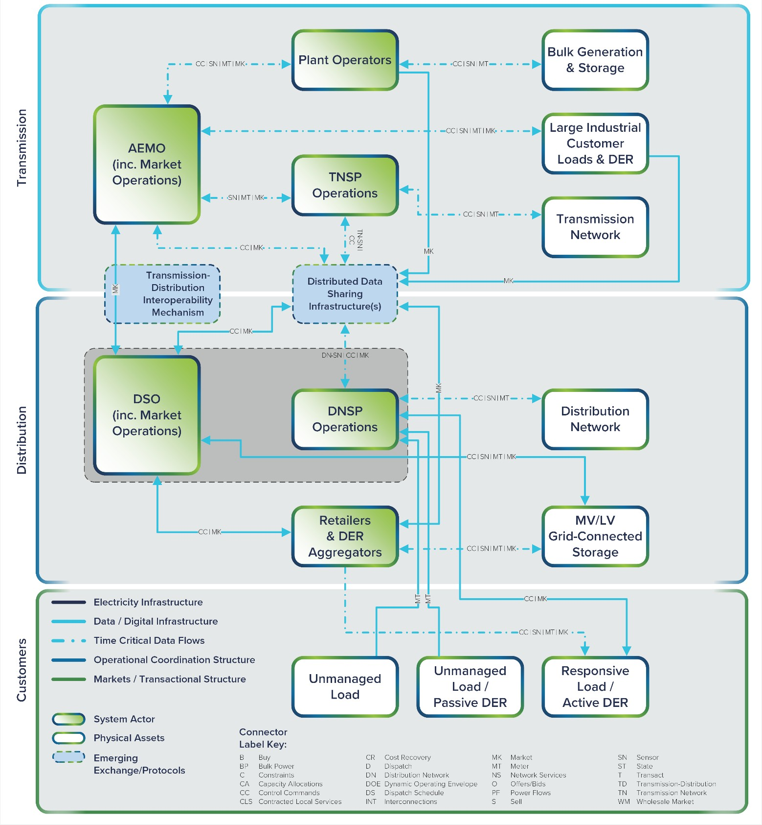
Digital Infrastructure

Slide 38
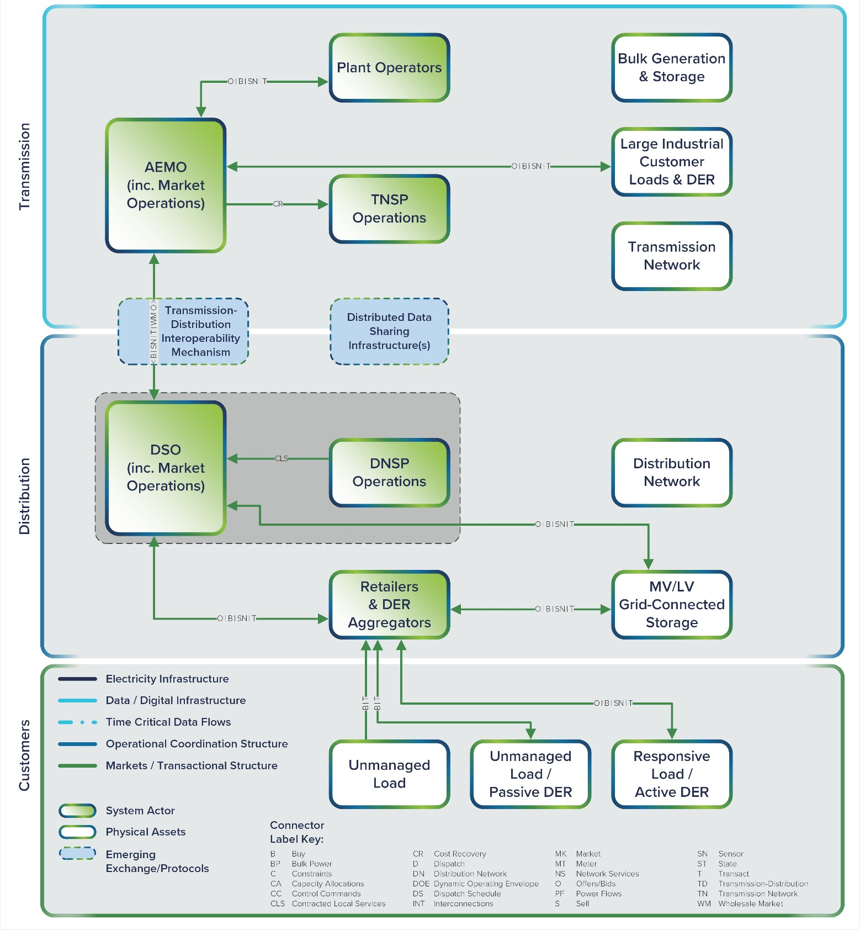
Transactional Structure

Slide 39
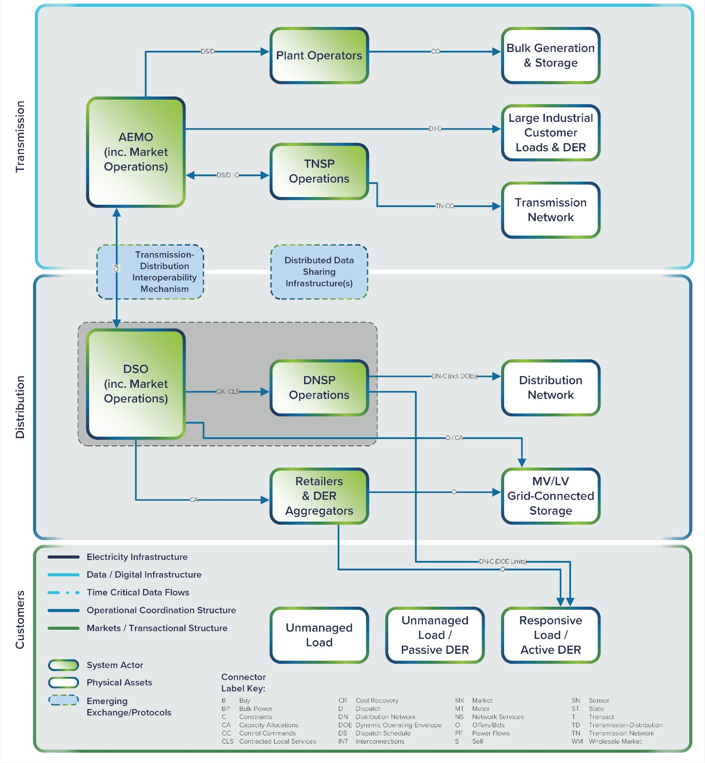
Operational Coordination

Slide 40
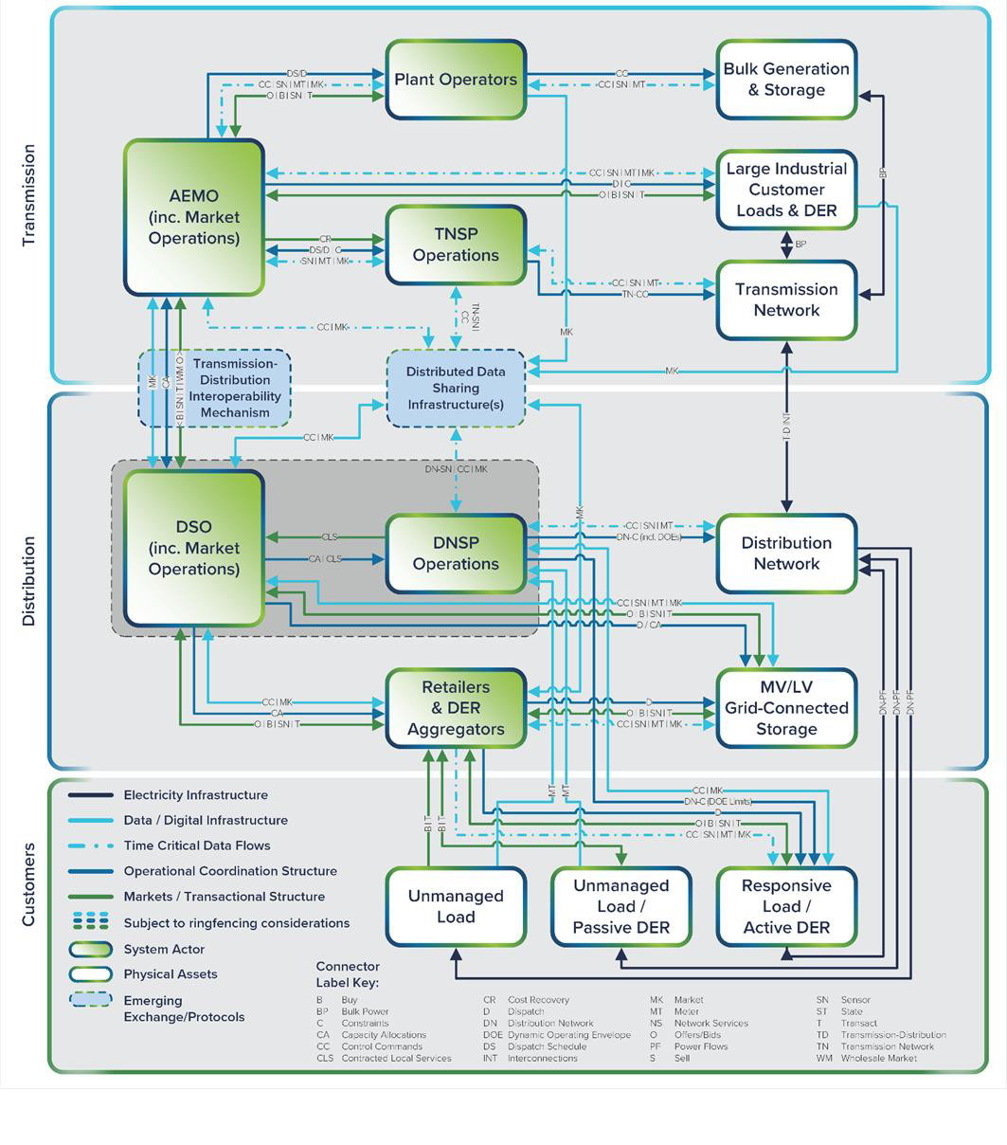
4 x Functional Layers

Slide 41
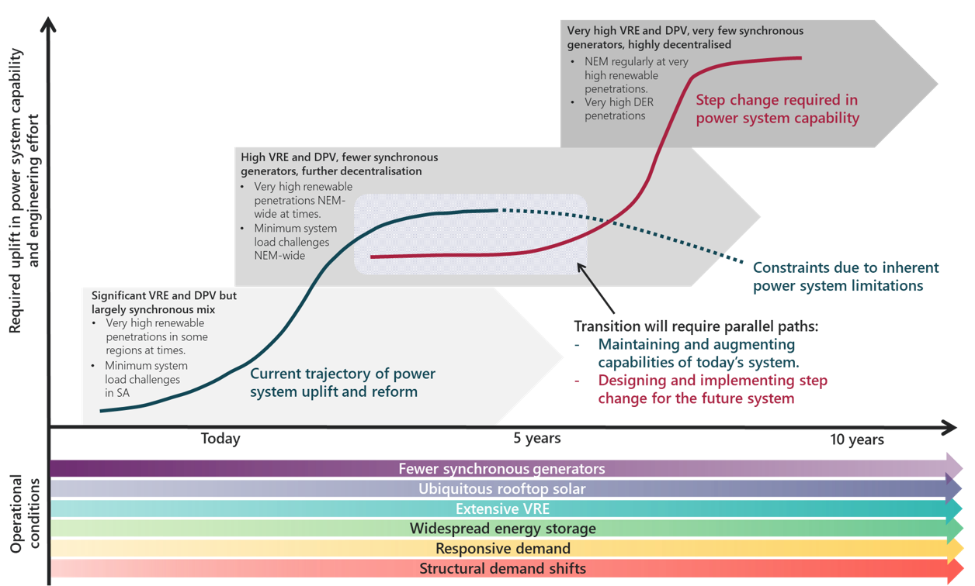
Systems Engineering tools are critical for ‘crossing the chasm’
Reliable, Affordable, Net Zero Emissions
PATH 1: Present-forward
PATH 2: Future-back
100% Fossil-fuel Based
Image: Engineering Framework – Interim Roadmap, AEMO, 2021; adapted from A Gambit for Grid 2035 – A systemic look into the disruptive dynamics underway, Pacific Energy Institute, 2021

Slide 42
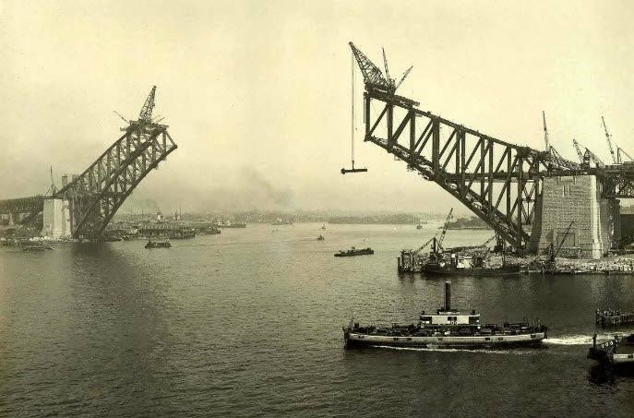
Enabling two parallel paths of transformational activity
Reliable, Affordable, Net Zero Emissions
100% Fossil-fuel Based
PRESENT-FORWARD
FUTURE-BACK

Slide 43
Thankyou
Mark Paterson mpaterson@energycatalyst.au

Slide 44
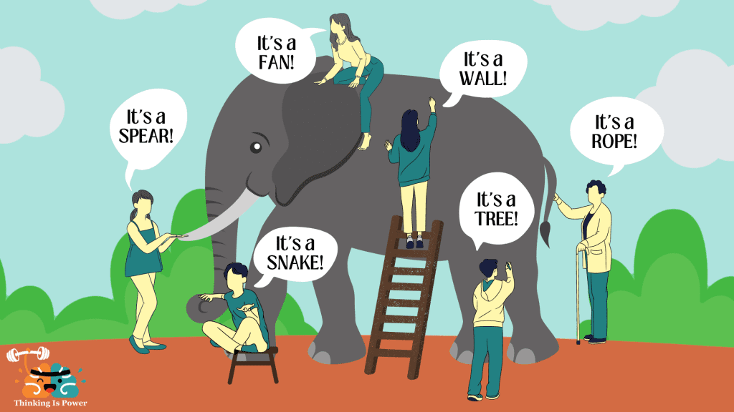
Decarbonizing our GW-scale grids requires new capabilities to enable whole-system transformations
The Laws of Physics interact with one integrated power system (blind to traditional siloes)
It is common for no single entity to be responsible for whole-system transformation
Limited documentation of the systems architecture, subsystems and interfaces embedded in the ‘as built’ grid
Future requirements typically span grid boundaries: supply chain entities, subsystems and disciplines
Today’s technology choices must be confirmed as scalable and extensible to meet future needs

