Slide 1



Australia's Global Power System Transformation (G-PST) Research
Topic 9
DER and Stability
Dr. Awais Ahmad
Research Fellow
School of Electrical Engineering and Telecommunications
UNSW Sydney
Notes:
Good morning, everyone. My name is Awais Ahmad, and I am a research fellow at UNSW. I am here to present some insights from GPST topic 9 DER and Stability. We are working in collaboration with UOW, AEMO, and CSIRO.

Slide 2
Acknowledgments
Thanks to Topic 9 Research Team and contributors
UNSW:
  Georgios Konstantinou, John Fletcher and Iain Macgill
UoW:
  Obaidur Rahman, Sean Elphick and Duane Robinson
AEMO:
  Jenny Riesz, Pat Graham, Taru Veijalainen, Filip Brnadic, Daena Ho , Naomi Stringer
CSIRO:
  Thomas Brinsmead and Julio Braslavsky
Notes:
These are the contributors of our research from each organisation.

Slide 3

Total System Approach
Notes:
We use a total system approach to address the problems caused by the large integration of DERs in the system.

Slide 4
Applying a Whole System Approach
Cannot be done in isolation.
It requires a three-pronged response, simultaneously considering:
Extensive laboratory-based experimental bench-testing of IBRs
  Hardware Testing
Evaluation of field behaviour of devices and systems using big-data analytics
  Desktop Studies
Development of operational and planning models for IBRs and loads that accurately capture all current and future behaviours.
  Operations
Laboratory Testing
Field Behaviour
Lessons applied to Modelling and Operations
Notes:
This cannot be done in isolation. It requires three-pronged responses.
The first one is extensive laboratory bench testing of the IBS and loads.
Then, we evaluate the behaviour of the devices and compare the responses.
This further helps in the development and planning of models for IBRs and loads that accurately represent the system's behaviour under different conditions.

Slide 5
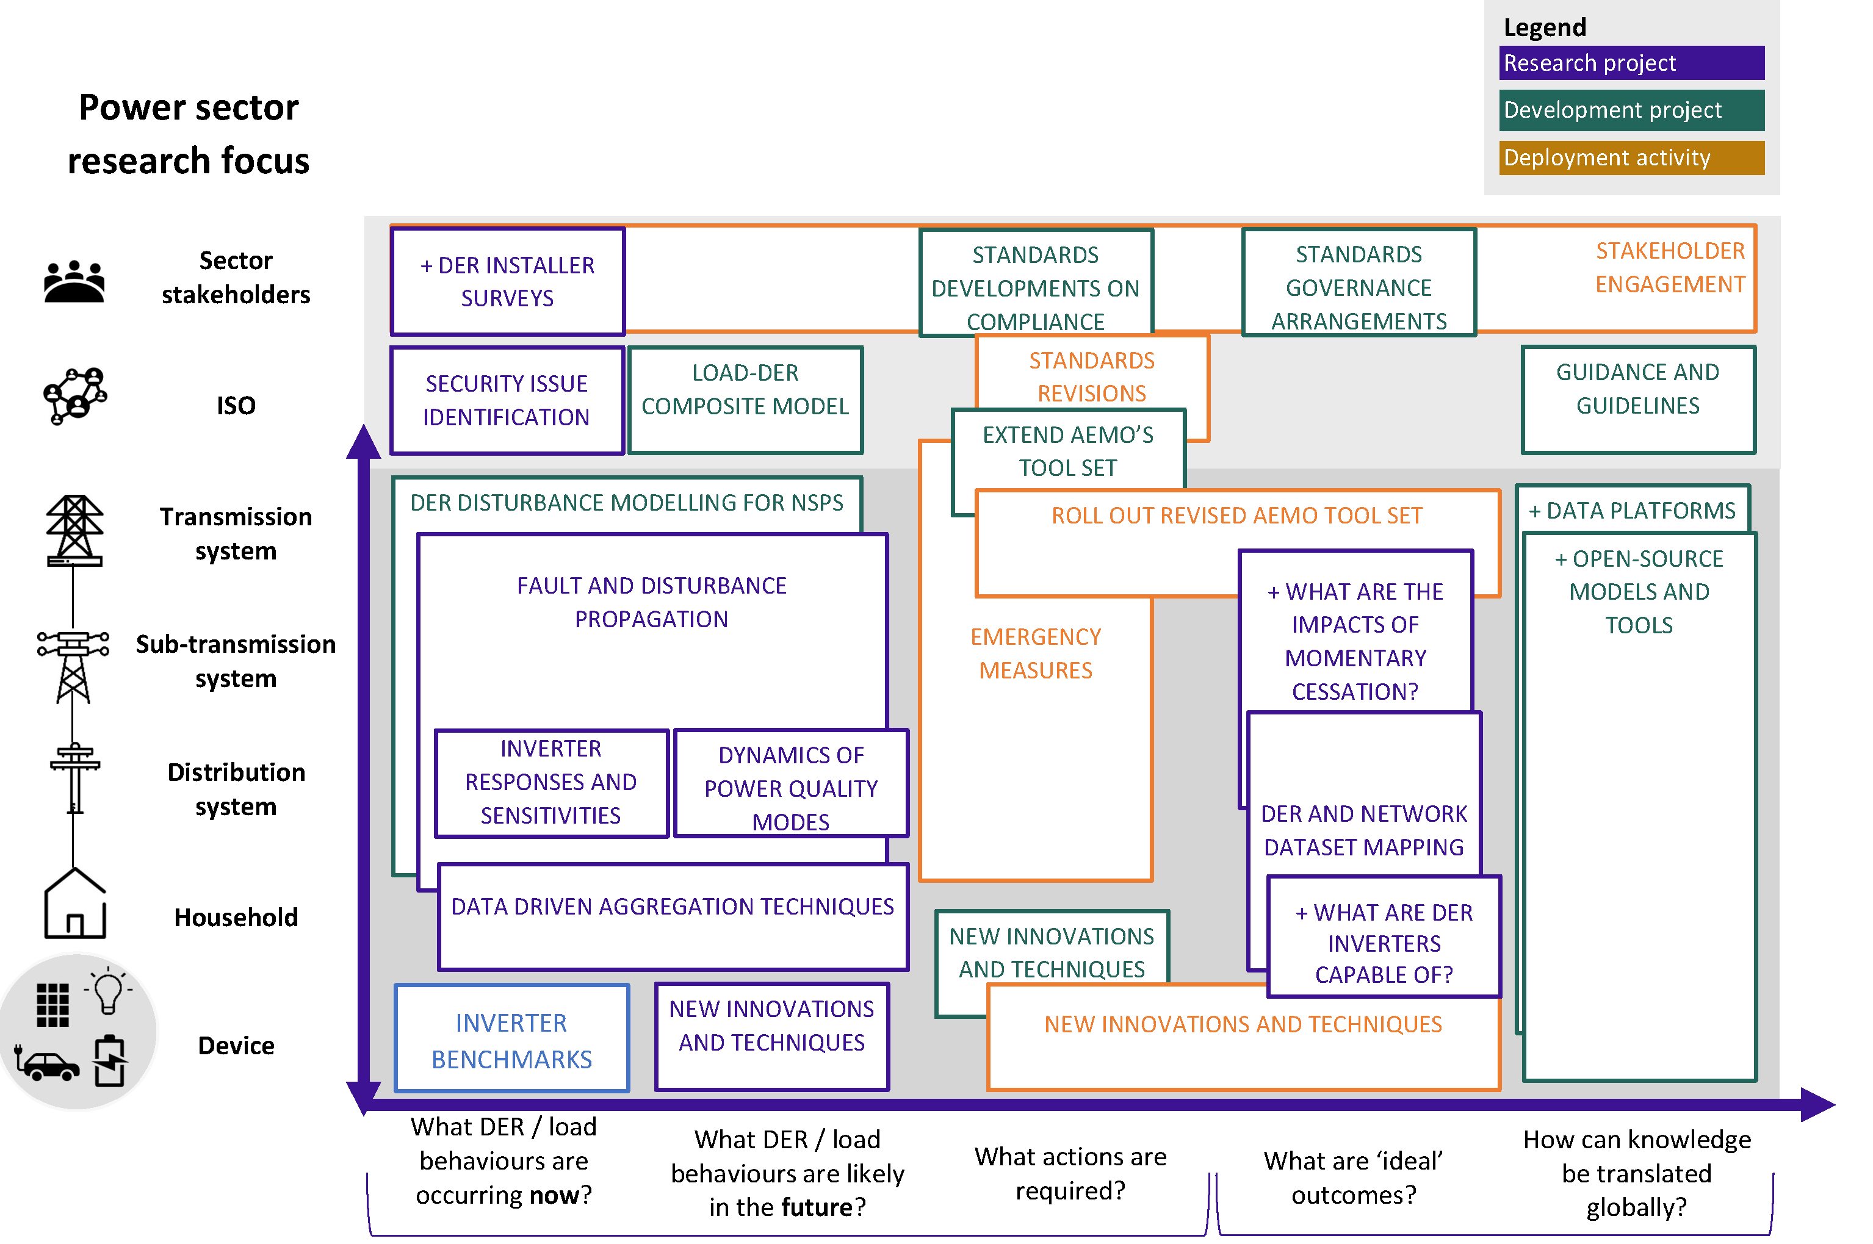
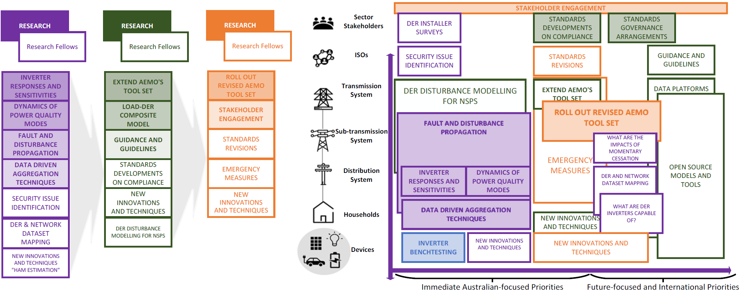

Topic 9 – DER and Stability – The Big Picture
Notes:
This is the big picture for the G-PST topic 9 road map, which includes short—and long-term research development and deployment activities. We have highlighted the activities we have already done under stages 2 and 3 of the project.

Slide 6
Scope of Topic 9
A future-proof pathway for load modelling – Futureproofing load models to account for changes in load compositions and new responses will allow operators to identify and predicts future causes of power reduction and system instability.
New bench-testing capabilities - Development of a comprehensive platform for experimental testing of multiple devices.
A research team that can readily adapt to the testing needs of AEMO – Readily available for testing and consultations with stakeholders of specific events or specific inverters / loads and support ongoing development work.
Open data sharing of inverter and load responses – An extensive dataset from the bench-testing of DER, BESS, EVs and loads.
Updated Load Models – Supporting the development of a new AEMO tool set for load modelling including revisions required to include higher penetrations of IBR throughout DNSPs networks.
Notes:
A future-proof pathway for load modelling – Power system loads are consistently evolving and a prompt response to developments and changes is of paramount importance [7]. Futureproofing load models to account for changes in load compositions and new responses will allow operators to identify and predicts future causes of power reduction and system instability. It also allows studies to further validation the interaction between DER and flexible loads, supports research on improvements that can be made to the system to allow it to remain operational during fault events, and contributes to information sharing with the industry regarding systemic risks.
New bench-testing capabilities at UNSW and UoW. The extension of the ongoing PV inverter bench-testing at UNSW [6], and complementing it with the capabilities at UoW, the project will enable development of a comprehensive platform for experimental testing of multiple devices. This outcome is important as the true response of all devices can only be observed through experimental testing which facilitates accurate measurements across multiple tests.
A research team that can readily adapt to the testing needs of AEMO – The skills and resources generated by the project can be readily used by AEMO to test specific events or specific inverters / loads and support ongoing development work, including in-field data driven analysis to support model validation.
Open data sharing of inverter and load responses – An extensive dataset from the benchtesting of DER, BESS, EVs and loads will be made openly available. Expanding the availability of open datasets allows for further work and more solutions to be developed both from the People involved in the project as well as other research organisations.
Updated Load Models – By extending experimental testing and measurements, the project will support the development of a new AEMO tool set for load modelling including revisions required to include higher penetrations of IBR throughout DNSPs networks. This objective can only be met through an integrated examination of inverter benchmark responses as well as network measurements and correlation of responses with real-world measurements.

Slide 7

Lessons
Learnt
Notes:
The lessons learnt from stages 2 and 3 of the project are summarised in the upcoming slides.

Slide 8
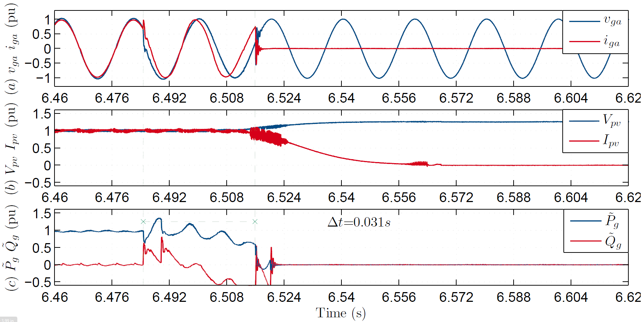
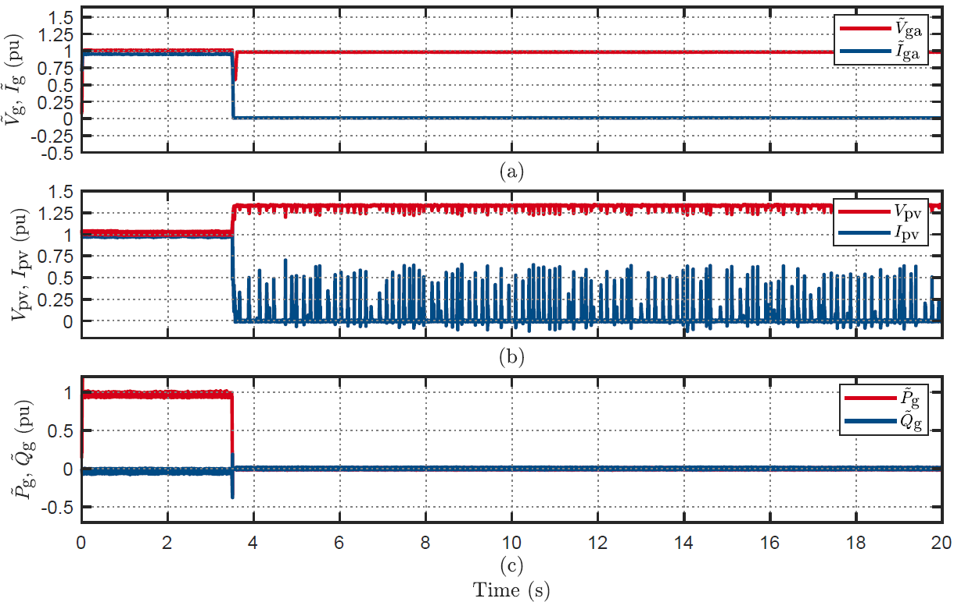
Key Findings for PV, BESS and HESS Inverters
VPAJ 30°
PV Inverters: All tested inverters complied with the AS/NZS 4777.2:2020 standard, showing appropriate fault-ride-through behavior, power curtailment, and ride-through behavior during frequency and voltage disturbances. This extensive testing led to the development and tuning of the composite load model parameters.
HESS: Limited testing on hybrid inverters revealed mixed results. Only two out of nine inverters rode through all voltage sag disturbances and frequency disturbance tests. The testing at different power levels suggests a reconsideration of the AS 4777.2 Standard.
BESS: The tested BESS showed limitations, with only partial success during voltage disturbance ride-through and Volt-Watt and Volt-Var responses. It struggled with comprehensive voltage sag testing and showed power oscillations during frequency and phase jump disturbances.
Disconnection
~6min to full power
Voltage sag of 0.3 p.u for 80ms
Disconnection and ~6min to full power
Notes:
These are the key findings from the testing of the PV, Battery energy storage and hybrid energy storage inverter.
PV inverters complying with the AS4777.2020 standard were able to ride through, curtail the power, and disconnect to different frequency and voltage disturbances as required by the standard. This testing helped develop and tune the composite load model parameters.
In the figures on the right side, you can see a HESS disconnect to a small phase jump of only 30 degrees and similarly for the voltage sag of 0.3p.u for only a short duration of 80ms. We have seen such behaviours before when we started the bench testing of PV inverters before the 2020 standard came out. After that, PV inverters complying with the 2020 standard were able to present desirable behaviour but not HESS and BESS.

Slide 9
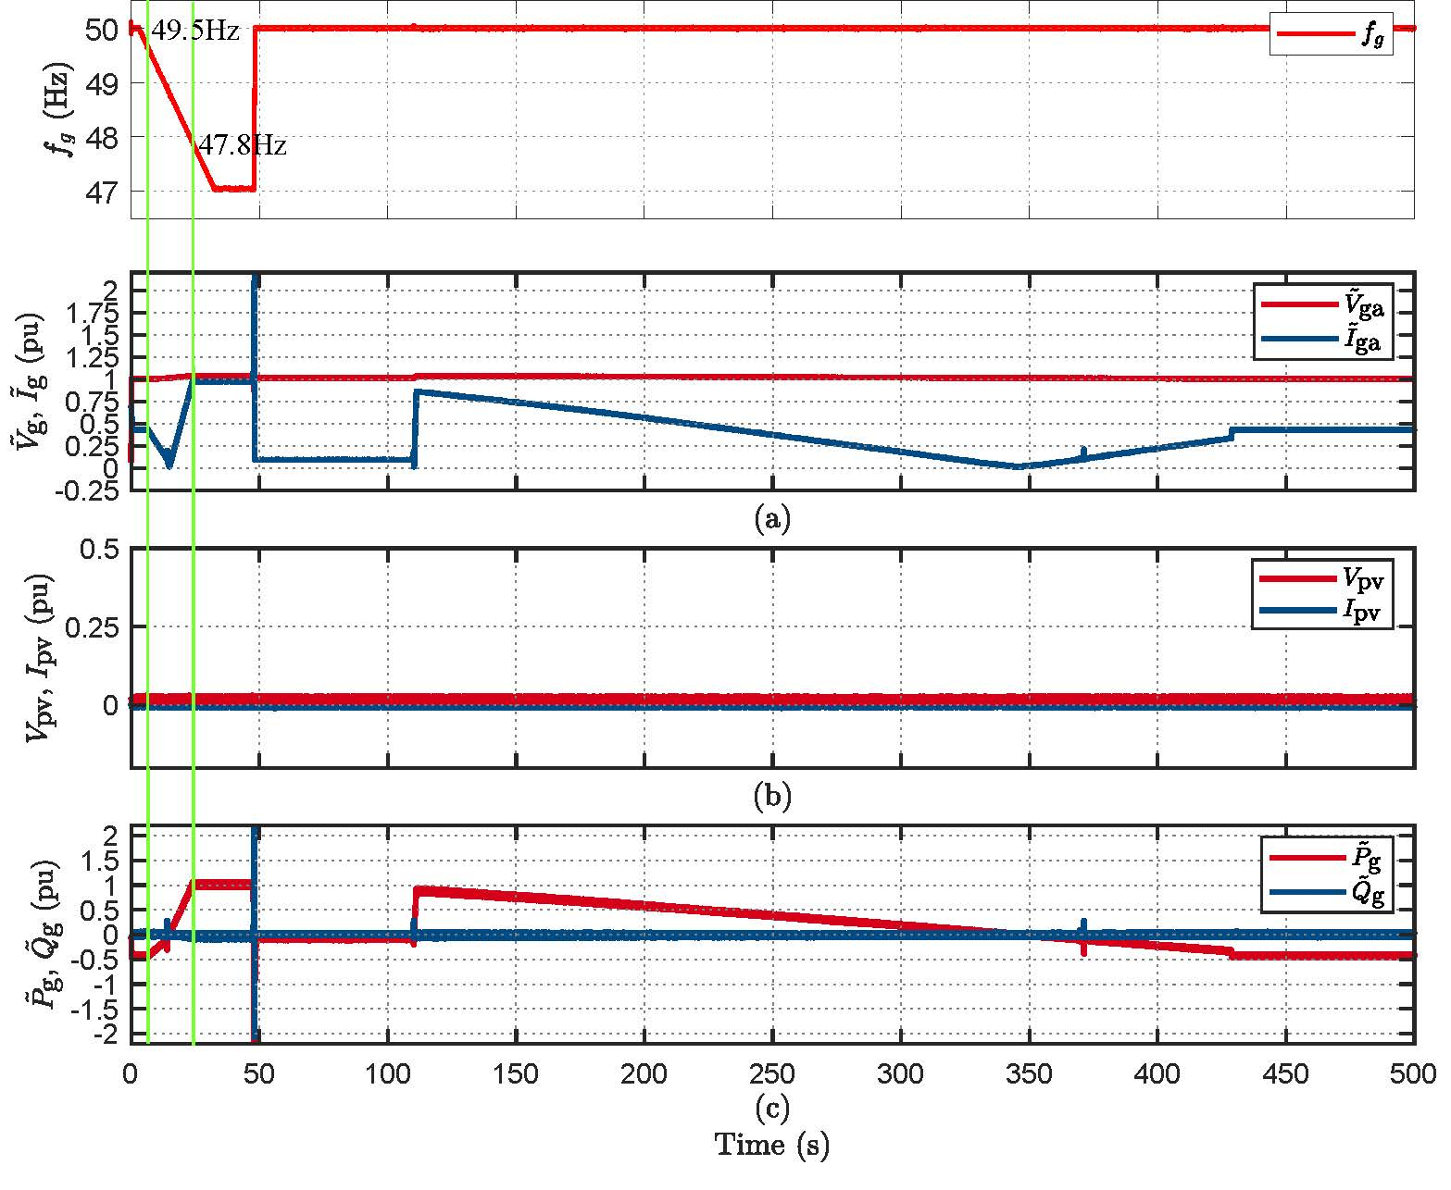
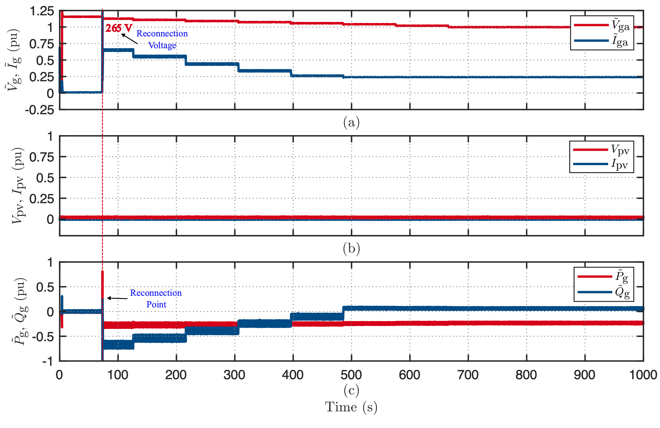
Key Findings DER Reconnections
Inverter reconnection following disconnection at RoCoF of 0.1 Hz/s
PV Inverters: Two out of 30 inverters following AS4777.2:2020 reconnected in less than 60 seconds, contrary to the standard's stipulation.
PV Inverters: Six out of 30 inverters took over 2 minutes to reconnect, exceeding the standard's recommended time frame, potentially resulting in a prolonged load on the power system.
PV Inverters: Nine out of thirty inverters ramped up power in under 6 minutes, not aligning with the standard's specifications.
PV Inverters: As per AS60038, the upper voltage utilization limit is set at 240 V. However, only 2 out of 30 inverters complied with this standard by not reconnecting when the voltage exceeded this threshold.
Notes:
Enhanced voltage management

Slide 10
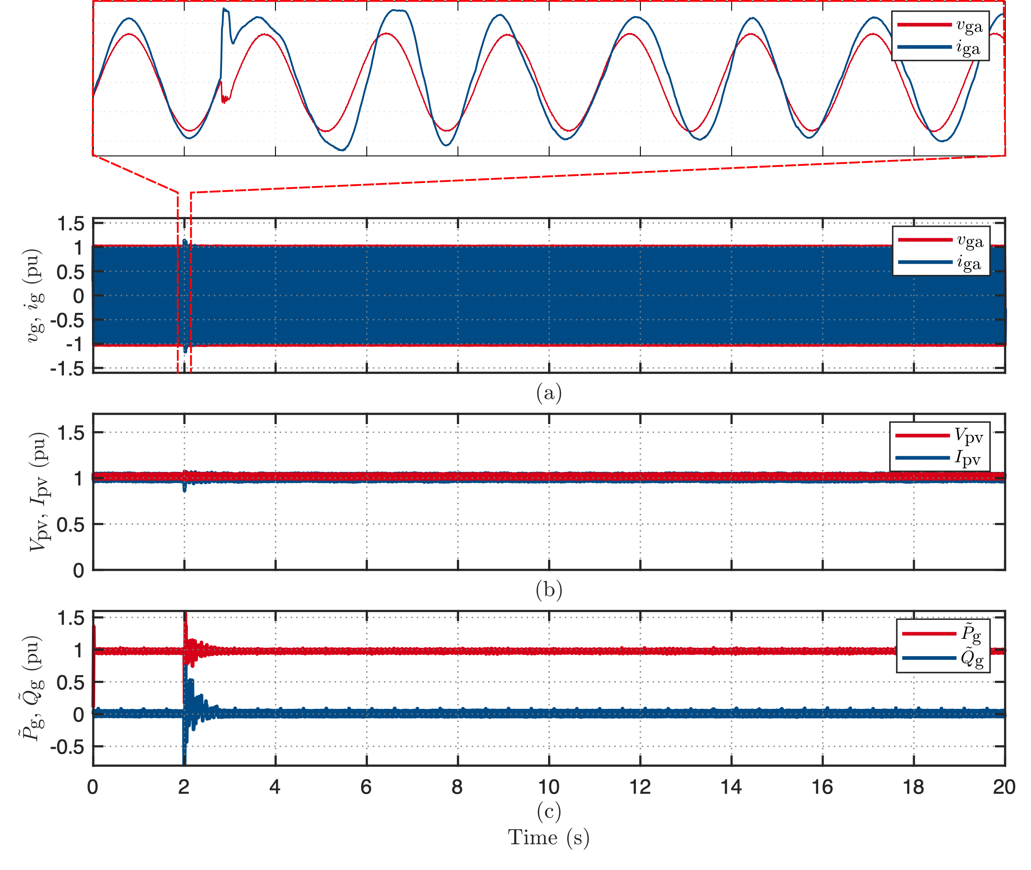
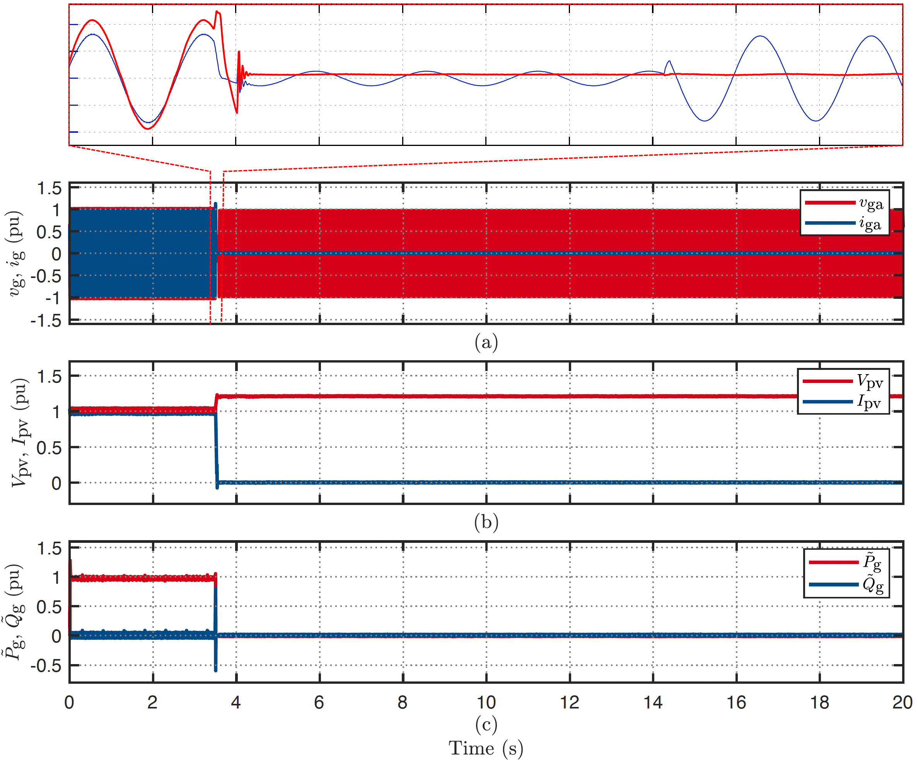
Key Findings on PoW Testing
VPAJ 30°at zero crossing
PV Inverters: Limited testing of the inverters revealed that inverters present inconsistent behaviors to the same disturbance (Ride-Through, Power Curtailment and Disconnection), if conducted at different points on the voltage waveform
PV Inverters: These findings highlight the significance of PoW in testing to ensure inverter performance and grid stability under a much greater range of grid conditions that previously considered.
Ride-Through
VPAJ 30°at 120°
Disconnection
Notes:
But still, we have to find the point that is most vulnerable to grid disturbance so it can be considered for the standard inclusion

Slide 11
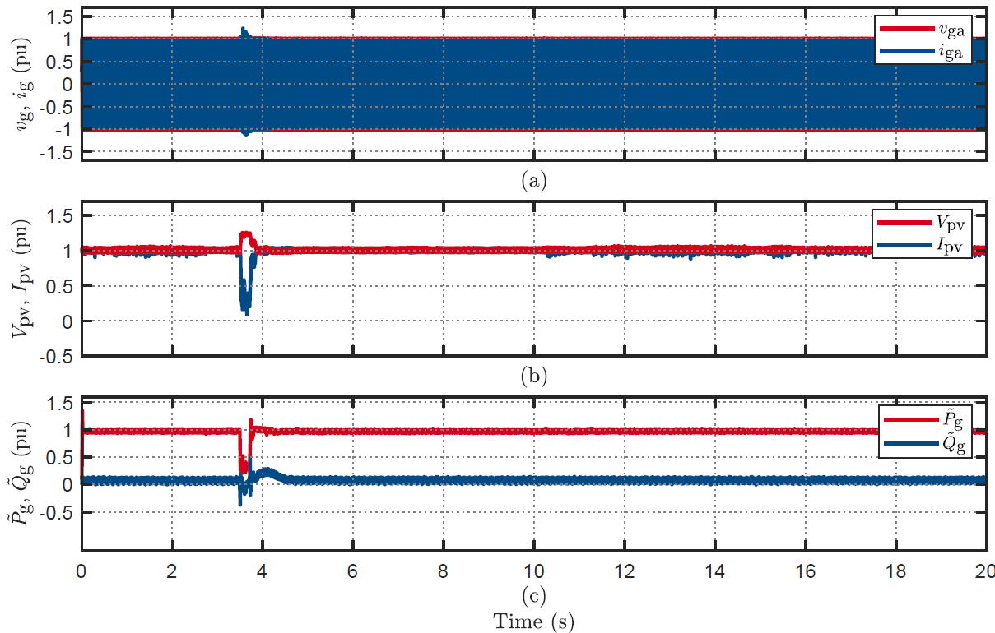
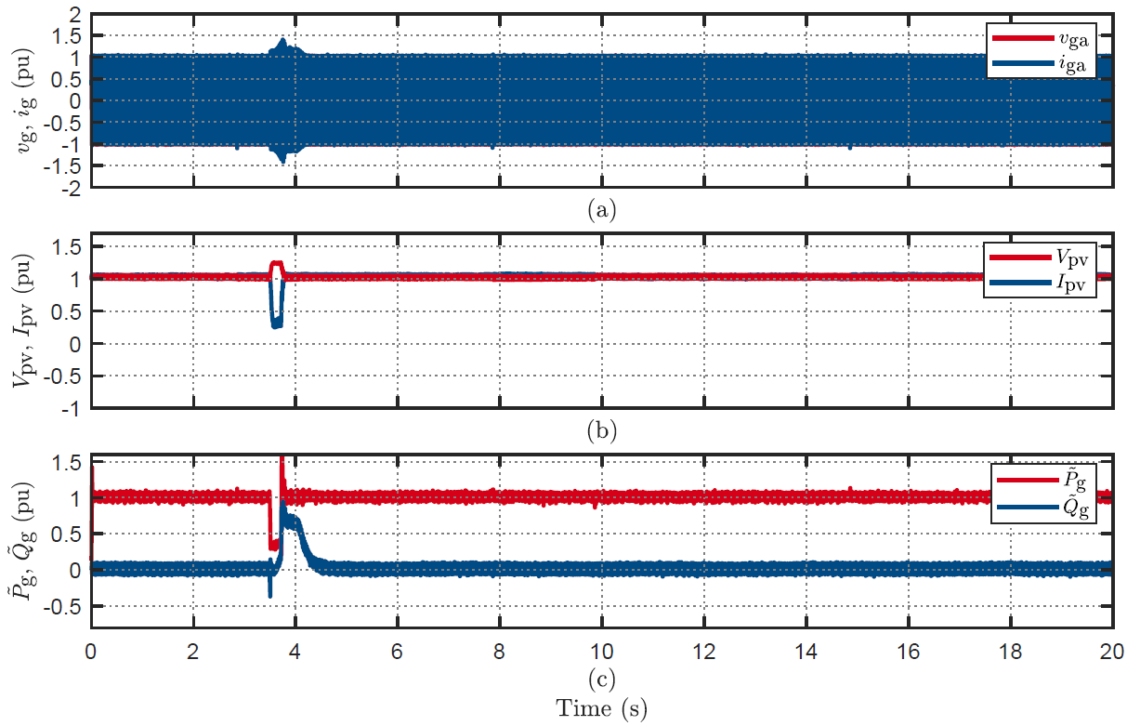
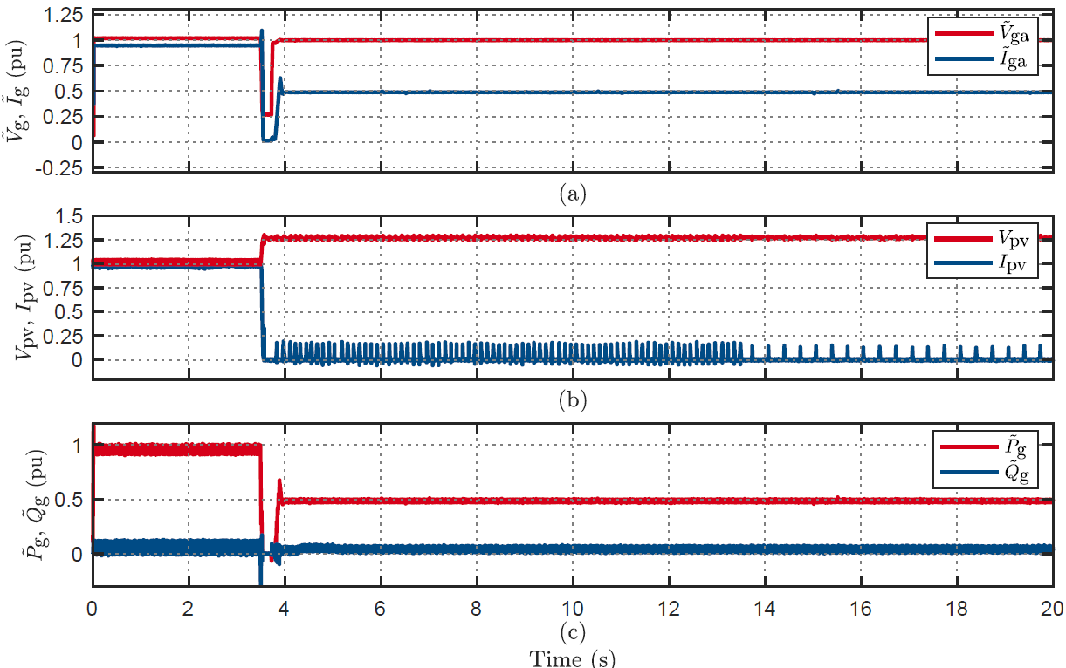
Key Findings on Parallel inverter Testing
PV Inverters: Nine out of 12 inverters presented varied behaviour to VPAJ disturbance when connected in parallel with another inverter.
PV Inverters: Six out of 12 inverters presented varied behaviour to voltage sag disturbance when connected in parallel with another inverter
PV inverters: Three out of 12 inverters presented varied behaviour to voltage swell disturbance when connected in parallel with another inverter
Ride-Through
Ride-Through
Ride-Through
Disconnected

Slide 12
Insights into Load Responses
Load responses to grid disturbances have identified areas not accounted for in the current rms composite load model, such as capacitor current overshoots and motor inrush currents.
Most appliances showed a temporary power cessation during disturbances before returning to normal operation. However, inverter-based air conditioners disconnected after voltage sag events.
Static loads behaved as expected, acting as constant load, power, or impedance loads.
Testing multiple devices of the same type always yields additional insights into their operation and modeling requirements.
Notes:
The other part of the project is the load testing and UOW does this.

Slide 13
Insights into EV Responses
The current complex load model lacks a component representing EVs or EV chargers – probably for good reason now but what about the future?
The response of EV chargers to a grid disturbance depends on the EV's onboard power electronics and any additional behavior from the EV charger itself.
Given the varying responses based on the EV fleet, could a stochastic model for the behavior of residential EV chargers may be more suitable?
Additional testing with various EVs is required, particularly considering the testing on fast chargers.
Notes:
Another part of the project is to test the EV as there are more and more Evs adding to our system it is important to understand the behaviour of Evs and how to represent it in

Slide 14
Engagement with Stakeholders and OEMs
BESS and HESS testing results were shared with stakeholders and OEMs to gather feedback on the methods and help us understand the captured behaviors.
OEMs were given detailed results on unexplained or unexpected behaviors, identifying recommended or necessary firmware updates.
All tested systems were connected to OEM cloud services, allowing for data examination during faults from both locally and remotely captured data.

Slide 15
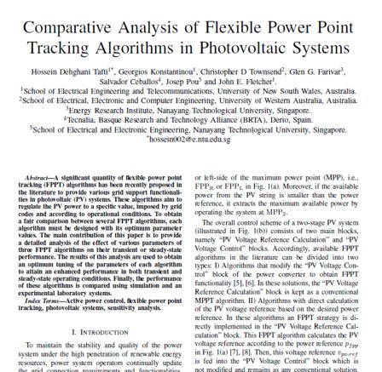
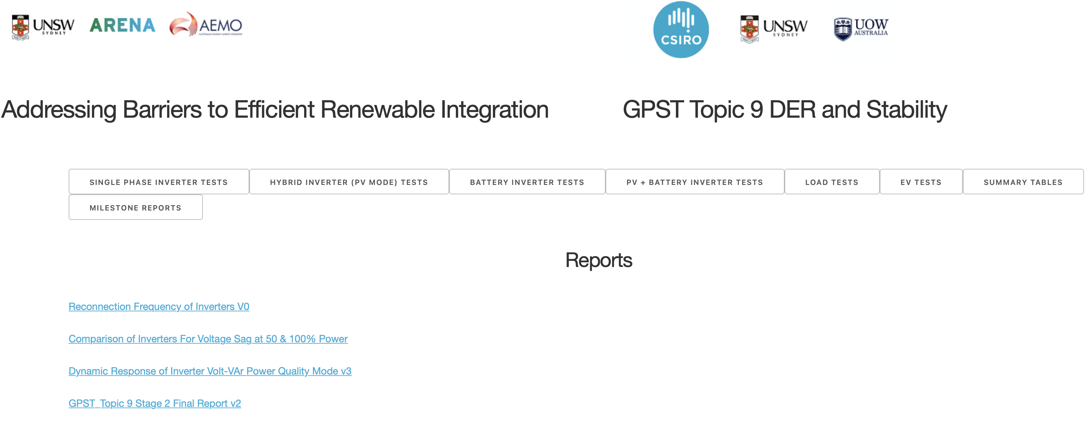
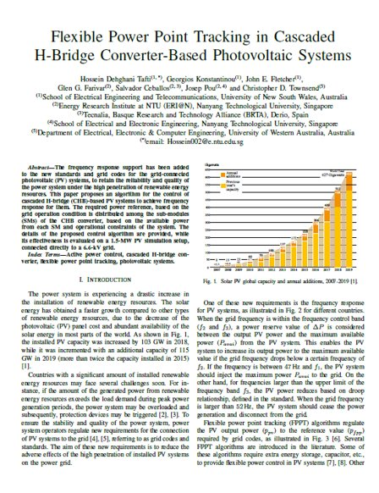
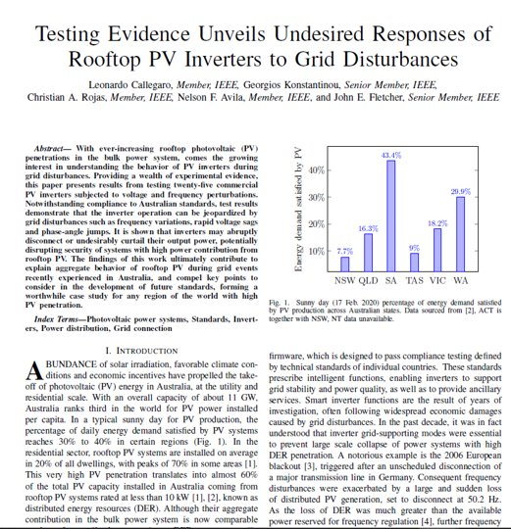
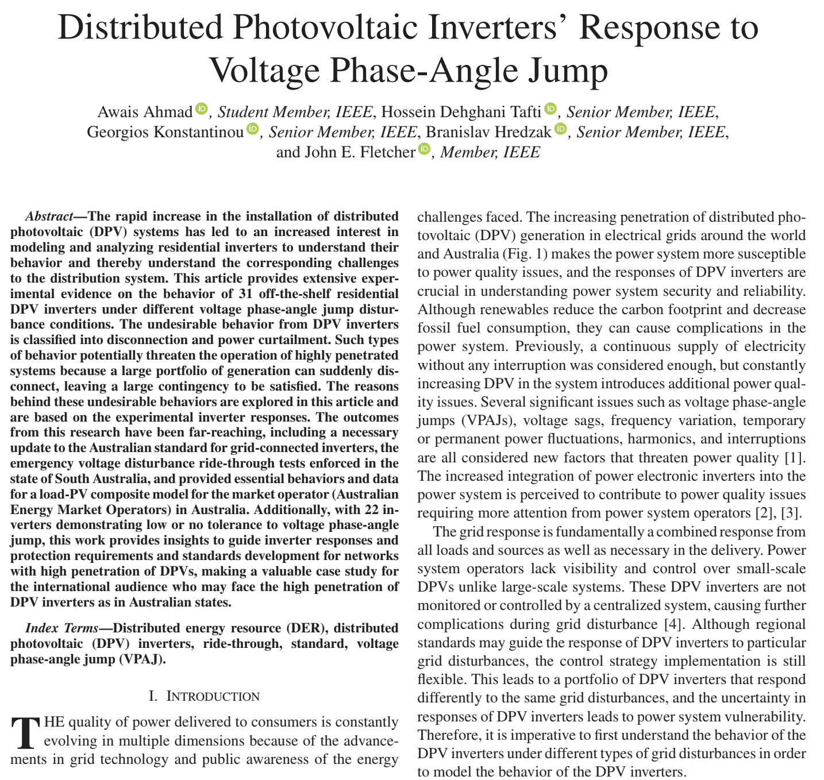

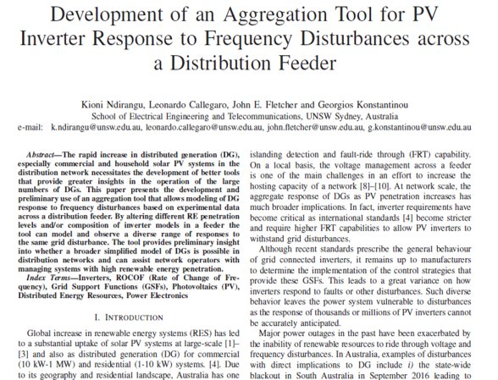
Project Website: https://pvinverters.ee.unsw.edu.au

Slide 16


Topic 9 – DER and Stability
Thank you
Questions

Slide 17
Testing
PV, BESS and HESS

Slide 18
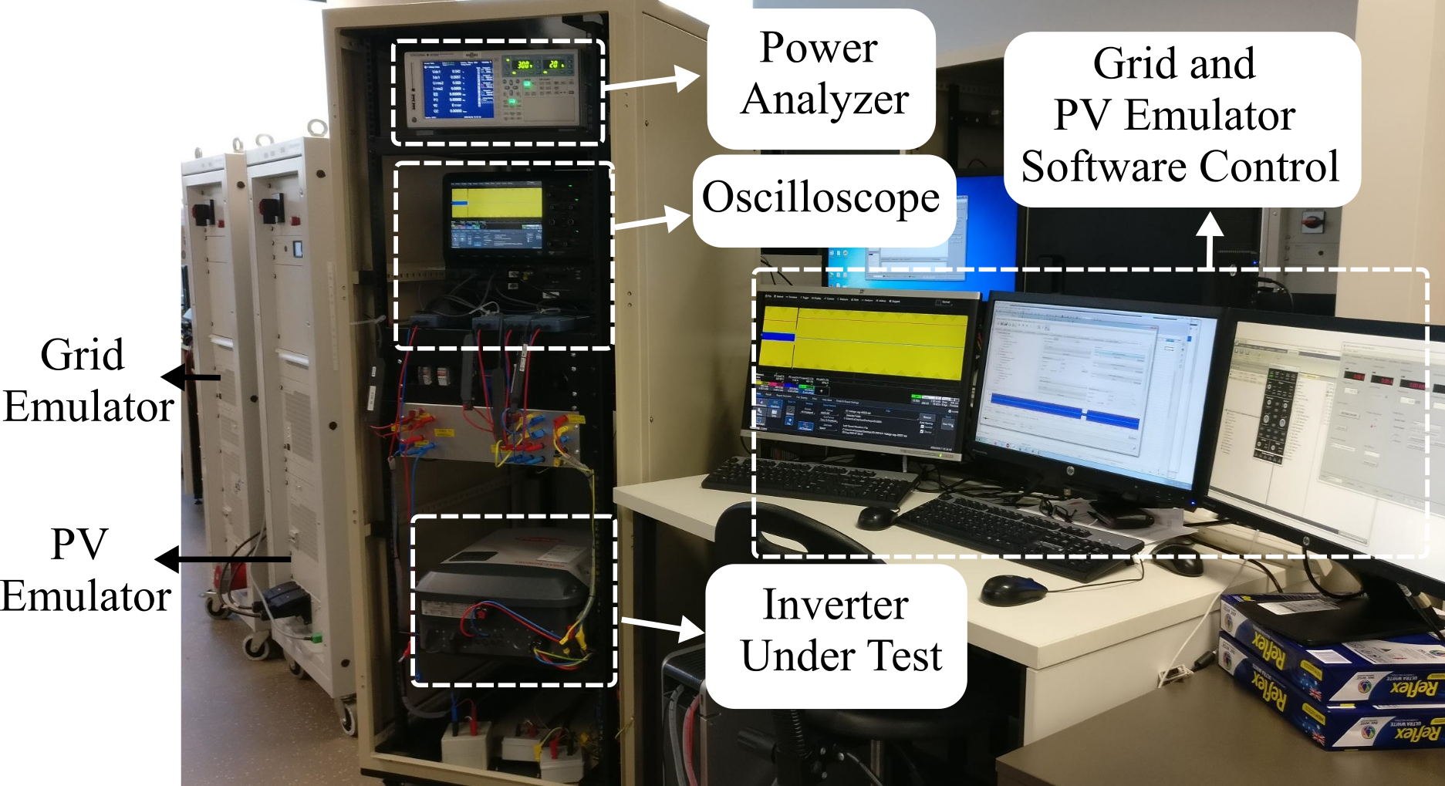
Inverters Testing
Bench Testing Setup
Sr. | Hybrid Inverters | PV Inverters | Battery Inverters
1 | PV + Battery | PV | Battery
2 | PV
3 | Battery
Inverters Bench Testing Modes

Slide 19
Bench Testing
ii. Frequency Response
i. Steady State performance
Sr. | Step Change
1. | +1.95 Hz
2. | -2.95 Hz
3. | ±5 Hz
4. | +2 Hz
5. | -3 Hz
 | Ramp Change
6. | ±1 Hz
7. | ±4 Hz
8. | ±0.4 Hz
Sr. | Test
1. | Steady State performance of inverter at Min%
2. | Steady State performance of inverter at 100%

Slide 20
Bench Testing
iii. Voltage Response
Sr. | Step Voltage Change
1. | 230 to 260V
2. | 230 to 50V sag for 0.9s
3. | 230 to 160V sag for 9s
4. | 230 to 270V swell for 0.9s
 | Ramp Voltage Change
5. | 230 to 185V for 15s
6. | 230 to 265V for 15s

Slide 21
Bench Testing
iii. Voltage Response (Fast Voltage Sag)
Sr. | Sag Magnitude (pu) | Duration (ms)
1. | 0.8 | 80 | 120 | 220
2. | 0.7 | 80 | 120 | 220
3. | 0.6 | 80 | 120 | 220
4. | 0.5 | 80 | 120 | 220
5. | 0.4 | 80 | 120 | 220
6. | 0.3 | 80 | 120 | 220
7. | 0.2 | 80 | 120 | 220

Slide 22
Bench Testing
iii. Voltage Response (Fast Voltage Swell)
iv. Voltage Phase-Angle Jump
Sr. | Swell Magnitude (pu) | Duration (ms)
1 | 1.05 | 80 | 120 | 220
2 | 1.1 | 80 | 120 | 220
3 | 1.125 | 80 | 120 | 220
4 | 1.15 | 80 | 120 | 220
5 | 1.175 | 80 | 120 | 220
6 | 1.2 | 80 | 120 | 220
Sr. | Phase Shift (Δθ)
1. | ±15°
2. | ±30°
3. | ±45°
4. | ±60°
5. | ±90°

Slide 23
Voltage Sag Tests: typical behaviours
Momentary cessation (highly desired): inverter stops power injection for the duration of the fault, and resumes power injection at the pre-disturbance level immediately after the fault is cleared
Ride-through (desired): inverter does not necessarily stop power injection during undervoltage event. However, post-fault power immediately equals pre-fault power
Power curtailment (undesired): post-fault power injected by the inverter is reduced and recovers to pre-disturbance value within a few seconds or a few minutes
Disconnection (undesired): inverter disconnects, raising an alarm. It turns back on according to its start-up procedure and ramp rate (2005 inverters <2 min, 2015 inverters ~7 min)
Notes:
-Momentary cessation: Few inverters from one manufacturer display this behavior
-Power curtailment: 1) Observed in some 2015 inverters 2) In some inverters power recovers within a few seconds, in others it takes minutes

Slide 24
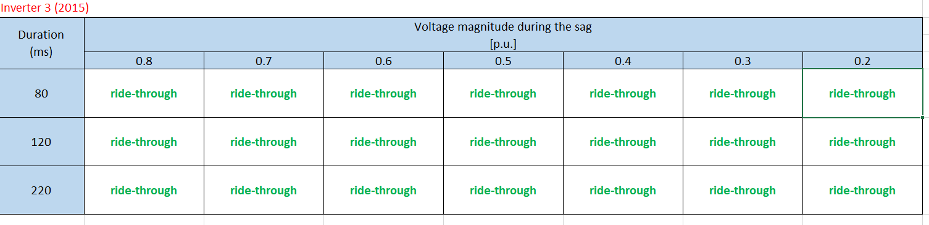
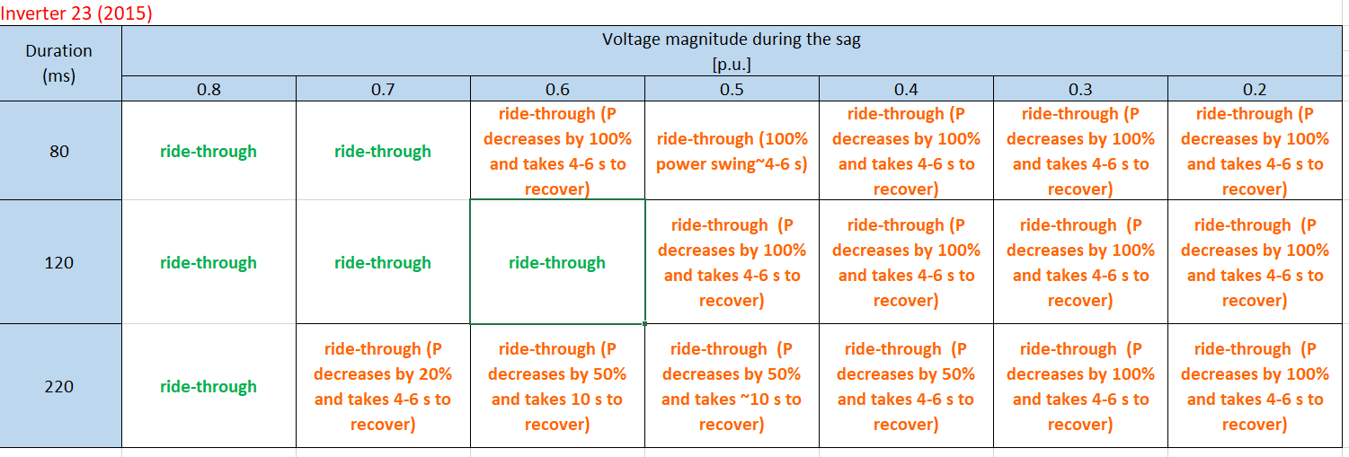
Voltage Sag Tests

Slide 25
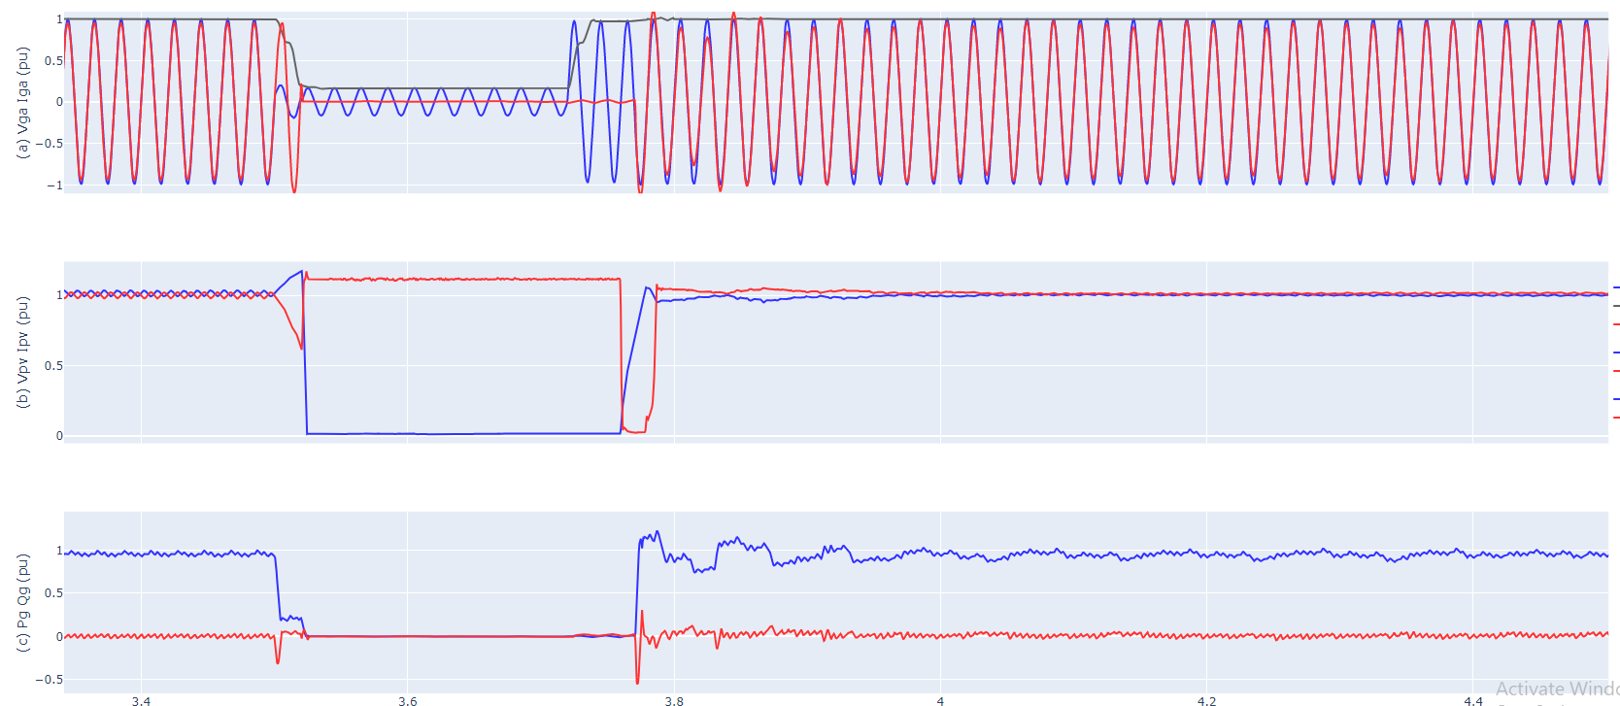
Voltage Sag Response:
Inverter 1, Ride-through with momentary cessation behaviour, sag with voltage of 0.2 p.u. for 220ms
ig
vg
Ipv
Vpv
Pg
Qg
Source: http://pvinverters.ee.unsw.edu.au/Sags (Inverter 1 AS 4777.2: 2015, test 23: 80% sag 220 ms)

Slide 26
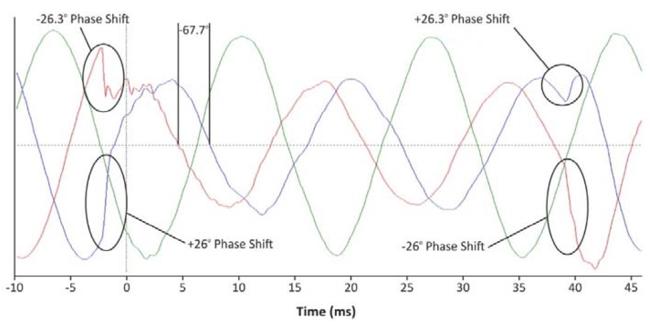
Grid voltage phase angle jump
Example of phase angle jump on a 500 kV transmission line, due to a fault in Southern California (Blue Cut Fire event 2016) [1]
[1] IEEE PES, "Impact of IEEE 1547 Standard on Smart Inverters," Technical Report PES -R67, May 2018

Slide 27
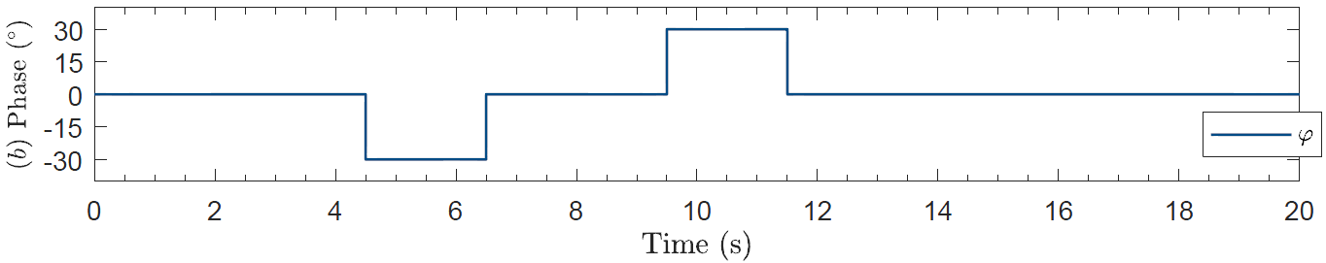
Grid voltage phase angle jump test
Test profile:

Slide 28
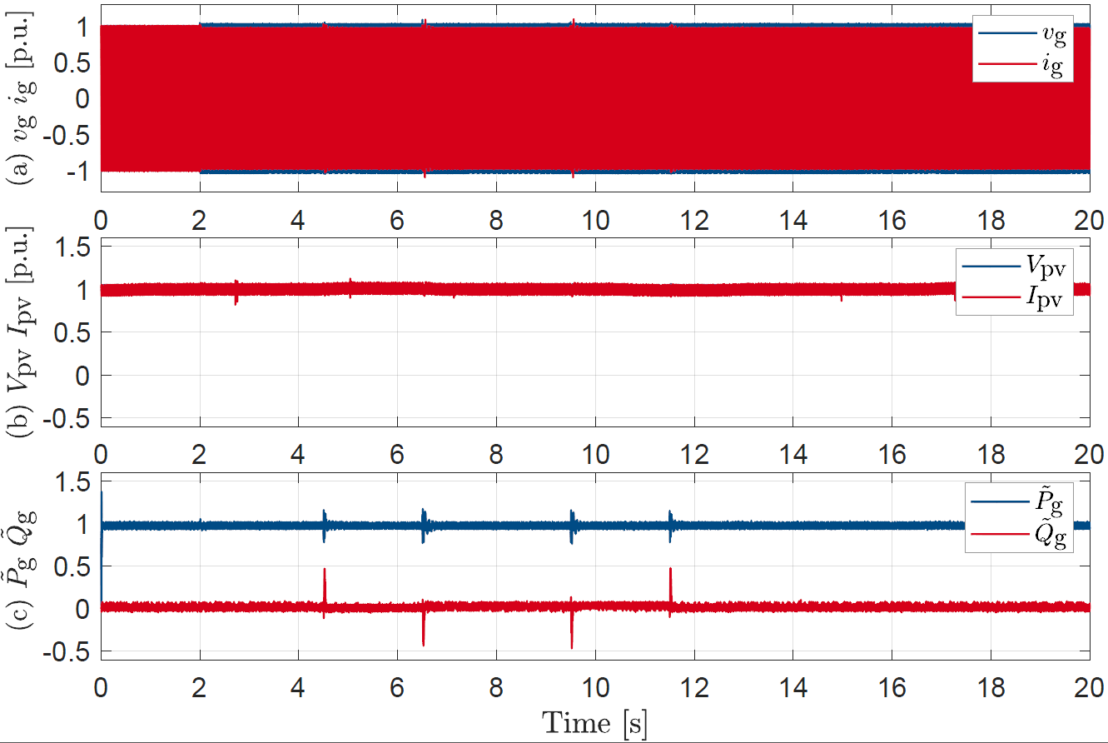
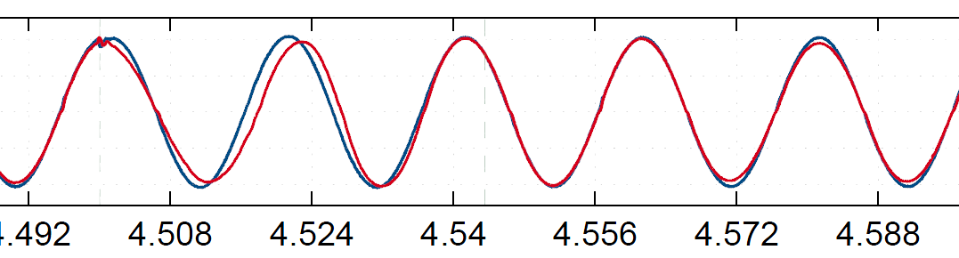
15° grid voltage phase angle jump : Ride-through
100 ms sag

Slide 29
30° grid voltage phase angle jump : Disconnect
Voltage phase angle jump
Disconnection and ~6min to full power

Slide 30
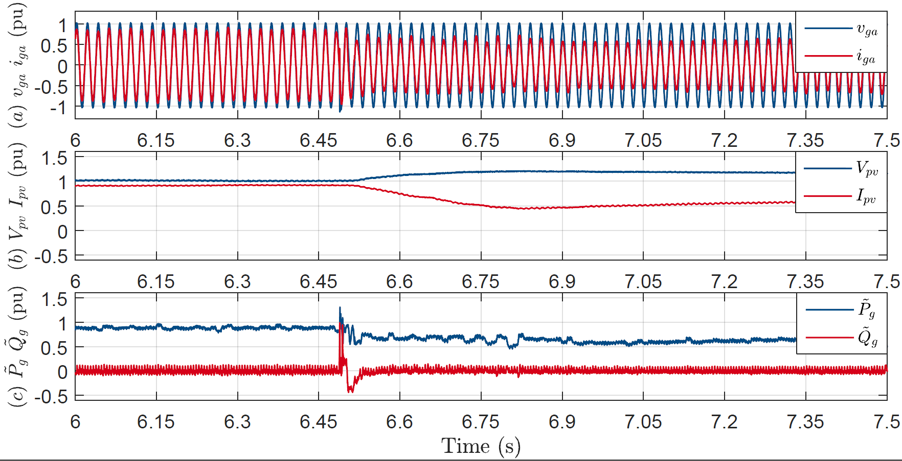
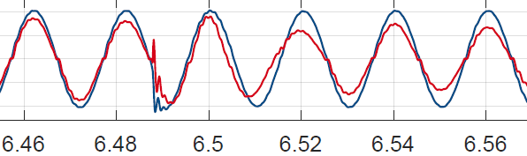
30° grid voltage phase angle jump : Power curtail
Power decreases and ramps up 16%/min

Slide 31
Grid Voltage Phase Angle Jump Summary
2015 inverters
2005 inverters
 | Brand | 15° | 30° | 45° | 90°
Inv. 1 | A |  | disc. | - | -
Inv. 2 | B | disc. | curtail | disc. | disc.
Inv. 3 | C |  |  |  | 
Inv. 4 | D | P=0 (?) | curtail | P=0 | P=0
Inv. 5 | E |  |  |  | 
Inv. 6 | A |  | disc. | disc. | disc.
Inv. 7 | A |  | curtail | P=0 | P=0
Inv. 10 | D | P=0 | P=0 | P=0 | P=0
Inv. 11 | F | disc. | disc. | - | -
Inv. 12 | D | P=0 | P=0 | P=0 | P=0
Inv. 13 | C |  |  |  | 
Inv. 16 | D |  |  |  | curtail
Inv. 17 | G |  |  |  | 
 | Brand | 15° | 30° | 45° | 90°
Inv. 6 | A |  |  |  | 
Inv. 8 | A |  |  |  | disc.
Inv. 9 | B |  |  | disc. | disc.
Inv. 14 | E |  |  |  | disc.
Inv. 15 | G |  | disc. | disc. | disc.
disc.: disconnection
curtail: P curtailment
P = 0: P curtailment 0 W, but remains connected
: no change in operation
Notes:
Inverters are undesirably disconnected or curtail their power under voltage phase jumps.
The phase jump angle and the point on wave affect the behaviour of the inverter.
Since the implemented controllers in inverters are not known, more advanced analysis on various possible control algorithms is still required as a future direction of the project.
These outcomes are reflected in the revision of the new standard and accordingly new test requirements are included in the revised AS 4777.2 standard

Slide 32
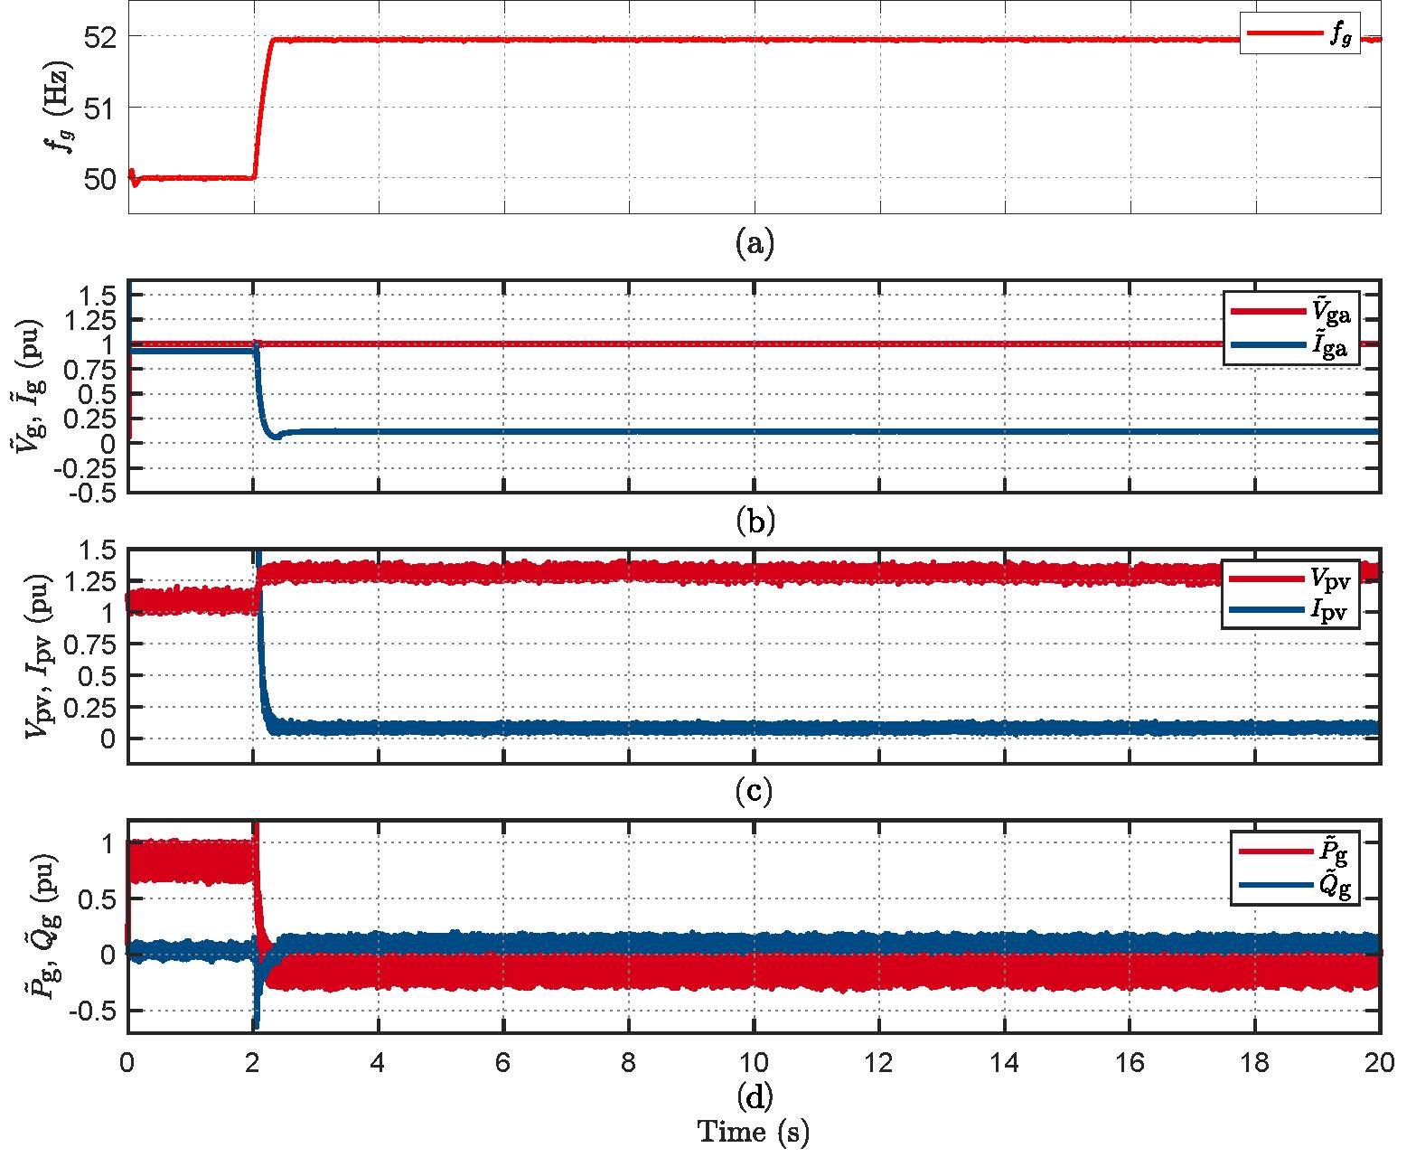
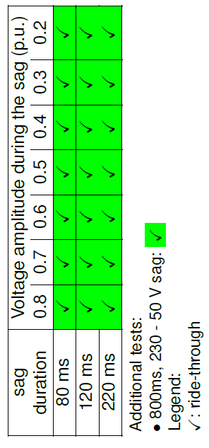
PV Inverter Bench Testing
  Power curtailment behavior to frequency step (1.95Hz to 51.95 Hz).
  Inverter ride-through all the comprehensive voltage sags (50% power).
  See more:
  https://pvinverters.ee.unsw.edu.au
Notes:
Left is frequency ramp
Right is voltage sags all tests

Slide 33
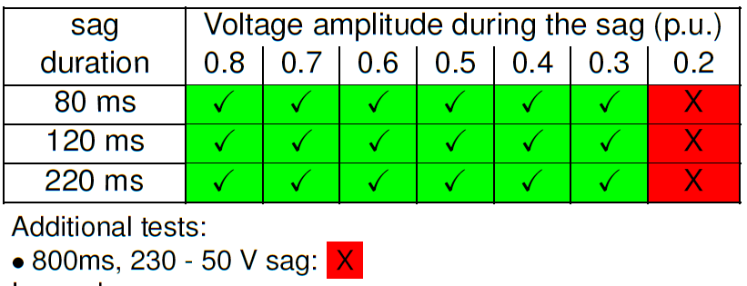
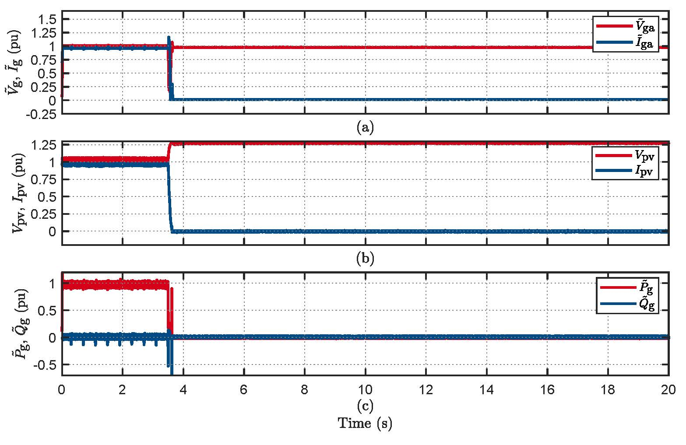
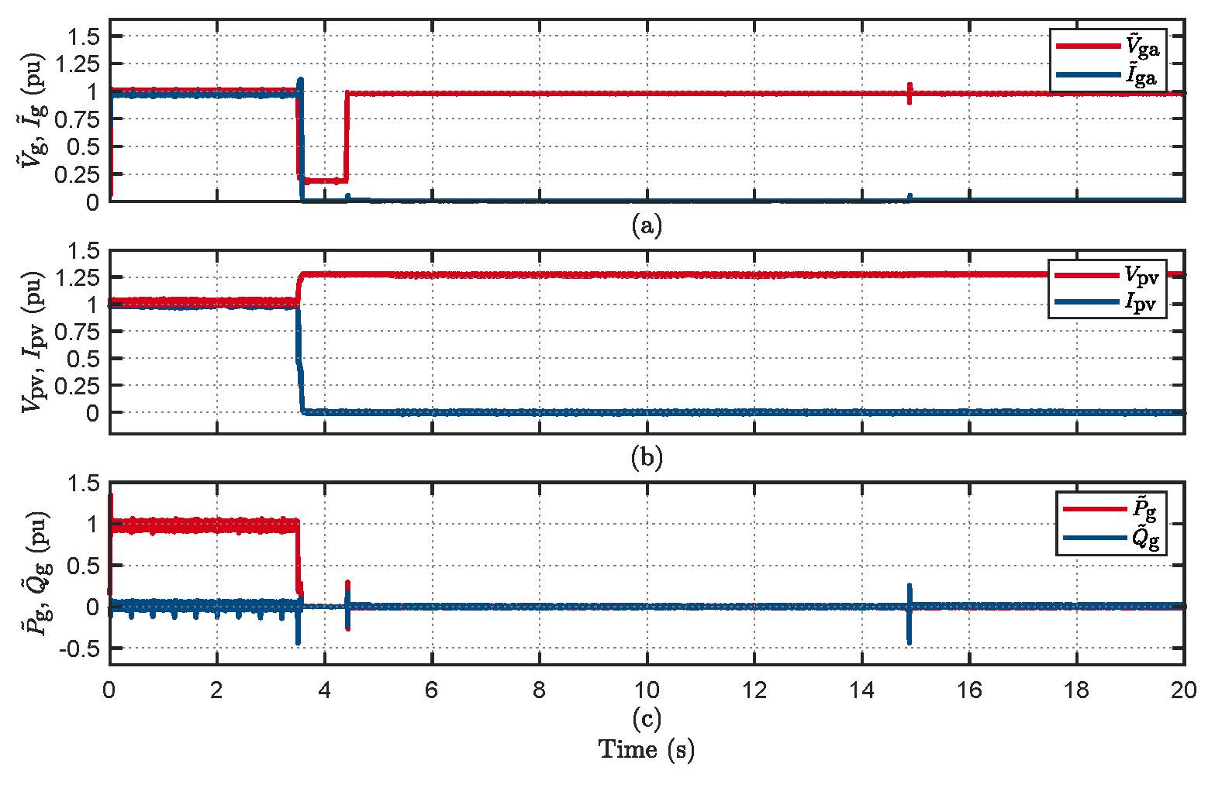
Hybrid ESS 1 Bench Testing (Mode 1)
  Inverter disconnection to voltage sag for time duration less than trip delay time
  Inverter disconnection to comprehensive voltage sag tests (50% power)

Slide 34
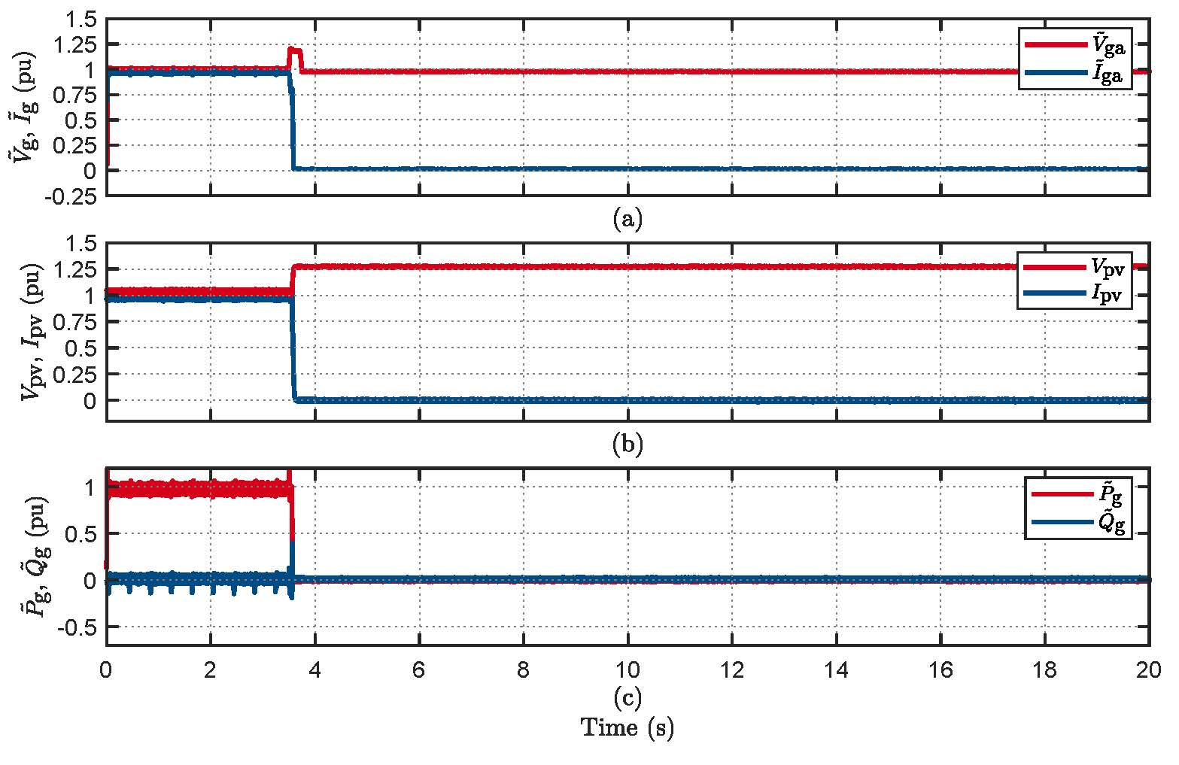
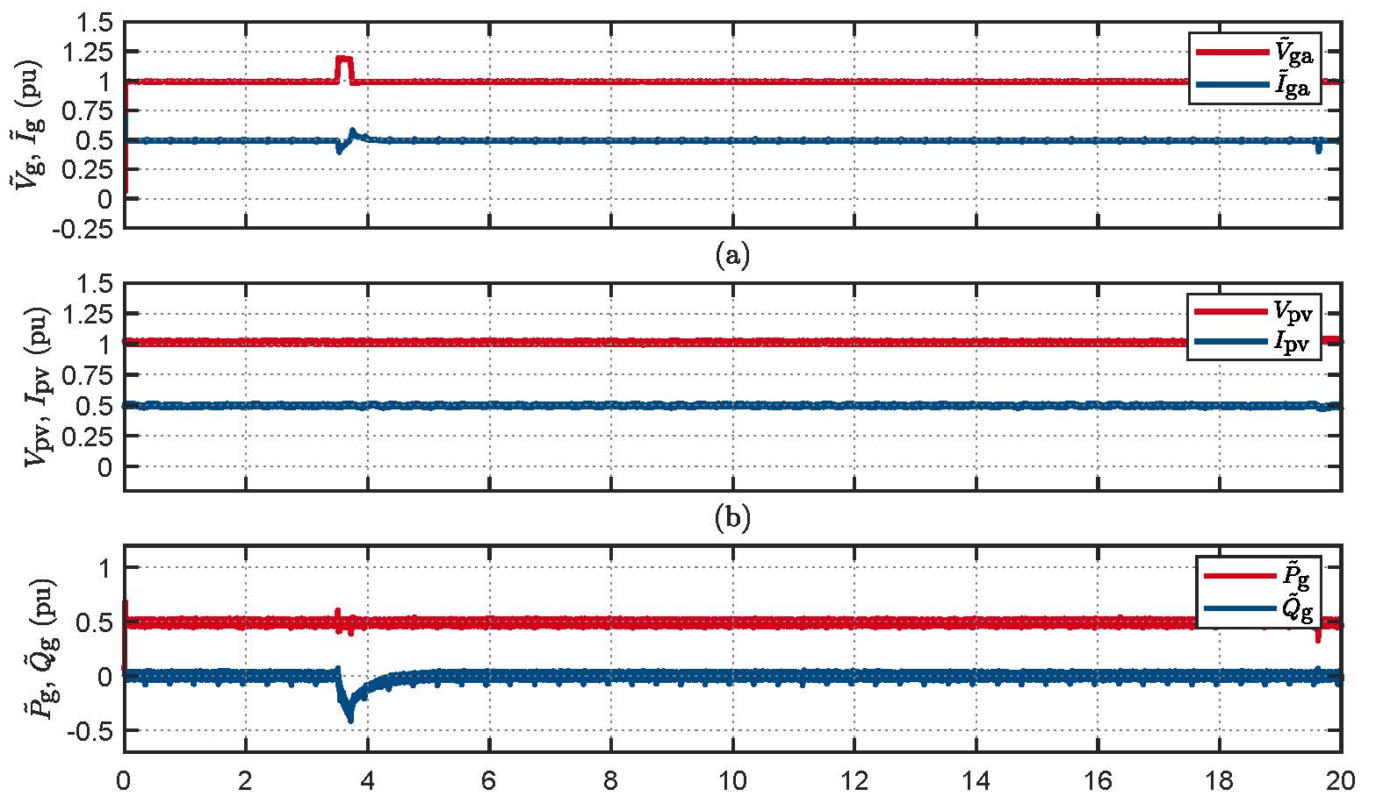
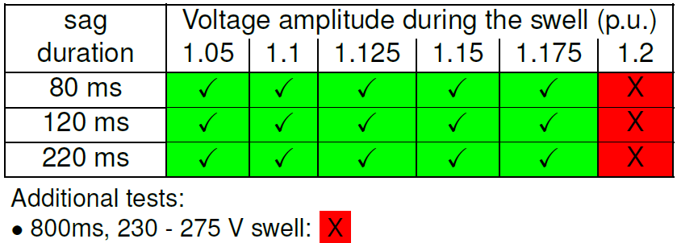
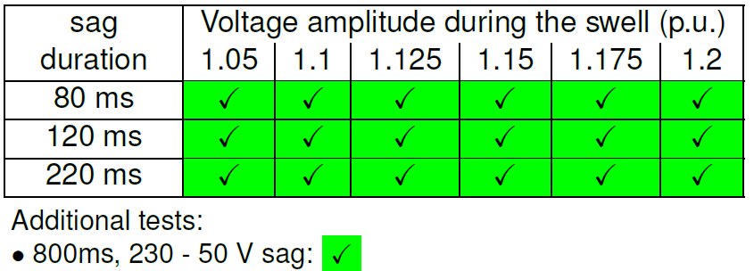
Hybrid ESS 1 Voltage Swell Tests (Mode 1)
Inverter disconnection at 100% power to voltage swell of 1.2 p.u for 220 ms
Inverter ride-through at 50% power to voltage swell of 1.2 p.u for 220 ms
Summary of voltage swell test results at 100% Power
Summary of voltage swell test results at 50% Power

Slide 35
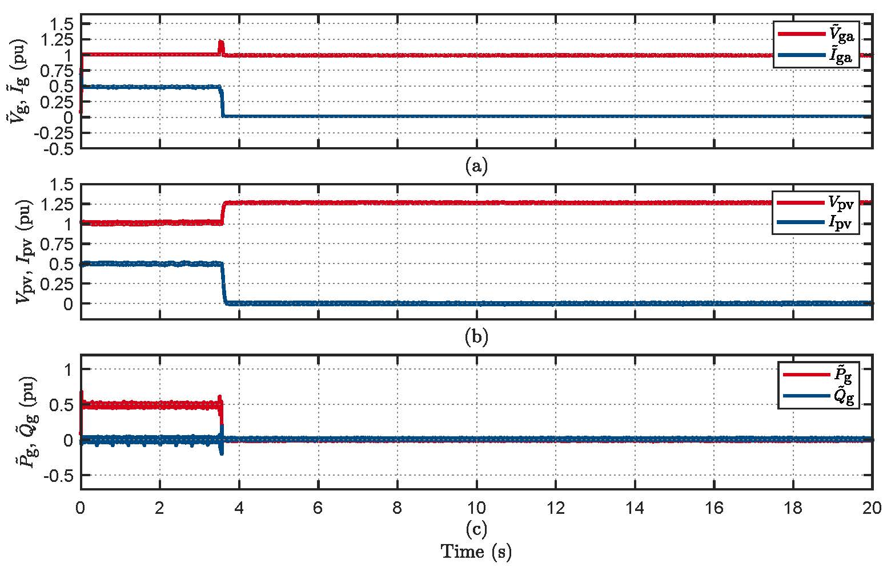
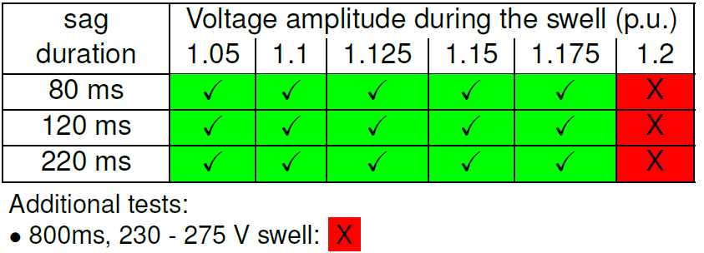
Hybrid ESS 1 Inverter Tests (Mode 2)
  Similar* behavior to bench tests as in Mode 1.
  The behavior to the comprehensive voltage sag tests is similar to Mode 1.
  Disconnection at 50% power for voltage swell of 1.2 p.u for 80 ms, 120 ms, and 220 ms.
    Inverter remained connected in Mode 1
Inverter disconnection at 50% power to voltage swell of 1.2 p.u for 80 ms
Summary of voltage swell test results at 50% Power

Slide 36
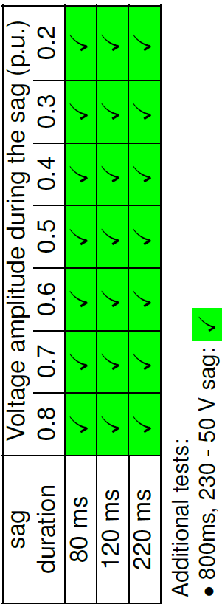
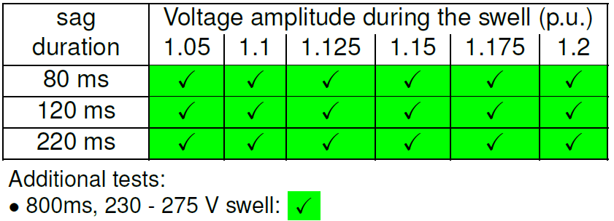
Hybrid ESS 1 Tests (Mode 3)
Summary of voltage sag test results at 50% Power
  Similar* behavior to bench tests as in Mode 1.
  Inverter rides through all voltage sag tests at 50% and 100% power
    Disconnection for voltage sag to 0.2 p.u in modes 1 and 2.
  Inverter rides through all voltage swell tests at 50% and 100% power
    Disconnection at 100% power for a voltage swell of 1.2 p.u in Mode 1
    Disconnection at 50% power for a voltage swell of 1.2 p.u. in Mode 2.
Summary of voltage swell test results at 50% Power

Slide 37
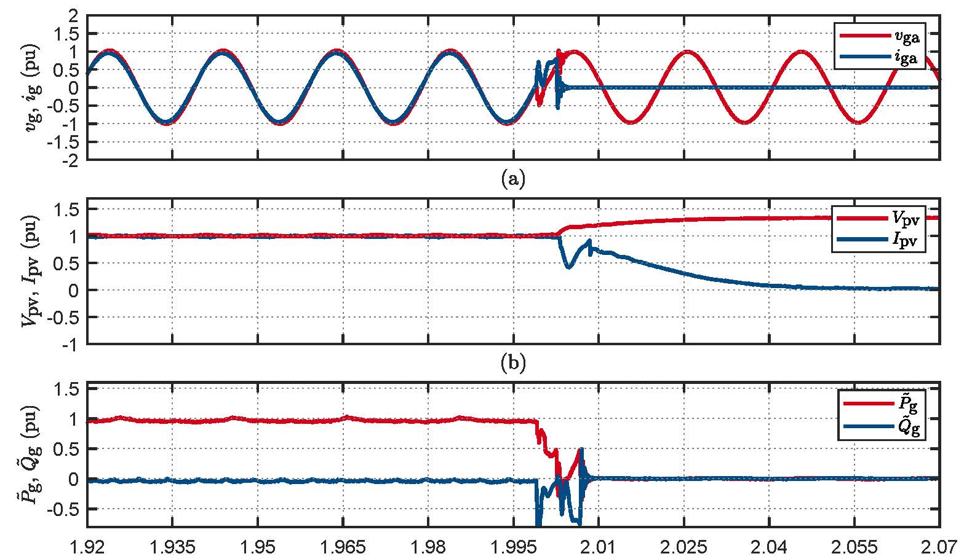
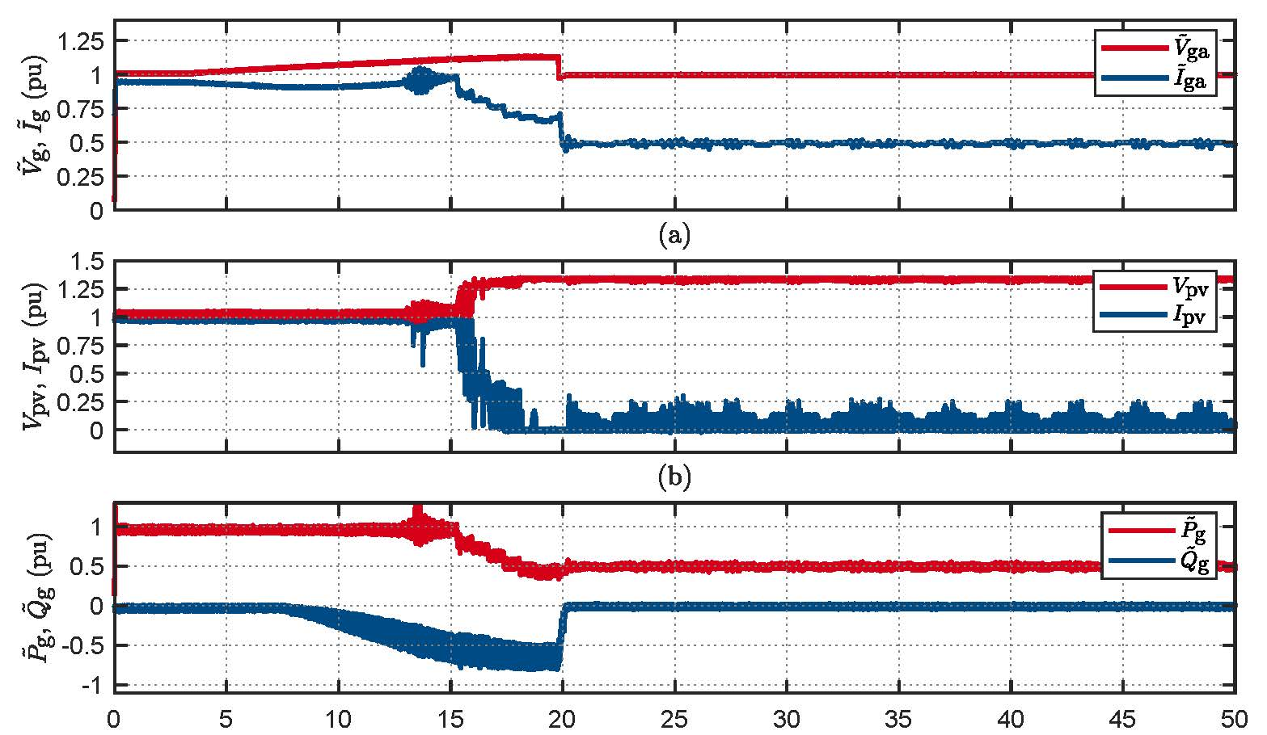
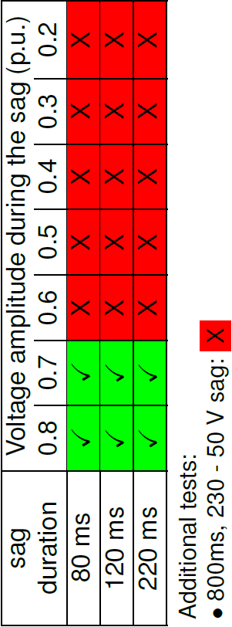
Hybrid ESS 2 Tests (Mode 2)
Inverter disconnection to ±30°phase jump
  Power curtailment (50%) after voltage ramp (Volt-Watt response).
  Inverter disconnected for ±30°and above voltage phase-angle phase jumps (see fig 10)
  Inverter started disconnection to the voltage sag of 0.4 p.u and above (Tab 8).
Inverter power curtailment to ramp voltage change
Summary of voltage sag test results at 50% Power

Slide 38
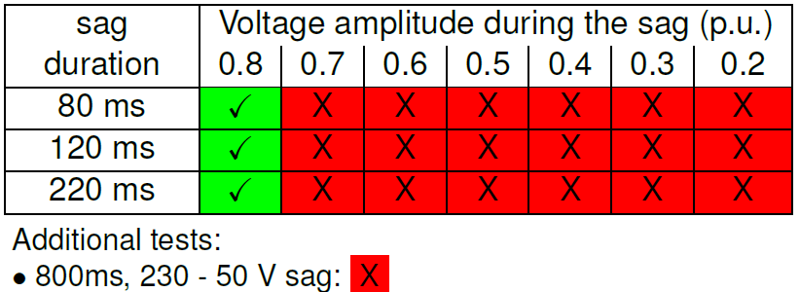
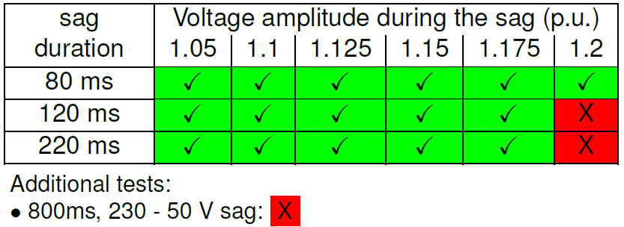
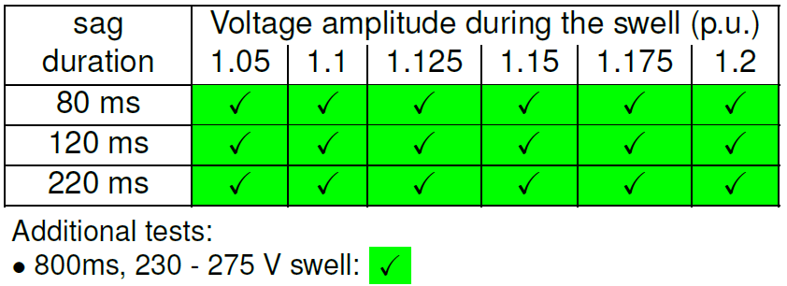
Hybrid ESS 2 Tests (Mode 1)
Summary of voltage sag test results at 50% Power
  Inverter disconnection for voltage sag of 0.3 p.u and above at 50% power
  Inverter disconnection for voltage swell of 1.2 p.u for 120 and 220 ms at 100% power
  Inverter remains connected for all voltage swells at 50% power.
Summary of voltage swell test results at 100% Power
Summary of voltage swell test results at 50% Power

Slide 39
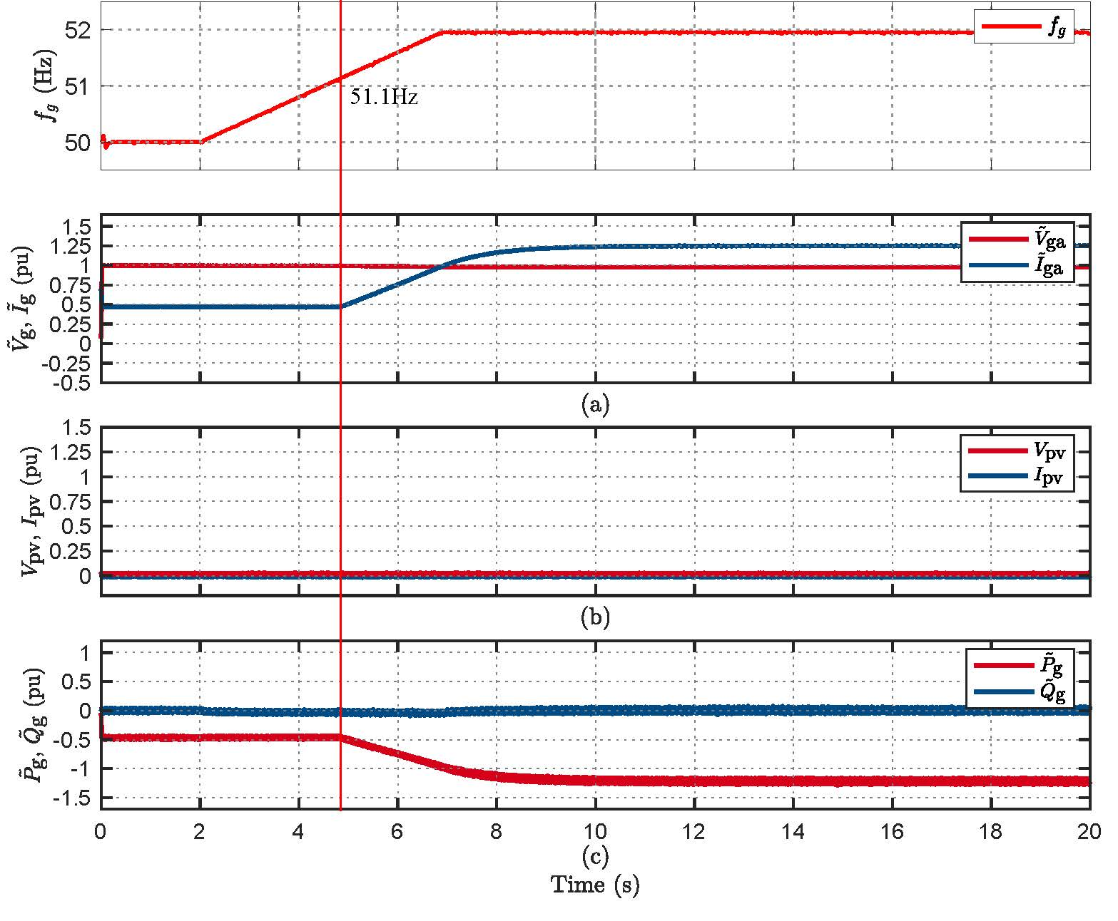
BESS 1 Testing
Inverter power curtailment to RoCoF of 0.4 Hz/s
  Inverter started drawing double power after a RoCoF event of 0.4 Hz/s to 51.95 Hz. – The point of power curtailment differs for different RoCoFs.
  Fig 12 presents the reconnection behavior of the inverter after a RoCoF of 0.1 Hz/s to 47.05 Hz. It seems the inverter reconnects at the same power level as before disconnection.
Inverter reconnection following disconnection at RoCoF of 0.1 Hz/s

Slide 40
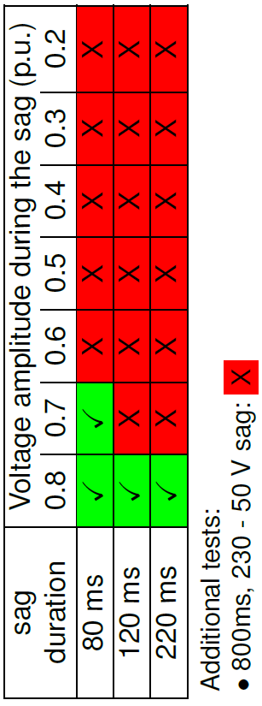
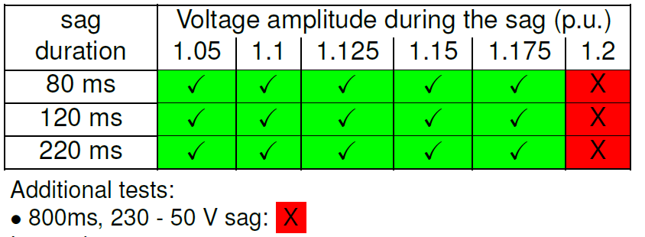
BESS 1 Testing
  Inverter disconnection for voltage sag of 0.3 p.u and above at 50% power
  Inverter started disconnection for voltage swell of 1.2 p.u for 80, 120 and 220 ms (see Tab 13).
Summary of voltage sag test results
Summary of voltage swell test results

Slide 41
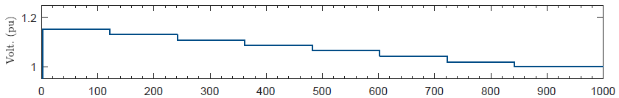
Reconnection Tests

Slide 42

Testing Procedure
The standard requires the following conditions to be maintained for the inverter to reconnect with the system after disconnection:
The system voltage should be kept within the utilization limits of AS 600038 for at least 60s.
The system frequency should be maintained within the range of 47.5 Hz to 50.15 Hz for at least 60s.
Black Start Test: To test the response of the inverter with nominal frequency and voltage after the system starts for the first time.
Enhanced Voltage Management: To test the response of the inverter after the system starts with elevated voltages.

Slide 43
Inverters Reconnection Tests
Example-Inverter 49:
  77s to reconnect to the grid
  17s to reach at maximum power.

Slide 44

Inverters Reconnection Tests
Example – Inverter 27:
  103.5s to reconnect to the grid
  418.6s to reach at maximum power
  (14.33% ramp rate)

Slide 45

Inverters Reconnection Tests
Example – Inverter 51:
  60s to reconnect to the grid
  430s to reach at maximum power
  (13.95% ramp rate)

Slide 46

Inverters Reconnection Tests
Example – Inverter 52:
  157s to reconnect to the grid
  352s to reach at maximum power
  (17% ramp rate)

Slide 47
Inverters Reconnection Tests
Example – Inverter 53:
  Reconnection to the grid at 265 V
  (outside the limits set in AS60038)

Slide 48
Summary of Results

Slide 49
Summary of Results

Slide 50
Point on Wave (PoW) Testing

Slide 51

Inverter 49
  Ride-through to voltage sag of 0.8 p.u at PoW
  Power curtailment to voltage sag of 0.8 p.u at PoW 90°

Slide 52
Inverter 49
  Disconnection to voltage sag of 0.8 p.u at PoW 120°

Slide 53
Summary of Results
Inv no | PoW Disturbance | Behaviour | -165° | -135° | -120° | -90° | -60° | -45° | -30° | -15° | 0° | 15° | 45° | 60° | 90° | 120° | 135° | 150° | -165°
46 | VPAJ |  | N/A | DC | N/A | DC | Disc | N/A | DC | PC | PC | PC | DC | DC | DC | DC | N/A | N/A | N/A
 | Volt Sag |  | N/A | N/A | N/A | N/A | N/A | N/A | DC | N/A | DC | N/A | DC | DC | RT | RT | DC | N/A | DC
49 | Volt Sag |  | PC | PC | RT | RT | PC | RT | RT | PC | RT | N/A | RT | N/A | PC | DC | DC | DC | RT
RT: Ride-through,
PC: Power Curtailment,
DC: Disconnection

Slide 54
Parallel Inverter Testing

Slide 55



Inverter 44 and 51 (VPAJ 60°)
Disconnected
Disconnected
Power Curtailed
Ride-Through

Slide 56



Inverter 44 and 47 (Voltage Swell of 1.15p.u for 120ms)
Ride-Through
Power Curtailed
Ride-Through
Ride-Through

Slide 57



Inverter 49 and 48 (VPAJ 30°)
Power Curtailed
Power Curtailed
Disconnected
Ride-Through

Slide 58
Inverter 51 and 48 (Voltage Sag of 0.07p.u for 220ms)
Ride-Through
Ride-Through
Disconnected
Ride-Through

Slide 59
Inverter 44 and 51 (VPAJ 60°)
Disconnected
Disconnected
Power Curtailed
Ride-Through

