Slide 1

Inverter modelling and testing for unbalanced electricity distribution system applications
A CSIRO collaboration project with Tapestry, X’s moonshot for the electric grid
Julio Braslavsky
Workshop on Managing system security and reliability with increased renewable generation
16-18 October 2024 | The Victoria Hotel | Melbourne, Australia
Notes:
X Development LLC, doing business as X, is an American semi-secret research and development facility and organization founded by Google in January 2010.
Ack Wurundjeri people traditional custodians of the land (Melbourne)

Slide 2
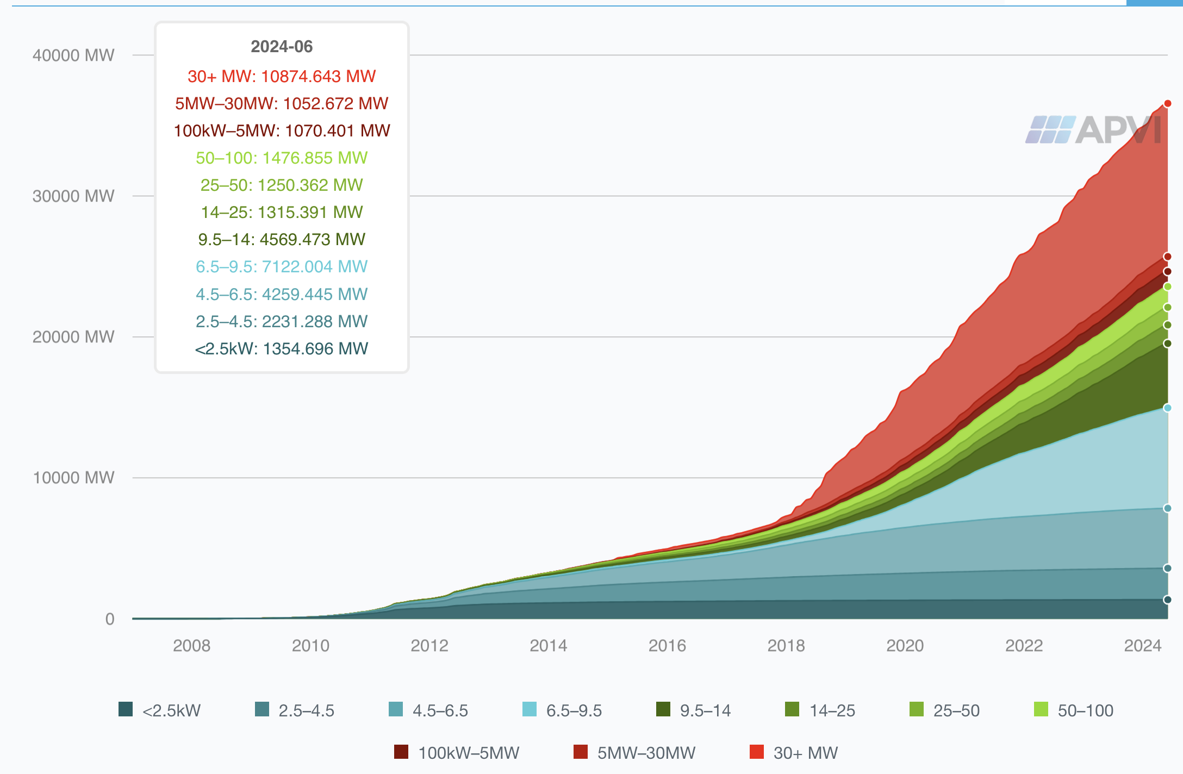
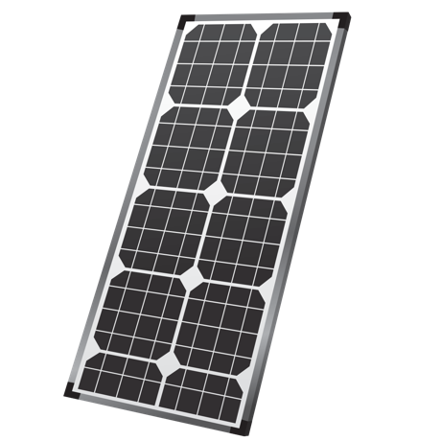
Solar photovoltaic generation growth in Australia
As of December 2023, over 3.84 million PV installations in Australia with a combined capacity over 36.6 gigawatts
Around 50% capacity from systems under 10 kW – rooftop solar PV connected to low-voltage electricity distribution networks
Australian PV Institute https://pv-map.apvi.org.au/
Notes:
Distributed energy resources in Australia, predominantly rooftop PV generation, have driven technological and operational changes in electricity systems.
The growth in new rooftop solar systems has averaged 12% year on year over the past five years, reaching 3.1 million systems in 2023.
Today, one-third of detached homes in the NEM have rooftop solar. By 2034 in the Step Change scenario, over half of the detached homes in the
NEM would do so, rising to 79% in 2050, driven by ever-falling costs. At that time, forecast total rooftop solar capacity is 72 GW.

Slide 3

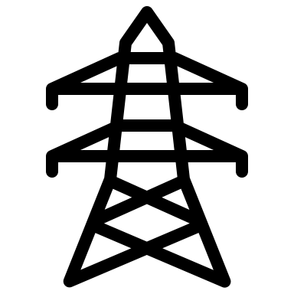


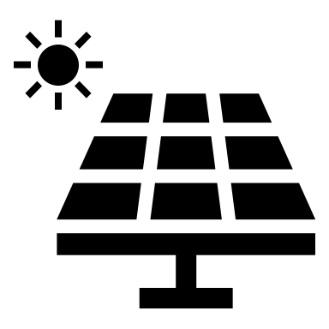




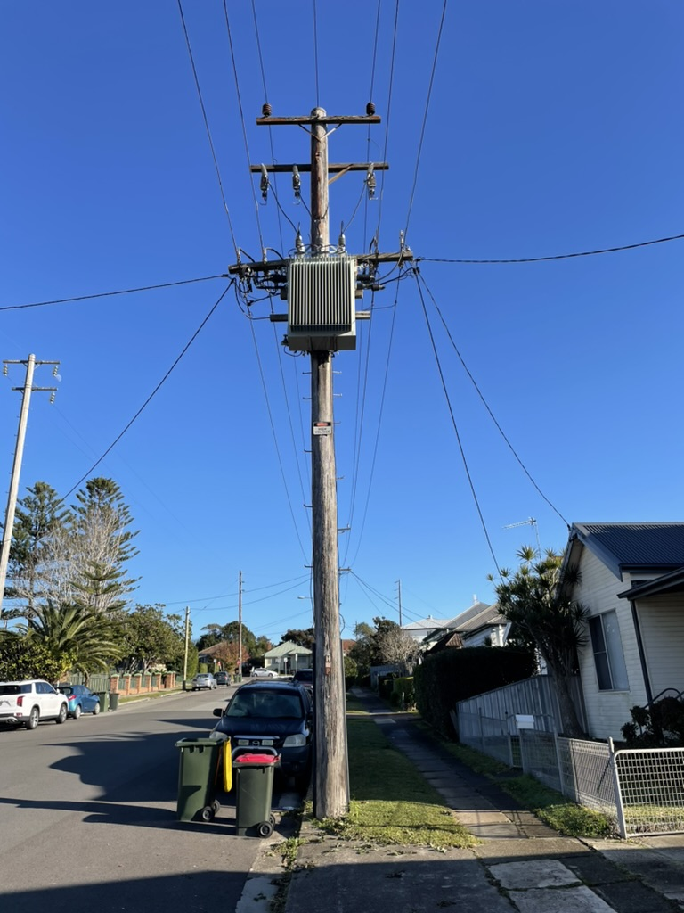
Low voltage distribution networks
a
b
c
n
High voltage transmission network
Low voltage distribution network
HV
MV
LV
Zone
substation
Distribution
transformer
CER
Transmission
Distribution
LV distribution network provides electricity directly to consumers
Radial and asymmetric structure
3 phase - 4 wires (phases a, b, c + neutral n)
230 V (line to neutral) – 400 V (line to line)
Consumer energy resources (CER): mainly single-phase connected
Significant phase unbalance – even in normal operation

Slide 4
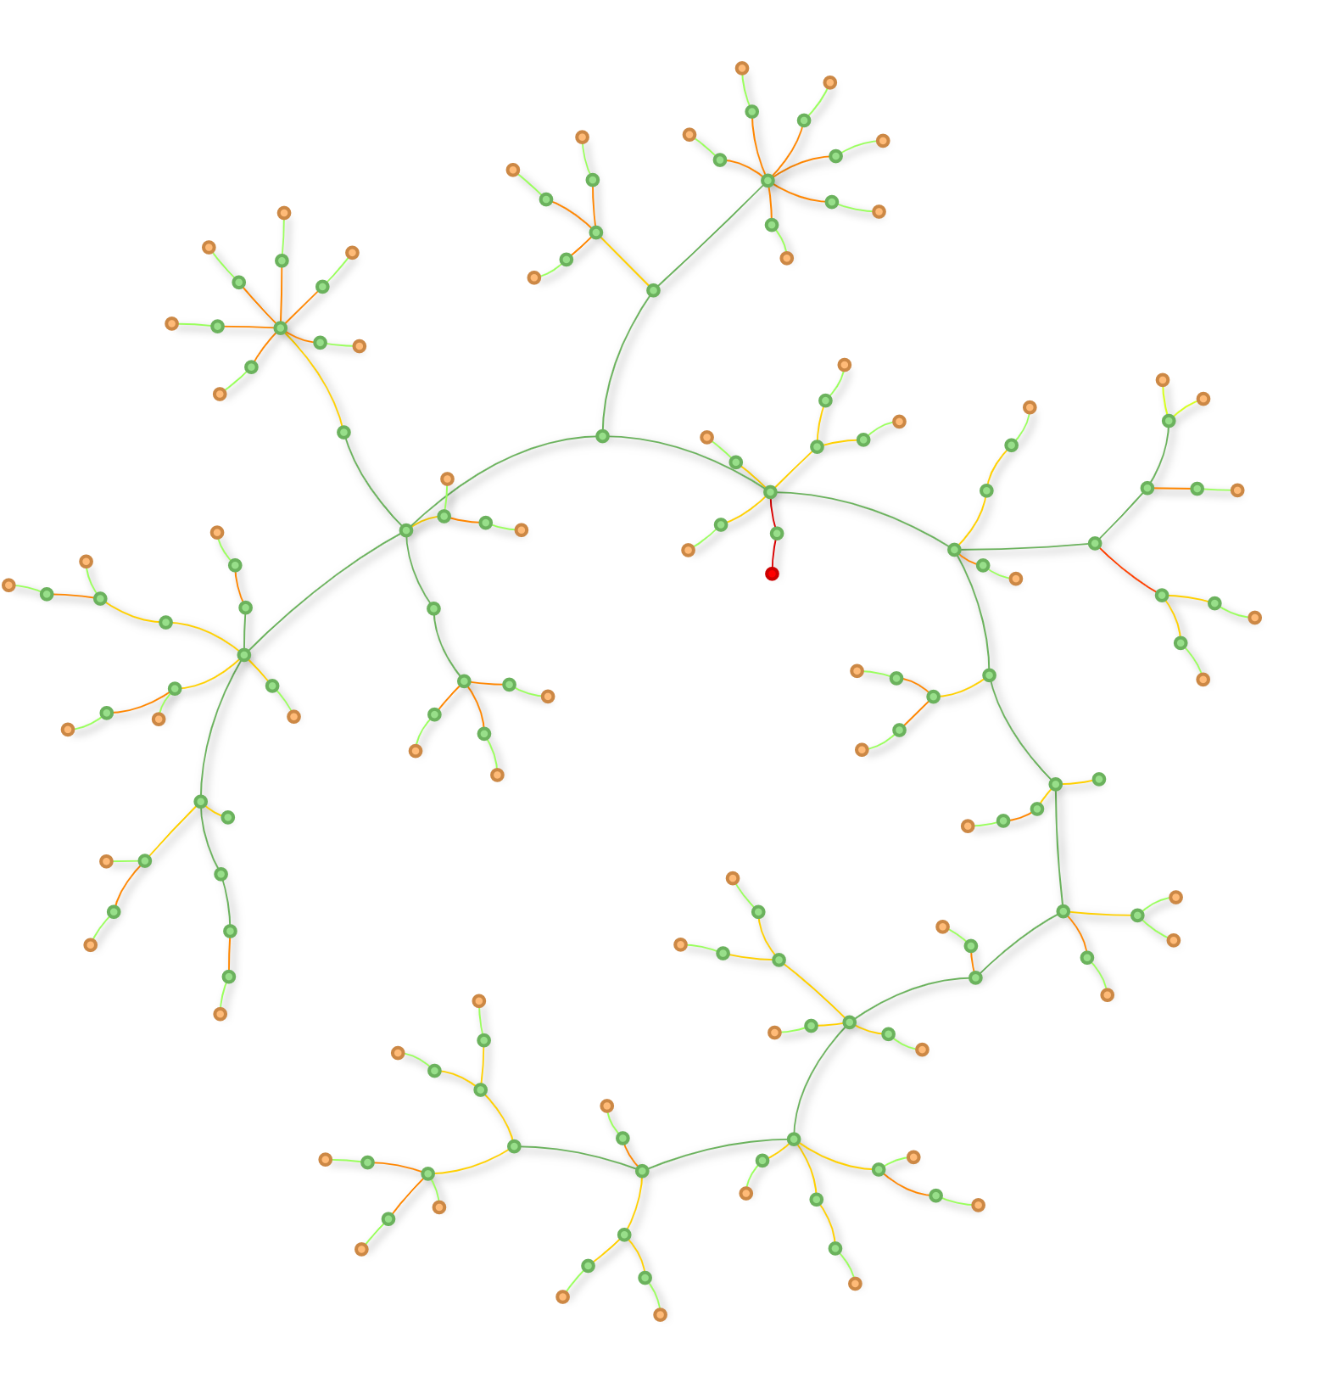

What is phase unbalance?
A distribution network with unbalanced loads
Low voltage feeder taxonomy
Network N
Houses are connected to different phase
Consumption is varied throughout the network
Unbalance prevents efficient utilization of network infrastructure
Phase a voltage violates the limits, while other phases stay within the limits

Slide 5
What is phase unbalance?
Balance
In a balanced 3-phase system currents have equal magnitude and are rotated 120 degrees
In an unbalanced system symmetry is broken: in angles and/or in magnitudes – unbalance residual currents circulate through the neutral
Partial reverse power flows
Unbalance
Partial reverse power flows can exacerbate unbalance

Slide 6
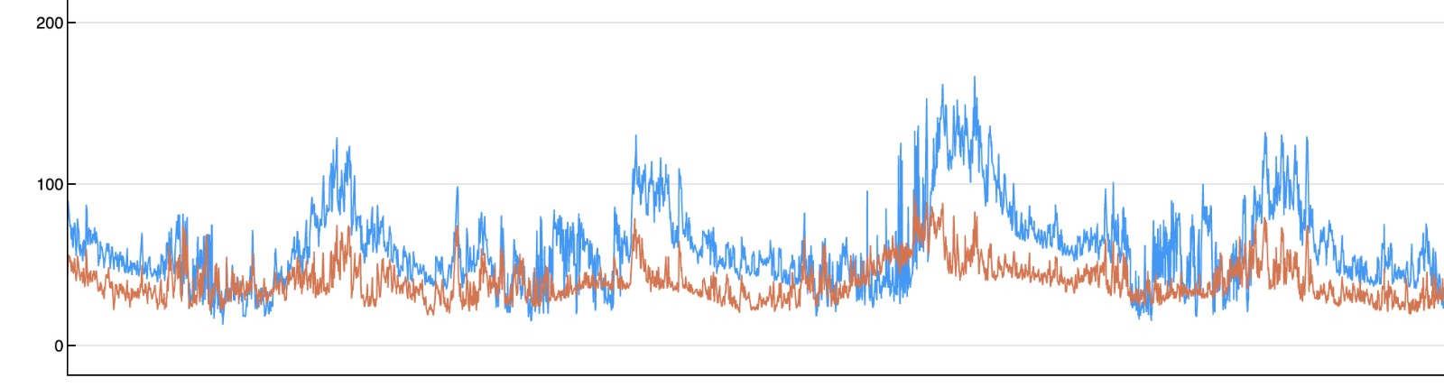
LV network unbalance and neutral currents
Field measurements of an Australian 3-phase 4-wire low-voltage network showing neutral RMS current versus the highest RMS current at any of the phases.
Neutral current
Highest phase current
RMS current (A)
Time
In some instances, the neutral current magnitude is higher than that in any of the phases – due to partial reverse power flows.

Slide 7
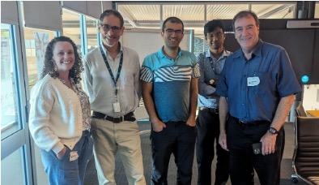
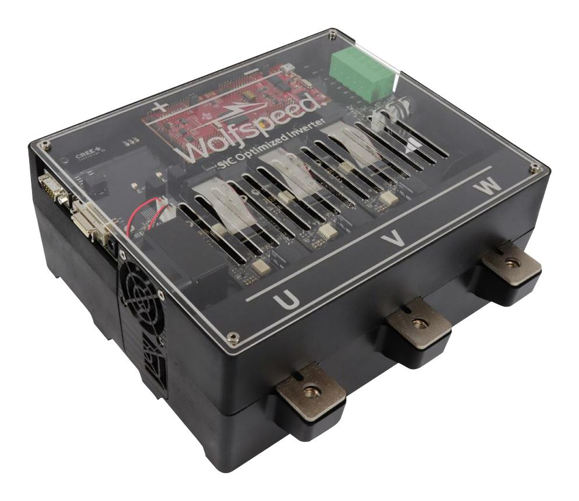
CSIRO - Tapestry collaboration project
Challenge: new gen inverters represent an opportunity to provide advanced power quality controls at a fraction of the cost and footprint​.
Purpose – develop cost-effective distribution network embedded inverters to improve network performance, system stability and CER / network utilization​.
Objectives
Repurpose a 300 kVA EV motor drive as grid-connected inverter
Develop 3-leg and 4-leg inverter models suitable for scalable power flow analysis
Develop and test grid-forming / grid-following and standalone / embedded operation modes
​Test phase unbalance compensation at LV feeder head​

Slide 8
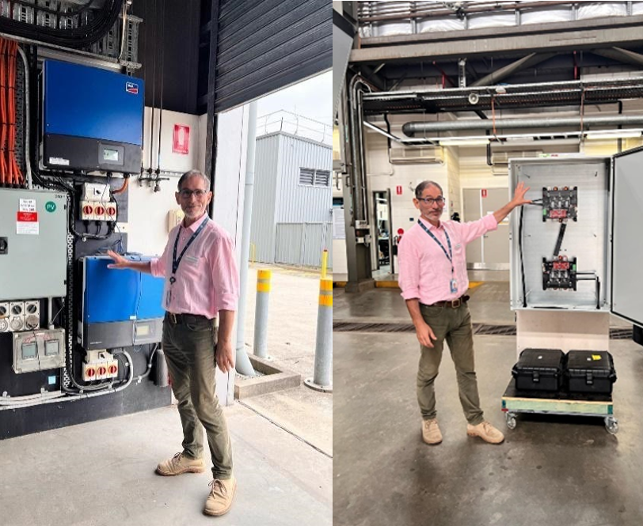
Prototype device
WolfSpeed Silicon Carbide-based MOSFET 3-phase 3-leg inverter (300 kW Automotive motor drive)
  800 V DC bus nominal (900 V max)
  360 A RMS output
  2x increased power density compared to a Silicon-based inverter
  Frequency 20-80 kHz
  CAN Interface
  Liquid cooled cold plate
  AUD $14,128 ~ 4.7 c/W
SMA Si 15 kW
WolfSpeed SiC 300 kW

Slide 9
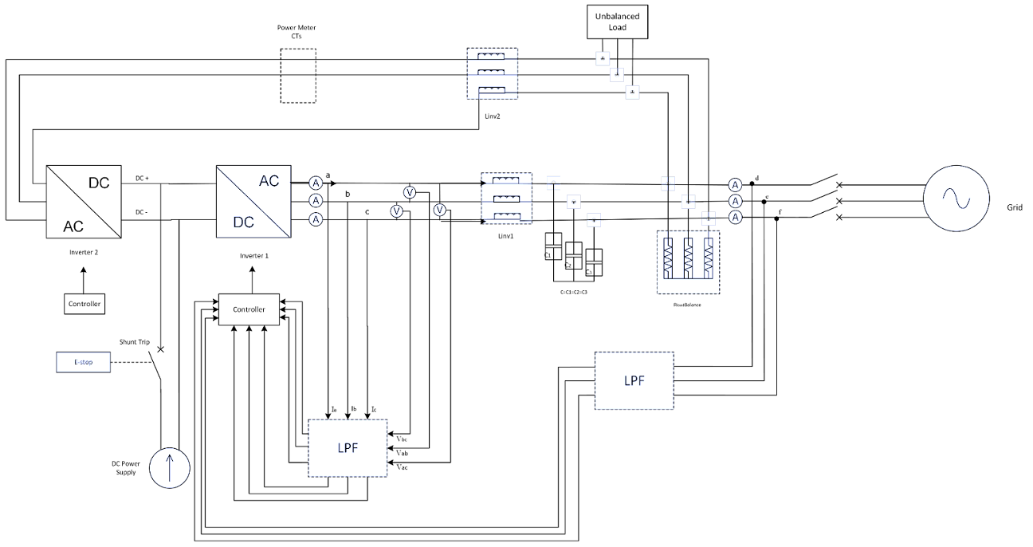
Inverter modelling and lab testing objectives
Mathematical models: develop 3-leg and 4-leg inverter models suitable for scalable PF and OPF analysis – Aim to solve large networks in short times
Lab testing – comms, inverter modes: ELV (low power) testing bench for back-to-back GFM – GFL in islanded operation
Control objective: Explore achievable inverter capabilities to provide dynamic unbalance compensation (negative sequence current injection) with 3-leg and 4-leg inverter configurations – Target POC at distribution TF secondary
B2B configuration

Slide 10

Mathematical models for power flow optimisation
Research paper (Heidari & Geth 2024)
Develops a mathematical framework to model inverters, single, three phase, 3/4-leg GFL and GFM in steady state – enables use in optimisation studies
Models interactions between distribution grids and IBR via unbalanced optimal power flow.
Highlights limitations of existing models.
OPF case study on 907-bus system shows no significant changes in convergence despite the increased level of detail in the model.

Slide 11
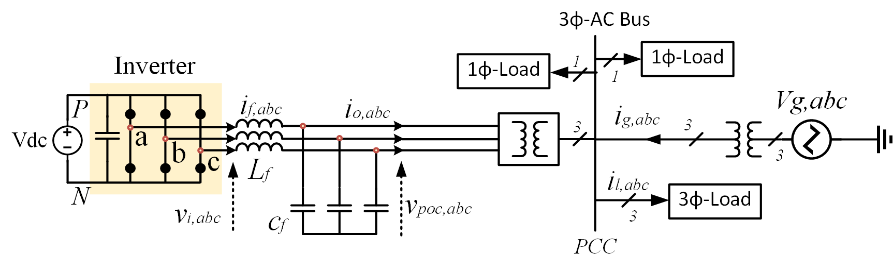
Dynamic unbalance compensation
Balance | Unbalance
Simulations: proof-of-concept controller performance – 3-leg GFM inverter supplies negative sequence currents to reduce unbalance introduced by connecting a single-phase load
Grid currents
Load currents
Inverter currents

Slide 12
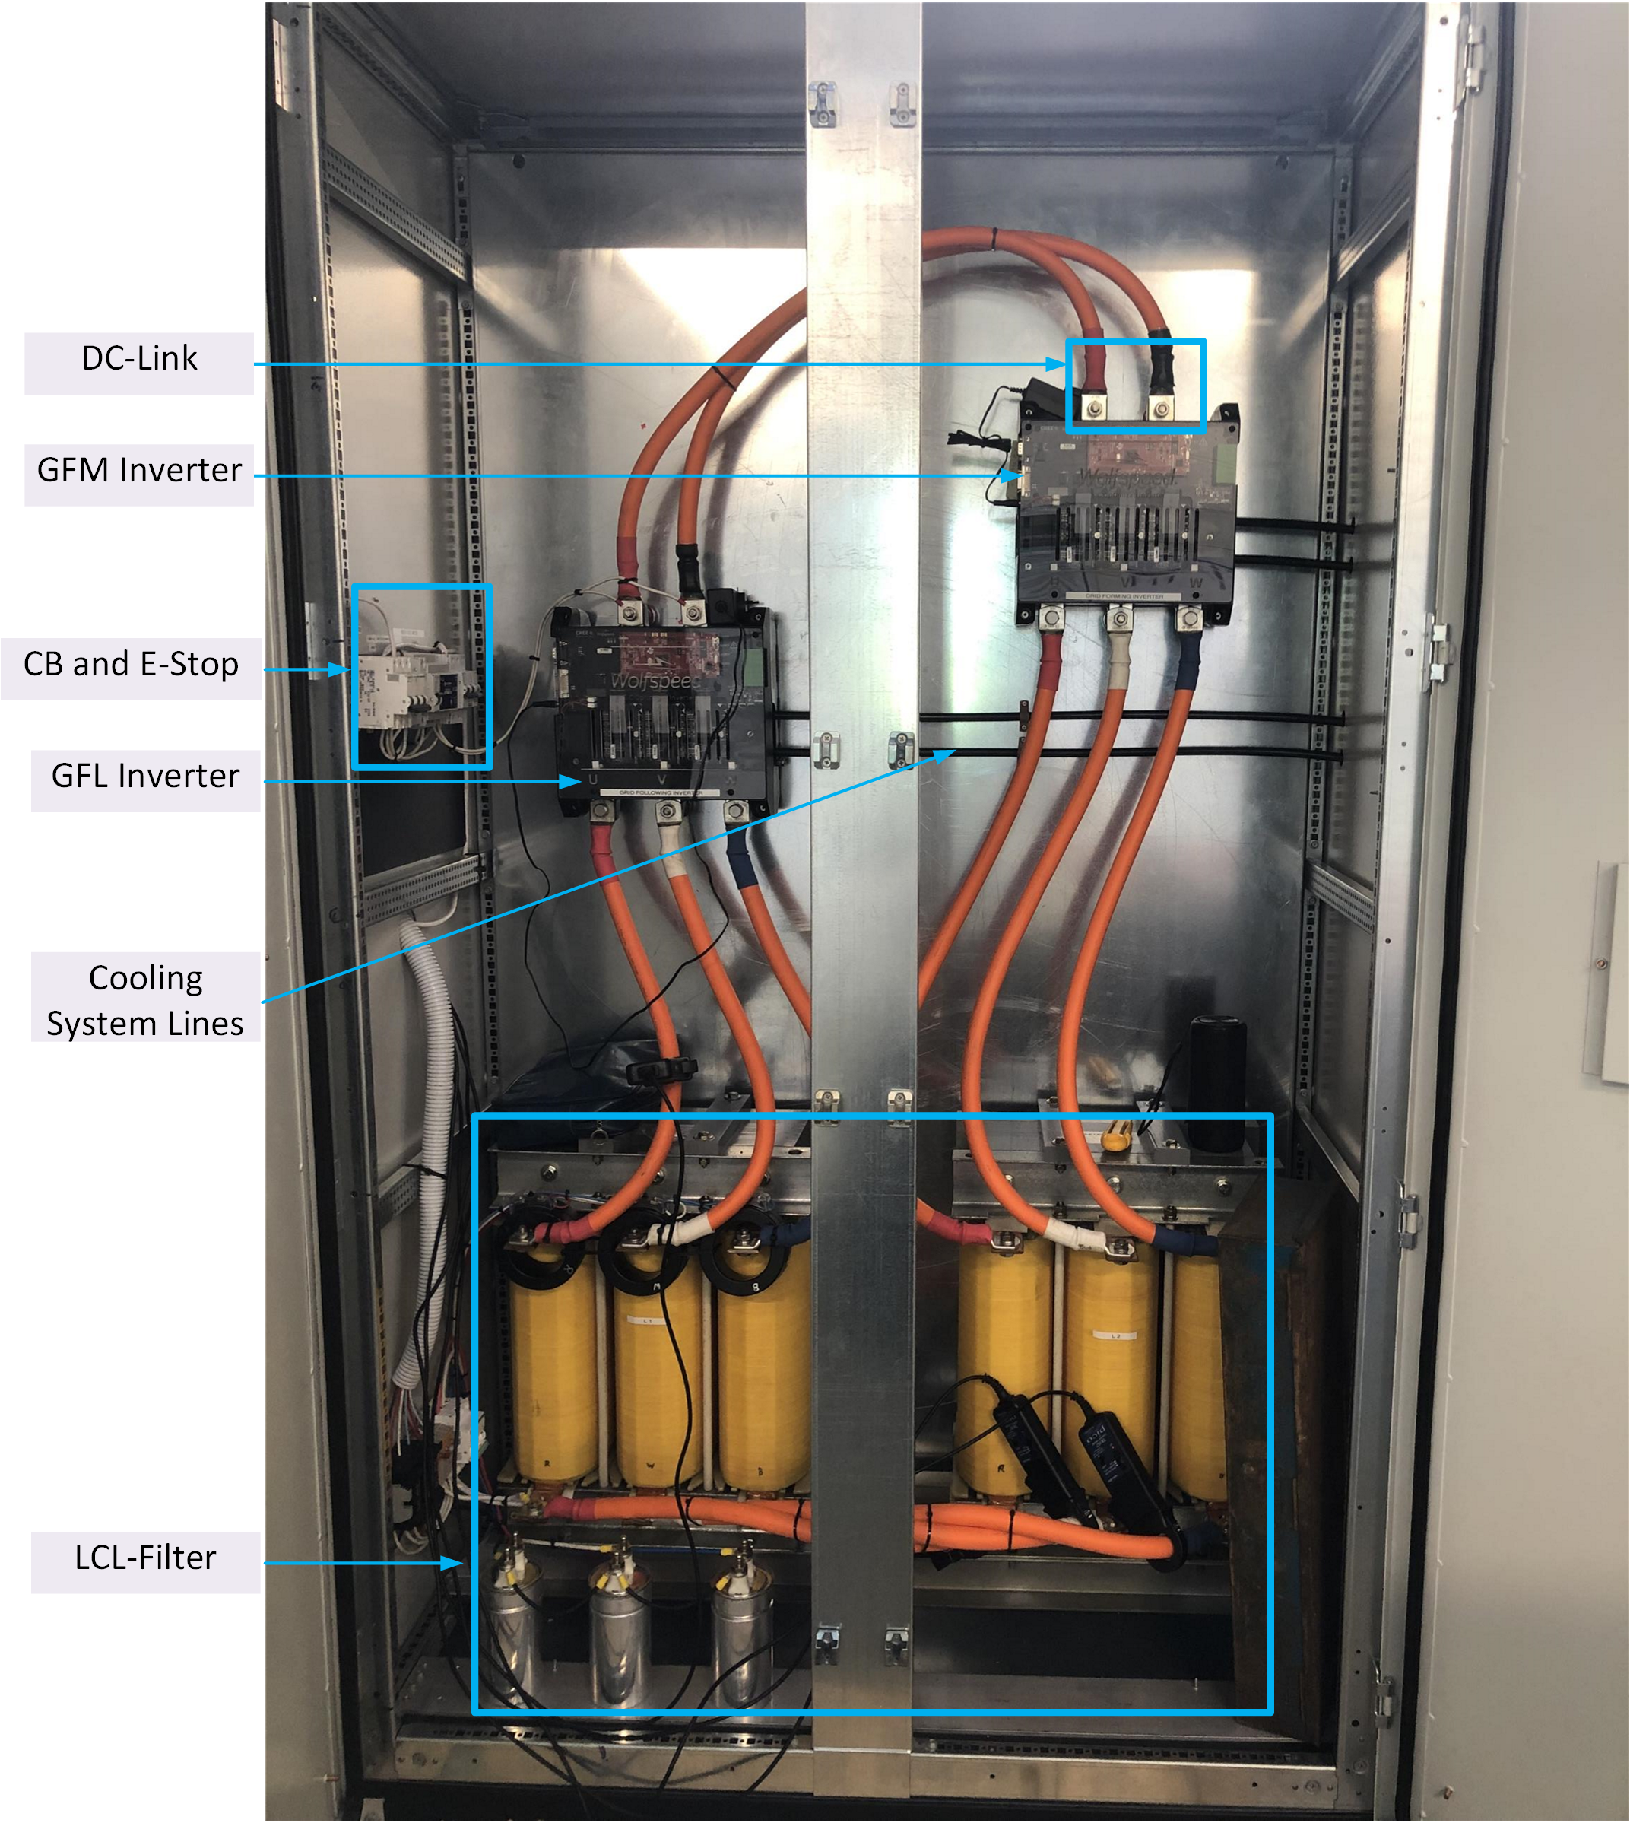
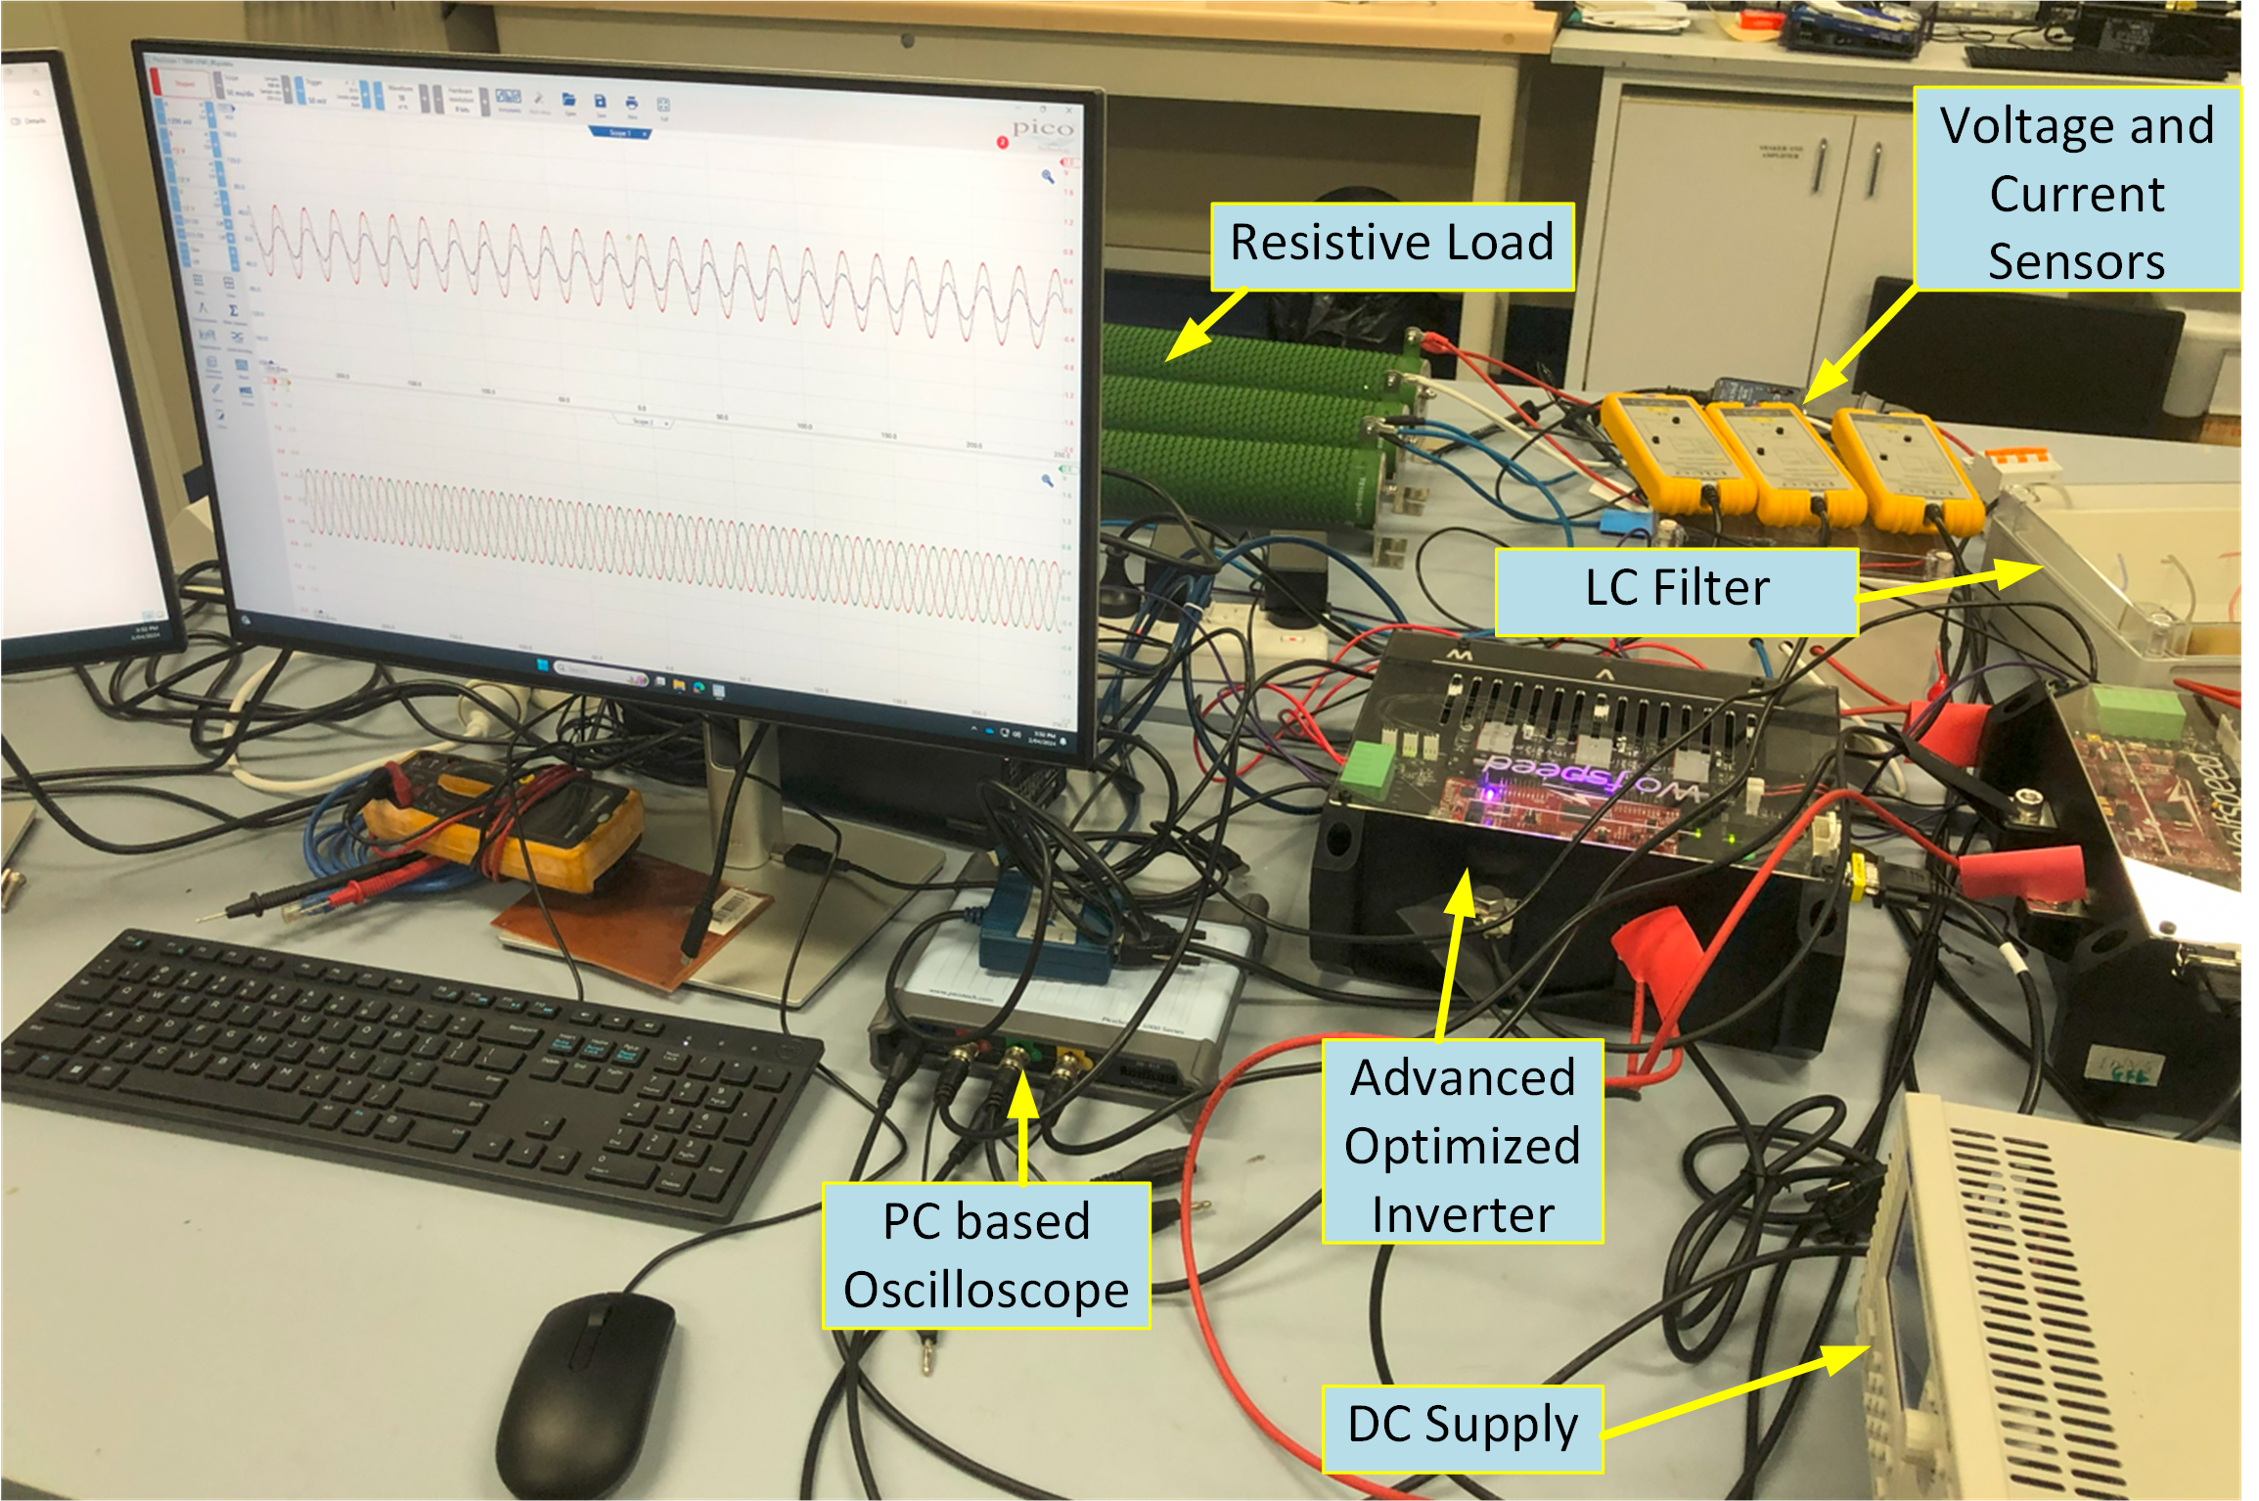
Experimental testing
Next step: High power, LV test scheduled November 4th at CSIRO Energy Centre
Back-to-back, grid forming / grid-following configuration tested at low power (ELV)
Looking for partners for a real-world LV network test!

