Slide 1
Distribution State Estimation &
Dynamic Operating Envelopes
Dr. Frederik Geth
Oct 17 2024
frederik.geth@gridqube.com

Slide 2





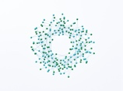
^{Based in Brisbane Australia}
2018
Arena funded project “Solar Enablement Initiative”
2020-2021
Energy Network Industry Innovation award for Australian-first digital system implementation of the operational state of the grid
2019
Spin-off founded by CTO Olav Krause
2024
Itron Global Partnership
11 employees, primary power engineers and software specialists
2023
CIRED best start-up award winner

Slide 3
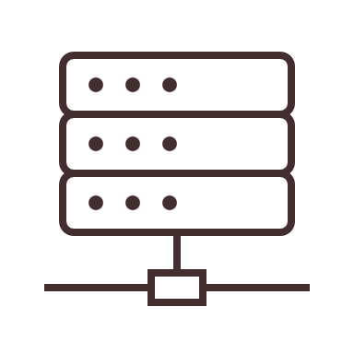
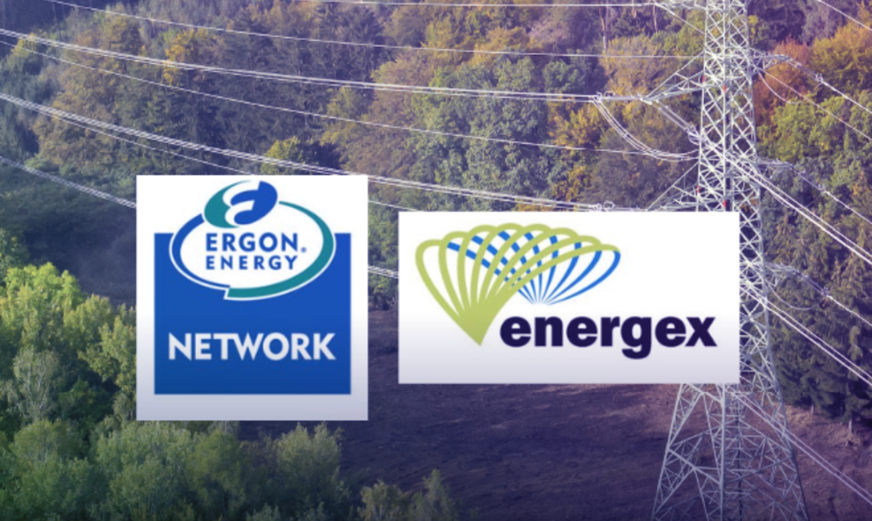
Energy Queensland
Enable transition to Distribution System Operator through:
State estimation a.k.a. real-time visibility
Constraint analysis and congestion identification
DOEs and network optimisation
These will support dynamic management capacity and network operations to maintain an efficient, safe, and reliable service while optimising customer value.
“…With better knowledge of DER connections, the AEMO can better manage the grid and ensure these systems deliver their expected value to energy consumers, the network and other market participants.”

Slide 4
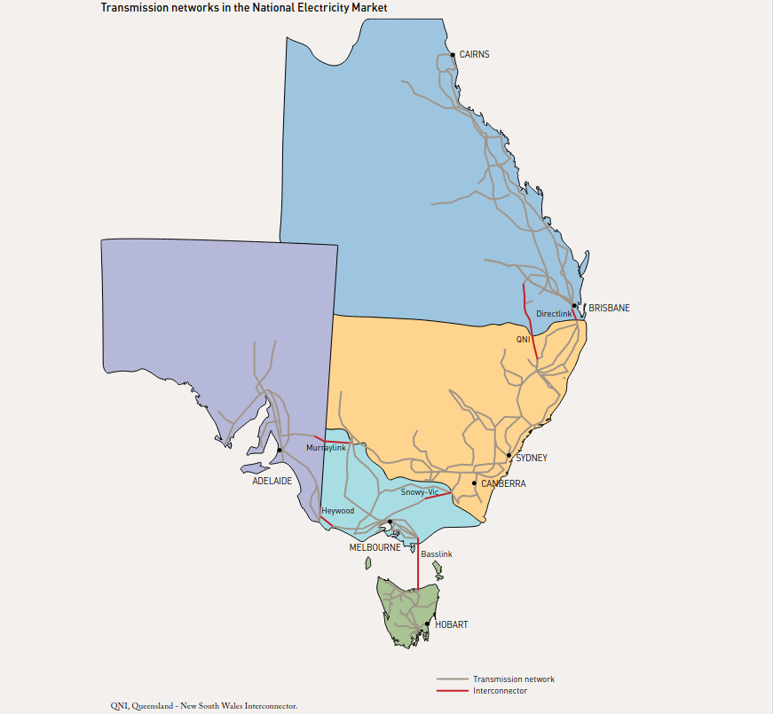
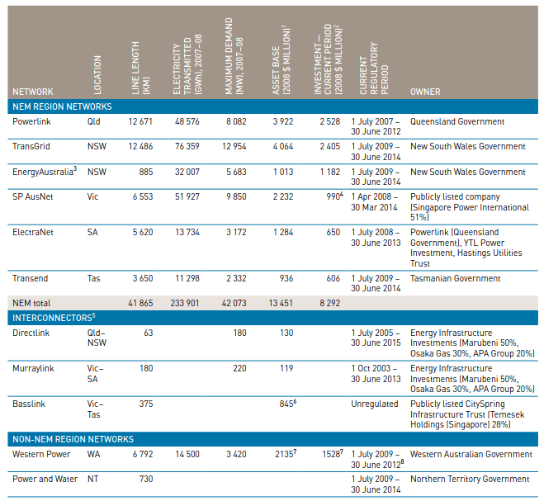
Transmission system in Australia
~2,400 electrical nodes
Source: AER, State of the Energy Market 2009

Slide 5
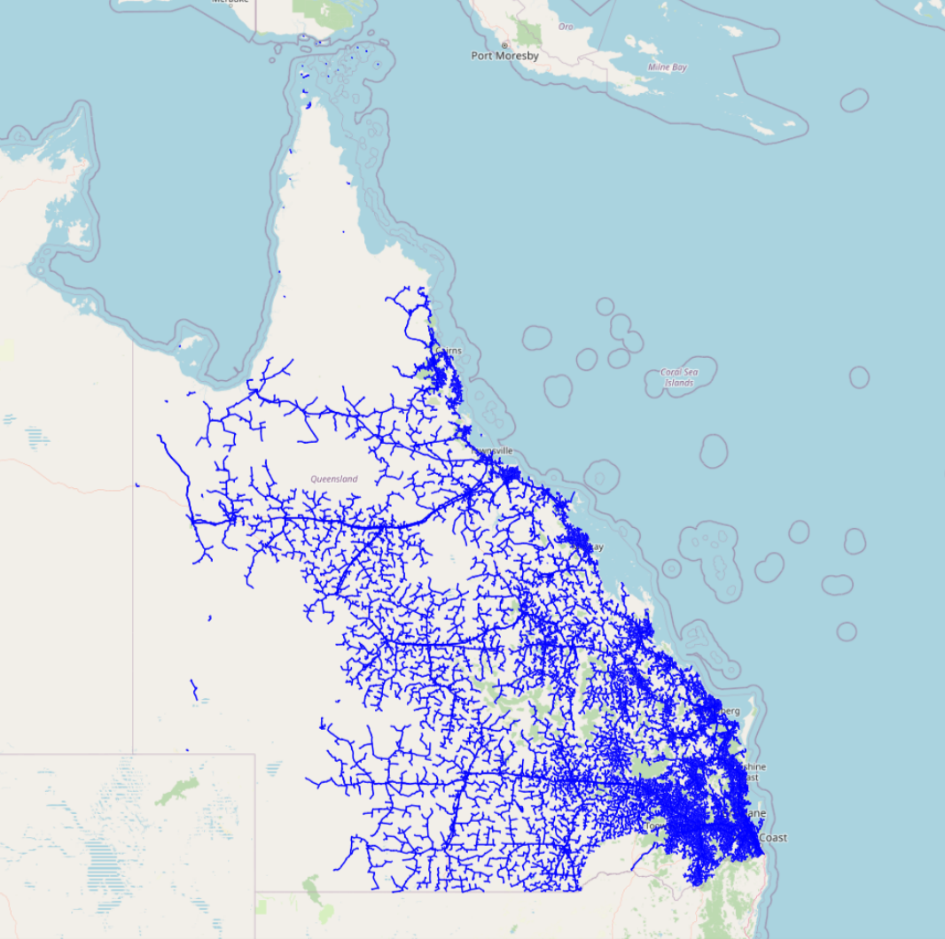
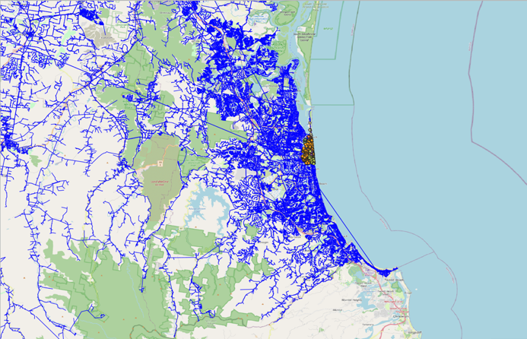
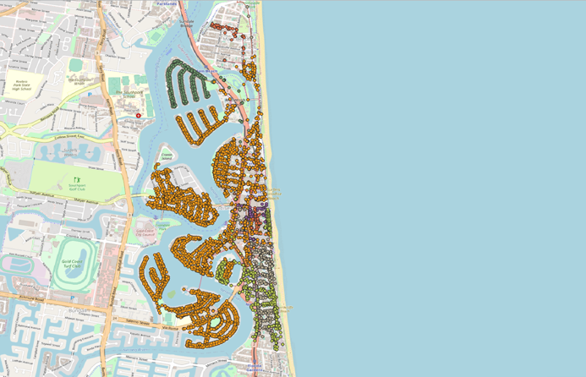
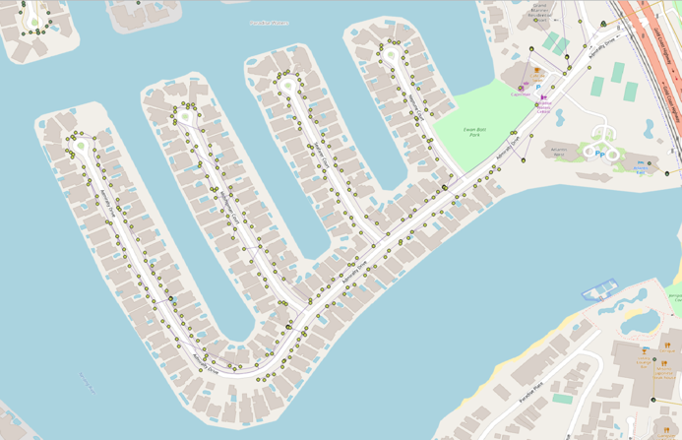
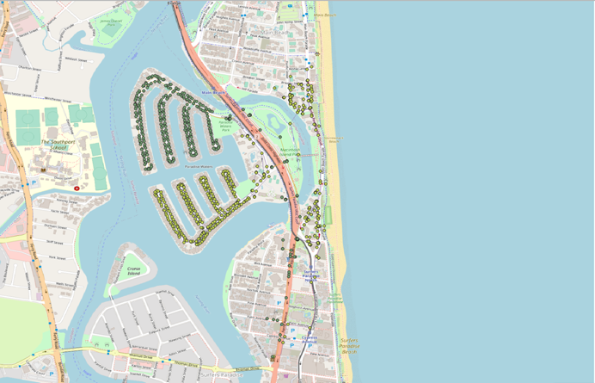
Distribution network in Queensland Australia
~14.5 million objects - ~30 million electrical nodes

Slide 6
Distribution State Estimation = reconciliation
voltages and currents in the network that best explain the sensor data you have, given that they have to satisfy the physics
  best is some kind of a distance metric, e.g. Euclidian or Manhattan
  explain means satisfy physics
    represented through the multi-conductor circuit laws

Slide 7
network visibility
congestion estimation
congestion identification
constraint identification
PV curtailment detection
observation engine
situational awareness
network inference engine
nonlinear least squares
root cause analysis
state estimation

Slide 8
Most likely flows and voltages in the network?
physical properties of the network
  network connectivity, impedance, load and generation connectivity, wye/delta configuration of transformers/loads/generators
sensors
  voltage meters at buses, smart meters, power meters on transformers
statistical information
  likely outputs of PV, consumption patterns of consumers, presence and ratings of PV installations

Slide 9
Why distribution state estimation now?
Isn’t this a solved problem?
Most transmission system operators use state estimation to keep lights on, right? So distribution networks should just build the network data sets and use the same engines?
NO!
phase unbalance needs to be included, as down in MV and definitely LV, load aggregation is limited and therefore load unbalance is real and significant
networks also aren’t transposed, so impedances aren’t balanced or even correctly representable in sequence coordinates
too few sensors, conventional nonlinear least-squares through Gauss-Newton algorithm doesn’t work

Slide 10
Need for physics-based decision support algorithms
Technical viability
Operational need
Economic viability
Technical viability:
Communication
Moore’s Law
Economic viability:
Cost to Asset value
Benefit over BAU
Operational need:
(Rooftop) PV and EVs
causing real problems

Slide 11
Data Versioning
Heterogeneous Time Scales
Data doesn’t have a permanent state. It’s a continuous change process.
By tendency update cycles get faster over time
Highest (current) cadence is event-driven processing (streaming)
Eventually all data sources will stream their changes/change events
Proper recording and historisation is crucial to not lose context of determined results
Reconciliation (State Estimation)
Versioning and Change Tracking (Audit Trail)
Periodic updates
High-frequency updates
Integration
GIS
Asset Data
Customer Statistics
Operation Switching
SCADA/ Telemetry
low
Velocity of Change
high

Slide 12
How do we deliver on-line network visibility and decision support?

Slide 13

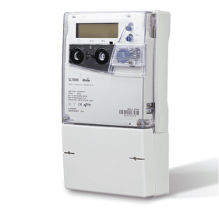
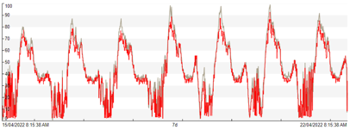
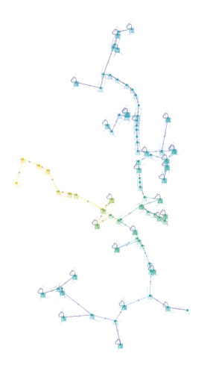

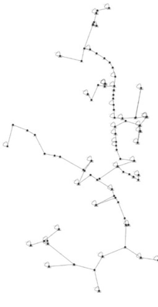
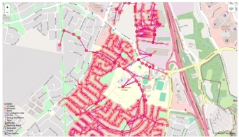
Sensor data linked
Find new feeder in GIS
Validated network model
Connectivity model validated
Asset data linked
Distribution state estimation
Congestion analysis
Dynamic Operating Envelopes
Improving network data

Slide 14
Sensor data linked
Find new feeder in GIS
Validated network model
Connectivity model validated
Asset data linked
Distribution state estimation
Congestion analysis
Dynamic Operating Envelopes
Improving network data

Slide 15

Electrical Model Building & Planning
Derive network models from source of truth,
e.g. GIS
Link up with asset databases, PV registers, standards, etc. using UUIDs
Representing all electrical components down from the zone substation, MV feeders, distribution transformers, LV feeders
Version control and synchronization
  Re-trace network models on the fly after planned outages or switching actions
  Create scenarios for planning studies
State estimation alerts when network model is out of sync

Slide 16
Sensor data linked
Find new feeder in GIS
Validated network model
Connectivity model validated
Asset data linked
Distribution state estimation
Congestion analysis
Dynamic Operating Envelopes
Improving network data

Slide 17
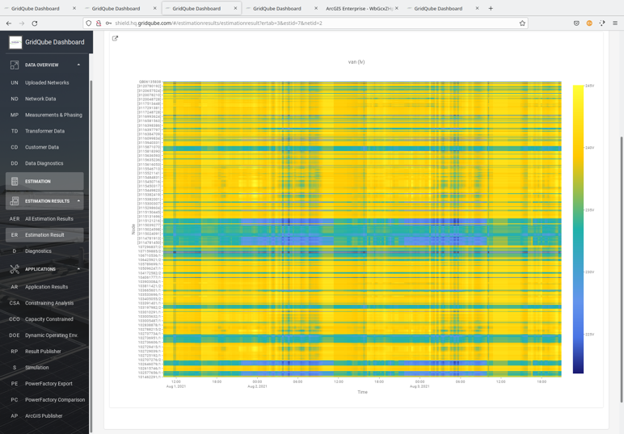
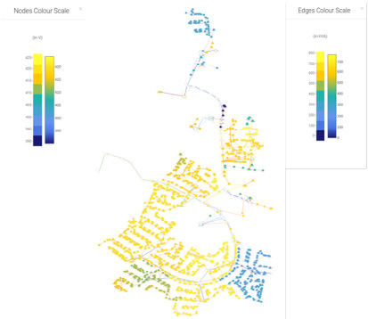
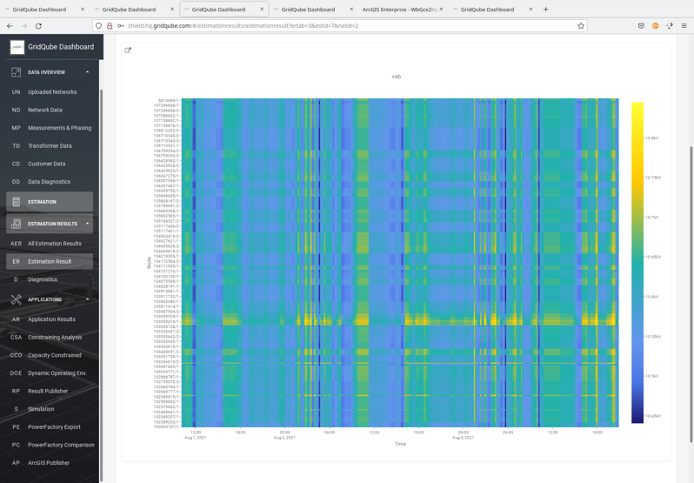
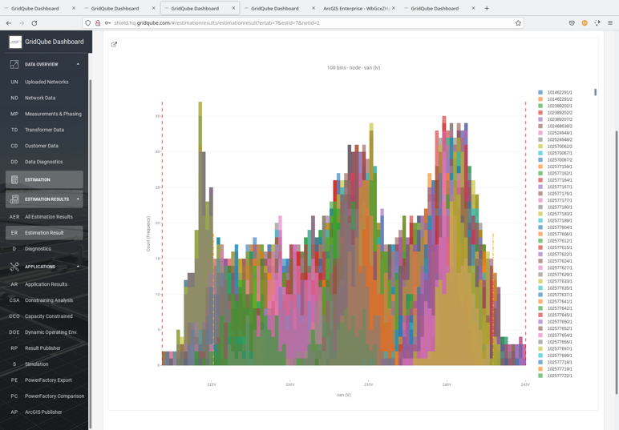
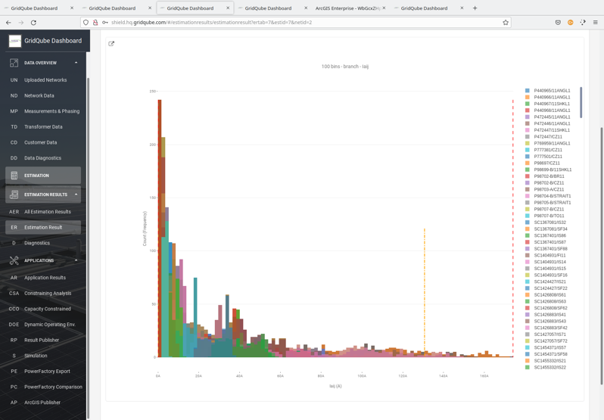
State estimation = Visibility

Slide 18
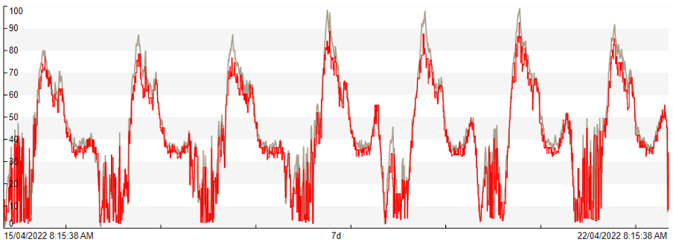
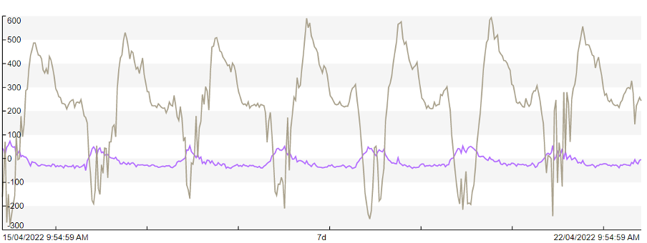
Identifying Network Congestion through Distribution System State Estimation
GridQube's state-of-the-art distribution state estimation engine
  Builds on detailed distribution network models, up to four-wire
  Is continuously validated against other electrical engineering tools in terms of circuit modeling correctness
  Builds on established weighted-least squares fitting algorithms
  Unique capabilities in establishing the most likely state in under-observed networks
  Leverages state-of-the-art math libraries, enabling scalable performance for large networks
Scale up from the limited meter coverage today, with the sensors distribution utilities have in place
  Deploy more over time, get more accuracy and certainty
Comparison of MV feeder current (amps). Grey line = Synthetic (SE), Red line = Measured
SE derived MV feeder active and reactive power reveals reverse power flows.
Grey = Active Power (kW), Purple = Reactive Power (kvar).

Slide 19
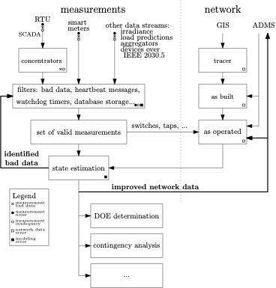
Network Model Validation
Measurements are real, models are not
  If the model can't explain the measurements, there's something wrong
  Sensor accuracy issues or misconfigurations can happen
  Errors in models are likely
  Reconcile data errors until measurements and data agree = Validation
Measurements come from various sources
  Smart meters, power meter RTUs on SCADA, transformer monitors
  Time synchronization unlikely to be perfect, but our technology is robust
Fixing inaccuracies in phase mapping of sensors, tap settings, transformer ratings
Once validated, run DSSE with telemetry data in real-time
  Continuous validation of network models, through the "residual errors“ being presented by the DSSE, which can generate alerts

Slide 20
Sensor data linked
Find new feeder in GIS
Validated network model
Connectivity model validated
Asset data linked
Distribution state estimation
Congestion analysis
Dynamic Operating Envelopes
Improving network data

Slide 21
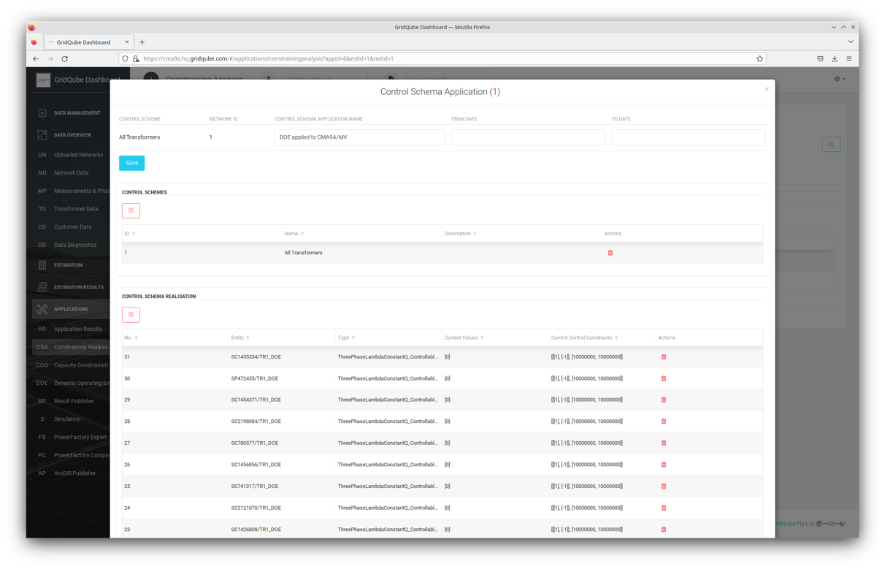

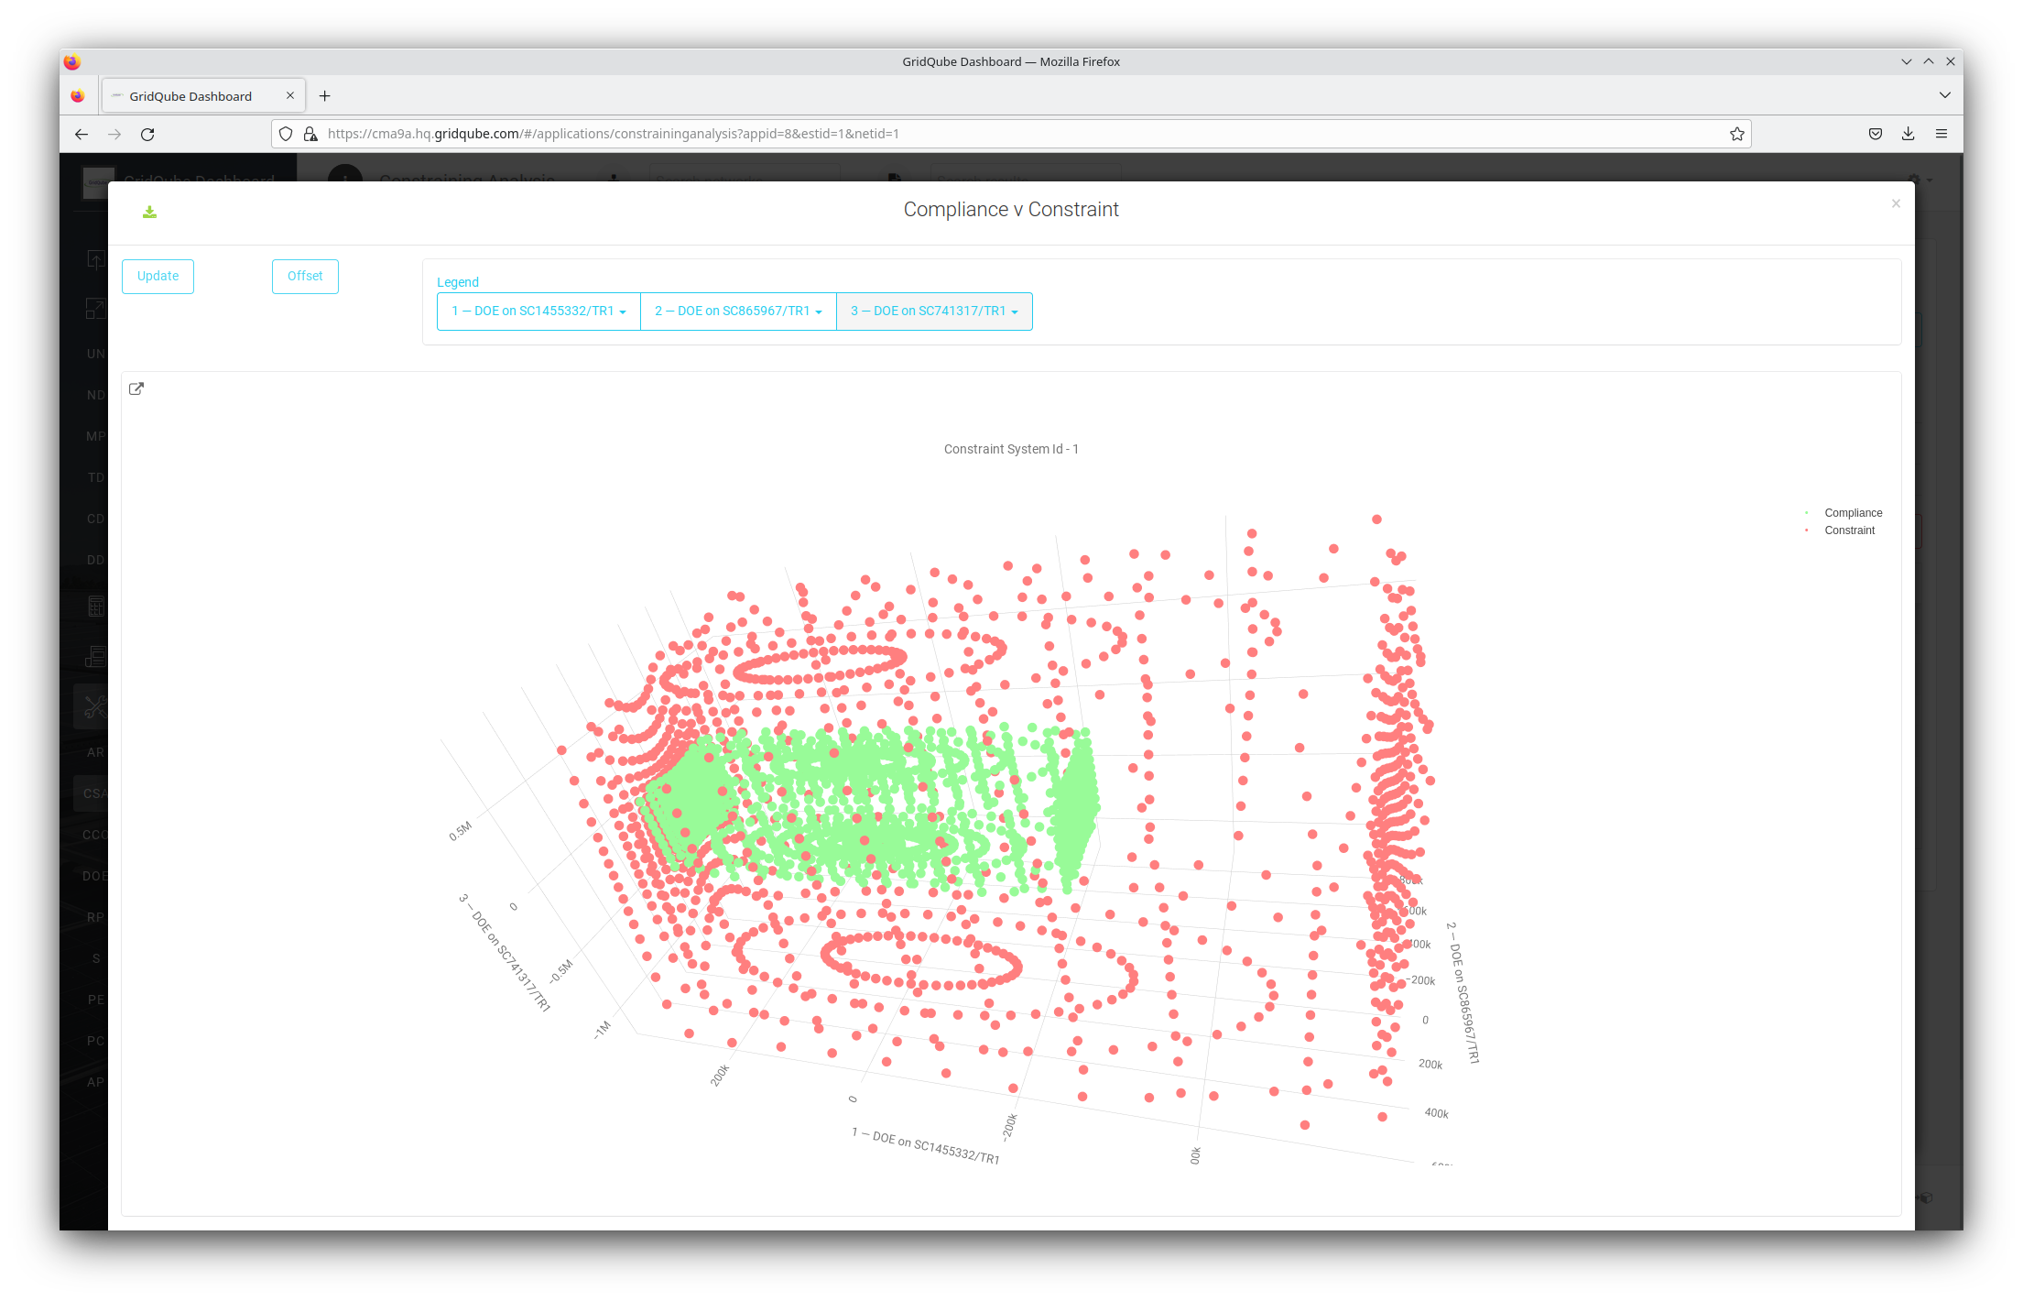
Constraint Analysis
Mapping network limits to decision variables
Set of all viable decisions
List of controllable devices
List of technical and
operational network limits

Slide 22
Real-time hosting capacity analysis
a.k.a. dynamic operating envelopes
How much additional exports and imports are available at any node in the system?
  Taking into account phase unbalance and neutral voltage rise
Publish import/export limits to message buses such as Kafka
  Communication to/from inverters through IEEE2030.5
Opportunity to improve customer equity!
  Physics give advantages to customers close to substation, DOE determination enables fair(er) access to the network

Slide 23
How do we work with network utilities?

Slide 24
Why GridQube?

Slide 25
Why GridQube?

Slide 26
Technology architecture
Forecasting
Compliance reporting
DOE
Dispatch
Pricing engine
Network analysis
Connection assessment
Integrated Grid Planning
Forecasting
engine
Compliance
engine
Optimization
engine
Simulation engine
“DIGITAL TWIN”
Query server
Technical Clearing House
Four-wire DSSE
Model Sync
Telemetry DB
Model DB
Including data model
Smart meters
DER register
Asset Data
SCADA
3rd party data
GIS

Slide 27
Customer engagement approach
Establish data interfaces
IT environment design, built, and deployment
GridQube core access
Decision support functionality
Establish known parameters and information from electric network devices that control electricity, in addition to statistical data on customers and demand, based on GIS and other utility databases.
Implement integration of GridQube's technology solutions in customer's IT systems or cloud environments and set up real-time data streams for network configuration and sensors.
Providing distribution system estimation in the GQ dashboard, enabling the visualization of the different aspects and constraints of the network modelled. In addition, diagnostic tools, data cleaning and calibration, and user training.
GridQube's four-wire optimal power flow engine enables design, planning and operation of network assets, distributed energy resources and EVs

Slide 28

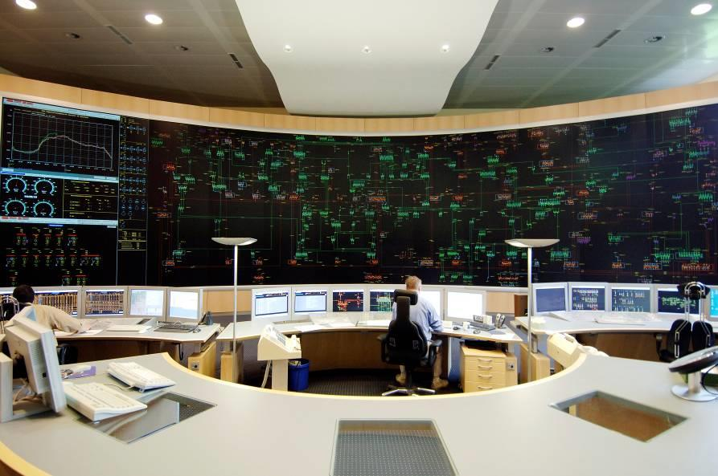
Electrical engineering focus
Maintain trust with planning teams and control room
Take-no-shortcuts approach to electrical engineering
  DSOs can validate w.r.t. PowerFactory, PSS/Sincal, …
  working with primitive abc(n) impedance matrices
    not reducing to sequence coordinates or positive sequence
  doing it right is doing it once
Work with customers to clean network data
  automate where possible

Slide 29
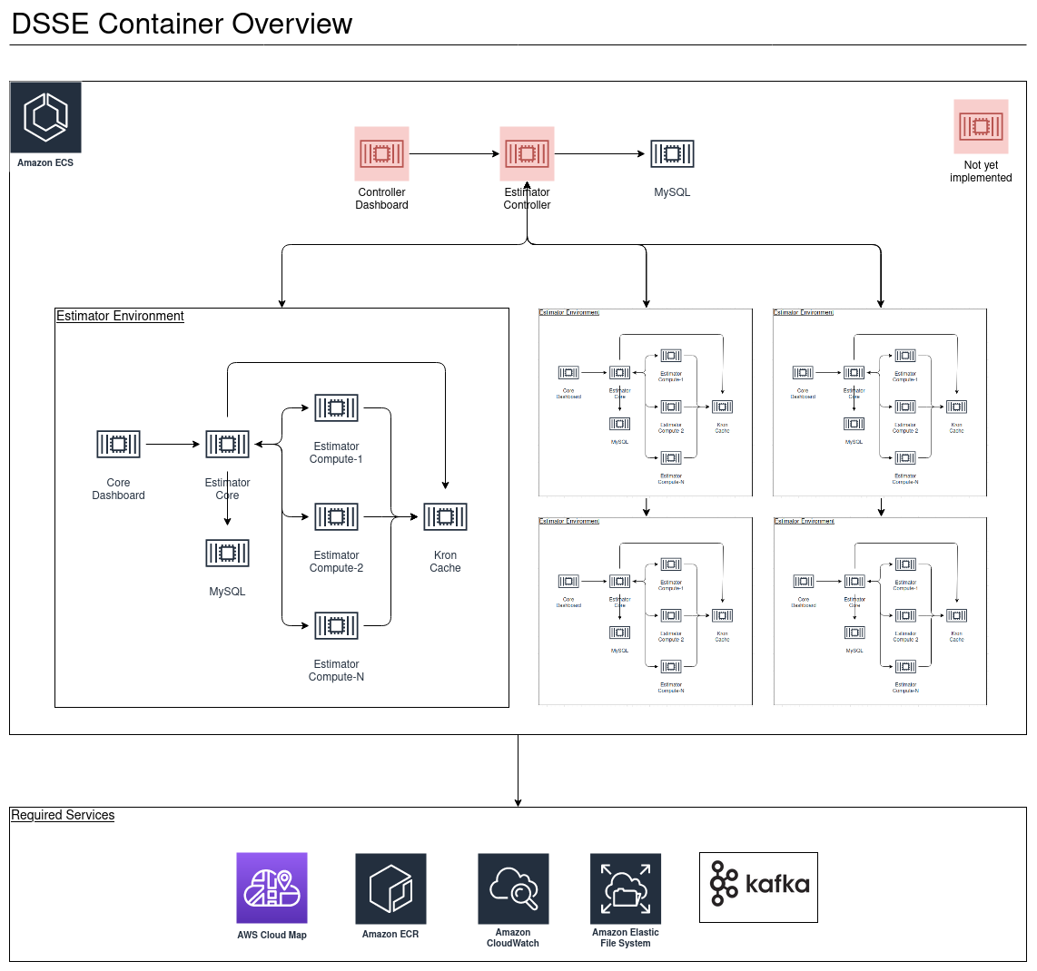
Made to scale
Cloud-like orchestration systems allow flexible scaling
Today’s ‘super computers’ are cloud (-like) environments with orchestrated, inter-dependent (micro-)services
Software isn’t delivered as a single, deployable piece, but as deployable images of its components, plus a digital orchestration/deployment chart, allowing automated deployment and scaling
To operate on the full state of Queensland the DSSE/CCO/DOE function stack had to be parallelised on multiple levels
Data stays inside of the utility’s cloud

Slide 30
Thank you!
Questions?
frederik.geth@gridqube.com

