Slide 1
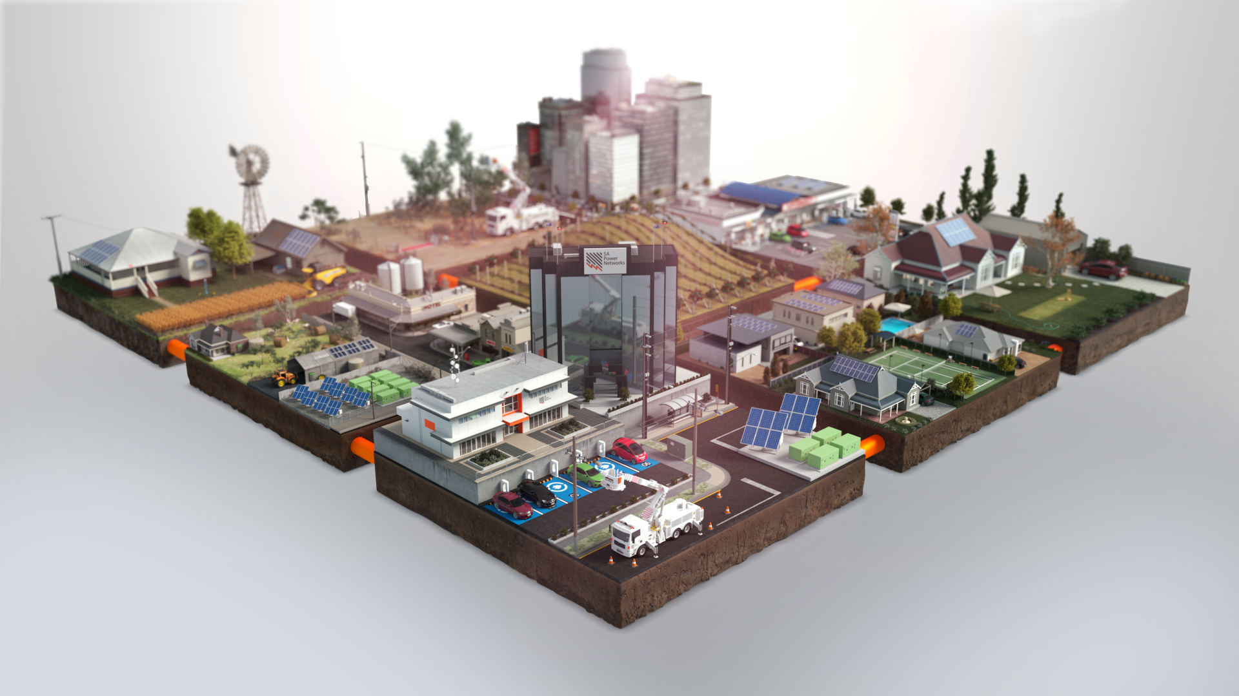

System Security – Distributed PV Backstop
Alex Ward
Future Networks Program Manager
SA Power Networks
17 October 2024

Slide 2










South Australia’s renewable milestones
70% of Annual Generation
met by Renewables
More than 1 in 3 customers have solar
2.5GW of
Rooftop PV
-26MW Minimum Demand
and 100% Rooftop Solar
1.5GW
Average
Demand

Slide 3
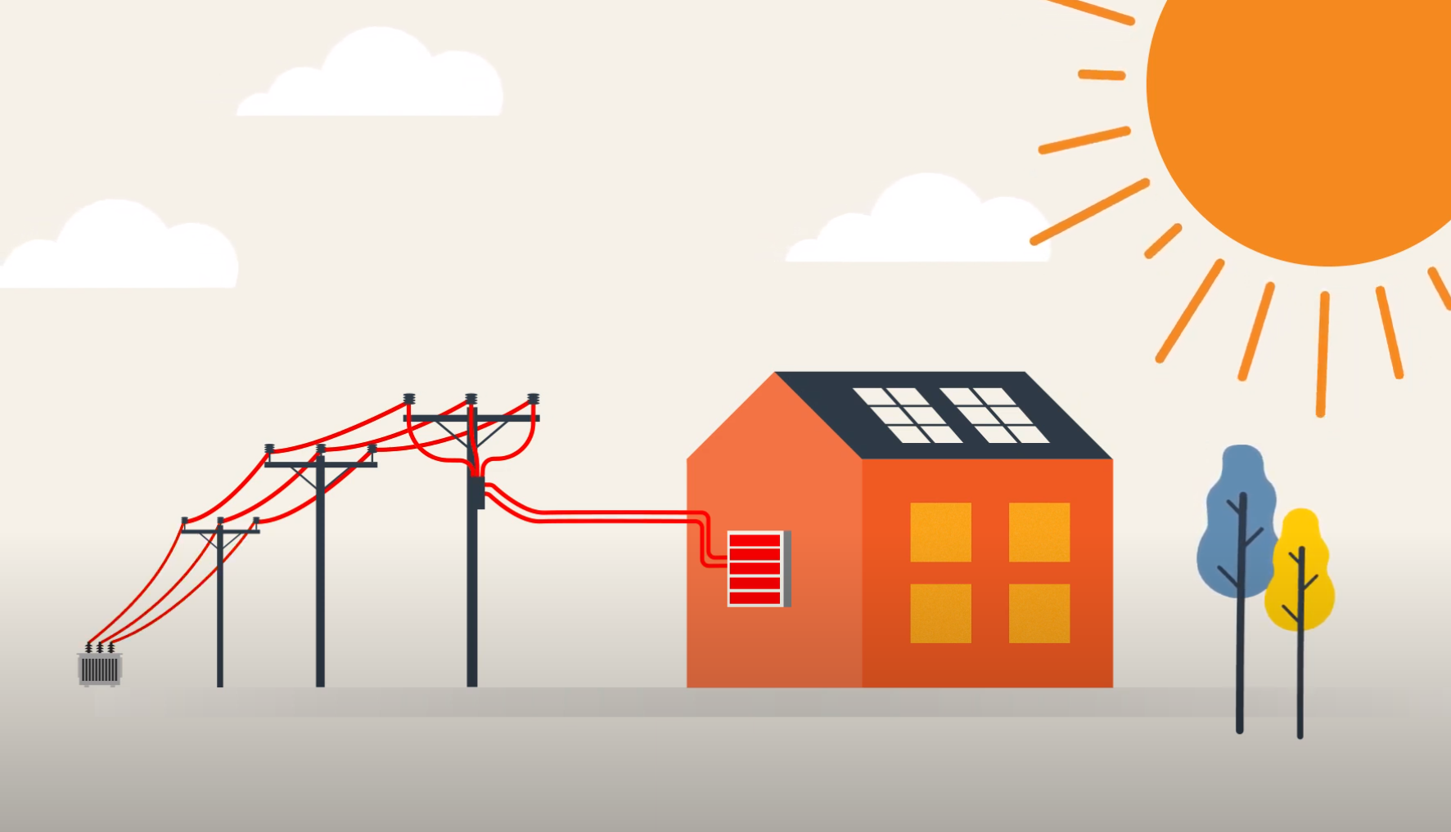
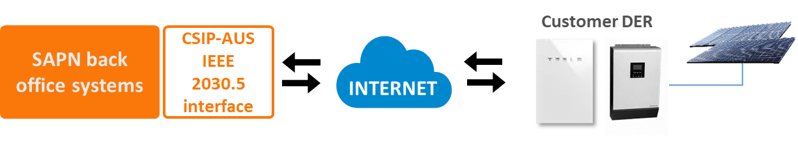
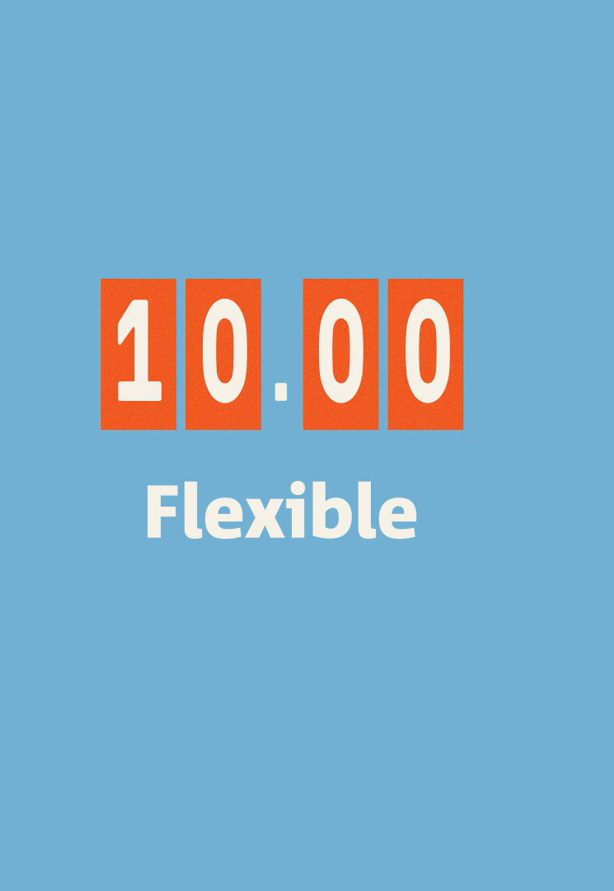
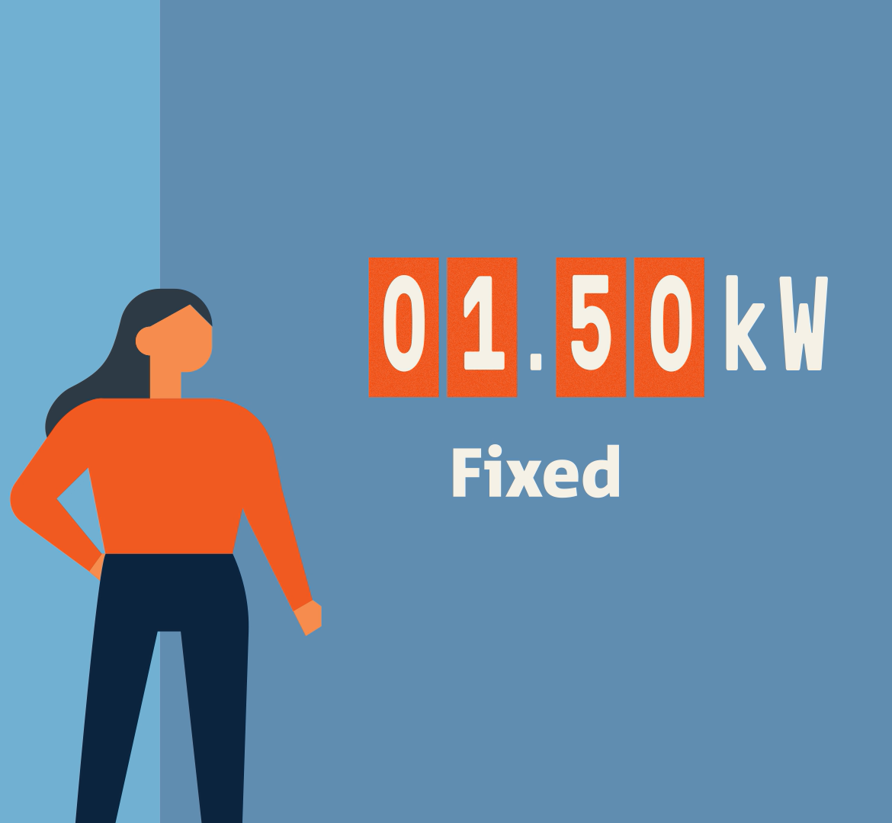


Our Flexible Exports offer
Customers with smart inverters can receive a flexible export limit
Choice between
  Fixed export 1.5kW/phase
  Flexible Exports 1.5-10kW/phase
Export limits at 10kW for 95% of customers 95% of the time

Slide 4

Our journey with flexible solar
‘Dynamic Exports’ SA Gov. Regulations announced
National technical standard published
SAPN enables technical and regulatory implementation
2020
Concept and early engagement
2022
SA Gov. Regulations in effect
Flexible Exports for Solar PV trial
>400 customers
2017
2019
Scale up team established
Flexible Exports rollout commences
2021
Reset proposal
$32m Capex
$3.8m Opex
First test with
Tesla VPP
1000 batteries
1 July
2023
2018
‘Grid of the Future’
Embedded IT team, new agile delivery
Customer Offer, Customer Journey, System design and Implementation plan

Slide 5
















Helping facilitate a national rollout
A consistent, national approach to CER integration will be least cost for customers and industry
National cyber security framework
National equipment standards, testing and certification

Slide 6
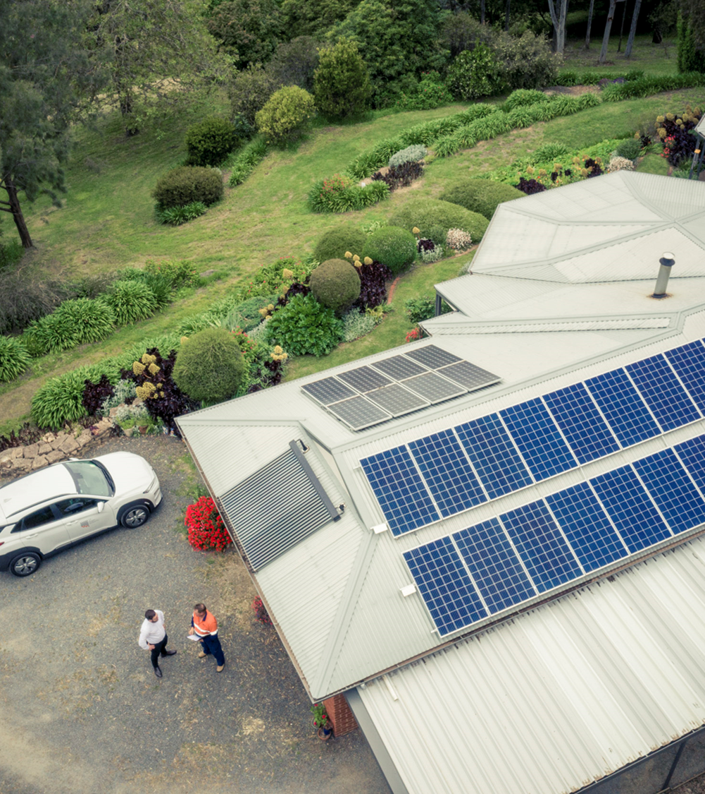
Why use Dynamic Operating Envelops for DPV Curtailment?
Several advantages over other mechanisms:
Fail safe behaviour when comms is lost (protects network and incentivises connectivity)
Incentive to commission site correctly (access to 10kW export)
Real-time feedback of system response (SAPN, installer and customer)
Enables ancillary response from storage

Slide 7
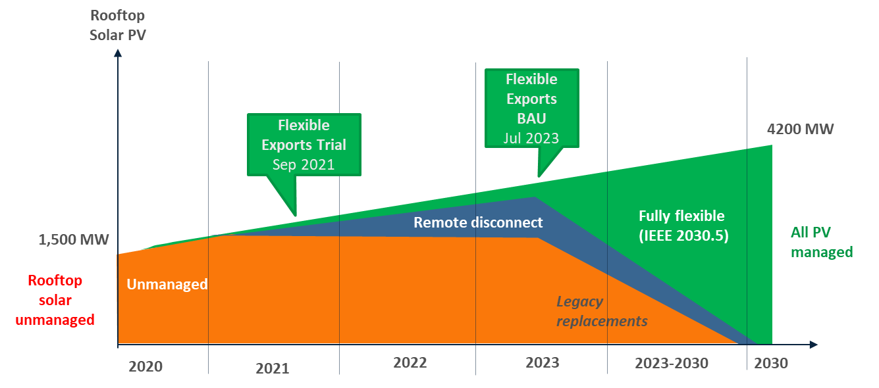
Transition to flexible DER
Flexible Exports will be rolled out across SA from July 2023 – December 2024
We’re on the path for all solar to be fully flexible by 2030

Slide 8





CER compliance improvement
Transformed our process
Introduced automated compliance program
>90%
Of a solar retailers sites must be compliant
Install
Apply
Once installers are engaged, they generally want to do the right thing
Compliance incentives and penalties must be aligned to the right parties
Install
Has led to…
Commission
Closeout
40%
95%
Compliance
Compliance

Slide 9
Export Limit (kW)
IEEE 2030.5 Resources
4x 15-minute events: forecasted network constraints
DERControl
10
DER Control events have a finite start time and duration
Decaying confidence schedule of 1-hour controls
Take last constraint
80% for 1 hour
60% for 1 hour
40% for 1 hour
8
DefaultDERControl
DefaultDERControls have no start or end time and are persisted through restarts.
Applied when no DER Controls are present e.g. during communications outage.
6
4
2
1.5kW failsafe
10:00
11:00
12:00
1:00
2:00
3:00
4:00
5:00
6:00
7:00
Time

Slide 10
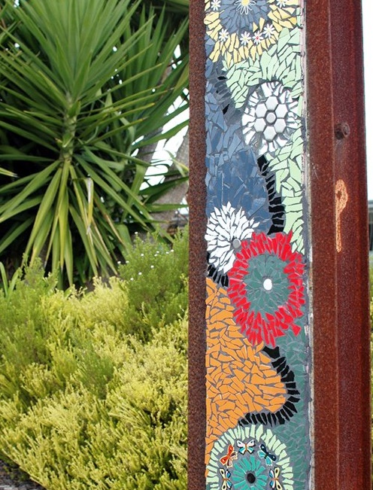

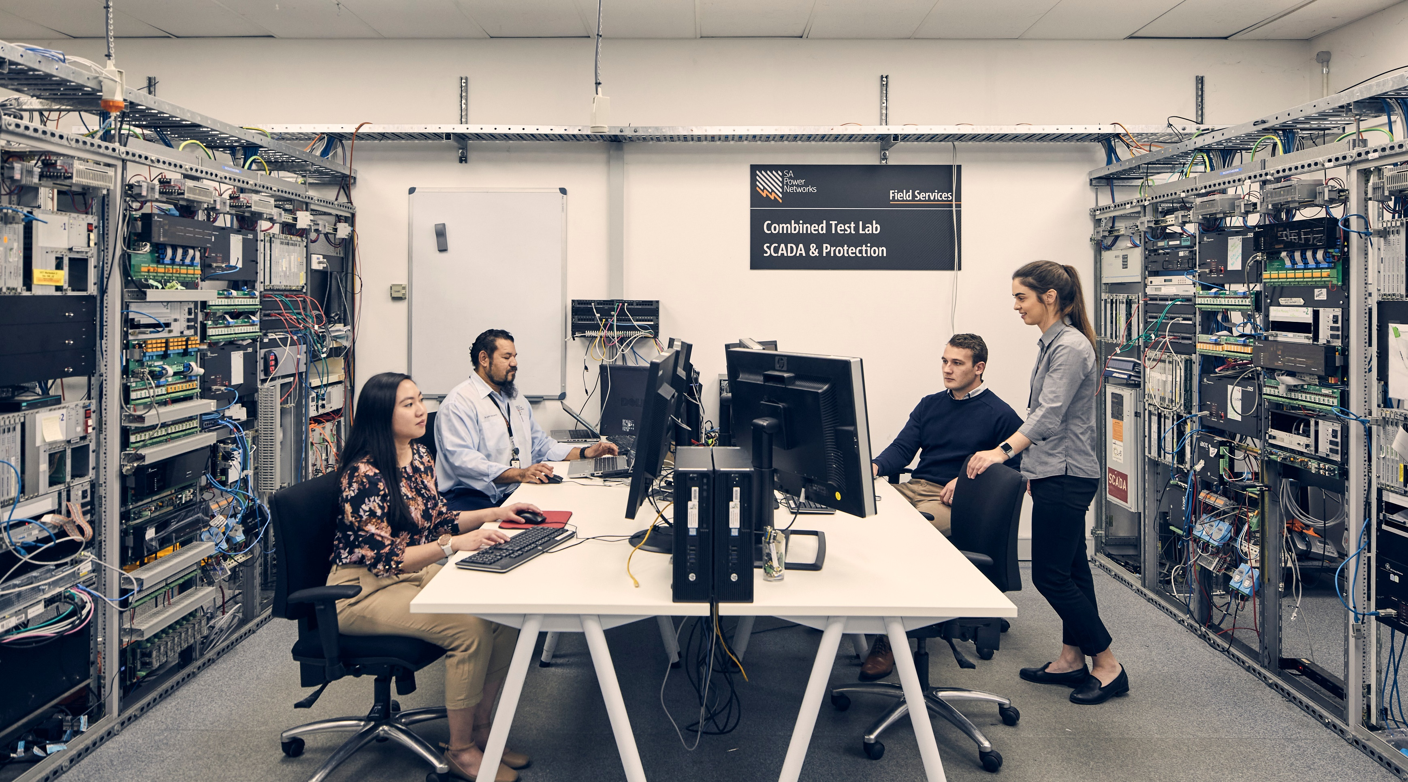

Structuring the program –
A multi- disciplinary effort
Engineering, technology and systems
Stakeholder and customer engagement
Internal business capability

Slide 11
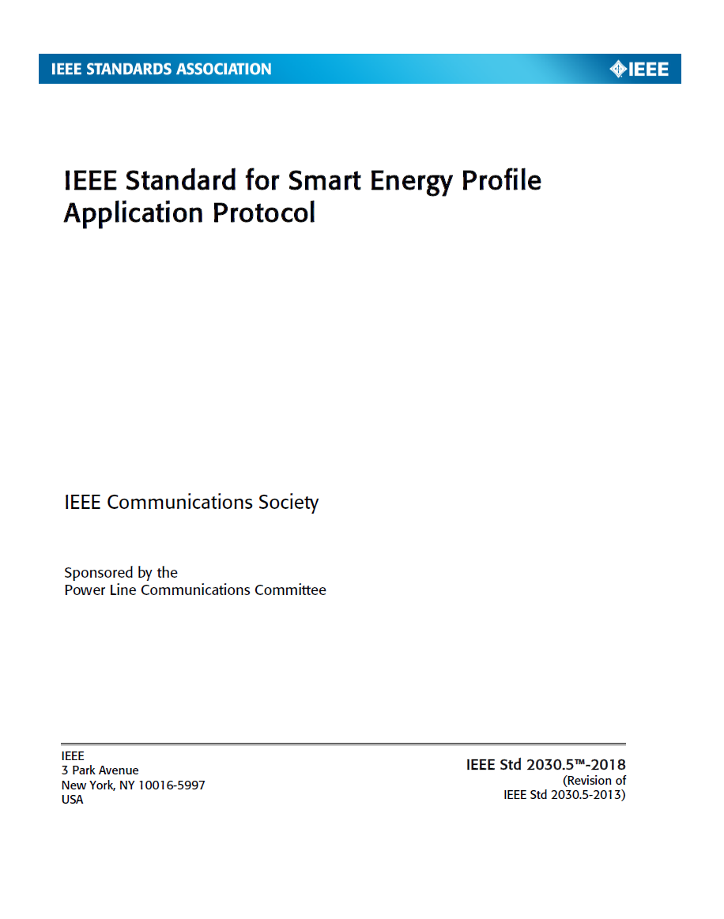
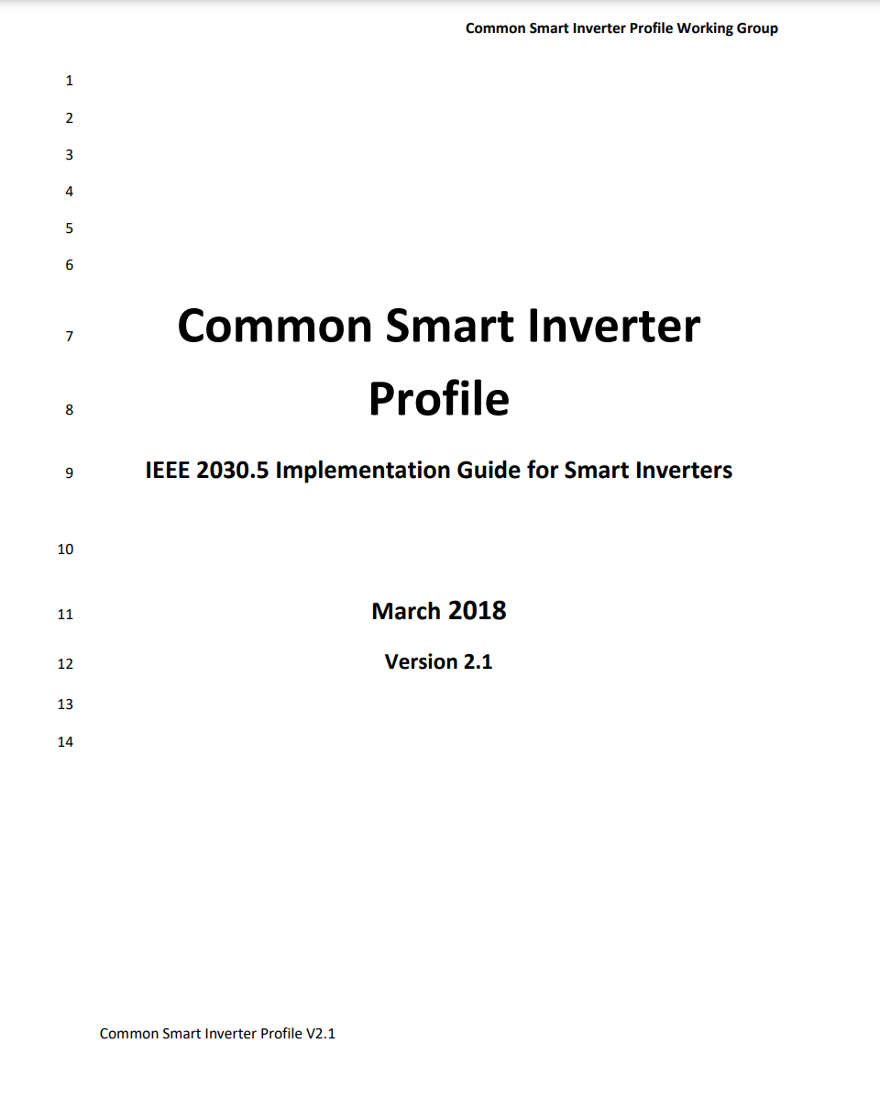
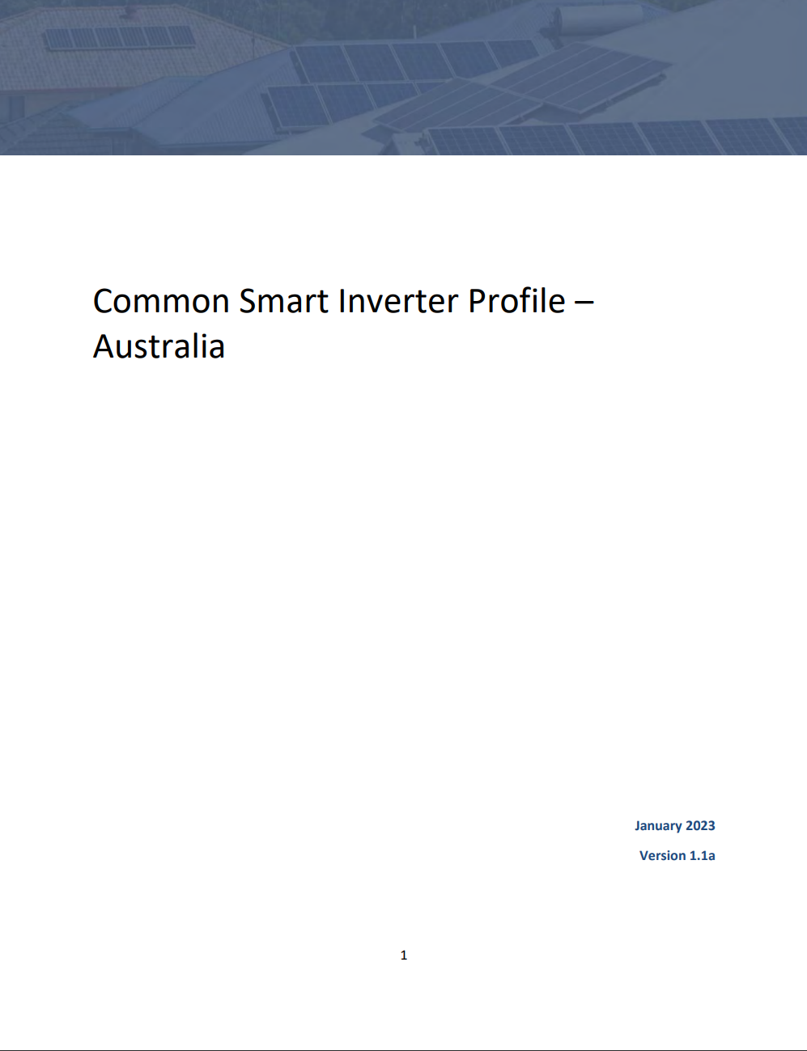
CSIP-AUS Journey
IEEE 2030.5:2018
Communications protocol for smart energy devices.
Contains 16 function sets
Common Smart Inverter Profile – (CSIP)
Implementation guide for network to DER smart inverter integration with a subset of optional function sets
Common Smart Inverter Profile – Australia (CSIP-AUS)
Additional extensions to support site level DOE use cases, written as deltas to CSIP.

Slide 12
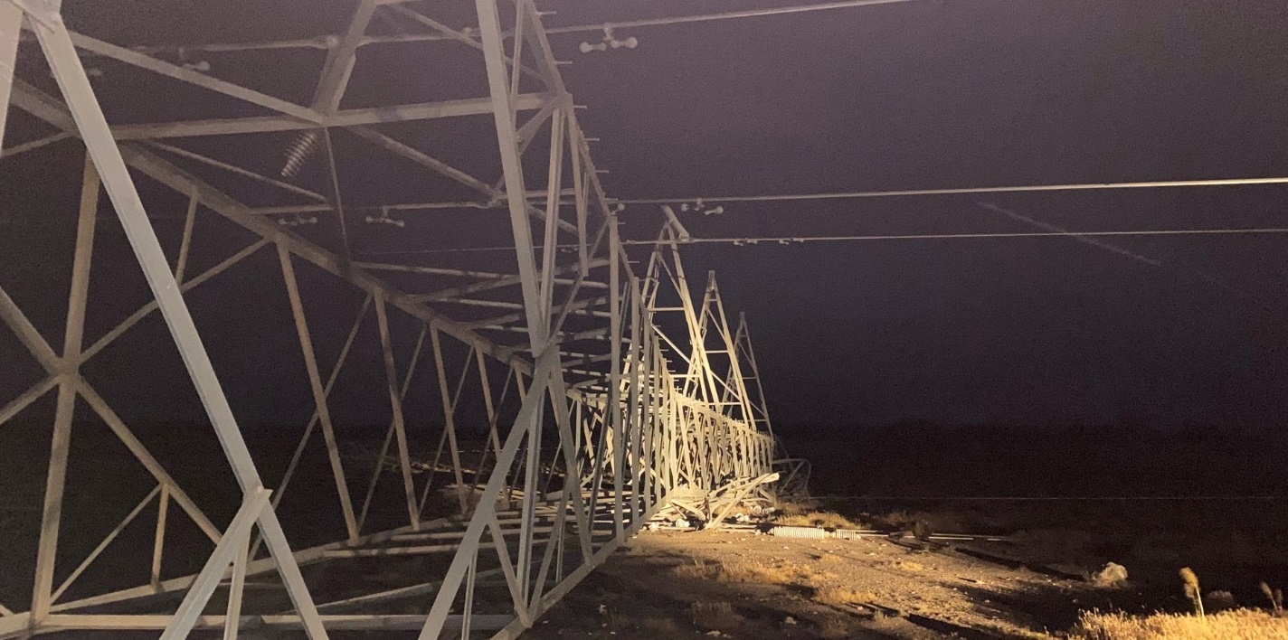
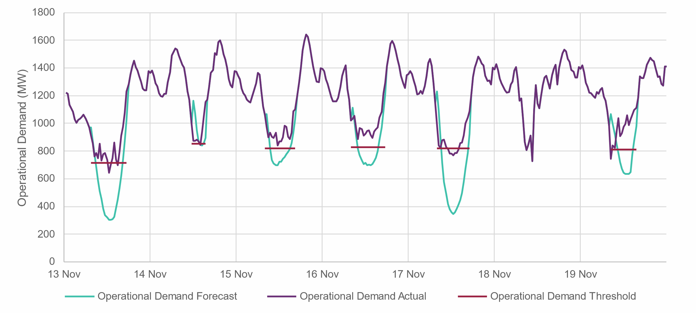




2022: DPV Control in Action – State Response
SA was islanded from the NEM November 2022 for 7 days
DPV curtailment required on 6 days to keep the system stable
Control mechanisms:
SCADA generators
Smarter Homes
(& Flexible Exports)
Emergency Voltage Raise
91.5% peak VRE while islanded

Slide 13
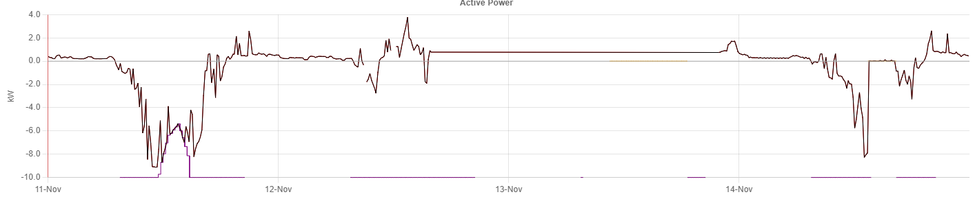
2022: DPV Control in Action – Customer Experience
Grid import
Grid export
Export limit
Friday 11 Nov:
Export limit reduced due to local network congestion
Saturday 12 Nov:
Power outage due to storm event
Comms interrupted
Sunday 13 Nov:
Power restored
Comms online
Monday 14 Nov:
Export constrained from 10kW to 0kW to maintain system security on AEMO direction
Solar self-consumption continues
Export limits at 10kV >98% of the time

Slide 14
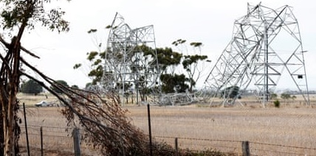
2024: DPV Control in Action
Several transmission towers failed in Victoria in February 2024
DPV curtailment required for
2 hours to keep the system stable
Control mechanisms:
SCADA generators
5MW curtailed via Flexible Exports Emergency Controls
Control execution speed: 15min
High response rate: 85% of devices curtailed
Smarter Homes
(only Flexible Exports)
Emergency Voltage Raise

