Slide 1
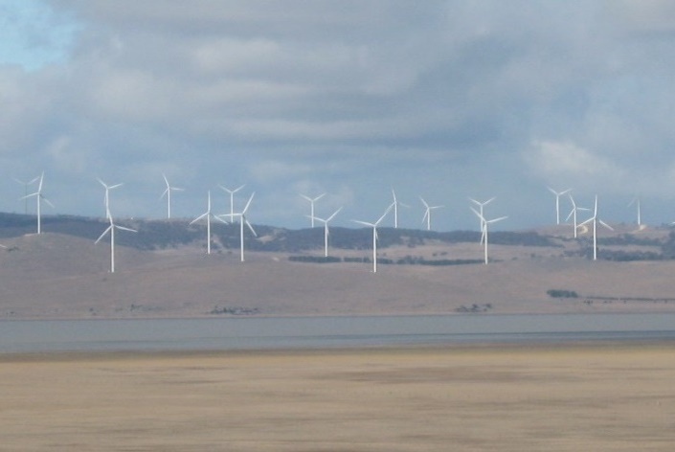
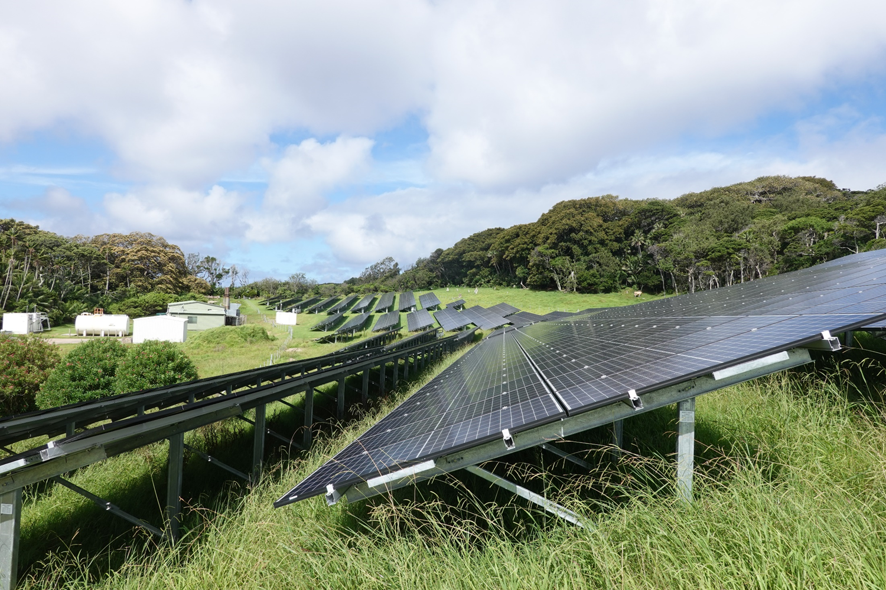
Pumped hydro energy storage to support the fastest energy change in history
Andrew Blakers
Australian National University
http://re100.eng.anu.edu.au/

Slide 2
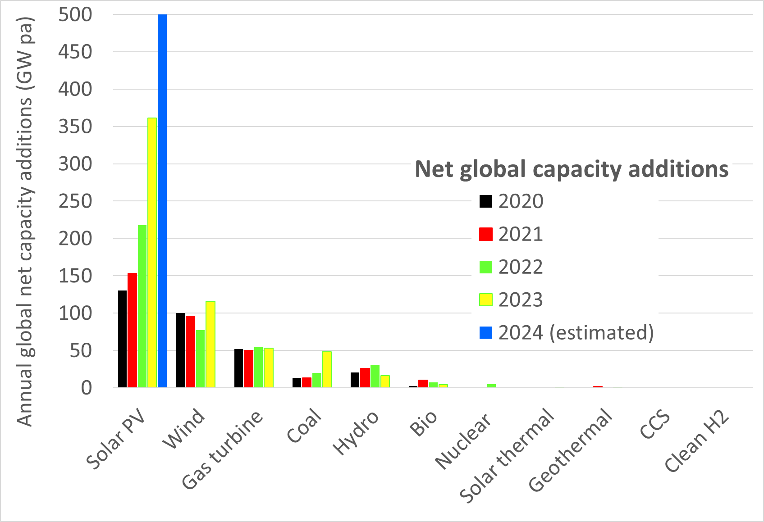
The solar revolution
Cheapest energy in history
All required technology is off-the-shelf
Storage is a solved problem
Notes:
Sources:
IRENA Capacity Statistics 2020 http://www.irena.org/home/index.aspx?PriMenuID=12&mnu=Pri
Nuclear: http://www.world-nuclear.org/information-library/facts-and-figures/world-nuclear-power-reactors-and-uranium-requireme.aspx
Coal: https://endcoal.org/
Hydropower Status Report: https://www.hydropower.org/
Has turbines: https://www.turbomachinerymag.com/worldwide-gas-turbine-forecast-2/

Slide 3
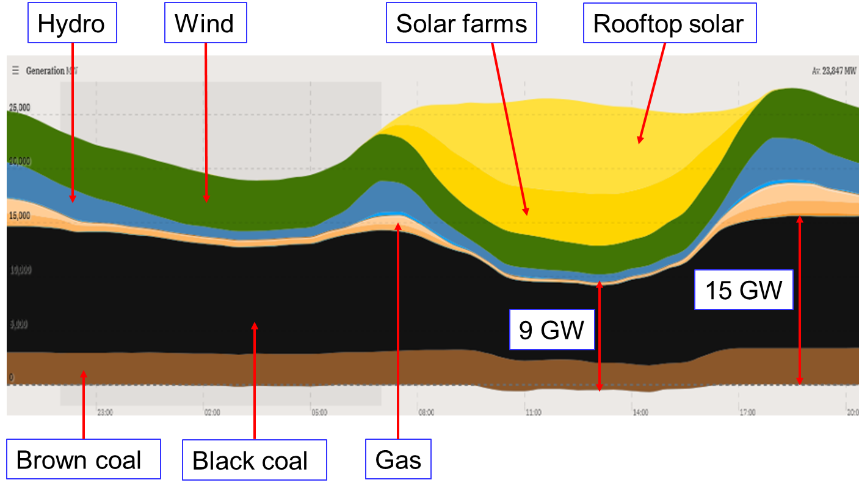
Balancing Solar & Wind
Solar panels and wind turbines everywhere
  Hugely reduces storage by smoothing-out local weather
Storage: Pumped hydro and batteries
Demand management
Load-following coal
Negative prices

Slide 4
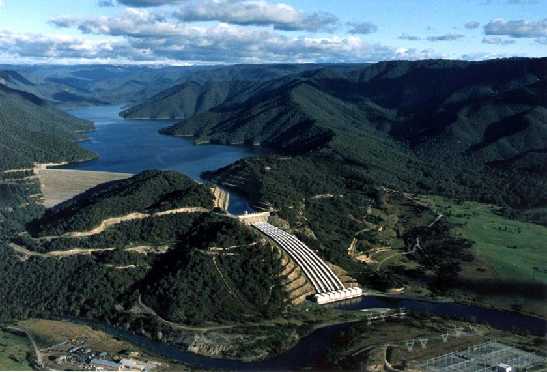
On-river pumped hydro storage: Tumut 3
Head: 151 m
Water volume: 6 Gigalitres
Combined reservoir area: 19 km²
1.5 GW power rating
The working material is H₂O, which is abundantly available and non-toxic

Slide 5
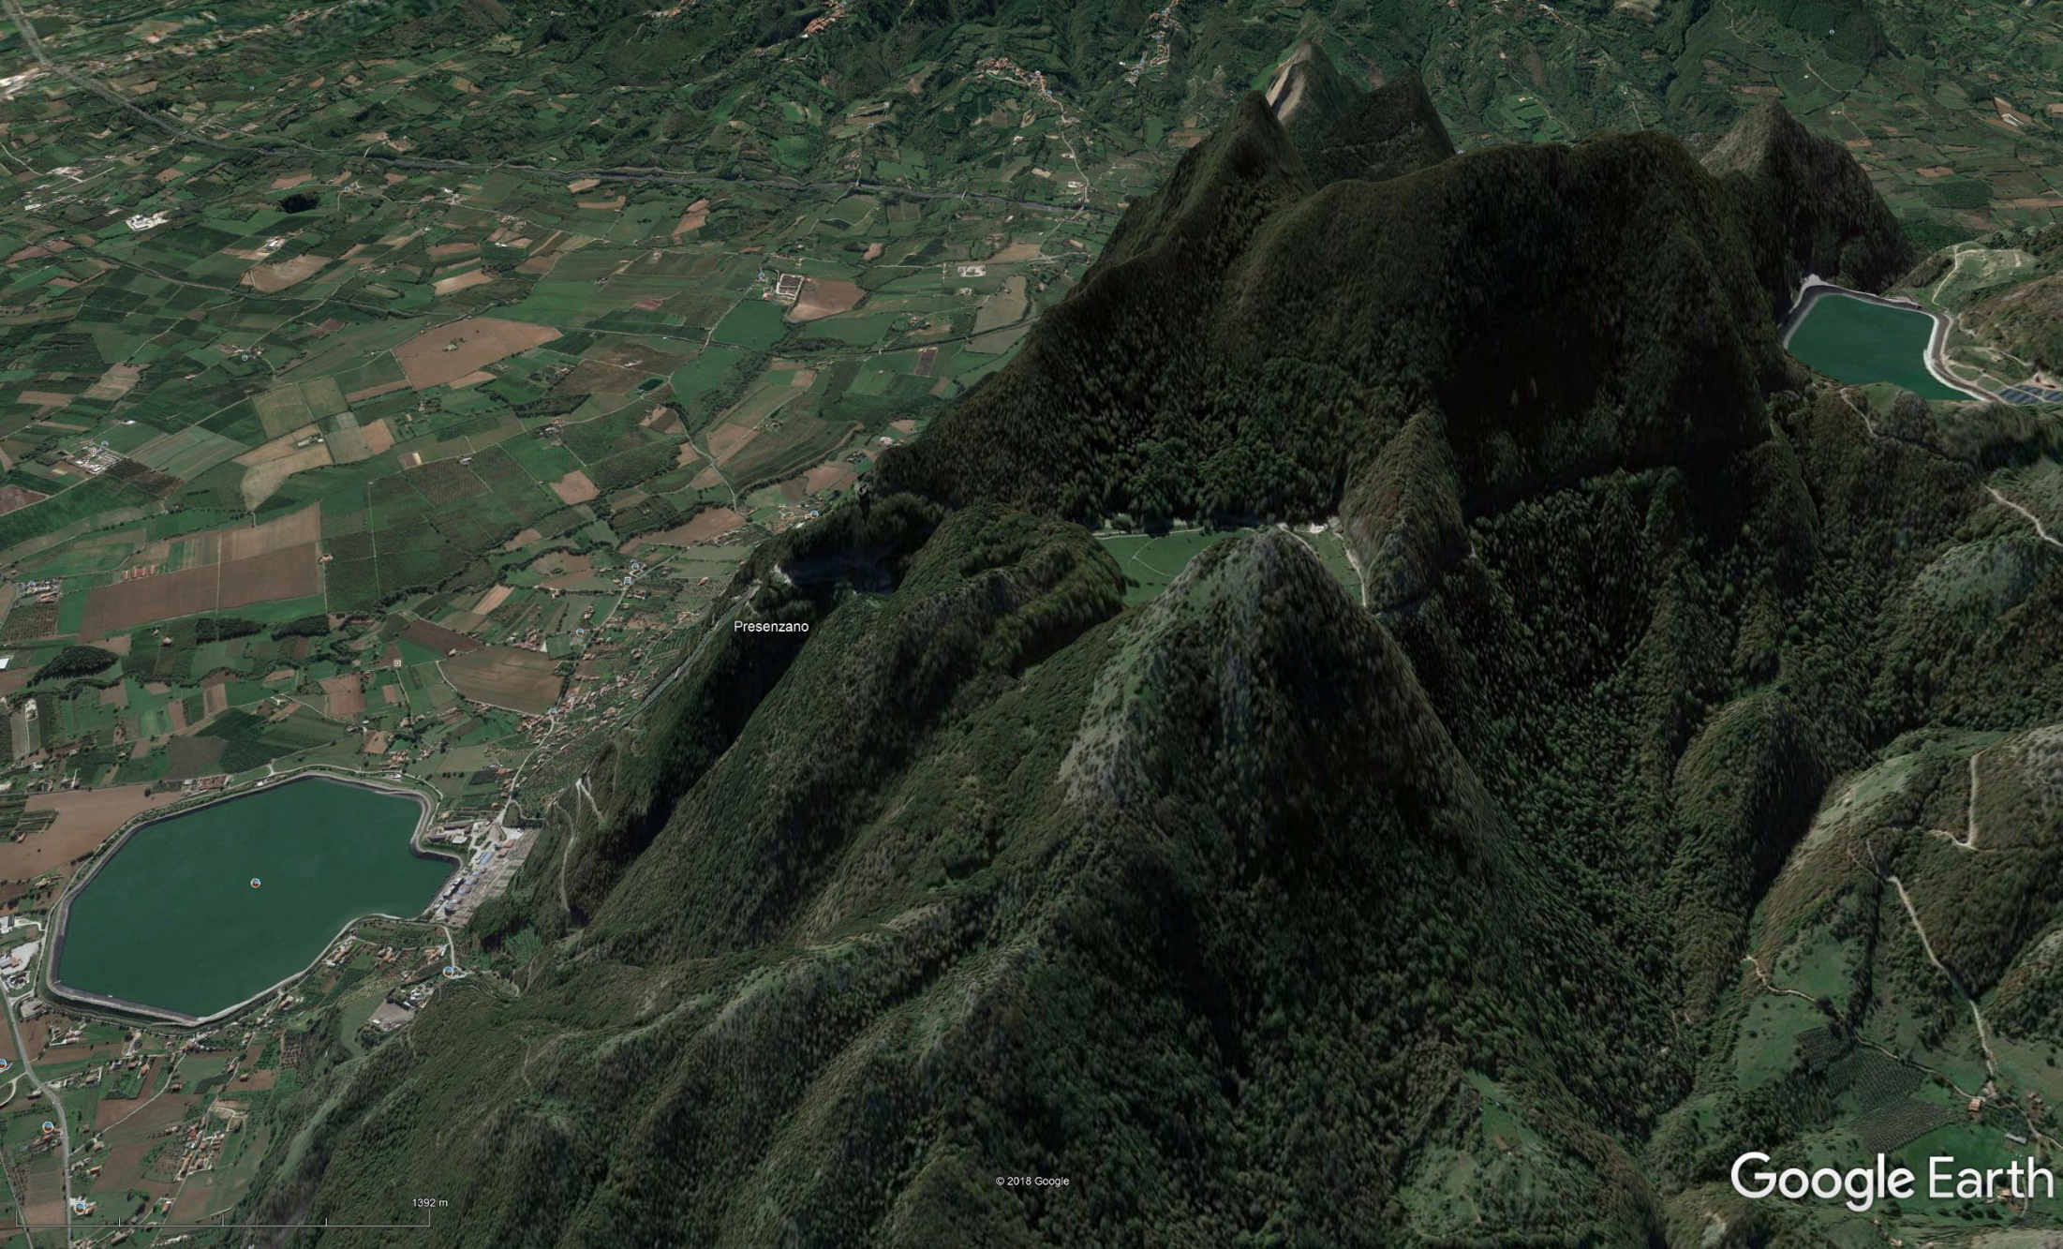
Off-river pumped hydro energy storage
Head: 500 m
Water volume: 6 Gigalitres
Combined reservoir area: 1 km²
1 GW power rating (6 hours)
Upper reservoir
Lower reservoir
Presenzano, Italy

Slide 6
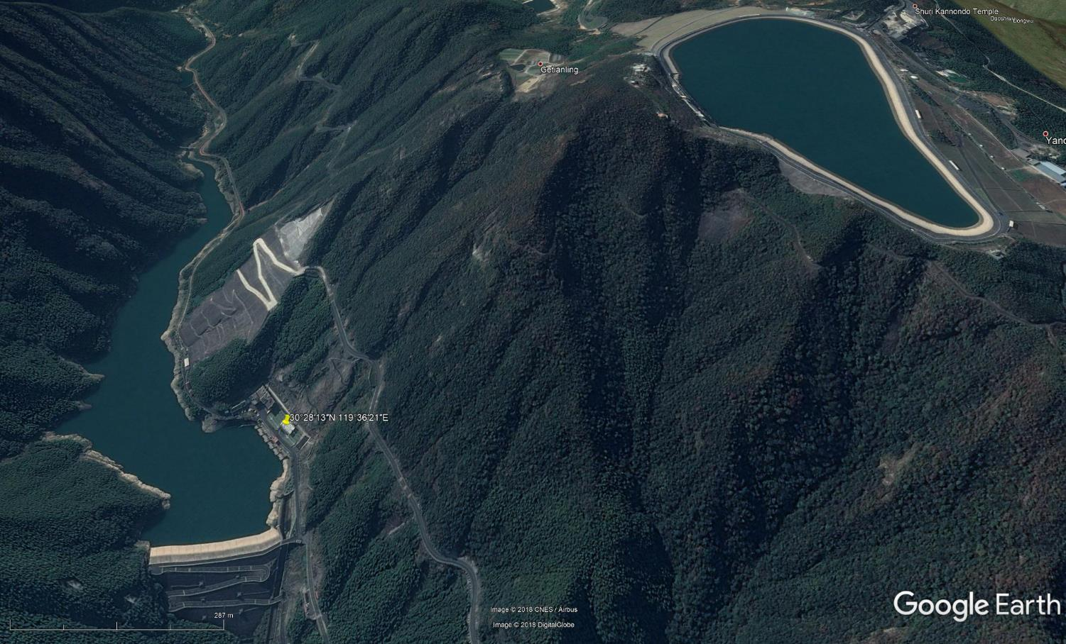
Off-river (closed-loop) pumped hydro
Tianhuangping Pumped Hydro
1.8 GW, 7 hours of storage
Large head (890m)
Low flood control cost

Slide 7
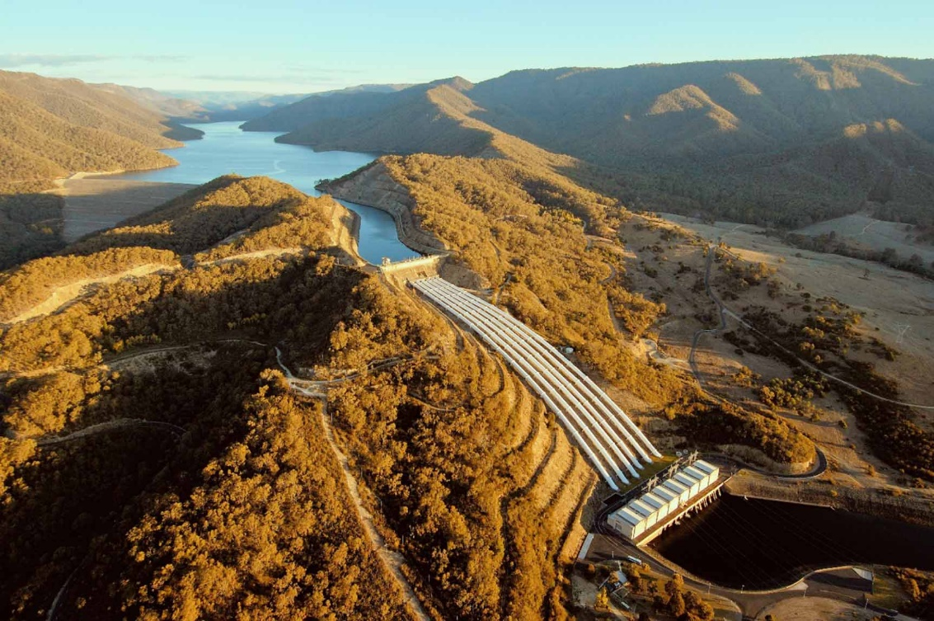
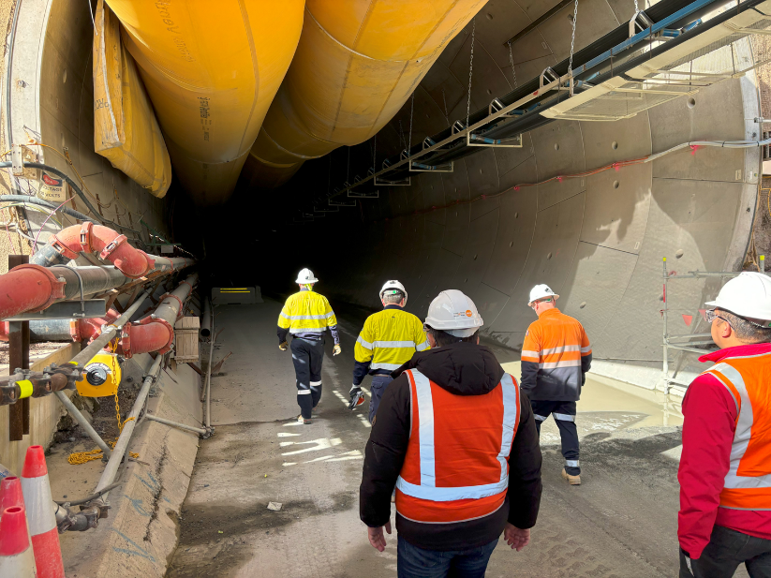
Snowy 2.0
Talbingo
Powerhouse tunnel
350 GWh, 2.2 GW = 7 million EV batteries
= bigger than all utility batteries in the world combined
Capital cost: US$8 billion/350 GWh = US$22/kWh
=12X cheaper than batteries
Speed of deployment: 350 GWh/8 years = 40 GWh/year
= 15X faster than big batteries

Slide 8
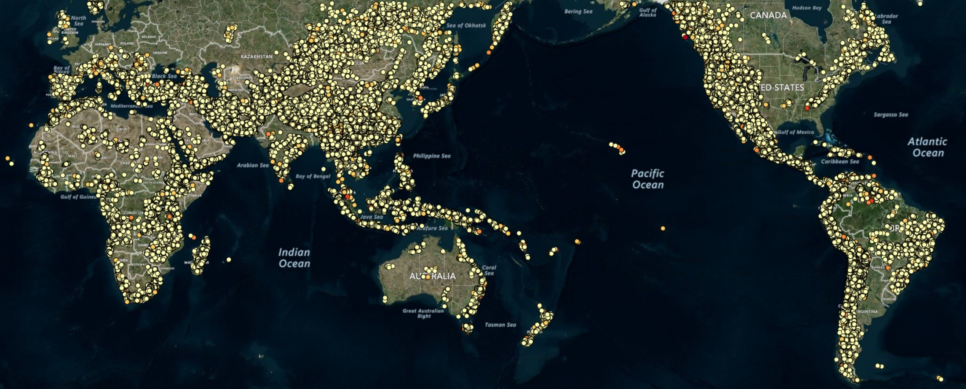
ANU’s global off-river pumped hydro energy storage atlas
0.8 million sites
86 million Gigawatt-hours = 2 trillion electric vehicles batteries
= 250 EV batteries per person
http://re100.eng.anu.edu.au

Slide 9
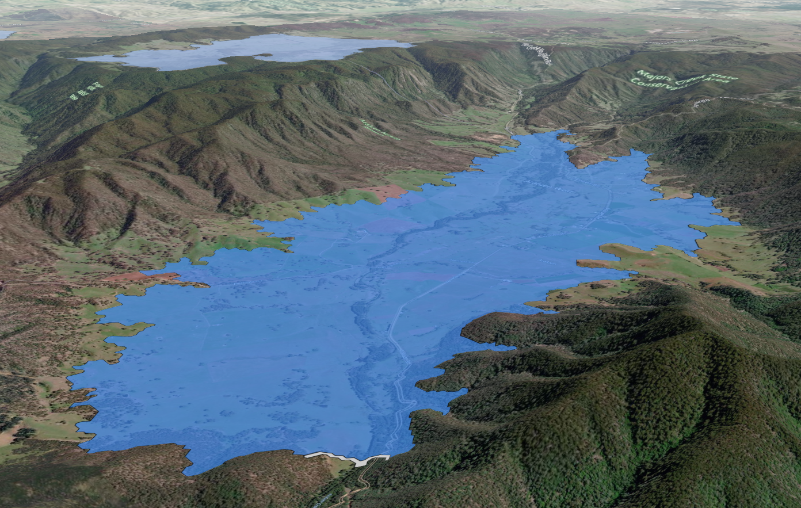
Araluen Valley, 500 GWh, Class AA
Upper
Tunnel
Lower
Dam wall
Australia needs 2 of these for complete decarbonization
http://re100.eng.anu.edu.au/global/index.php

Slide 10
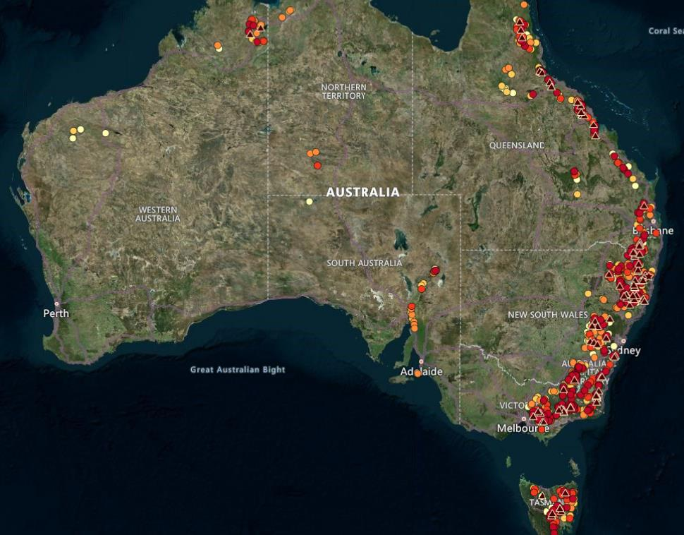
Australia’s large pumped hydro energy storage
300X more than needed to support 100% renewable energy
150 GWh storages
http://re100.eng.anu.edu.au/global/index.php
Tiny area of land flooded for full decarbonization: 4m² per person
Tiny volume of water per day:
4 litres per person

Slide 11
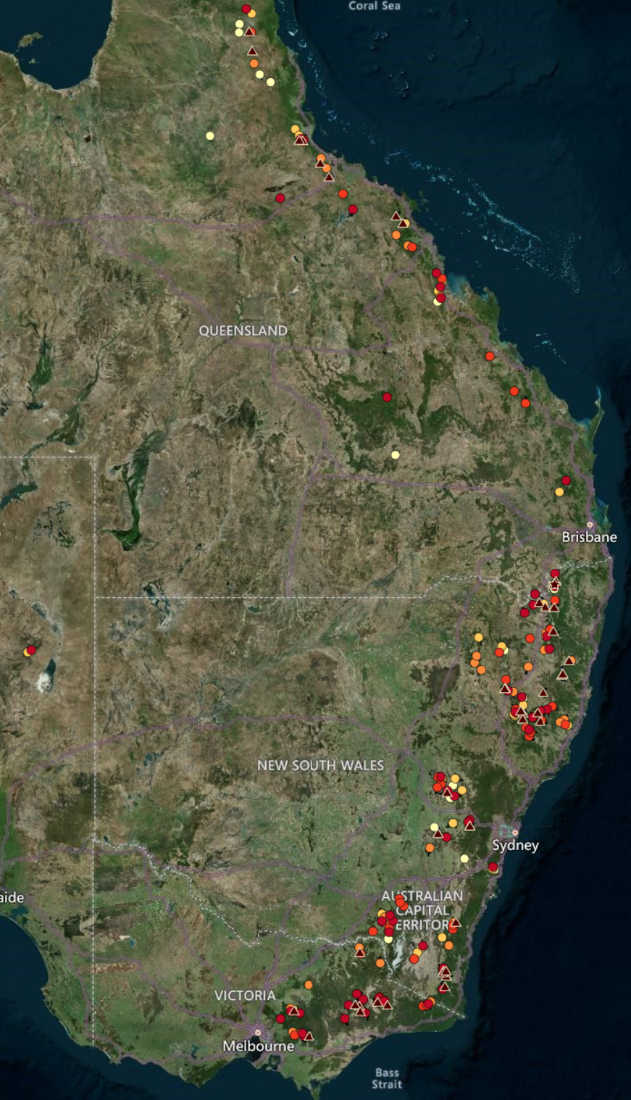
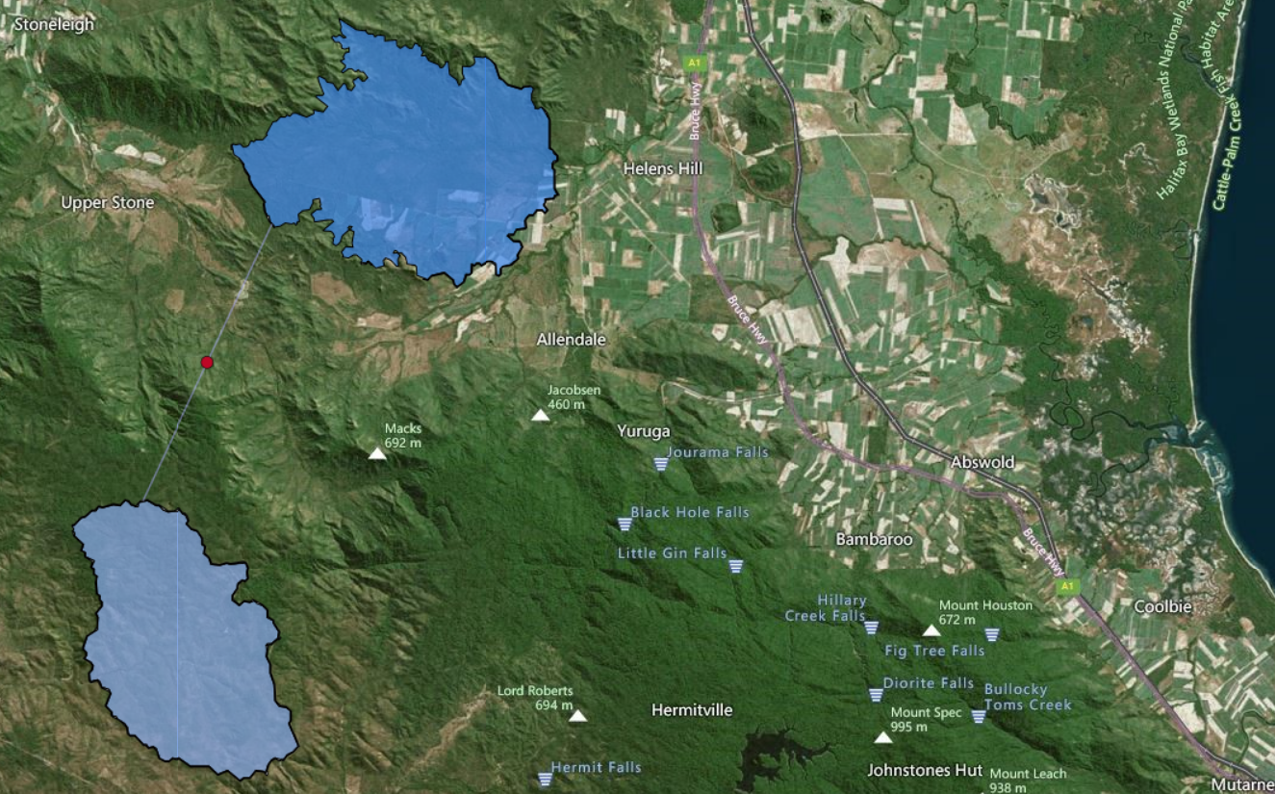
PHES Atlas
Size (GWh)
  2, 5, 15, 50, 150, 500, 1500, 5000
Head 100-1600 metres
Atlases
  Greenfield
  Bluefield (existing reservoirs)
  Brownfield (old mining sites)
http://re100.eng.anu.edu.au
500 GWh sites
Enough for 10 million people each
5000 GWh Class A site near Townsville.
Enough storage for 100 million people.

Slide 12
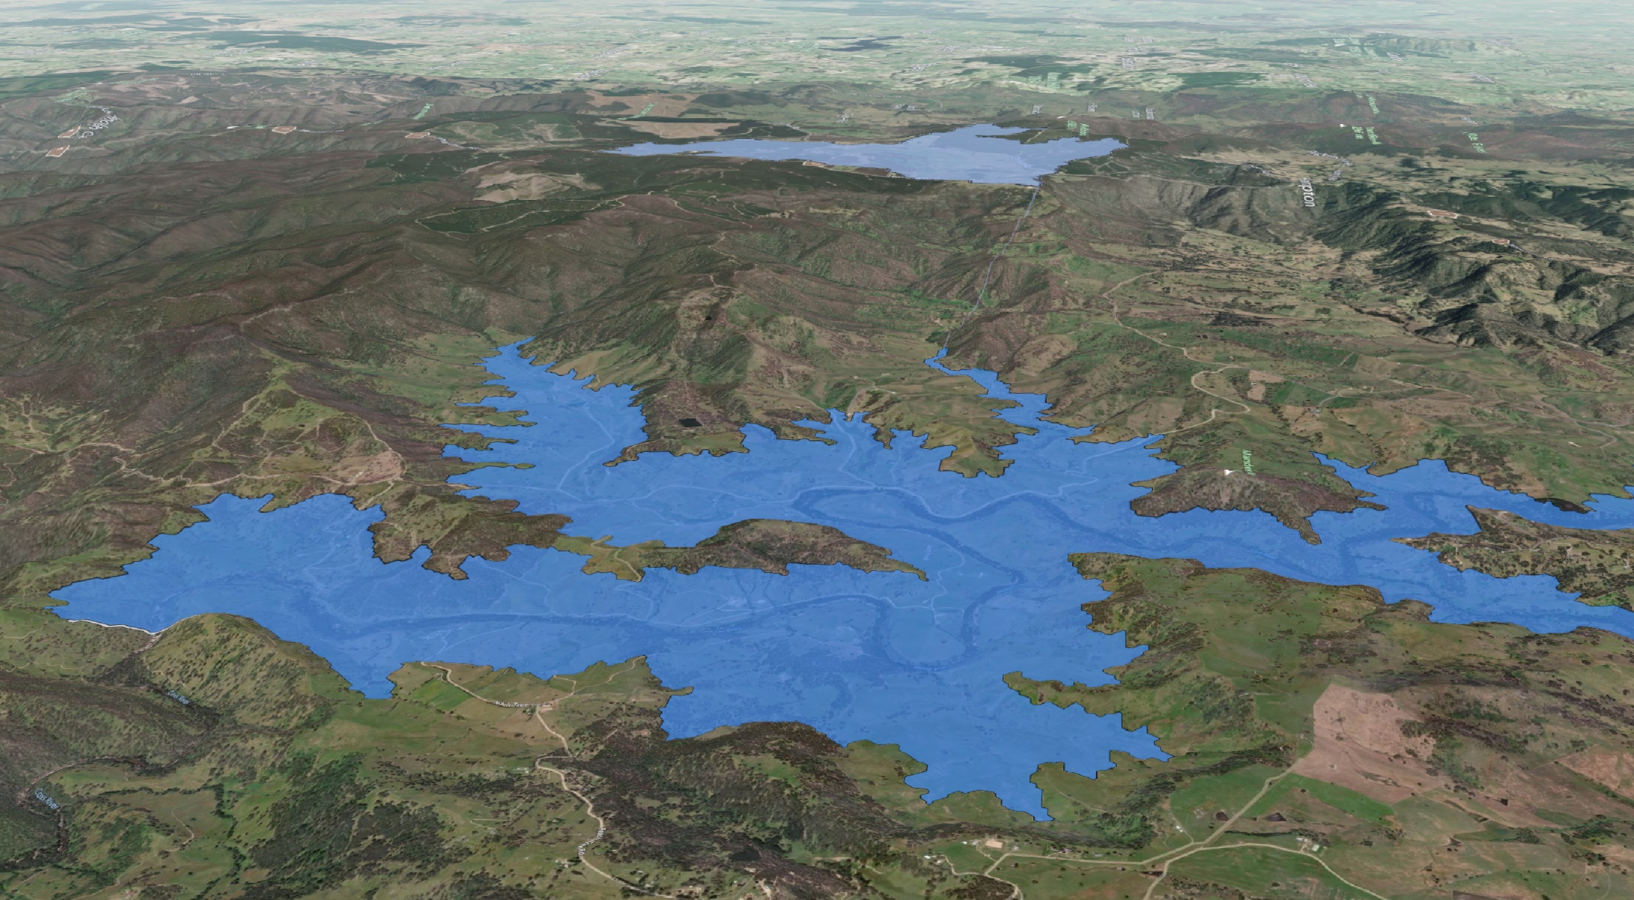
Pumped hydro solves overnight storage
Australia has 5000 sites, 300X more than required
Low cost, low-impact, off-the-shelf technology
Enough storage here for complete decarbonization
1500 GWh Class AA site near Lithgow

Slide 13
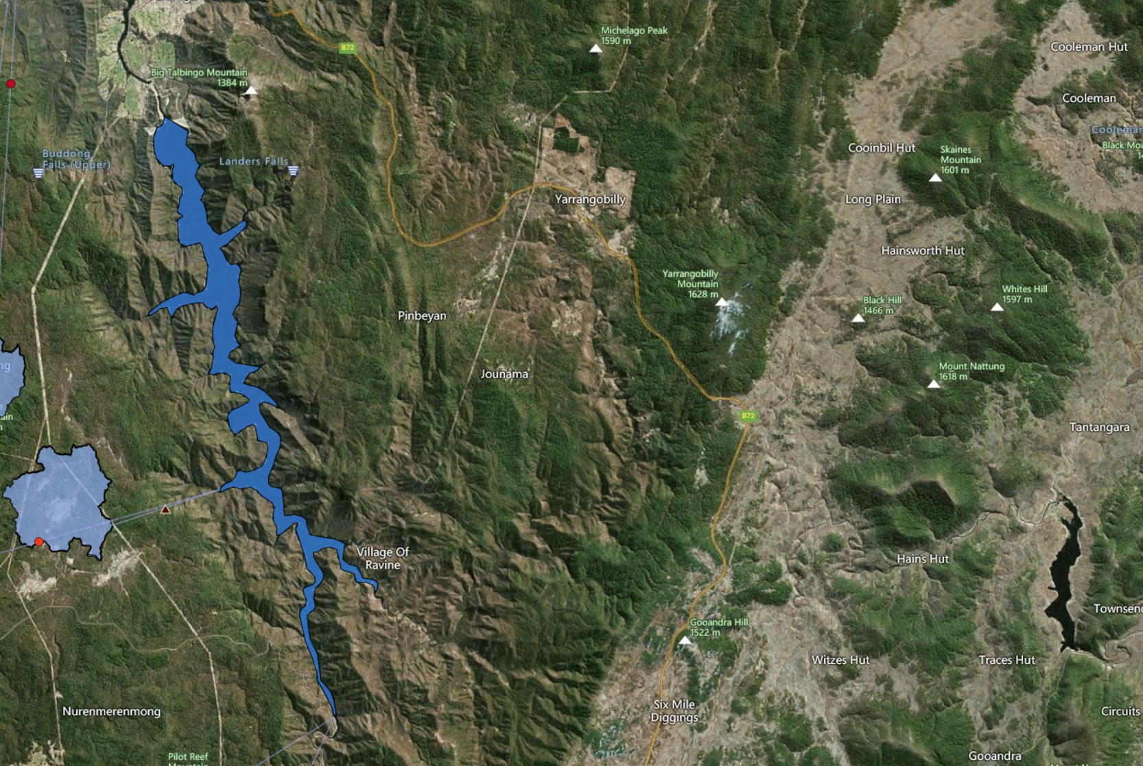
“Snowy 3.0” Class AA
Same workforce, roads, transmission, tunnel borers, concrete plant, workcamps
Lots of options including connection to Blowering
Snowy 2.0 tunnel, 27 km long (350 GWh)
“Snowy 3.0”
(100-500 GWh)
https://re100.eng.anu.edu.au/pumped_hydro_atlas/

Slide 14
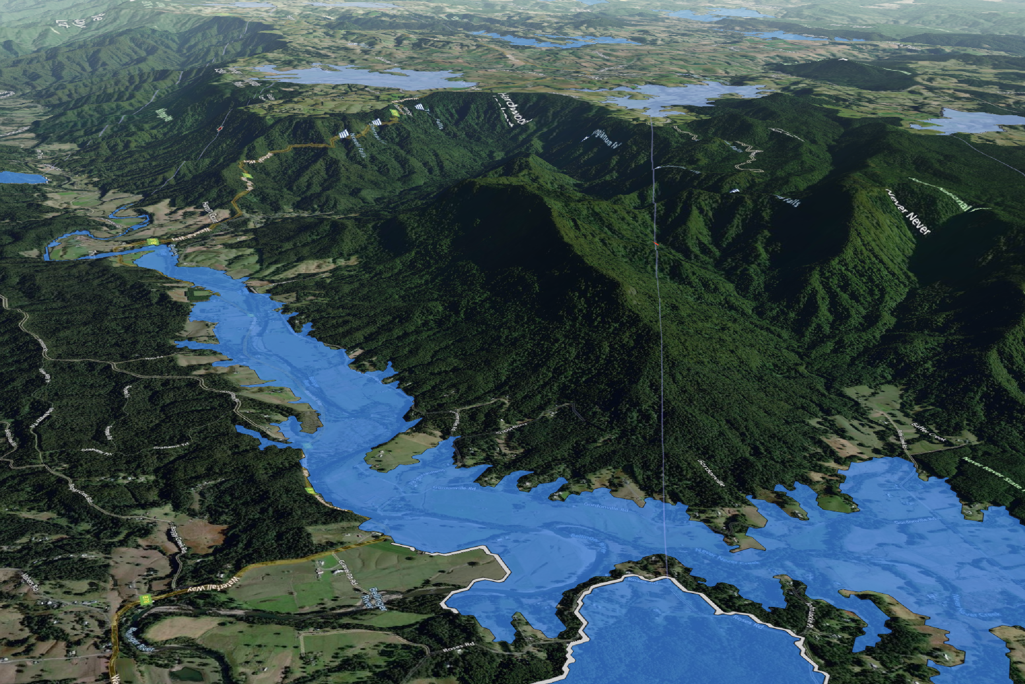
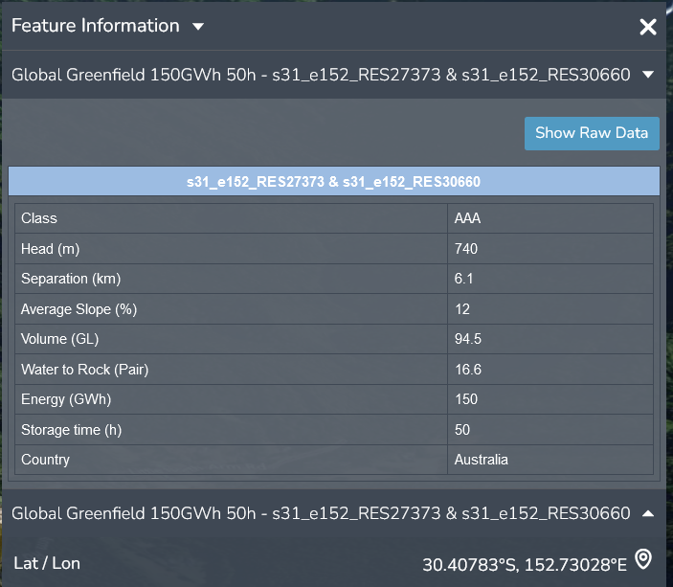
Coffs Harbour 150 GWh Class AAA

Slide 15
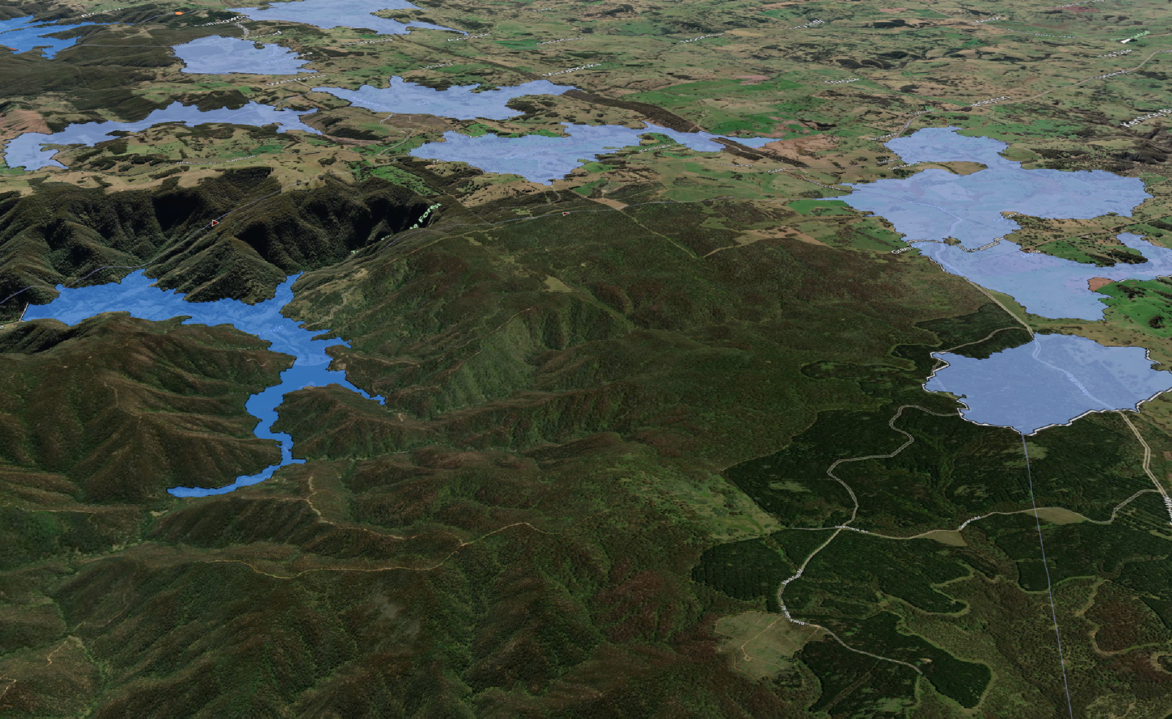
Tamworth 150 GWh Class AA
Short pressure tunnel
Aqueduct

Slide 16
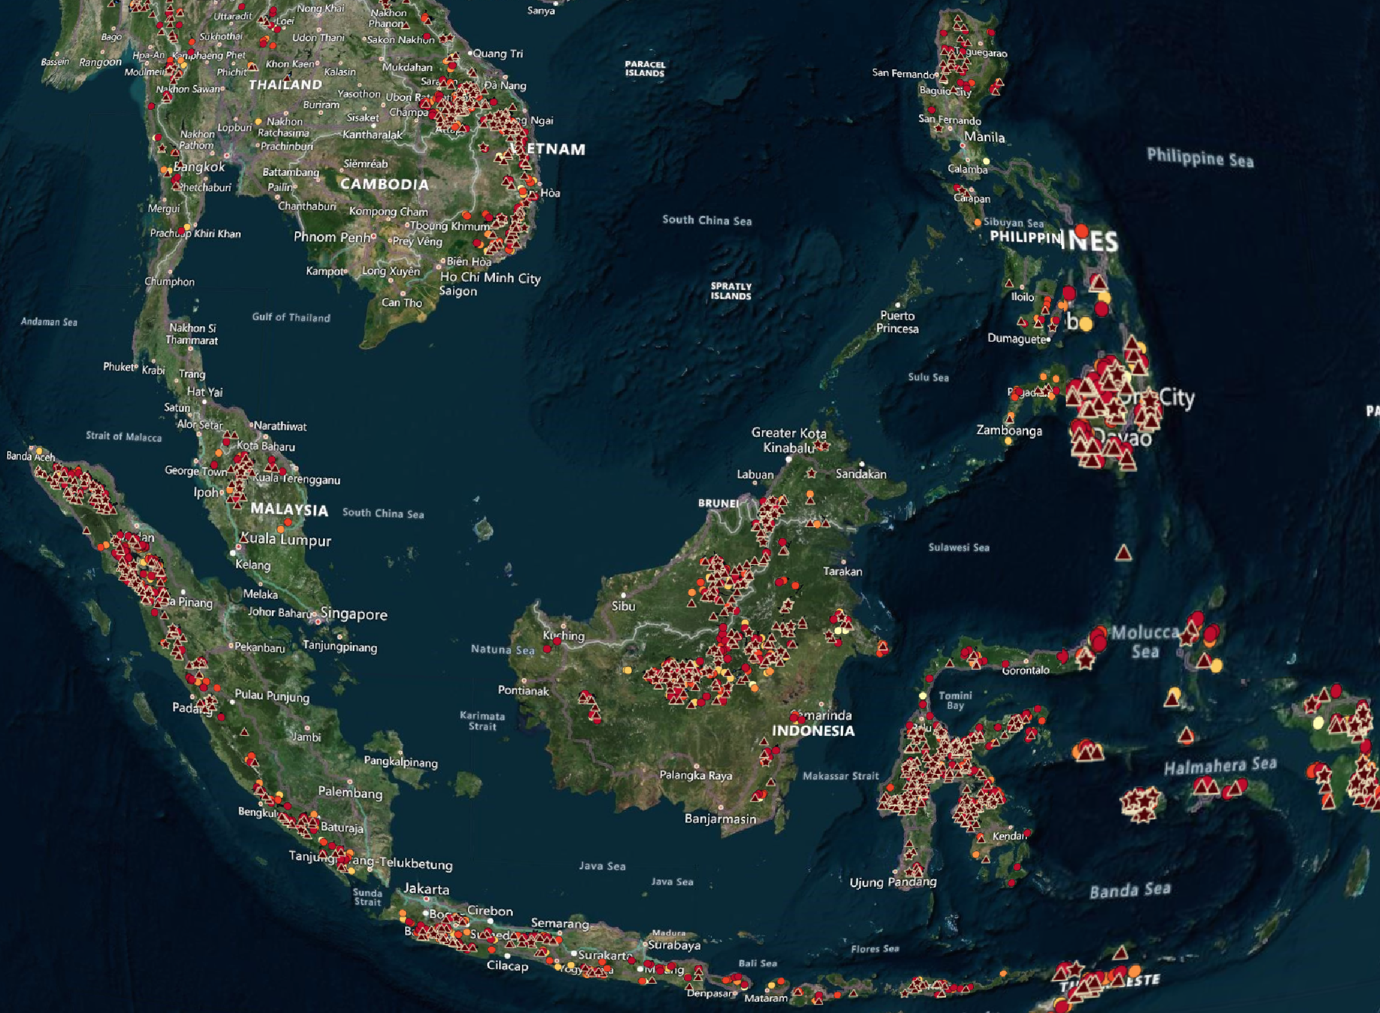
Excellent sites everywhere.
200X more than needed to support 100% solar energy.
500 GWh

Slide 17
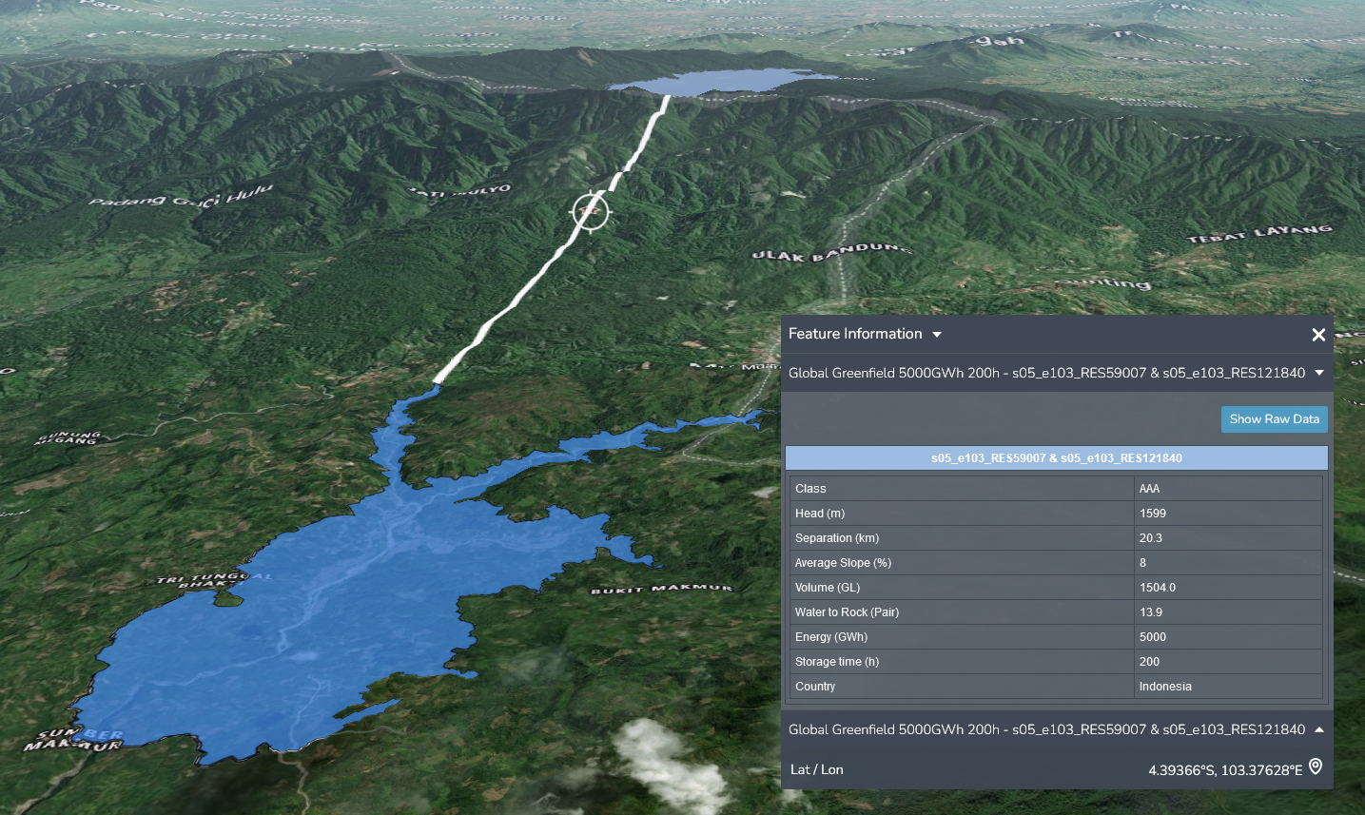
Extraordinary sites are extraordinarily cheap
Sumatra 5000 GWh Greenfield Class AAA site
= 100 million EV batteries
Head=1600 metres
Slope=8%
Water/Rock ratio=14
Flooded area=50km²
ASEAN needs 8 of these when it is affluent and fully decarbonized
Capital cost: US$10/kWh = 30X less than a Big Battery

Slide 18
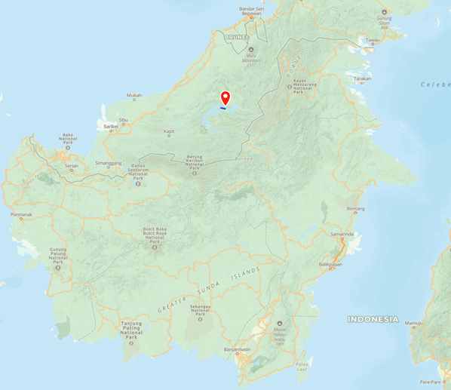
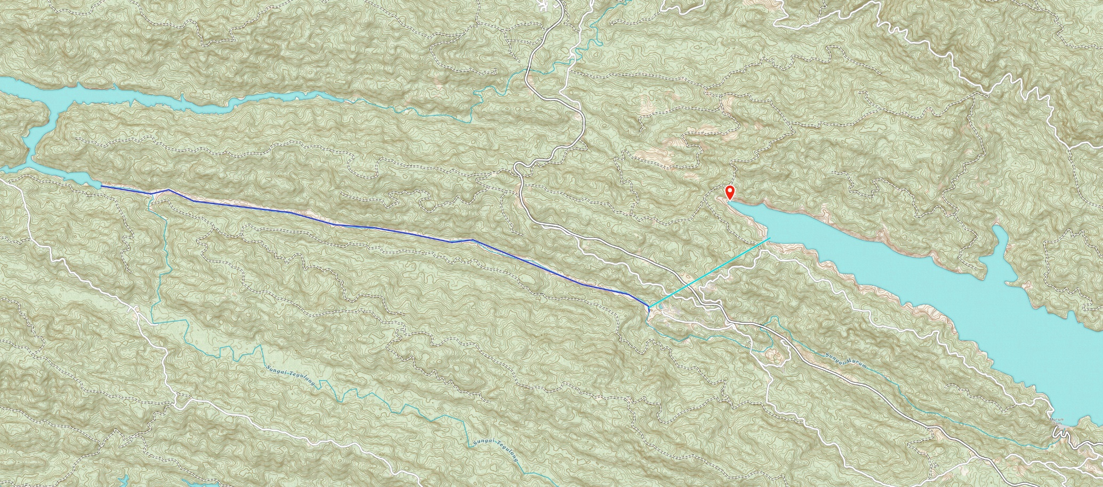
Bakun and Murum
Head = 300 m
Storage = 4000 GWh
  = 80 million EV batteries
  = Storage for 80 million affluent and fully electrified people
Capital cost: US$8/kWh
12X Snowy 2.0
500 km
Bakun
Pressure tunnel (3km)
Aqueduct (12km)
Space for 100 GW of floating solar
Murum

Slide 19
A solar-dominated energy system
Generation will triple
  Electrify transport (EV), heating (heat pumps, furnaces), chemicals (ammonia, metals), aviation (synfuels)
Solar will dominate
  Much easier to build than wind and transmission
Large overnight storage is required, especially in winter
  50 GWh + 2 GW per million people
Hybrid storage:
  Pumped hydro + batteries better than either alone
 | Energy storage $/GWh | Storage power $/GW
Pumped hydro | Cheap | Moderate cost
Batteries | Expensive | Cheap
Hybrid | Cheap | Cheap

Slide 20
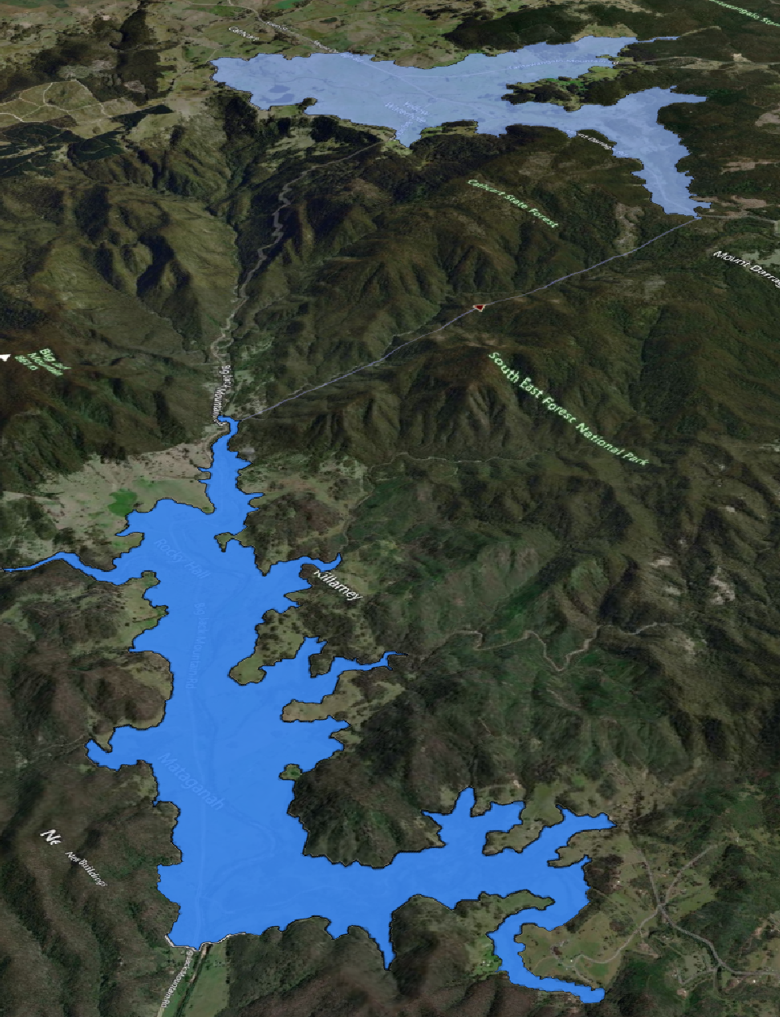
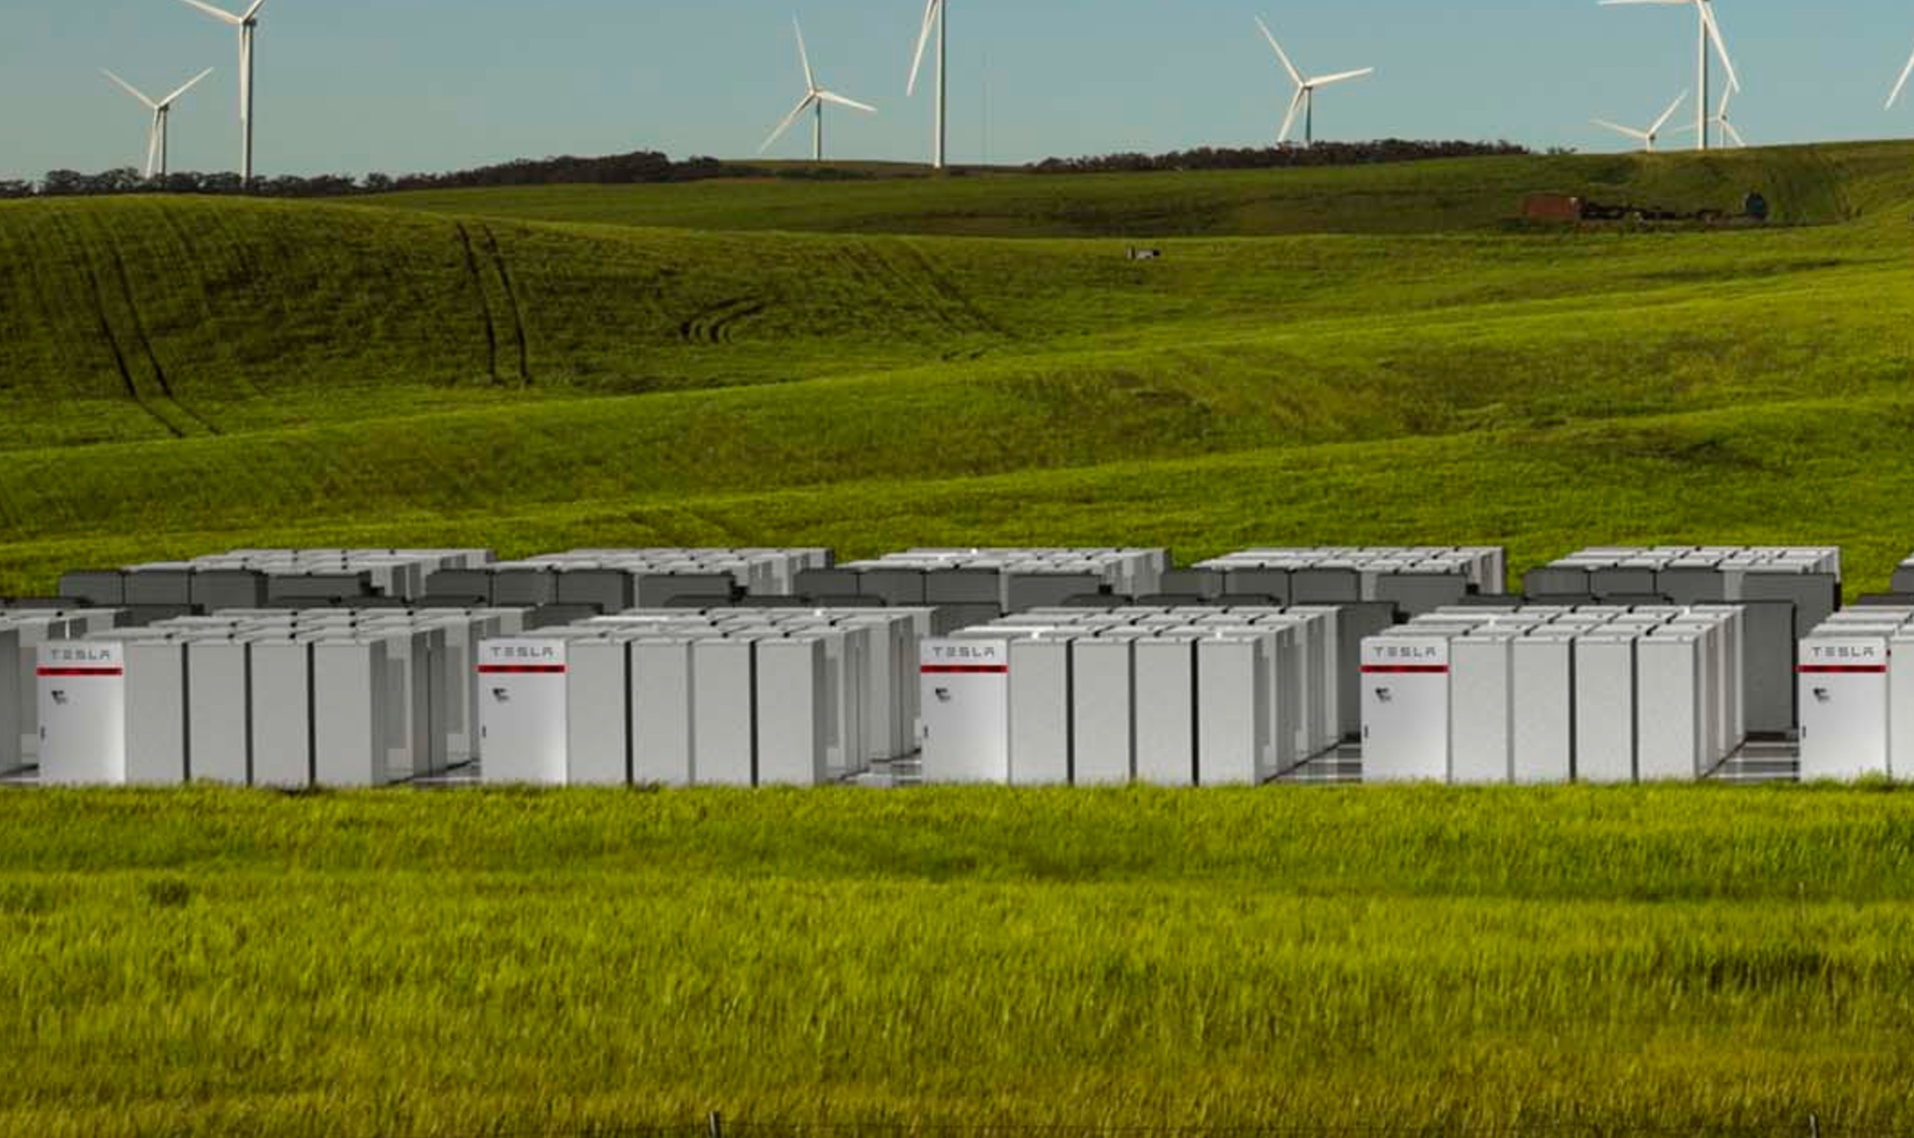
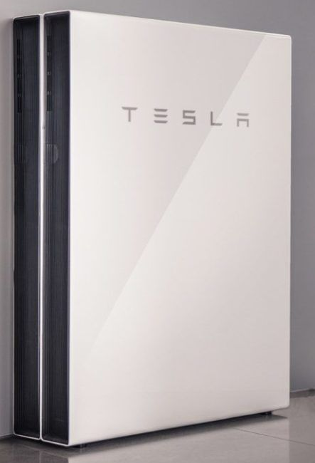
Trickle-charging in a bad week
350 GWh
2 GW
2 GW, 24/7 = 48 GWh
Every day for a week
Hornsdale
12 x 4-hour big batteries = 48 GWh
12 GW
LOAD
24 GW
Key points:
Storage charging storage
PHES: very cheap energy storage
Batteries: cheap power
5 million home batteries = 48 GWh

Slide 21
Battery and pumped hydro capital cost
- expressed as capital cost per kWh of storage (US$/kWh)
Triple-priced PHES in GenCost causes grid models to reach for gas backup

Slide 22
Trickle charging
Storage charging storage during stress-weeks
A solar dominated system needs LOTS more storage than a solar/wind/transmission optimised system
Low power PHES (150 hours of storage) is very cheap
Gas turbines with 2-5% duty cycle cost US$200-400/MWh
  Pumped hydro is cheaper - get rid of gas entirely

Slide 23
Extraordinary pumped hydro sites
= extraordinarily low cost
Thousands of extraordinary sites (Class AA, Class AAA)
Extraordinarily low storage cost: 10-30X cheaper than batteries for overnight and longer energy storage
PHES trickle-charging batteries 24/7 during stress-weeks avoids the need for gas backup
Hybrid battery + PHES is better than either alone
GenCost/ISP estimates for PHES are double or triple

Slide 24
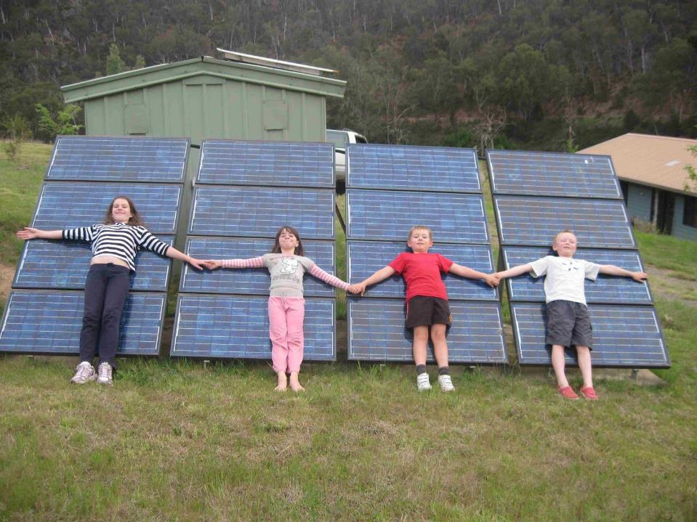

Thank you!
http://re100.eng.anu.edu.au

