Slide 1
Operating a System with High VRE
Decarbonising Isolated Grids
CSIRO – Thomas Wearne
October 2024

Slide 2
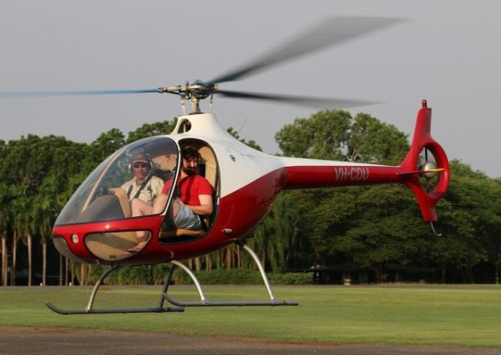
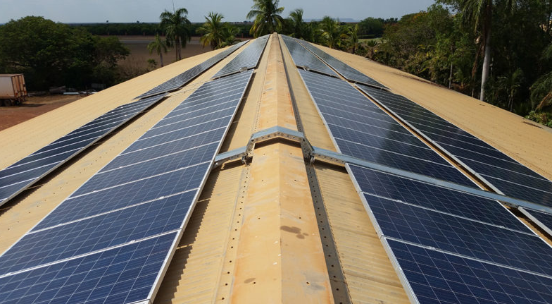
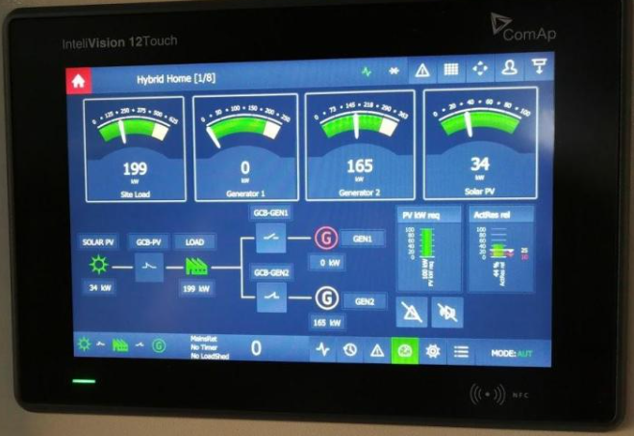
About Me
Studied Renewable Energy & Elec. Power Engineering (2014).
Designed/Commissioned ~12 SAPS in the solar industry.
Worked for Power and Water as a Power Systems Engineer, mainly on Alice Springs Future Grid (ARENA project)
Joined CSIRO in January 2024. (Working in DER space including 2030.5, EVs and microgrid decarbonisation.)
Notes:
(Thesis was SAPS for remote indigenous community)

Slide 3
Overview
1. About Me
2. Generator Loading & Spinning Reserve
3. Generator Modularity
4. Turning Generators OFF
5. The Role of Batteries
6. The Microgrid Controller
7. Renewable Energy Fraction (REF)
8. Solar Geometry & Array Orientation

Slide 4
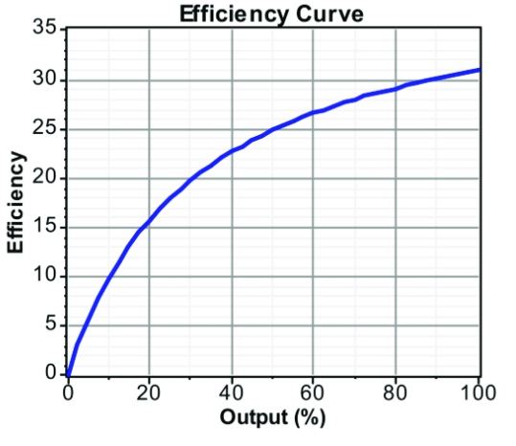
Generator Loading & Spinning Reserve
A system is operating securely when it can withstand the loss of the largest generator (and load). This requires generators to operate with headroom (“spinning reserve”.)
Fuel efficiency drops with decreased loading, so headroom has real cost. There is incentive to increase unit loading but also to decrease the output of largest operating generator.
Cummings KTA50-G3 Prime Ratings
Loading | kW | L | kWh/L
100% | 1097 | 261 | 4.2
75% | 822 | 199 | 4.13
50% | 548 | 139 | 3.94
25% | 275 | 76 | 3.62

Slide 5
Generator Modularity
Comparison 2 vs 4 generators
If the same load is met with four generators instead of two, the contingency size halves and loading improves.
The modern trend is larger numbers of “micro” generators. (for 16 x 2 MVA loading = 94%). These are faster!*
 | Rating | time step 0 | time step 1 | time step 2
Load | 30 MW | 30 MW | 30 MW | 30 MW
Generator 1 | 30 MVA | 15.0 MW | 15 MW | 30.0 MW
Generator 2 | 30 MVA | 15.0 MW | 15 MW | 0.0 MW
Spinning Reserve |  | 30.0 MW | 15 MW | 0.0 MW
Operating Point |  | 50% | 50% | 100%
 | Rating | time step 0 | time step 1 | time step 2
Load | 30 MW | 30 MW | 30 MW | 30 MW
Generator 1 | 10 MVA | 7.5 MW | 7.5 MW | 10.0 MW
Generator 2 | 10 MVA | 7.5 MW | 7.5 MW | 10.0 MW
Generator 3 | 10 MVA | 7.5 MW | 7.5 MW | 10.0 MW
Generator 4 | 10 MVA | 7.5 MW | 7.5 MW | 7.5 MW
Spinning Reserve |  | 10 MW | 7.5 MW | 0.0 MW
Operating Point |  | 75% | 75% | 100%
Notes:
A 30 MVA machine might take 30 minutes to start whereas a 3 MVA machine might be able to start in 30 seconds.
Much easier to accept load change at higher loading. The 50% generator probably cannot double output fast enough to avoid failure in the above example (load shedding etc.)
True headroom is how much load can be accepted in a single step from a given position. This is tested in commissioning and can be an important quality.
Certainly fewer generators are cheaper (capex) but probably more expensive to run and compromises performance.

Slide 6
Generator Modularity
Modularity also helps with high penetration of solar PV. Spinning Reserve ~=80% PV output (new largest contingency,
if not single point of connection)
Comparison 2 vs 4 generators + Solar PV
 | Rating | time step 0 | Cap Factor
Load | 30 MW | 30 MW
Generator 1 | 30 MVA | 6.0 MW | 20%
Generator 2* | 30 MVA | 6.0 MW | 20%
Solar PV | 25 MVA | 18 MW | 72%
Min Load Diesel | 20%
Curtailed Solar PV | 7 MW
Spinning Reserve Actual | 48 MW**
Spinning Reserve Needed | 14.4 MW | (~80% output of PV)
 | Rating | time step 0 | Cap Factor
Load | 30 MW | 30 MW
Generator 1 | 10 MVA | 2.0 MW | 20%
Generator 2 | 10 MVA | 2.0 MW | 20%
Generator 3 | 10 MVA | 2.0 MW | 20%
Gen 4 (OFF) | 10 MVA | 0.0 MW | 0%
Solar PV | 25 MVA | 24 MW | 96%
Minimum Load Diesel | 20%
Curtailed Solar PV | 1 MW
Spinning Reserve Actual | 24 MW
Spinning Reserve Needed | 19.2 MW | (~80% output of PV)
Notes:
*Can anyone tell me why we can’t turn off Generator 2 here if Generator 1 has enough reserve to replace 18 MW of solar PV?
** In reality this is nowhere near what these engines could provide in a load rejection event, because the short durational load acceptance capability will be far less than 80% of rated, particularly from a low-load starting position. This is likely not better than +20%.

Slide 7
Turning Generators Off (HCO)
In addition to fuel efficiency and avoided RE curtailment, operating hours = maintenance $, particularly at low loading.
Contingency (RAISE) is just ONE factor which affects the minimum number of Generators which must remain ON. Other ESS include Contingency (LOWER), regulation, fault ride-through, voltage regulation (VAr provision), inertia* and fault current provision* (system strength & protection)
Solar PV can provide some ESS but is “grid following” and much better suited to LOWER than RAISE.
Notes:
*BESS aren’t better at everything!

Slide 8
The Role of Batteries
It’s assumed the main role for batteries is to shift renewable energy around (hours). However, power and stability services (seconds) are currently where batteries provide most value.
Batteries decouple ESS from generators so they can switch OFF. Batteries operate at 0% load, respond faster* than engines and are far better at load-acceptance.
Load | 30 MW | 30 MW | Capacity Factor
Generator 1 | 30 MVA | 6.0 MW | 20%
Gen 2 (OFF) | 30 MVA | 0.0 MW | 0%
BESS | 8 MVA / 4 MWh | 0.0 MW | 0%
Solar PV | 25 MVA | 24.0 MW | 96%
Minimum Load Diesel | 20%
Curtailed Solar PV | 1.0 MW
Spinning Reserve Actual | 32.0 MW
Spinning Reserve Needed | 19.2 MW
2 generators + BESS
Notes:
*30 MVA Diesel generator might be able to go from 6 MW to 30 MW in 5 minutes, the BESS can go from -100% to +100% in <1s.

Slide 9
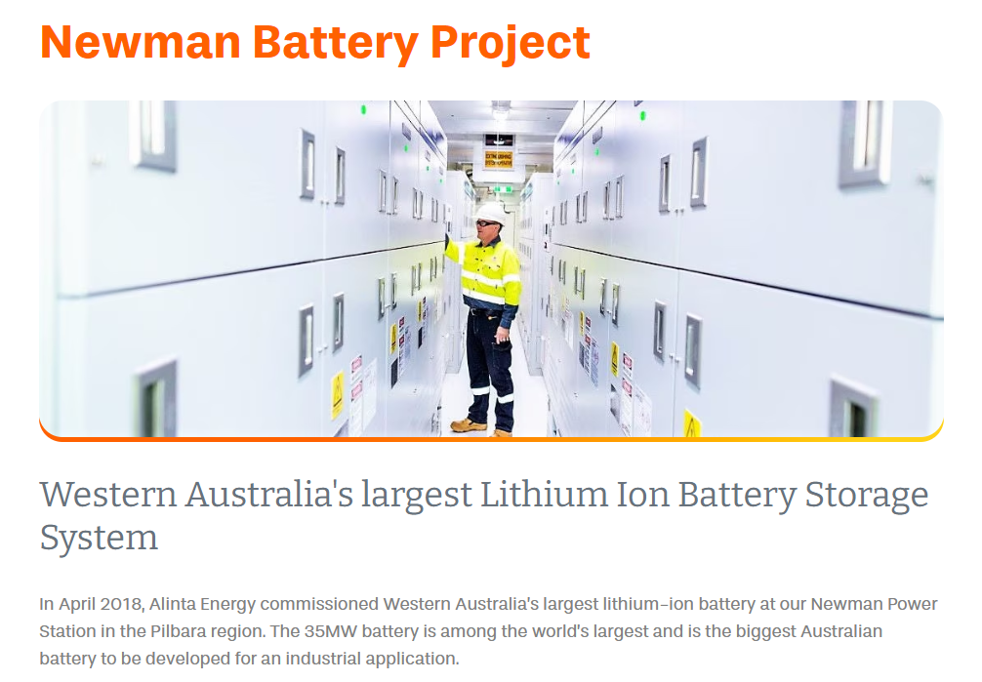
Notes:
The Newman BESS was added to a power system with no renewables. Its value was in assisting gas generators to function more optimally.
Located in the Pilbara region of WA, Newman Power Station is a 178MW dual fuel (gas and distillate) power station that has supplied electricity to the area since the 1970s.

Slide 10
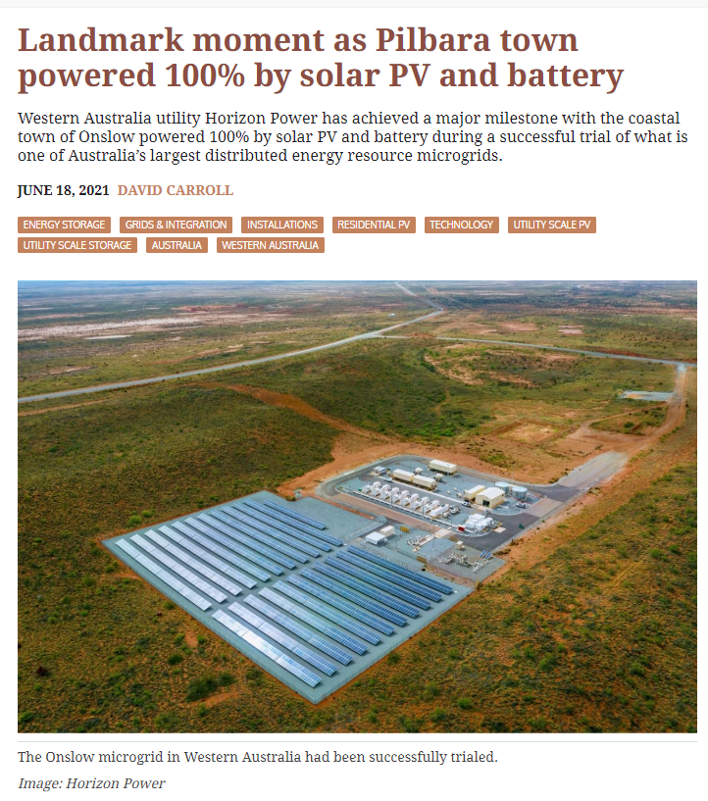
The Microgrid Controller
The MG controller tunes the system, chooses generators and apportions isochronous control. It can control DPV without comms by varying frequency (50-53Hz).
Increasingly we see thermal generators block-loaded (power fixed for any freq.) and not participating in isochronous control or regulation (load-following). BESS are far better (faster and better load acceptance).
Notes:
Isoc vs blockload
Droop = primary control (way of sharing load without comms, freq changes, power output responds, but doesn’t restore freq to nominal
Isoc = freq stays the same, power changes (secondary control layer)
Blockload = power stays the same for any freq. (magical powers gone)

Slide 11
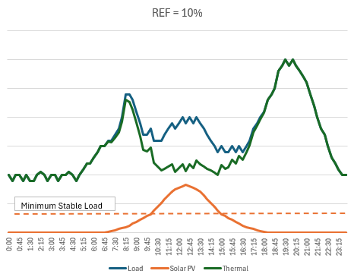
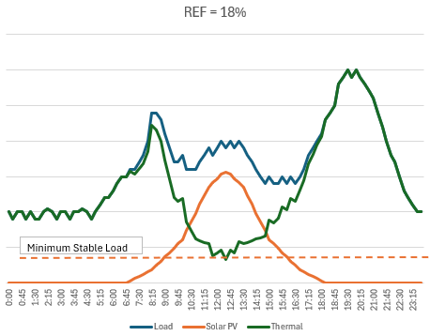
Renewable Energy Fraction (0-20%)
Adding uncontrolled solar PV will eventually cause three issues:
Thermal generation will approach MSL but can’t switch off.
Clouds may challenge the fleet’s ability to ramp/step.
Poor fuel economy and maintenance costs/issues.

Slide 12
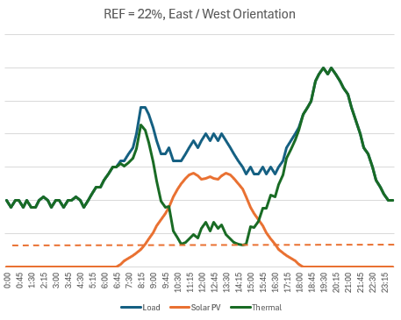
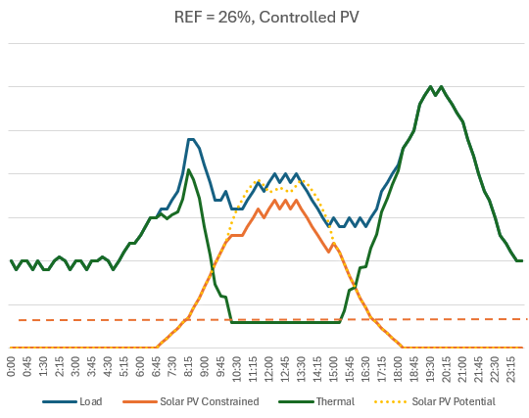
Renewable Energy Fraction (20-30%)
Varying array orientation (East, North etc.) and tilt (10°, 20° etc.) can improve REF. However, quickly new PV must be curtailable. Shifting load may also provide some improvement.

Slide 13
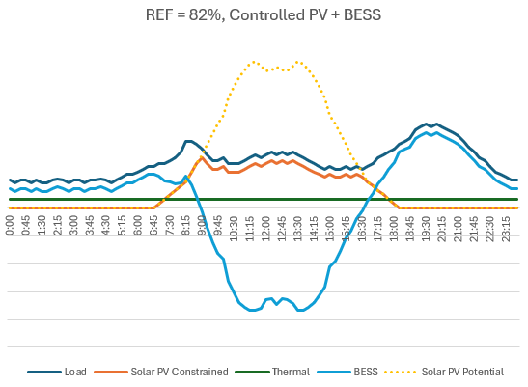
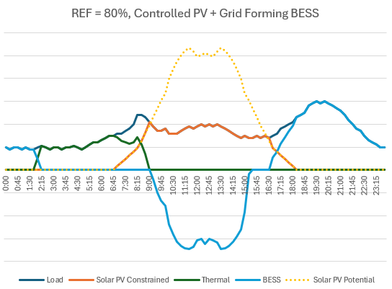
Renewable Energy Fraction (50+%)
50+% REF (PV Only) will involve batteries, and the recommendation is to achieve HCO by or before this stage.
Question: At what REF are BESS a good investment?
100% REF is uneconomical. A net zero fuel is likely needed.
Notes:
This hopefully makes it clear that not all batteries are created equally. If we compare the $/kWh of lithium vs. flow batteries vs Pumped hydro etc. we don’t do the situation justice…
Also do we buy generators with good qualities in year zero knowing these become redundant in year 5 when we add batteries to take over these qualities?
BESS are likely needed somewhere between 20-50% REF depending on the modularity and performance qualities of the diesel generators. Is it good to defer this investment? Do these qualities become redundant once batteries are attained?

Slide 14
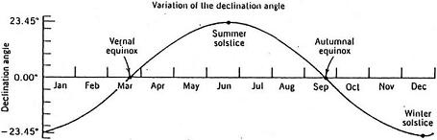
Solar Geometry & Array Orientation
It’s common to see solar array design based on what is most productive annually. This is “equator facing at the latitude angle”, (minimum angle of 10° is recommended.)
In a city like Jakarta (6° S) North panels would face the wrong way for nearly half the year! East/West is a better choice.
If the load is greater some periods, design can optimise for this.

Slide 15
Summary
Thermal generator fleets can have qualities which work better with VRE. These include low-load capability, fast-start and fast- load acceptance capability. Modularity is highly beneficial.
Adding solar PV will quickly compromise stability, especially if it is not curtailable. It is important to achieve PV control early and to solve control of DPV as well as centralised PV.
Dispatch is for security first. Thermal generators can’t be switched off unless we secure ESS from other sources i.e. batteries and controls. Attaining BESS initially/early impacts other asset decisions. BESS are very good at many ESS.
Operating HCO is an important technical achievement.

Slide 16
Thank you

Slide 17
Term | Definition
ARENA | Australian Renewable Energy Agency
BESS | Battery Energy Storage System
CSIRO | Commonwealth Scientific and Industrial Research Organisation
DER | Distributed Energy Resources
DPV | Distributed Photovoltaic
ESS | Essential System Services
EV | Electric Vehicle
FCAS | Frequency Control Ancillary Services
HCO | Hydrocarbons OFF
MG | Microgrid
MSL | Minimum Stable Load
PV | Photovoltaic
REF | Renewable Energy Fraction
SAPS | Stand Alone Power System
VAr | Volt-Amp Reactive
VRE | Variable Renewable Energy

Slide 18
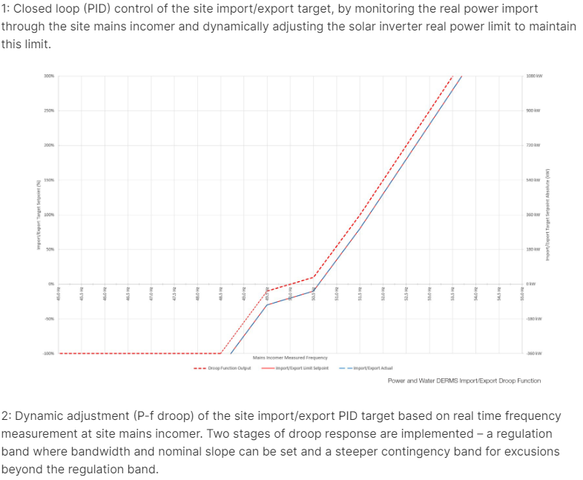

Slide 19
