Slide 1
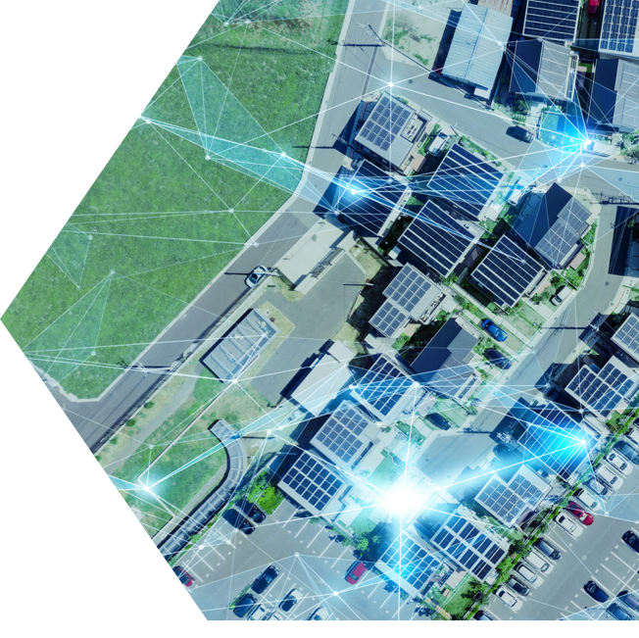



The Time is Now
Getting smarter with the grid
CSIRO | G-PST
October 2024

Slide 2
Agenda
Key findings
Modelling approach
Results
Recommendations

Slide 3
Key findings
Modelling approach
Results
Recommendations

Slide 4
There are opportunities within the distribution grid that can be unlocked and enabled now
Australia is already working hard to deliver the large-scale renewable generation projects and transmission infrastructure that we need to transform the grid, and we must not lose focus on that
What this shows is that the distribution network can do more of the heavy lifting now to help achieve our targets and deliver benefits to customers.
L.E.K. undertook whole of energy system modelling to independently determine what levers we can and should pull now at a local level, with customer outcomes at the forefront.
These benefits can be unlocked by a set of targeted, pragmatic actions → steps can be taken to enact these actions immediately (in the next 12 months) to set our energy system on the path to an optimised result by 2030.

Slide 5
Key findings
Modelling approach
Results
Recommendations

Slide 6
Comprehensive ‘whole of energy system’ modelling was undertaken
Wholesale modelling
Network modelling
Customer assets, fuels and emissions modelling
Key inputs
Costs of investment and operation of different generation types
Committed investment plans for generation and transmission (incl. state government targets)
Coal retirement plans
Outputs from system modelling (specifically peak load and native demand by region)
CER capacity additions
Capex for CER asset types
Gas and petrol prices
Generation output by fuel type
Key outputs
Grid capacity
Generation output
Wholesale energy prices
Network capex and opex
Network revenue
Average price (c/kWh)
Total energy costs related to their total energy needs
Emissions from the NEM
These models produced outputs for every year from 2024 - 2050, but we have focused on the near-term impacts (in 2030) and the steps to unlock them.
The results were compared against a baseline of the ISP Step Change scenario*, as well as a ‘Missed Opportunities’ scenario
representing an increasingly likely ‘prolonged transition’ for the broader energy system.
Note: * Sourced from the 2024 Integrated System Plan, June 2024
Source: Endgame Economics; Dynamic Analysis; L.E.K. Analysis

Slide 7
Identified the most impactful opportunities for distribution networks to benefit consumers
Long list of possible
‘system changes’ in the distribution networks^
Consumer benefits
modelling of each change
vs. the baseline*
Prioritised set of
system changes
in distribution networks
‘All Levers Pulled’ combined scenario
A mix of system changes representing one option to close the ‘gap’ vs. the baseline
add rooftop solar & BTM storage
add rooftop solar & BTM storage
$$
$$$
add community generation
1
add Rooftop PV & FTM storage
add rooftop solar & FTM storage
add rooftop solar & FTM storage
$$$
$$$
2
faster transport electrification^
$$$
$$
add community generation
add community generation
3
deliver CER coordination**
faster transport electrification^
$$
faster home/business electrification^
$$
4
-$
faster transport electrification^
faster home/business electrification^
add Rooftop PV & BTM storage
5
$$
$$
-$
deliver CER coordination**
deliver CER coordination**
faster home/business electrification^
6
Barriers to each system change and Actions required
to overcome them
Notes: ^ The starting point for our system changes was the 2024 ISP Step Change scenario, so changes that “add” are above the ISP, and “faster” is relative to the ISP trajectory.
* The baseline used for comparison was the ‘Missed Opportunities’ scenario.
** Less coordination was tested in our scenario modelling since the ISP Step Change scenario already assumes high levels of coordination without a clear pathway to achieve this.
The ‘less coordination’ scenario was used to validate the need for coordination and the additional costs that would be incurred if coordination is not achieved.

Slide 8
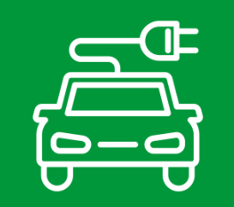
Optimised ‘All Levers Pulled’ scenario deploys complementary system changes to deliver benefits
All Levers Pulled scenario combines multiple changes that are beneficial for energy consumers in a way that complement each other and present an overall vision for an energy system with a more ambitious but optimised role for the distribution grid.
7 GW of additional ‘community generation’ by 2030, consisting of smaller scale renewable generation plants connected to the distribution grid, and designed to utilise available capacity at the sub-transmission level on these networks
5 GW of additional Rooftop Solar by 2030 installed on commercial & industrial facilities with available rooftop capacity, and on residential premises (with a focus on rental properties and low-income households)
5 GW of distribution-connected battery storage by 2030 installed by utilising existing land and connection points available on distribution networks, and made available to customers via distribution network and third-party partnerships
1M more EVs on the road by 2030, representing a scenario in which customers feel more confident buying an EV and the customer-driven tipping points for uptake of electrification of transport occurs faster than anticipated
Facilitate coordination of consumer energy resources, with a clear plan for how this can be achieved so that the consumer benefits of coordination can be secured
Notes: In this scenario the changes are made across the NEM by 2030 (compared to the 2024 ISP Step Change scenario).

Slide 9
Key findings
Modelling approach
Results
Recommendations

Slide 10
Leveraging the distribution grid to assist the energy transition delivers benefits to the system & customers
Reduces total energy system costs
by $7 billion per year in 2030
Reduces energy costs for a typical* residential consumer by $160 per year in 2030
Secures the delivery of 82% renewables by 2030
Total energy system costs
(FY2030)
Billions of AUD
Household energy costs (incl. home gas and ICE fuel costs)
(FY2030)
AUD
Electricity generation by generation type
(FY2030)
TWh, %
-3%
~251
~255
Non-
renewable
26%
Non-
renewable
18%
-7%
Renewable
74%
Renewable
82%
ISP Step Change Scenario
Missed Opportunities
All Levers Pulled
Missed Opportunities
All Levers Pulled
Missed Opportunities
All Levers Pulled
As a comparison point for modelling purposes, we have prepared a ‘Missed Opportunities’ scenario. This scenario deploys large scale generation at rates consistent
with the maximum levels achieved in Australia to date. This baseline represents an increasingly likely ‘prolonged transition’ for the broader energy system,
and also demonstrates the customer benefits from seizing the opportunity for distribution networks to contribute to the desired outcomes of the energy system.
Note: * Based on a customer who is connected to the grid, does not have a solar system, battery or EV, and still uses a mix of electrical and gas assets in their home; does not include gas distribution costs
Source: Endgame Economics; Dynamic Analysis; L.E.K. research and analysis

Slide 11
All customers are also better off, not just those that have access to solar and EVs
Total customer energy costs [including vehicle fuel costs] by customer type*
(FY2030)
AUD (2023 real)
-$160
(-3%)
-$84
(-2%)
-$38
(-1%)
-$212
(-7%)
-$136
(-7%)
Missed Opportunities
All Levers Pulled
Missed Opportunities
All Levers Pulled
Missed Opportunities
All Levers Pulled
Missed Opportunities
All Levers Pulled
Missed Opportunities
All Levers Pulled
Customer type 1
No solar, no EV
Customer type 2
Solar system, no EV
Customer type 3
Solar + battery, no EV
Customer type 4
EV, no solar
Customer type 5
Solar system + EV
Adding an extra 1.2 million EVs to the road by 2030 means moving an extra 1.2 million customers from Types 1-3 to Types 4 and 5
Adding an extra 5 GW of rooftop solar by 2030 means moving an extra c.230,000 residential customers from Type 1 to Types 2, 3 or 5
Note: * Energy includes the cost of transport fuel, gas (excluding gas distribution costs) and electricity
Source: ABS; ACCC, CSIRO Gen Cost; Dynamic Analysis; Electric Vehicle Council; Endgame Economics; Energy.gov. Vic.gov, Redback Technologies, Solar Choice, L.E.K. analysis

Slide 12
Key findings
Modelling approach
Results
Recommendations

Slide 13
Enabling a distribution grid that better serves customers
Action Theme / Headline
Link Local
Energy Hubs
Amplify Untapped Solar
Soak up Surplus Solar
Plug in more EV Chargers
Sync with the Grid
Align the treatment of connection costs between transmission and distribution to remove the disincentive for renewables to connect to local energy hubs
Create a regulatory pathway that allows investments to create network capacity in local energy hubs
Introduce an incentive scheme for larger scale C&I rooftop solar to facilitate investment above self-consumption and share it with the local community
Expand existing programs to provide low-cost, CER financing options for renters and customers with poor access to capital
Introduce an AER class waiver to allow distributors to share battery capacity with third parties, enabling customers to benefit from the full battery value stack
Amend regulatory valuation methods to recognise the time-shifting ability of batteries to release customers’ solar when it’s most valuable
Classify EV charging infrastructure as a ‘distribution service’ in our regulatory framework, so distributors’ existing poles and skilled workforce can be leveraged to provide a base level of community charging
Implement consistent role definitions, backed by technical standards and consistent policies, to drive the formation of the partnerships, markets and incentives needed to ensure coordination of consumer energy resources
Enabling Initiatives
Greater Regulatory Flexibility
Review inclusion of Distribution in the ISP
Enable greater flexibility within a 5-year determination period – could include flexibility for annual tariff changes, improved expenditure adjustment mechanisms, and a role for early, enabling, and efficient ‘anticipatory’ grid investment
Work with AEMO to consider the range of options for contribution of distribution networks in the 2026 ISP, and to co-optimise between large scale and small scale in developing an optimal development pathway

