Slide 1
System Operator Collaboration and Navigating the Transition
Luke Robinson
16th October 2024

Slide 2
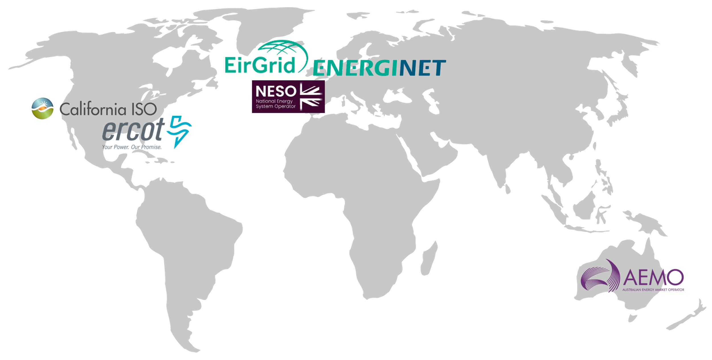
System Operator collaboration
Collaboration of six system operators, led by their CEOs, and supported by a rotating Executive Director role and technical Designates and engagement with partner organisations.
Overarching objective is to enable operations of 100% IBR power systems.
Collaboration is through:
  Revision and delivery of the Research Agenda
  Technical engagements including secondments & development of knowledge sharing briefs
  Collaboration with CSIRO and others

Slide 3
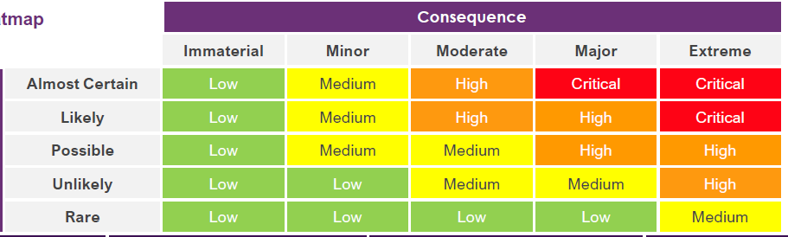
Research Agenda review
The Research Agenda, published in 2021, is a foundational, objective document detailing cutting-edge research challenges guiding SO collaboration and research priorities.
System Operators are putting greater priority on progress to deliver outcomes that assist with the transition, mitigate operational risks, and help demonstrate how to operate (very) high VRE/ IBR/ DER systems.
The is being undertaken by:
  Aligning on relevant research questions + new relevant topics
  Identifying shared priorities to focus our efforts
  Working together to address shared priorities to deliver tangible outcomes
  Demonstrating & sharing what is needed to operate with very high renewables…
Notes:
Key risks:
Ability to maintain security & reliability incl. resource adequacy
Adequacy of operational tools & systems
System restoration / restart capability

Slide 4
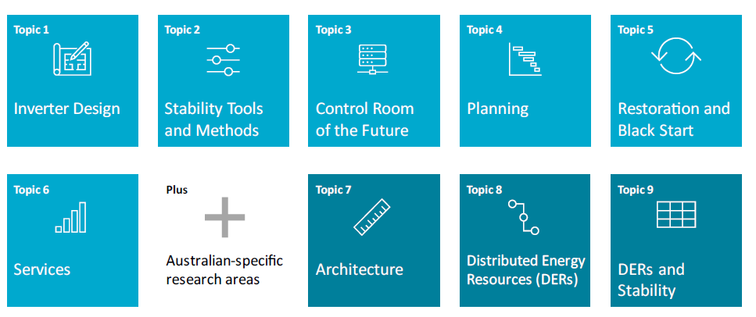
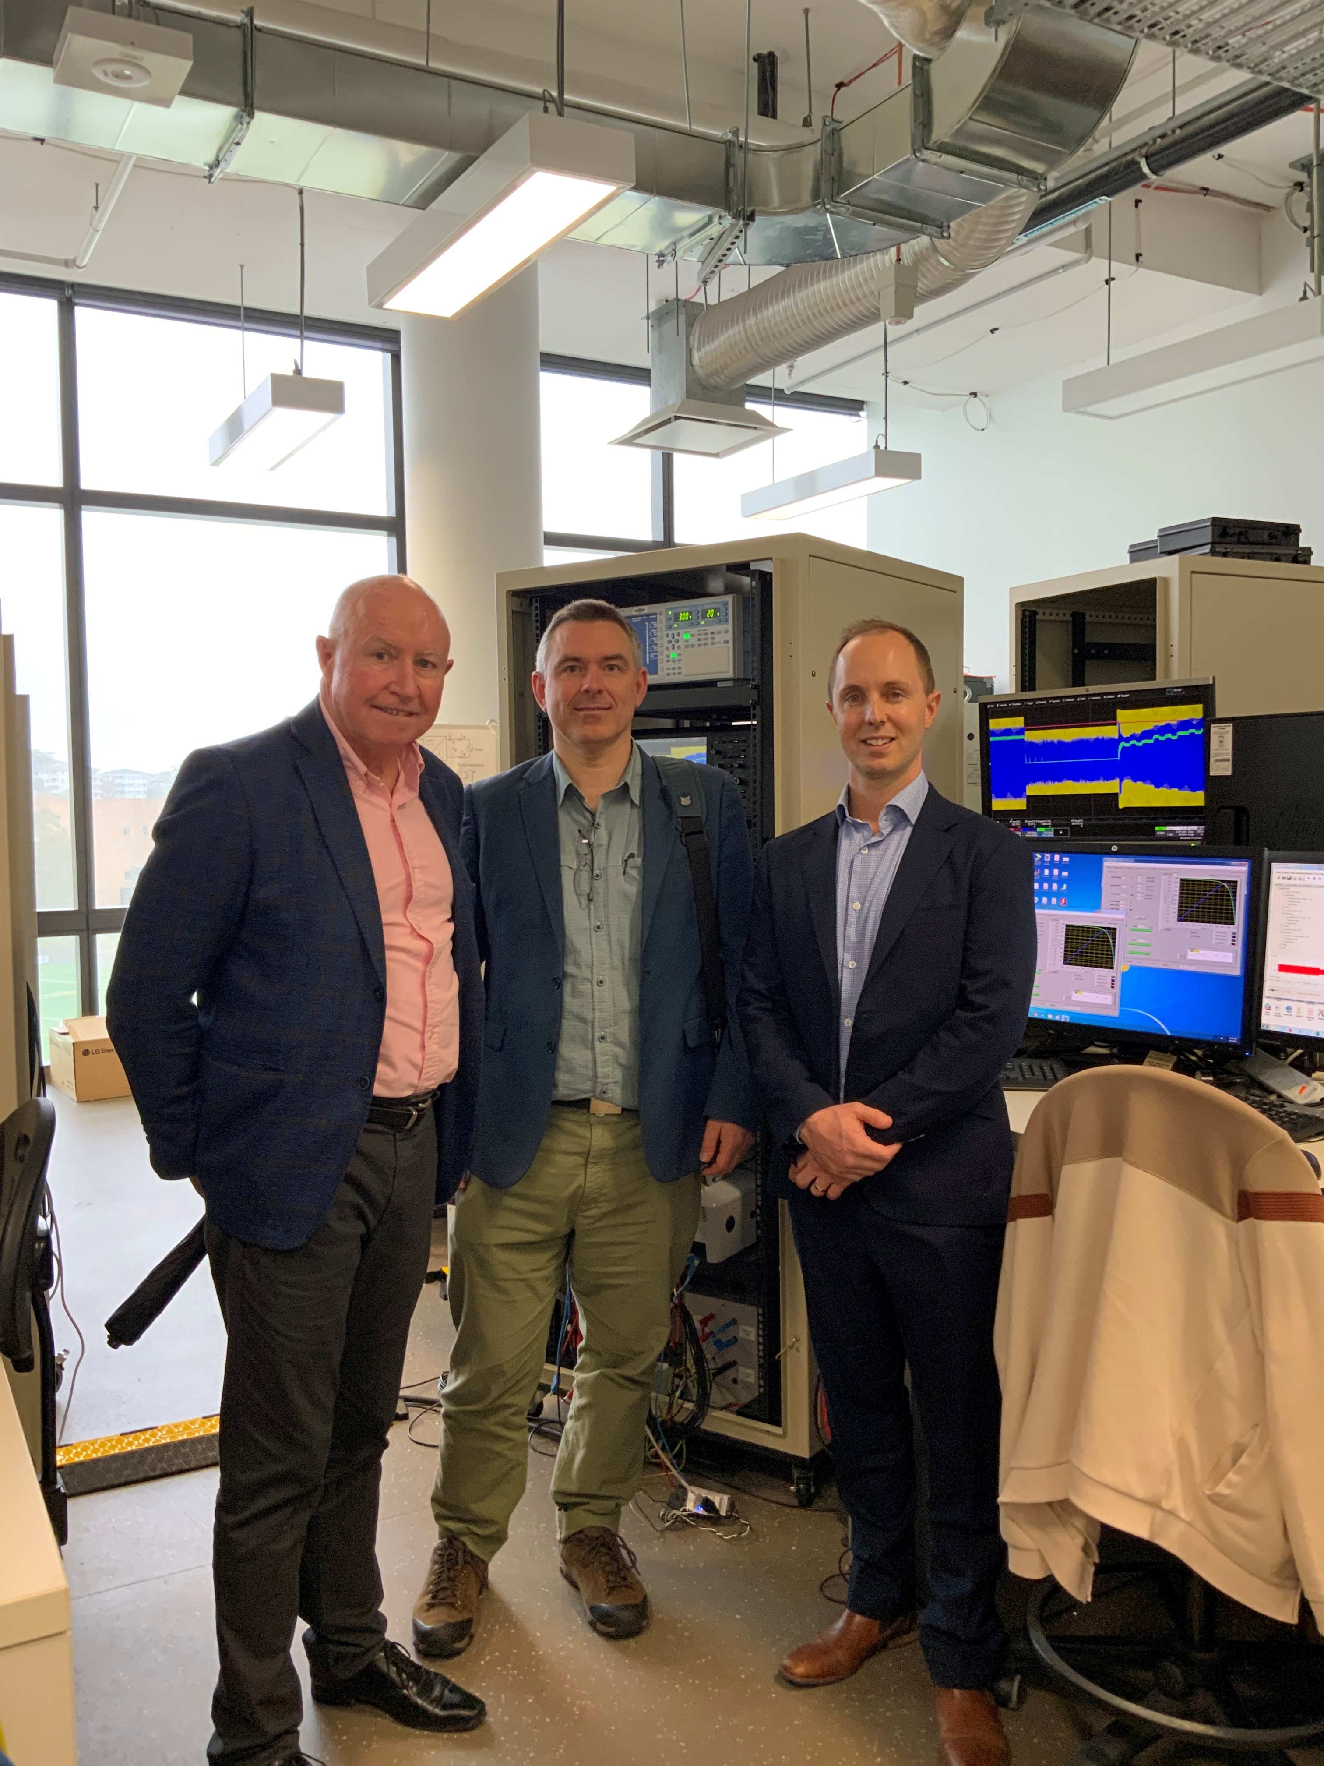
Key topics
CSIRO / AEMO / UNSW collaboration to test household PV, BESS, EV and load devices helping refine models used by AEMO use to plan and operate the system.

