Slide 1
Australia’s Integrated System Plan
GPST Workshop
Eli Pack – Group Manager, System Planning
2024-10-16

Slide 2
We are on a journey to 100% renewable energy

Slide 3

The Integrated System Plan is a roadmap for the energy transition
A roadmap for the National Electricity Market (NEM) energy transition.
Optimal development path for reaching net zero by 2050.
Least-cost path for transition within Commonwealth and State policies.
Provides expert information for a range of stakeholders.
Serves regulatory purpose of identifying ‘actionable’ projects which should progress as urgently as possible.

Slide 4
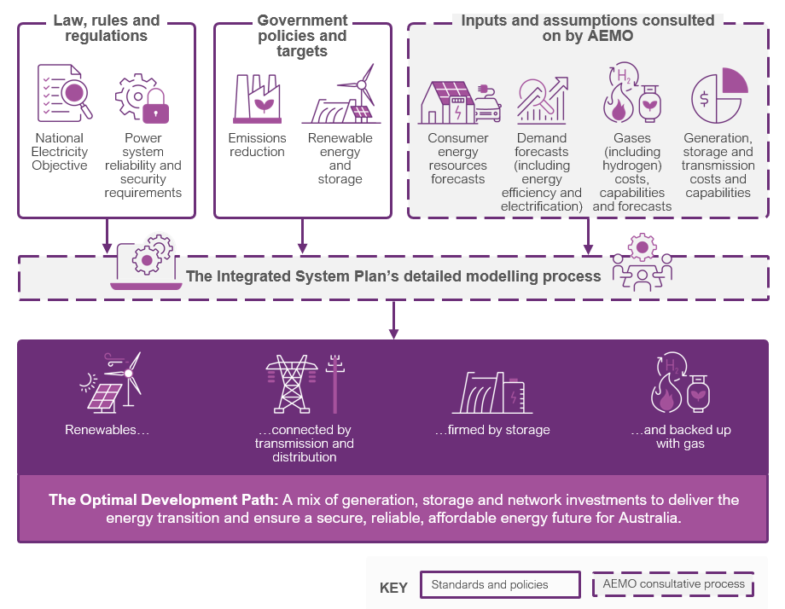
The ISP takes standards, policies and consulted-on inputs and assumptions to model the optimal development path

Slide 5
We’ve been on a mission for transparency
Existing Gen Data Summary
WACC
Renewable Energy Zones
Demand Input Summary
Gas expansion candidates
Gas reserves and resources
Gas infrastructure
Pipeline transmission tariffs
Gas production costs
Scenarios
New Entrant Data Summary
Fuel Price Summary
Scenario and REZ settings
Summary data
Demand
Policy settings
Interconnector and transmission settings
Generator reliability settings
ST model properties
Generator technical and financial settings
Gas system properties
Regional Build Cost Summary
Build cost
Capacity Factors
Gas and Liquid fuel price
Gas system properties
Summary data
Regional Cost Factors
Lead times and project life
Refurbishment
Fixed OPEX
Value of consumer reliability
Consumer Risk Preferences
Generator Regional Build Cost
Variable OPEX
Retirement
Emissions
Energy Consumption
Rooftop PV
DSP
Connection cost
Storage properties
Heat rates
Marginal Loss Factors
Inputs, Assumptions & Scenarios
Maximum Demand
PVNSG
Embedded energy storages
Build limits
Coal and Biomass price
Auxiliary
Gross State Product
Electric Vehicles
Aggregated energy storages
Complex Heat Rates
CCGT Unit Maximum Capacity
Minimum Up and Down Times
Energy Efficiency
Electrification
Hydrogen and other green gas
ST model properties
Maximum Ramp Rates
GPG Minimum Stable Level
GPG Start Cost
Renewable Policy Targets
Carbon Budgets
Maximum capacity
Firm Capacity
Seasonal ratings
Generator Reliability Settings
Generator reliability settings
Interconnector Capability
Augmentation options
Hydro Scheme Inflows
Transmission component costs
Reserves
Generation limits
Maintenance
Hydro Climate Factor
Proportioning factors
Interconnector representation

Slide 6
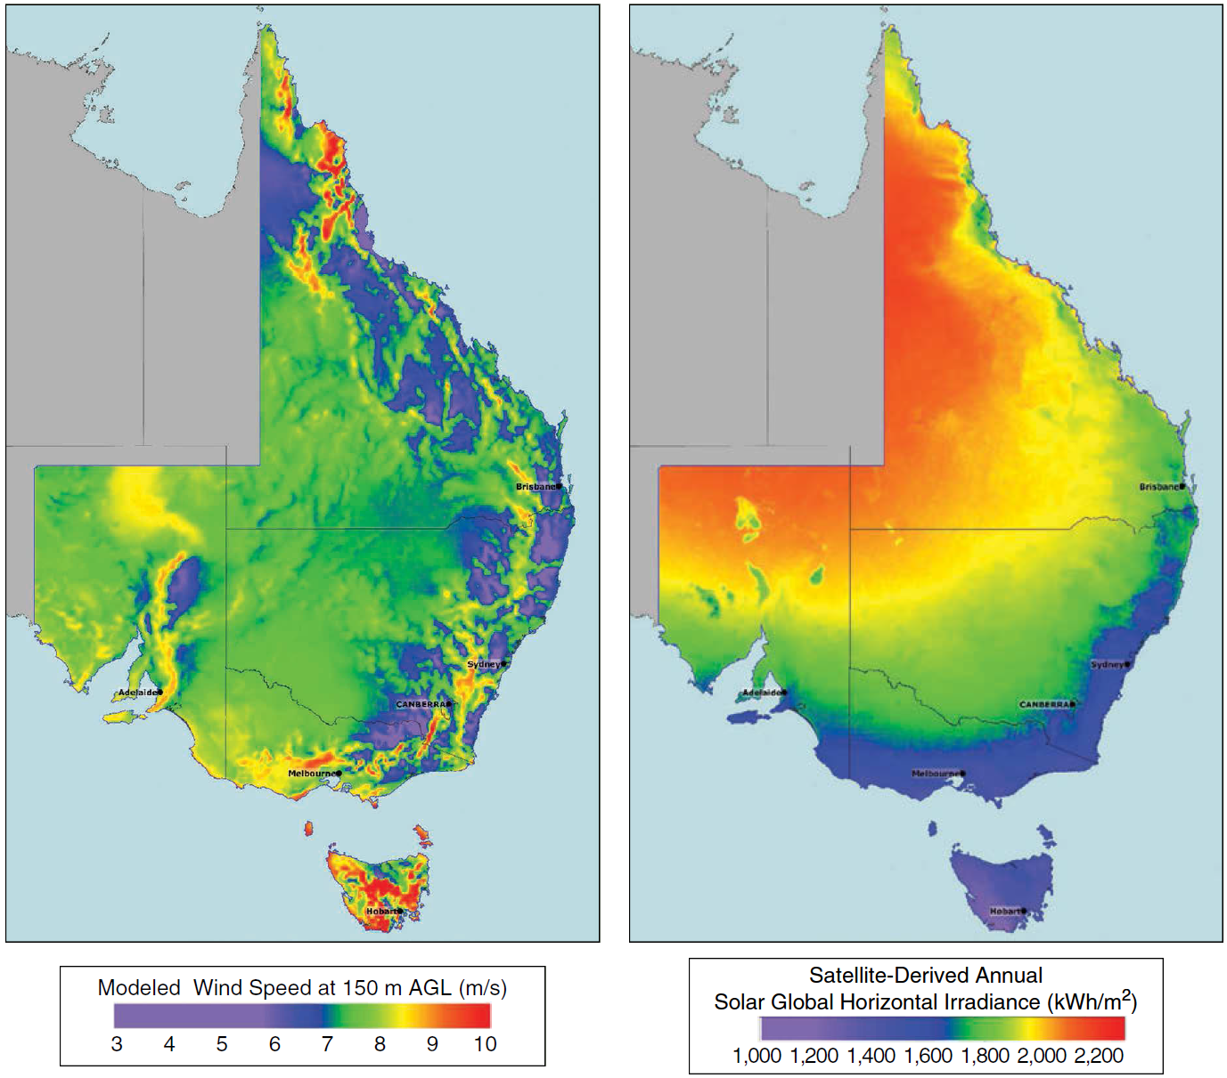
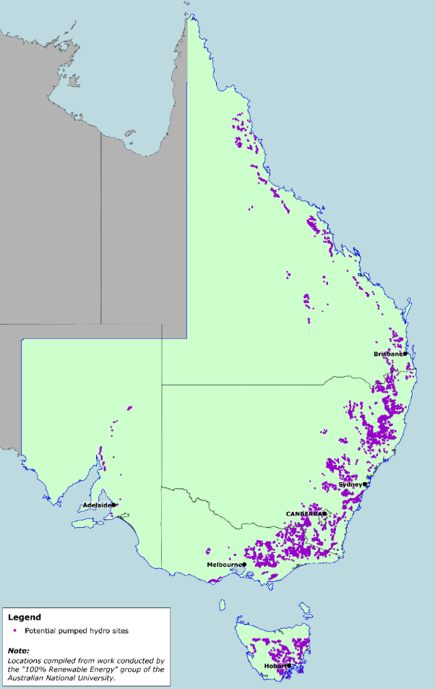
Where are the best renewable resources?
Source: DNV GL
Source: DNV GL
Source: ANU
Possible pumped hydro sites

Slide 7
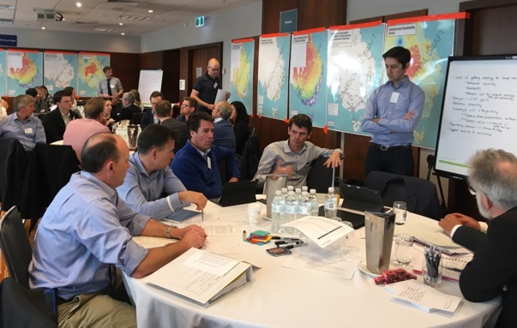

Where are the best renewable energy zones?

Slide 8
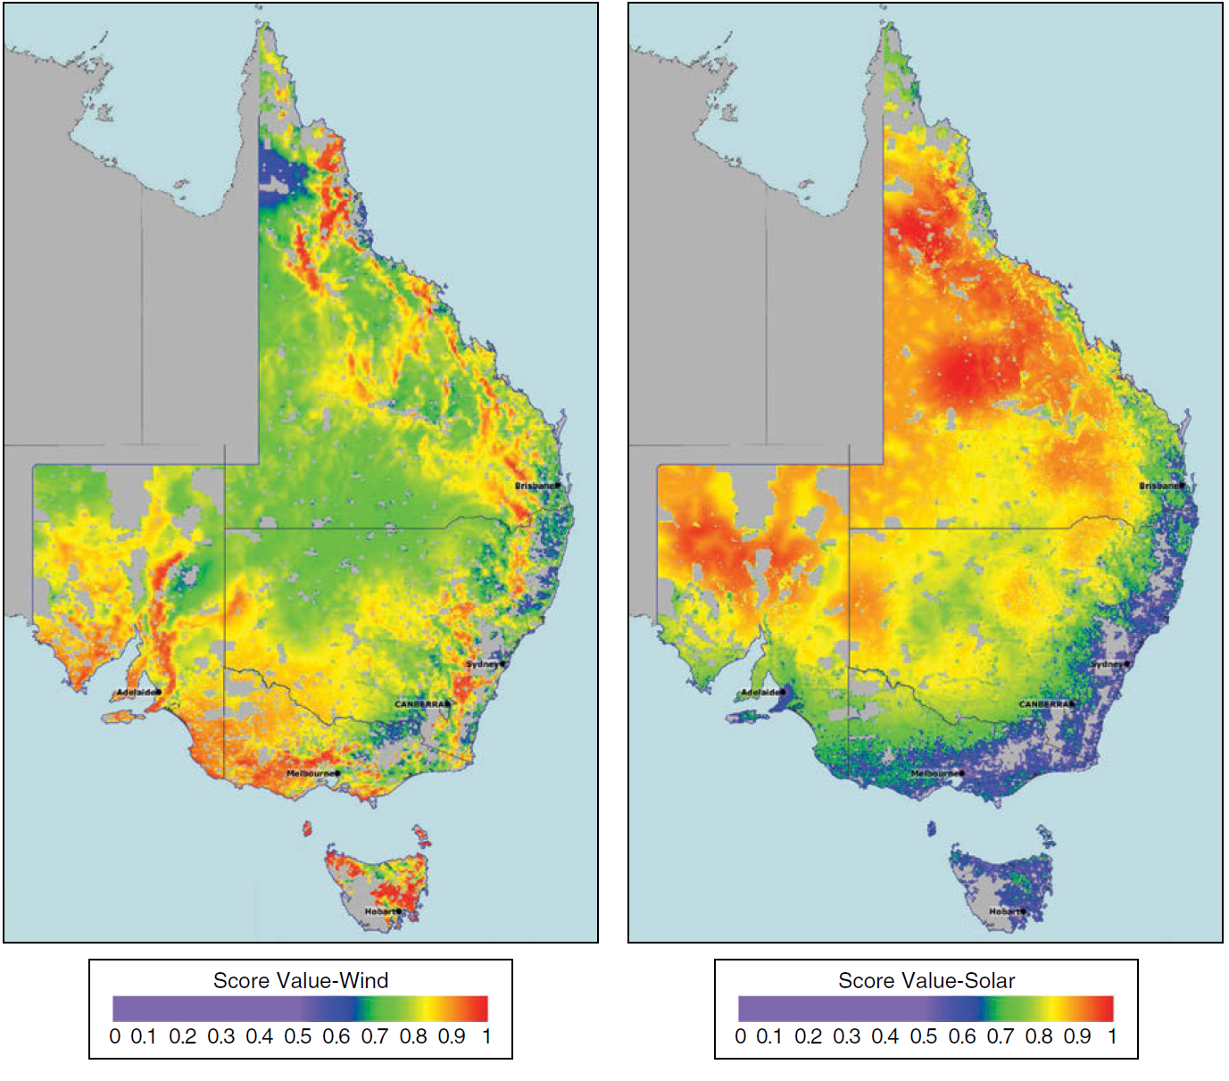
What factors might help to identify renewable energy zone candidates?
Resource quality
Correlation with demand
Land parcel density
Land cover
Road access
Terrain complexity
Population density
Protected areas
Electricity network
Source: DNV GL
Source: DNV GL

Slide 9
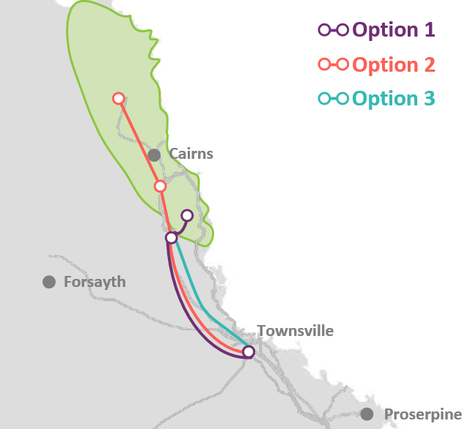
How could we develop a renewable energy zone?

Slide 10
The transition is well underway, with electricity generation shifting to low emissions and renewable energy
Rooftop solar and other distributed solar
Historical
Utility solar
Annual generation (TWh)
Wind
Mid-merit gas
Brown coal
Passive CER storage
CER storage
Utility storage
Black coal
Hydro
Biomass
Flexible gas-powered generation

